Slide 1
Children and youth
International
Non-Governmental Organizations
dr Łukasz Prus

Slide 2
Examples:
Save the Children International
SOS Children's Villages
The Reggio Children
The World Organization of the Scout Movement
World Assembly of Youth
World Federation of Democratic Youth

Slide 3
Save the Children Fund and Save the Children International
Story of the Save the Children Fund (SCF) shows the creation of NGO by an inspired, charitable, and effective individual in one country,
Which after developed into a major INGO, the Save Children International.
Save Children International comprises SCF and 30 member organisations working to deliver change for children in 120 countries.

Slide 4
SCF was born British and now is multinational.
Non-religious organization.
Deals with relief and development with an orientation on children,
like UNICEF at the I.O. level.
It is politically neutral and impartial.

Slide 5
HISTORY
Behind every great movement,
there is a leader with an even greater vision.
In 1919 two sisters, Eglantyne Jebb and Dorothy Buxton
founded Save the Children to
handle Russian crisis and
to feed children facing starvation after the First World War.

Slide 6
Eglantyne Jebb, and her sister Dorothy Buxton
were part of the Fight the Famine/ starvation/hunger movement,
spreading information about what was happening in Europe.
Eglantyne Jebb has remained famous for drafting the first Charter of the Rights of the Child in 1923,
which evolved into the International Convention of the Rights of the Child,
adopted in November 1989 by the UN General Assembly.

Slide 7
Born in 1876, Jebb came from a well-to-do, cultured and socially conscious family.
Her sister Dorothy married the Liberal MP Charles Buxton.
Charles had helped to found the Macedonian Relief Fund in 1903.
In 1912/1913 Englantyne Jebb came to the Balkans to administer help and supplies on behalf of the Macedonian Relief Fund.
This allowed her to witness at first hand the impact of war on civilians.

Slide 8
Jebbs distress at the finding that
so many children abandoned and suffering what
was the reason for the creation of SCF.

Slide 9
During the World War I, conscious of the suffering of civilians, Jebb tried to awaken the public conscience.
It was from the periodical reports
sent to them by friends in the International Red Cross,
that Jebb first learned how the people of Vienna were starving to death,
and that children of six were so thin and small that
they looked like babies of two.

Slide 10
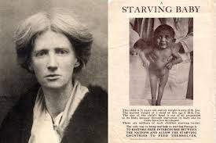

Slide 11
In 1919, Jebb was arrested for distributing
leaflets/handbill/brochure in Trafalgar Square –
showing a shocking photo of two emaciated/starving children.
Above it the headline read:
‘Our Blockade has caused this – millions of children are starving to death'.

Slide 12
Allied nations put in 1914 during the war blockade on Central powers (Austria, Hungary and Germany).
This caused huge amount of suffering for people of former Central powers.

Slide 13
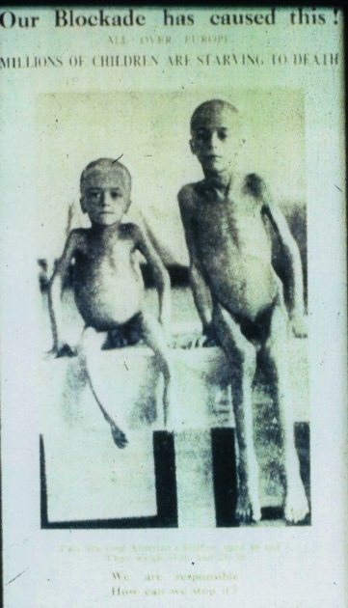

Slide 14
At her trial she was found guilty,
but the prosecuting counsel/judge
was so impressed with her that
he offered to pay her £5 fine.
It was the first donation to the charity she went on to found, Save the Children.

Slide 15
Within two years Save the Children led a massive relief effort for the widespread famine in Russia.
In 1921, Save the Children was feeding 650,000 children a day and saved hundreds of thousands of lives
To fight the Russian famine, SCF sent its own teams which, in a remarable example of international cooperation.

Slide 16
Within two years Save the Children led a massive relief effort for the widespread famine in Russia.
In 1921, Save the Children was feeding 650,000 children a day and saved hundreds of thousands of lives
To fight the Russian famine, SCF sent its own teams which, in a remarable example of international cooperation.

Slide 17
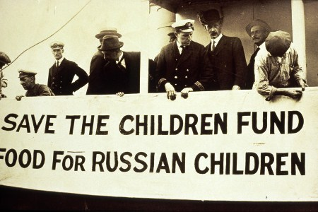
September 1921: at the height of the Russian famine the Torcello, chartered by Save the Children, set sail from London carrying 600 tons of life-saving aid

Slide 18
In its first year, the Fund raised more than 400,000 pounds in the knowledge that money would be instantly allocated to milk,
hospital supplies and
clothing to help children throughout famine and war-stricken areas.
Jebb was not sentimentalist, but
a practical humanitarian.
An Anglican, she received the full support of Pope Benedict XV.
Pope asked her to ensure that her organization to save the children were formed in every country and
that the relief was administered regardless of race, color or creed

Slide 19
Save the Children is the U.K. largest international voluntary agency concerned
with child health and welfare.
SCF strategy is to work with the poorest people in the poorest parts of the world.
The emphasis is on health, nutrition, education and social programs in 50 countries.

Slide 20
SCF initiated various programmes to assist children
Feeding programmes
Provision of clothing
Protection against epidemic
Sponsorship Scheme, by means of which individuals or a group od people, “adopt” a child, sending $.
There are 3 types of sponsorship:
A) Individual Child Sponsorship (ICS) - where there is a one to one relationship between child and sponsor.

Slide 21
The sponsor is able to communicate with the child via email or air mail.
The sponsor can also visit the child and the school community.
B) Life Line Sponsorship where there are many sponsors to one child.
The child acts as a representative for the school community, and
as such there is no one to one association and there is no communication with the sponsors.

Slide 22
C) Program Sponsorship where there is no child association at all, but rather the sponsor just wishes to contribute to our programs in the community.
https://www.youtube.com/watch?v=qut-FJRYoaw
Another pioneer scheme of the SCF was the building of a model village
for Armenian refugees in Bulgaria in 1926, followed by the building of two more villages in Albania.

Slide 23
During the Spanish Civil War, SCF looked after many children who were in holiday camps when fighting broke out:
They were brought to safety in France until they could be reunited with their families.
This was just the start - over the next decades Save the Children
would grow to become a global organisation saving thousands of children's lives each year.

Slide 24
Towards the end of WW II, SCF helped in France,
and then in West Germany itself to care for orphans (lonesome children) and
the children of displaced persons.
In Greece, SCF opened hospitals and clinics, feeding centres and welfare clinics
They also distributed clothes.

Slide 25
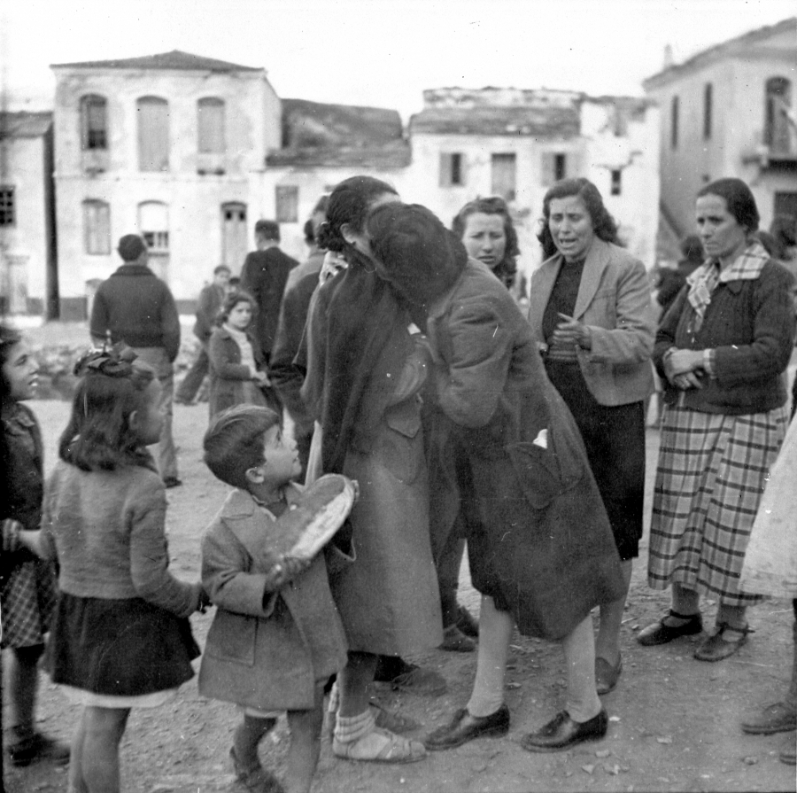
Greek refugees who lived in a refugee camp in Moses Wells, Egypt from 1945 to 1948 reunite with family members on their island home of Samos

Slide 26
The main aim of SCF programmes is on strengthening child-related government services.
These range from support for village health workers schemes to advice on establishing a national nursing council.
SCF UK contribution to the fight against AIDS has focused on research, and public education.

Slide 27
In Nepal, SCF helps to recruit and train volunteer health workers and
runs basic and
refresher training courses in all aspects of health care for local staff and
staff employed by the government
or other organizations.

Slide 28
As mentioned above, it was largely on response to the wishes of Pope Benedict XV that the Save the Children Movment should spread to all countries, that
Jebb put forward the idea of an international organization to link
the various national bodies with the same aims as the SCF, so that they could work on a world wide scale more effectively.
On the 6 January 1920, Jebb created the Save the Children International Union in Geneva,
national SCF groups were set up in the 1920s in Switzerlad, France, Sweden etc.

Slide 29
After WW I, the SCIU instituted relief action, with the emergency distribution of foods.
It later set up homes,
Clinics
And hospitals
Supplied qualified social workers to help in planning and establishing national child welfare councils.

Slide 30
It introduced the system of “sponsorships”,
Now applied by many organizations in different regions.
While the SV Movement is non-political and non-religious
Its Swedish branch is know to be more activist and outspoken in sensitive political human rights issues than other national branches and than the Alliance itself

Slide 31
For example, in May 1990, the Swedish group published a report accusing Israel of major HR violations against children,
during 30 months of the Arab uprising in the occupied territories,
including its responsibility in the deaths of more than 150 children
The Israeli government spokesman said in response that SCF was an organization that had shown itself in the past to be biased against Israel

Slide 32
https://www.youtube.com/watch?v=jd0bEq1DwBM
https://www.youtube.com/watch?v=_ppZRl5houE
https://www.youtube.com/watch?v=LoEyd6_jztc
https://www.youtube.com/watch?v=IpBGfmIMfr0

Slide 33
The Geneva Declaration of the Rights of the Child, which Jebb wrote, was adopted by the League of Nations in 1924.
Three decades later it inspired the UN Convention on the Rights of the Child,
now signed by almost every country in the world.

Slide 34
http://www.un-documents.net/gdrc1924.htm

Slide 35
Today, there are signs that
the world is making real progress towards Jebb vision.
In 2012, the number of preventable child deaths fell by 700,000 to 6.9 million – the biggest drop ever in a single year.

Slide 36
That wasn’t a one-off.
Since 1990 the number of children dying annually has fallen by 5 million.
There are still far too many children dying needlessly.
But collective efforts are having a huge impact.

Slide 37
In 2016, Save the Children reached more than 157 million children, including more than 56 million children directly.
S.C. 2030 ambition
No child under age 5 dies from a preventable cause
All children learn from a quality, basic education
Violence against children is no longer tolerated

Slide 38
Areas
Children's Health
Child Education
Child Protection from harm
Emergency Response
Emergency Response – In Times of crisis

Slide 39
Nearly 5.9 million children die each year due to preventable and treatable causes,
including 1 million babies who die on the day they are born.
Malnutrition (lack of proper nutrition) and starvation contributes to the deaths of children and a lifetime of poor health.

Slide 40
156 million children under five years old are too short for their age,
50 million children do not weigh enough for their height,
and 42 million children are overweight.
Save the Children works to improve health and nutrition of mothers,
newborn babies and children, with
special attention to poor

Slide 41
HIV
37 million people are living with AIDS: approximately 1 in 200 people in the world today.
More than 2.6 million children under 15 are currently living with HIV and AIDS.
That's why Save the Children has prevention programs to stop the spread of AIDS and protection programs to help children who have been orphaned.

Slide 42
Save the Children works to prevent the spread of HIV and
ensure children affected by AIDS get the help they need.
Save the Children is globally recognized for leadership in improving the lives and
futures of children and families living with HIV and AIDS

Slide 43
Save the Children is a key player in Nepal's HIV response,
providing targeted intervention services to key affected populations –
people who inject drugs,
men who have sex with men,
female sex workers,
and people living with HIV,
in partnership with several civil society organizations in 48 districts of Nepal.

Slide 44
In Nepal, Save the Children is working to eliminate mother-to-child transmission of HIV.
Last year, S.C. helped increase the percentage of pregnant women being tested for HIV – from 35 percent to 50 percent.
S.C. are now accelerating our efforts to achieve 100 percent testing coverage by the end of 2017

Slide 45
Case study
Zeria was diagnosed as HIV-positive while pregnant with Joylet.
A mother’s worst nightmare!
Zeria, a young mother from Malawi, was horrified to be diagnosed as HIV-positive while pregnant with her fourth child, and possessed by fears:
- ”Will I transmit the virus to my unborn child?”
- ”Will my baby be sick – or even survive? ”

Slide 46
- ”Will I? What will become of my children?”
- ”Is there any hope for our family in need?”
Physically ill and sick with worry for her unborn child, Zeria recalls:
“The thought of being HIV-positive and pregnant was horrifying.
I thought of my unborn child and feared my baby would be born HIV-positive.”

Slide 47
Zeria’s fears were not unfounded.
Without any help, about one-third of HIV-positive mothers transmit the disease to their children –
putting both mother and child at great risk for HIV-related complications and even death.

Slide 48
Mother-to-child transmission of HIV is the spread of HIV from an HIV-infected woman to her child during pregnancy, childbirth
Mother-to-child transmission is the most common way that children become infected with HIV.

Slide 49
Can mother-to-child transmission of HIV be prevented?
Yes.
Because of the use of HIV medicines and other strategies,
the risk of mother-to-child transmission can be lowered to 1% or less.
The risk of mother-to-child transmission of HIV is low when:

Slide 50
HIV is detected as early as possible during pregnancy (or before a woman gets pregnant).
Women with HIV, receive HIV medicine during pregnancy and childbirth
babies born to women with HIV, receive HIV medicines for 4 to 6 weeks after birth and are not breastfed.

Slide 51
With help from S.C., Zeria learned how to live with HIV – and to protect her unborn child.
She participated in Save the Children-
funded, community-based
counselling and services designed to prevent mother-to-child transmission of HIV and AIDS.

Slide 52
Soon Zeria was overjoyed to give birth to a healthy baby girl,
and she named her Joylet.
Zeria now leads a growing support group for others in the community who are HIV-positive,
helping to change HIV-related attitudes and behaviors

Slide 53
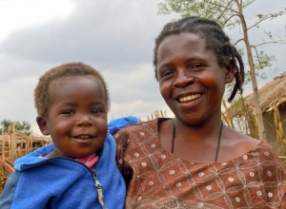
Zeria and Joylet

Slide 54
Child Education
In 2016, Save the Children helped give 13.8 million children around the world the opportunity to learn.
BREAKING BARRIERS TO GIRLS EDUCATION

Slide 55
Girls and boys in West Africa enroll in primary school in fairly equal numbers.
However, many girls never go on to high school,
because they face discrimination and are at risk of child labor (childbirth),
early marriage and pregnancy, and gender-based violence while at school .

Slide 56
“School Me” program in Sierra Leone seeks to help girls make
A successful transition from elementary to high school education.
Did You Know?
One girl under age 15 is married every seven seconds.
Girls are 3X morelikely to be out of school
Girls are 2X more likely to be subjected to sexual violence

Slide 57
Changing the World of Refugee Girls with Save the Children
The Syrian refugee crisis, now in its sixth year, has had a significant negative impact on education —
for Syria's refugee children and children in Jordan's host communities.
Girls suffer most. Many girls aren't in school
Save the Children and Always are working in Jordan to provide education and life skills.

Slide 58
https://www.youtube.com/watch?v=LpKvDNMgUcQ
https://www.youtube.com/watch?v=OXkP5-JXpvg

Slide 59
Protection from Harm
Save the Children is on the ground every day ensuring children are protected from harm,
including abuse,
Neglect, and violence,
and S.C. promote a safe family environment for every child.
In 2016, Save the Children helped protect 3.8 million children from harm.

Slide 60
Child Friendly Spaces (CFS) are one of Save the Children's most well-known activities,
to protect children during the first phase of an emergency or in areas of long-term crisis.
CFS also help keep children safe during the day, and
that allows parents to focus on finding support and
services in the immediate aftermath of an emergency and gradually rebuild their lives

Slide 61
Healing (therapeutic) and Education Through the Arts
HEART is an arts-based approach to providing
psychosocial support for children affected by serious or chronic stress.
It uses the arts to help children communicate feelings related to their experiences.

Slide 62
HEART also uses arts-based creative learning methods to make
education more interactive and fun in math, vocabulary, literacy, history, and other subject areas.
https://www.youtube.com/watch?v=mweZR7gw_cU

Slide 63
When crisis strikes,
and children are most vulnerable/sensetive/endangered, Save the Children is there –
as S.C. have been for every major humanitarian crisis since World War I.
Children don’t choose sides and
neither do S.C.

Slide 64
S.C. responded to 131 global humanitarian emergencies in 59 countries in 2016,
reaching 6.6 million children.
Focused on preventing the drowning deaths of those attempting to cross between North Africa and Italy,
Save the Children rescued more than 2,700 children and adults in just the rst two months of operation last year.

Slide 65
Ethiopia experienced its most devastating drought in 50 years,
Save the Children provided food,
water,
health care and
other essential support to more than one-third of the 9.7 million people suffering from malnutrition.

Slide 66
Save the children trucked in emergency water supplies,
distributed lifesaving hygiene kits and
trained farmers to care for livestock
as they waited for the rains to come.

Slide 67
S.C. trained community workers to explain the causes of malnutrition and
how to prevent the outbreak of disease.
S.C. also helped thousands of children remain at more than 200 schools by using donkeys to carry water and food to remote communities

Slide 68
CHILDREN’S EMERGENCY FUND
When children around the world are in danger of physical or emotional harm,
when they’re caught in an acute or prolonged crisis,
when disaster causes them to lose their homes and everything they cherish,
Save the Children is there to help.

Slide 69
One vital driver of this work is our Children’s Emergency Fund (CEF),
a source of exible funding that enables us to respond immediately whenever and wherever children need us.
In 2016, the CEF helped us respond to emergencies in more than 40 countries, including the United States.

Slide 70
https://www.youtube.com/watch?v=_ppZRl5houE
https://www.youtube.com/watch?v=Aa3o7vWG93w
https://www.youtube.com/watch?v=j9stzTcqCXU

