Slide 1
Intellectual property law

Slide 2
Programme
Introduction to international IP law – comparison of the Copyright System and Author’s Right System
Polish Copyright protection act
Copyright International Conventions
Patents, trademarks and industrial designs

Slide 3
Books
Silke von Lewinsky, INTERNATIONAL COPYRIGHT LAW AND POLICY, Oxford 2008
Tim Press, INTELLECTUAL PROPERTY, CONCENTRATE, Oxford University Press, 2015

Slide 4
Evaluation
Written exam in May
or
public presentation of topic agreed upon with lecturer

Slide 5
Key facts -
Original works – copyright and moral rights
Sound and film recording – neighbouring rights + performers’ right
Data bases
Typographical arrangement of published editions
Inventions – patents
Product designs + trade marks and brands
Semiconductor topographies
Plant varieties – plant breeders rights
Geographical indications and local names

Slide 6
Typography - arrangement and appearance of text. Typography concerns the look of the glyphs, fonts, and they are placed on the page.
ABCD
EFGH
IJKLŁOP
MNO

Slide 7
Semiconductor topographies

Slide 8
Plant varieties

Slide 9
Freedom of culture
“stop insulting millions of citizens describing them as pirates, calling them criminals, just for the sake of sharing culture” – ultimate goul of creativity is to influence other people , to be accessed by others
vs
exclusive rights of creators = control
creation is encouraged with the economic benefits
Notes:
Monopolu reduces access

Slide 10
What is the difference ? What is the source ?
Creativity
Vs
Knowledge

Slide 11
copyrights
conomical
reproduction
distribution
rental, lending
public performance, comunicating to the public (broadcasting)
adaptation
moral
atribution right
right to object to derogatory treatment of a work
right to object to false attribution
right to privacy of certain photographs and films

Slide 12
Copyrights limits
Idea (expression) dichotomy
Limited time duration (public domain)
Exhaustion of rights
Free use
Notes:
Expression of ideas is protected, not the idea itself

Slide 13
Copyright directive 2001/29/EC art. 5
Without copyright owner consent:
criticism
news reporting
reserch
archiving
Implemented by UE countriess to a greater or lesser scope in national countries

Slide 14
Middle Ages

Slide 15
Middle Ages
General freedom of printing, reprinting and publishing
The author is vested his talent by God and therefore he is obliged to share with other for free, as it costed him no efforts to gain such talent
Natural gift and abilities, no training, no costs, difficulty of copying

Slide 16
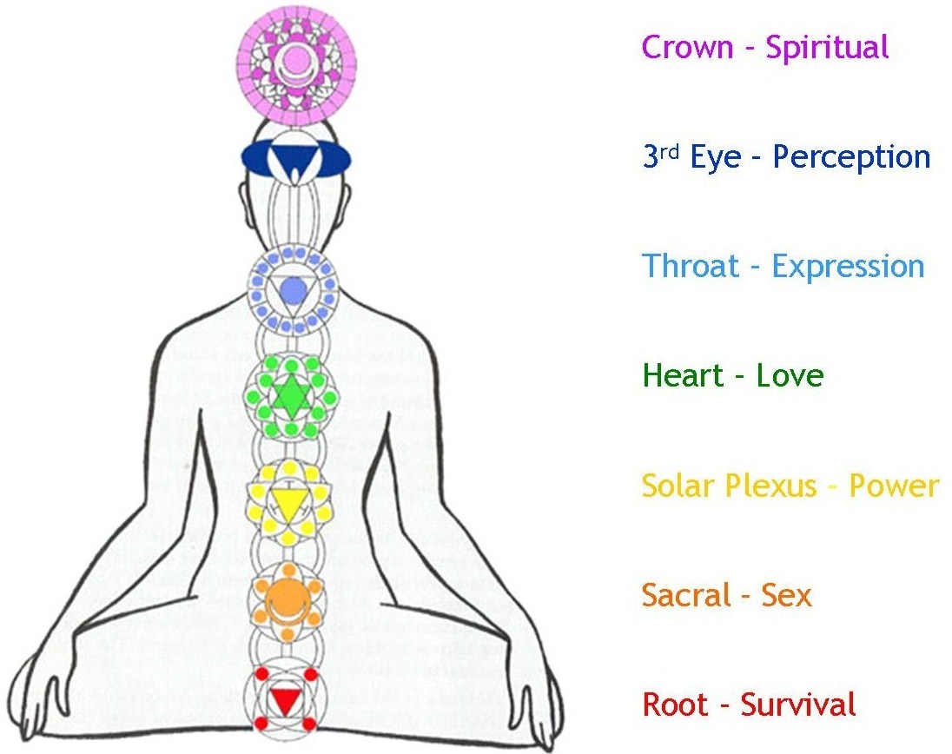
Creativity in East

Slide 17
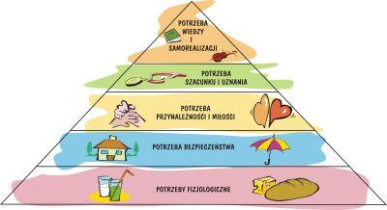

Slide 18
First legal act of „Copyrights”
English Statute of Anne 1710
Author has right to gain copies of printed book
XVIII – statutes in France

Slide 19
Teritoriality
The effects of national copyright legislation are limited
Foreign author does not benefit a uniform worldwide copyright
Author’s domicile, author’s origin, citizenship nationality, the place of first publication
Different conditions of protection
Discrimination of foreign works

Slide 20
Territoriality – problems and rules
(1) The law applicable to determine the existence, validity, duration, attributes, and infringement of intellectual property rights and the remedies for their infringement is:
(a) for registered rights, the law of each State of registration.
(b) for other intellectual property rights, the law of each State for which protection is sought.
(2) The law applicable to a noncontractual obligation arising out of an act of unfair competition is the law of each State in which direct and substantial damage results or is likely to result, or of the State or States in which the act giving rise to the damage occurred.

Slide 21
France and Belgium
In mid XIX century, France and Belgium unilaterally applied national treatment to all foreign authors, yet they remained the only ones, so they discontinued the practice on 1921 France, 1964 Belgium

Slide 22
Two major systems of Copyrights
Anglo – American
New Zeland
Commonwealth countries
Sri Lanka
India
Different Asia approach – the author strives for recognition, popularity
Continental European
So called socialist system – Soviet Union and afiliated eastern and central European Countries
Emphasis on direct earnings, society as a whole prevails in case of conflict more often in socialist system

Slide 23
Author’s vs society
Highlighting public benefits as a rationale of protection
Protection necessary to stimulate creation and dissemination to the public (spread around)
Publishing industry important
Protection to author because he has created the work, to which he always remains linked
Works are of exclusive property of author – it is a matter of justice
Bound irrespectiv of the scope of utility to the public – personality right are emphasized rather
Yet civil law is based on more abstract level, absence of definitions, judges more free

Slide 24
Formalities
Registration prima facie evidence recquired first, 1982 England modified and limited it only for infringement actions
Berlin revision of Berne Convention – 1908 prohibited formalities
USA 1989 delated in favour of foreign works
Now: voluntary fulfillment of formalities to gain prima facie evidence to claim damages
Mere fact of creation is enough to gain protection – perception
Natural law philosophy: the author of work of the mind enjoys an exclusve right of intangible property on the basis of mere fact of its creation
No act of State is recquired
Public law - deposit one copy of publication to central libraty

Slide 25
Fixation needed
Expression
The works expressed are protected from the moment of expression, improvisation of music, speaches, dance

Slide 26
Protection of work = protection of rights
No registration needed (registry enter)
No adnotation
No formalities
Irrespectively of © sign ! ☺

Slide 27
Originality
Higher level of creativity is generally recquired, although the laws under the author’s rights system often describe works in simple words:
„personal intellectual creation”, „works of mind that might be perceived bu others”
Copyright subsists in a work, that is to say,any expression within the field of literature , art or science in so far as it constitutes its author’s own intellectual creation
Neighbouring rights gain less protection, they are more limited (time)
Very low level of originality is recquired – what is not copied is original
Meny works here protected do not reach the necessary level of creativity in author’s right system
Copyright covers phonograms, broadcasting, while in the other system there is a separate notion for this scope of protection i.e. „neighbouring rights”

Slide 28
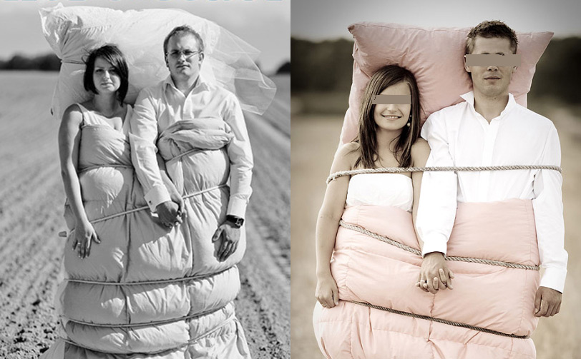
Rafał Bednarz Fotofabryka

Slide 29
Entity - person
Original result of labour or investment are protected, copyright are vested not only to the natural persons, also to legal persons that make investment
do not need in the system notions like „right holder”, „ right owner”
Full freedom of contract, only case law limits the freedom
Only a natural person may be an author
There is always succession and the successor in title is vested with the right
More frequent statutory remuneration (retirement for autors)
Copyright contract law is statutory restructed
Initial owner - the author assigns or (exclusively or not ) licenses the economic rights to legal person

Slide 30
Moral rights in European system can not be assigned
Moral rights do not refer issues of morality but simply to non economic, intellectual and artistic interest of the author.
Decision of Swedish court of appeal holds that the insertion of commercial breaks in certain movies was a violation of moral rights of the film director because the continuity and dramaturgy of the movie was interrupted
The Olimpic Stadion in Munich was „rescued” from planned transformation into a socer stadion
Right of divulgation (wheather the work should be published)
Right of authorship (paternity) to claim his own name be used in connection withhis work or he remains anonymous
Integrity right – authors exclusive decision to change the work

Slide 31
In the European Copyright Code draft:
The author can consent not to exercise his moral rights. Such consent must be limited in scope , unequivocal and informed
Clear and one meaning, direct

Slide 32
Moral rights in Anglo – American system
In the copyright system the concept of moral rights has always been alien, even today, after the Berne convention has been adopted and imposed certain level of moral rights notions.
Respect of authors choices seems to have less value on copyrights than the best possible profit making commercialisation.
In this system moral rights are usually transferable (waivable)
Ghost writer

Slide 33
Ghostwriter
A ghostwriter is a professional writer who is paid to write books, articles, stories, reports, or other texts that are officially credited to another person. Celebrities, executives, and political leaders often hire ghostwriters to draft or edit their books, autobiographies, , magazine articles, or other written material. In music, ghostwriters are used in film score composition, as well as for writing songs and lyrics for popular music genres.
the clients ultimately keep all advances and post-publishing royalties and profits for themselves. In Canada, The Writers' Union has established a minimum fee schedule for ghostwriting a book
In Poland we do not have even the notion of ghost writer ☺

Slide 34
Broadcasting
original term broadcast referred to the literal sowing of seeds on farms by scattering them over a wide field
distribution of audio and video content to
a dispersed (spread over) audience via radio, television, or other. Receiving parties may include the general public or a relatively large subset

Slide 35
Natural person
Nasciturus
0-13 years – no capacity exept minor contracts
13- 18 (16) years – limited capacity
Adults – full capacity for legal acts
Natural person may be incapacitated fully or partially – District Court sentence.

Slide 36
Personal interests art. 23 – 24 C.C.
Personal interests of a human being in particular health, freedom, dignity, freedom of conscience, name or pseudonim, image, privacy of correspondence, inviolability of home and scientific, artistic, inventice or improvement achievements are protected by civil law, independently of protection under other regulations

Slide 37
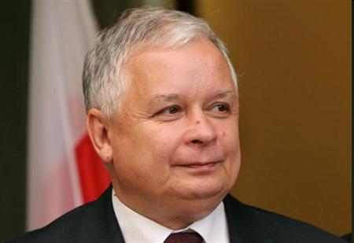
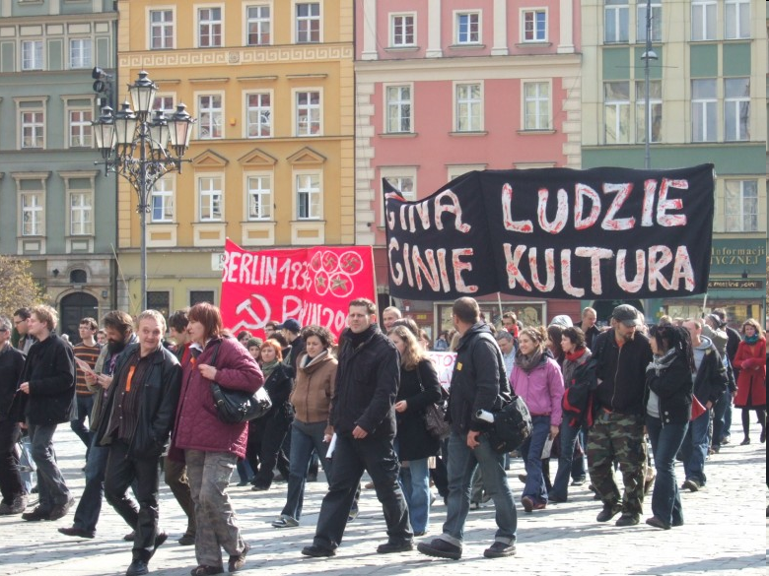
The act of divulging a picture of natural person
Art. 81 Polish Copyright act of 4.2.1994
1.
Publishing a picture recquires the preson’s consent
If the model has been payed the consent is presumed unless otherwise stated in contract
2. Consent is not recquires when publishing a picture of :
Public person – when the picture is taken while performing official function / work, social, political duties
2) When the person is merely a detail of a bigger composition as for example: assembly, landcape, scenery, public meeting

Slide 38
Legal persons
Art. 33 CC legal persons are the State Treasury and organizational units, wchi are accorded legal personality by specific regulations
Legal personality attained upon its entry in a relevant register : KRS.
Legal person acts through its bodies – management boards generally
Invalid legal act when unauthorized reprezentation – remedy of damages only

Slide 39
Example
An unknow painter creates a painting and signs it with the name of Max One (famous painter) – which copyright is violated? Economical, moral, right to claim authorship, right of intergrity or other ?
Are Moral rights of perpetual or limited duration ?

Slide 40
Example
Why an actor who participate in the movie is not protected ?
Why he may not prohibit the broadcasting of the movie ?
Perhaps he may prohibit distribution of his photos ?

Slide 41
Sources of law
National law – national cases (author, licencee, infringer are from the same country)
European Law – directives, systems of protections (patent, trademarks) drafts of European Copyright Code
International Conventions – Berne Cinvention, WIPO treaties
World Intellectual Property Organisation

Slide 42
European Copyright Code
transparency and consistency in European copyright law - works in the field of literature, art and science.
Chapter 1: Works
Chapter 2: Authorship and ownership
Chapter 3: Moral rights
Chapter 4: Economic rights
Chapter 5: Limitations

Slide 43
European copyright law must operate within the confines of the international commitments of the European Union and its Member States,
the Code takes account of the substantive norms of the Berne Convention and the TRIPs Agreement. Also, the members of the Group have found it hard to ignore the aqcuis communautaire in the form of seven Directives that the European legislature has produced in this field since 1991

Slide 44
In ECC not protected:
Facts, discoveries, news and data
b. Ideas and theories;
c. Procedures, methods of operation and mathematical concepts
Official texts of a legislative, administrative and judicial nature, including
international treaties, as well as official translations of such texts;
(b) Official documents published by the public authorities.

Slide 45
Berne Convention
Main copyright convention – adopted 1886
Revised almost every 20 years, finally the Paris Act 1971, that produced final clauses, as a consequence of the simultanous adoption of Convention Estabilishing the World Intellectual Property Organisation – which was to administer the Bern Convention in the future
1988 – UK and USA fully accesed

Slide 46
Administration of Berne Convention
Berne Convention set up a bureau to handle administrative tasks. In 1893 it became the United International Bureaux for the Protection of Intellectual Property (French acronym BIRPI), in Berne.
In 1960, BIRPI moved to Geneva, to be closer to the United Nations and other international organizations. In 1967, it became the World Intellectual Property Organization (WIPO), and in 1974 became an organization within the United Nations.

Slide 47
UCC – Universal Copyright Convention
Latin America, USA, Soviet Union
1940’ – 1952 adopted
Low protection
Relations between North and South Americas
Reason not to join Berne Convention at first:
Lack of moral rights
Formalities of registration
28 years protection (publ.)
mandatory copyright notice ©

Slide 48
Conventions
Berne Convention
Copyrights
1971 Geneva Phonograms Convention – anti-piracy treaty
1996 WCT
Rome Convention 1961
Neighbouring rights
Model for TRIPS and WPPT
Protection of :
Performers
Producers
Phonogrames and Broadcasting organisations
1996 WPPT

Slide 49
The Berne Convention rests on three basic principles.
the principle of “national treatment”, according to which works originating in one of the member States are to be given the same protection in each of the member States as these grant to works of their own nationals.
automatic protection - national treatment is not dependent on any formality; protection is granted automatically and is not subject to the formality of registration, deposit or the like.
there is independence of protection, according to which enjoyment and exercise of the rights granted is independent of the existence of protection in the country of origin of the work.

Slide 50
Protected works
Article 2 contains a non-limitative (illustrative and not exhaustive) list of protected works
Derivative works, that is those based on other pre-existing works, receive the same protection
Art. 2(2) provides for the possibility of making the protection of works or any specified categories thereof subject to their being fixed in some material form.

Slide 51
Folklore protection
One of the important provisions is the one that covers works or expressions of what is called “folklore.”
Art.15 (4) Without mentioning the word, the Convention provides that any member country may
give protection to unpublished works where the identity of the author is unknown, but where there
is every ground to presume that the author is a national of that country,
by designating, through the national legislation, the competent authority which should represent the author of unknown identity and protect and enforce his rights in the countries party to the Convention.
By providing for the bringing of actions by authorities designated by the State, the Berne Convention offers to countries whose folklore is a part of their heritage, a possibility of protecting it.

Slide 52
Berne Convention http://www.wipo.int/treaties/en/ip/berne/summary_berne.html
exclusive rights of authorization:
the right to translate,
the right to make adaptations and arrangements of the work,
the right to perform in public dramatic, dramatico-musical and musical works,
the right to recite literary works in public,
the right to communicate to the public the performance of such works,
the right to broadcast (with the possibility that a Contracting State may provide for a mere right to equitable remuneration instead of a right of authorization),
the right to make reproductions in any manner or form (with the possibility that a Contracting State may permit, in certain special cases, reproduction without authorization, provided that the reproduction does not conflict with the normal exploitation of the work and does not unreasonably prejudice the legitimate interests of the author; and the possibility that a Contracting State may provide, in the case of sound recordings of musical works, for a right to equitable remuneration),
the right to use the work as a basis for an audiovisual work, and the right to reproduce, distribute, perform in public or communicate to the public that audiovisual work

Slide 53
Film authorship in Berne Convention
Most diversely regulated in member countries
Copyright- only producer is first owner, director, cameramen others are not recognized as authors of film (as authors of scenario dialogues, music separate)
Continental Europe – joint authors of film – natural persons or authors of pre-existing works – novel f.ex.

Slide 54
Art. 14 Berne Convention
European approach
14bis 2a – leaves the determination of the ownership in the cinematografic work to the law of the country for which protection is claimed
Presumption of legitimation; where authors of particular works contractually agreed to make contribution to the film, they can no longer object to the specified way of exploitation

Slide 55
Challenges to Berne and Rome Convention
Technical, economic and legal development
Possible: interpretation, amandements, still diffucult on international level
Authentic interpretation: binds all contracting parties
Individual – judicial
Question of whether computer programes are works in Berne Convention

Slide 56
Computer programme
Source code – series of instructions transformed into machine code to interact with the computer’s central processing unit in order to achive certain result

Slide 57
WIPO Copyright Treaty
(adopted in Geneva on December 20, 1996)
Article 3 Application of Articles 2 to 6 of the Berne Convention
Contracting Parties shall apply mutatis mutandis the provisions of Articles 2 to 6 of the Berne Convention in respect of the protection provided for in this Treaty.

Slide 58
WCT
Article 4 Computer Programs
Computer programs are protected as literary works within the meaning of Article 2 of the Berne Convention. Such protection applies to computer programs, whatever may be the mode or form of their expression.

Slide 59
WCT
Article 8 Right of Communication to the Public
Without prejudice to the provisions of Articles of the Berne Convention, authors of literary and artistic works shall enjoy the exclusive right of authorizing any communication to the public of their works, by wire or wireless means, including the making available to the public of their works in such a way that members of the public may access these works from a place and at a time individually chosen by them

Slide 60
WPPT 1996
The WIPO Performances and Phonograms Treaty deals with the rights of two kinds of beneficiaries, particularly in the digital environment:
performers (actors, singers, musicians, etc.);
(ii) producers of phonograms (persons or legal entities that take the initiative and have the responsibility for the fixation of sounds).

