Slide 1
Antitrust law
mgr Zuzanna Witek
2018

Slide 2
The European Single Market
The European Single Market, Internal Market or Common Market is a single market which seeks to guarantee the free movement of:
goods,
capital,
services,
and labour – the "four freedoms" – within the European Union.
The market encompasses the EU's 28 member states, and has been extended, with exceptions, to Iceland, Liechtenstein and Norway through the Agreement on the European Economic Area and to Switzerland through bilateral treaties.
Through the Deep and Comprehensive Free Trade Area (DCFTA), three post-Soviet countries Georgia, Moldova and Ukraine were given access to the Single Market in selected sectors.
Turkey has access to the free movement of goods via its membership in the European Union Customs Union

Slide 3
History - from the European Coal ans Steel Community to the single market and currency
The European Economic Community (EEC)
One of the original core objectives was the development of a common market offering free movement of goods, service, people and capital.
Free movement of goods was established in principle through the customs union between its then-six member states.

Slide 4
Discussion
Why is it so difficult for the EU Member States and Peoples to choose between a « united market » and a Federal state ?

Slide 5
Further developments
Since 2015, the European Commission has been aiming to build a single market for energy and for the defence industry
On 2 May 2017 the European Commission announced a package of measures intended to enhance the functioning of the Single Market within the EU
Single Digital Gateway (a proposal for a single digital access point for information and administrative services)
Single Market Information Tool (a proposed regulation under which the Commission could require EU businesses to provide information in relation to the internal market and related areas where there is a suspicion that businesses are blocking the operation of the single market rules)

Slide 6
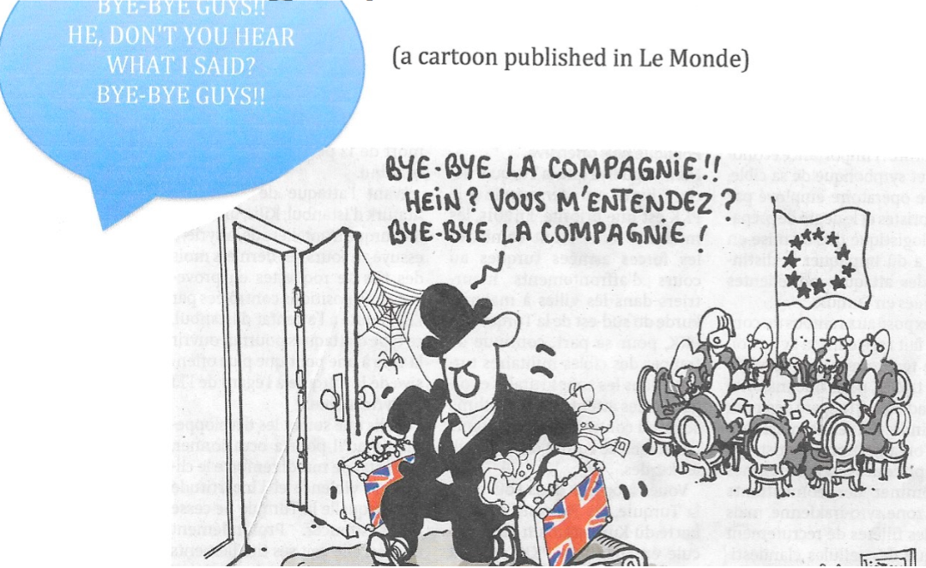
Brexit
ACT 1: BREXIT and so what ? A tragedy or a new future?

Slide 7
ACT 2 in Brussels : You should have learned that referendum means yes

Slide 8
ACT 3: The Brexit leader leave and come back
„I do not think it would be right for me to try to be the captain that steers our country to its next destination”
„I thought it could not happen. My Lord, I am not prepared to be Prime Minister. » I am a new Othello. Finally, I am at the Foreign Office. Thank you Tatty May"

Slide 9
Now, should we build a new Europe? Should we not? But, how could we do it in the aftermath of such an earthquake?

Slide 10
Analysis
What about the divisions in the EU?
What about the troika formed by Germany, France and Italy?
What about the new Member States?
What about the division of the UK? Will we have to say The divided Kingdom or « small Britain »?

Slide 11
What can be done at the institunional level?
The Parliament should become more representaive of the peoples and received the full powers of a Parliament. The Council (of ministers) should become a Senate of the States with permanent representaives appointed by the States.
Nationnal Parliaments might have representaives in the EU Parliament?
The Commission should become the EU Government chosen by the Parliament and the Council or it might be done for the Euro zone with a fiscal evolution
A Union fiscal policy should exist with a transfer of fiscal power to the EU Institutions: Parliament and Council.
A financial and banking Union for the Euro zone. It is at the final stage.
A power to veto the national budgets, which do comply with the obligations of the Treaty
A real ministry of foreign affairs is needed.
A common defence policy has to be developed.

Slide 12
A moment for Hope
In UK the young people voted at quite 75% in favour of « Remain ». A new referendum might be organized later by the end of the negotiations…. But T. May said that “Brexit is Brexit!”
By the end of the negotiation, UK might be in the position of obtaining a status similar to what have conceded in 2015 for preventing the Brexit.
Shame on the liars who blame systematically Brussels for their own failures and choices.

