Slide 1
Criminal Procedure and Courts
Pre-trial. The file of criminal process. The access to a file. Disclosure and discovery.

Slide 2
Pretrial procedure - definition
Initial stage of the criminal procedure.
Source of the information about the crime: police report, aggrieved party/other people information about the crime, media information etc.
Key aspect: any information must justify the suspicion that a crime has been committed.
Different models of pretrial procedure, different obligations, different meaning of first stage of criminal process.

Slide 3
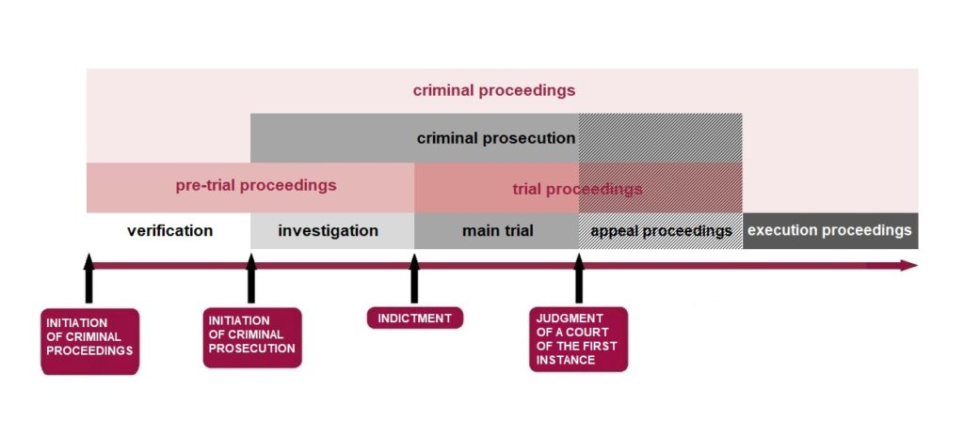
https://verejnazaloba.cz/en/more-about-public-prosecution/all-about-criminal-proceedings/stages-of-criminal-proceedings/

Slide 4
Pretrial procedure - definition
The objective of pre-trial proceedings is to clarify the matters of fact indicating that a crime has been committed. In this stage of proceedings, the public prosecutor plays an important part, since he performs supervision over the activity of Police authorities and decides on filing an indictment to the court.
Tasks in pre-trial proceedings:
to secure the groundwork basis for the decision, whether to file an indictment and let the court deal with the case or to waive further criminal prosecution of the person concerned,
to ascertain all circumstances important for deciding on the criminal offense, its perpetrator, punishment and protective measure, as well as deciding on the claim of the aggrieved person for compensation of damage, and to secure the necessary evidence,
to uncover the causes of criminal activity and circumstances that allowed or facilitated commission thereof.
https://verejnazaloba.cz/en/more-about-public-prosecution/all-about-criminal-proceedings/stages-of-criminal-proceedings/

Slide 5
Pretrial model of process
https://cdn.istanbul.edu.tr/file/JTA6CLJ8T5/09D5F39F97C84464A03B6F78552B92BF <-- see book about different approaches to pretrial proceedings in several countries
One common point – pretrial stage of the proceedings is the most inqusitorial part of the whole process. Non-judicial authorieties play crucial role and may decide about rights and freedoms of participants of the proceeding.
There is no publicity of the pretrial stage of proceeding.

Slide 6
Meaning of pretrial stage of proceedings
„Recent times, the pre-trial process has arguably been the subject of more heated debates than the trial phase has been. One reason for this, is that the pre-trial process is one which begins with a simple suspicion and subsequently seeks to reach a certain degree of suspicion so that indictment can be introduced to the court by prosecutor. Despite the existence of uncertainty as whether sufficient evidence required in order introduce the indictment to the court will be established, the main fundamental rights and freedoms, inter alia, freedom of liberty and right to privacy can be intervened by the public prosecutor and even police officers at a very early stage in of a criminal case, in all jurisdictions covered by this book. This clearly places core protections, such as presumption of innocence, at risk of harm. This raises an interesting disjunction, whereby on the one hand, at pre-trial stage the degree of suspicion required to deprive a suspect’s liberty is lower than it is in trial, on the other, the fundamental rights and freedoms are at increased risk of violation in the pre-trial stage”.

Slide 7
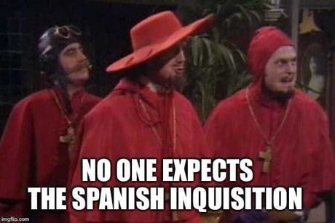
all modern criminal justice systems moved away from
their tradition of nondisclosure.

Slide 8
Files in pretrial stage of criminal proceedings
https://www.oas.org/juridico/PDFs/mesicic4_svg_man_guid_prep_case_file.pdf <-- in some countries there is common standard of building case files in pretrial stage of process
What is in the case files?
Evidence – mostly (real evidence, recordings, witness statments, expert witness opinion etc.)
Decisions made in preterial stage of proceedings (preventive measures, custody)
Decision/formal notification about the charges

Slide 9
Why access to a case files is crucial for the defendant?
What factors must be balanced during pretrial stage of the proceedings?
Is it possible to allow digital access to a case files?

Slide 10
Access to case files is a fundamental aspect of the legal process that supports the principles of transparency, accountability, and fairness in the administration of justice. It allows parties to a case, as well as the public, to understand and participate in the legal proceedings.
The rules of access to a case files may differ in certain countries. During pretrial stage of the proceedings usually public prosecutor may decide to whom access to a case files will be granted.
It is also important to remember that the meaning of pretrial evidence may be different in certain jurisdictions.

Slide 11
Access to a case files
Access to case files may vary in different countries, but among EU member states, it is standard practice to provide the case files to the accused no later than the moment the case is referred to court (at the stage of judicial proceedings). Before the case is referred to court, the public prosecutor must disclose all the evidence material they possess. Furthermore, the method of providing evidence material must ensure a real opportunity to familiarize oneself with these documents.
Access to case files in the case of deprivation of liberty (ruling on temporary detention/custody) must be fully guaranteed.

Slide 12
ECtHR judgments:
425. In determining whether Article 6 § 3 (b) has been complied with, account must be taken also of the usual workload of legal counsel; however, it is not unreasonable to require a defence lawyer to arrange for at least some shift in the emphasis of his work if this is necessary in view of the special urgency of a particular case (Mattick v. Germany (dec.), 2005). In this context, in a case in which the applicant and his defence counsel had had five days to study a six-volume case file of about 1,500 pages, the Court did not consider that the time allocated to the defence to study the case file was enough to protect the essence of the right guaranteed by Article 6 §§ 1 and 3 (b). The Court took into account the fact that in the appeal the applicant had analysed the case material in detail, that he had been represented before the appeal court by two lawyers, who confirmed that they had had enough time to study the file, and that the applicant had not been limited in the number and duration of his meetings with the lawyers (Lambin v. Russia, 2017, §§ 43-48).

Slide 13
Disclosure in criminal cases
The European Court of Human Rights (ECtHR) has described disclosure as “a fundamental aspect of the right to a fair trial”. The Court also held that Article 6(1) of the European Convention on Human Rights (ECHR) requires the prosecution to disclose to the defence all material evidence in their possession for or against the accused. This is based on the Court’s rationale that there should be equality of arms between the prosecution and defence, which means that each party must be given a reasonable opportunity to present their case and that neither party is placed at a disadvantage.

Slide 14
Disclosure in criminal cases
The ECtHR has also held that the equality of arms principle places an obligation on the prosecution to disclose to the defence all the material evidence in the case, whether it is of an inculpatory or exculpatory nature. The right to a fair trial is also enshrined in Article 47 of the Charter of Fundamental Rights of the European Union. In addition, the 2012 EU Directive on the right to information in criminal proceedings requires that an accused be provided with access to all relevant material by prosecuting authorities.
There is no common standard how the disclousure should look like.

Slide 15
Disclosure in criminal cases
Disclosure obligations in criminal procedure vary according to the type of evidence, which falls into three broad categories:
evidence that the prosecution plans to present at trial to prove the defendant’s guilt;
evidence in the prosecution’s possession that it does not plan to present at trial, either because it favors the defense in some way or because its value is marginal or unknown; and
evidence in possession of the defense that it plans to present at trial.

Slide 16
Prosecution Evidence of Guilt
English courts have recognized a common law duty for prosecutors to disclose, prior to trial, the evidence on which they will rely to prove guilt. In general, the prosecution discloses a bundle of witness statements and identifies experts or scientific reports on which it will rely, either when a case is committed to Crown Court or in advance of a magistrate court proceeding for either-way offenses.
English courts consider this obligation essential to a fair trial and a requirement of the equality-of-arms principle, having rejected the long-standing argument in the common law world that trial by “surprise” or “ambush” serves the truth-finding enterprise

Slide 17
Government Evidence That Does Not Favor the Prosecution’s Case
Over the last several decades, all jurisdiction have to some degree required the prosecution to share material that undermines its case, either because it is exculpatory in nature or because it impeaches the credibility of government evidentiary sources.

