Slide 1
Political Socio-economical and Legal Though
classes

Slide 2
Piotr S. Kozdrowicki
piotr.kozdrowicki@uwr.edu.pl
https://prawo.uni.wroc.pl/user/33381
consultations: room 306A

Slide 3
How to pass the classes?
Every Student needs to write 3 essays
deadline: 7.01.2019
Every Student needs to present one of his/her essays at the classes
start of presentations: 29.10.2018
4 presentations at each classes
Attendance
2 absences possible

Slide 4
Philosophy of antient world:
Cynicism
Stoicism
Epicureanism

Slide 5
Cynicism

Slide 6
Cynicism
Κυνόσαργες [Cynosarges]
Κυνικός [Cynicos]

Slide 7
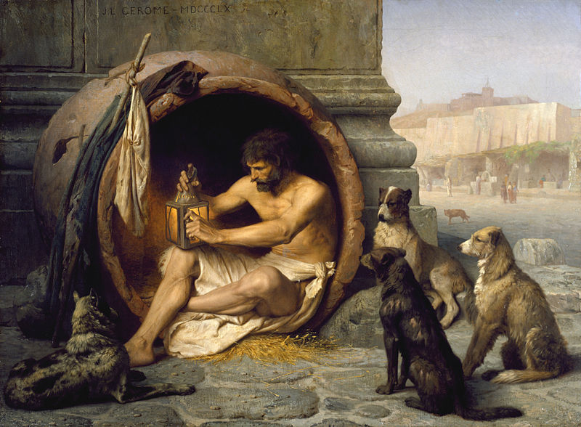
Diogenes of Sinope

Slide 8
Ethics

Slide 9
Ethics
Virtue: living in accord with the Nature

Slide 10
Virtue
Latin: virtus, Greek: ἀρετή [aretē]

Slide 11
Virtue
Latin: virtus, Greek: ἀρετή [aretē]
ethikē aretē – virtue of the character

Slide 12
Cynic virtue = life lived in agreement with Nature
avoiding civilisation

Slide 13
How to live free?
ἄσκησις [askezis]

Slide 14
How to live free?
ἄσκησις [askezis]
self-sufficiency

Slide 15
How to live free?
ἄσκησις [askezis]
self-sufficiency
courage of expression

Slide 16
How to live free?
ἄσκησις [askezis]
self-sufficiency
courage of expression
egoism

Slide 17
Living free
εὐδαιμονία [eudaimonia]

Slide 18
Freedom by the Cynics:
παρρησία [parrhēsia] – frankness
(freedom of speech)

Slide 19
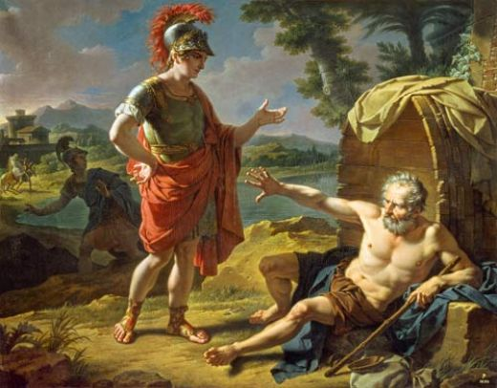
Diogenes of Sinope and Alexander the Great

Slide 20
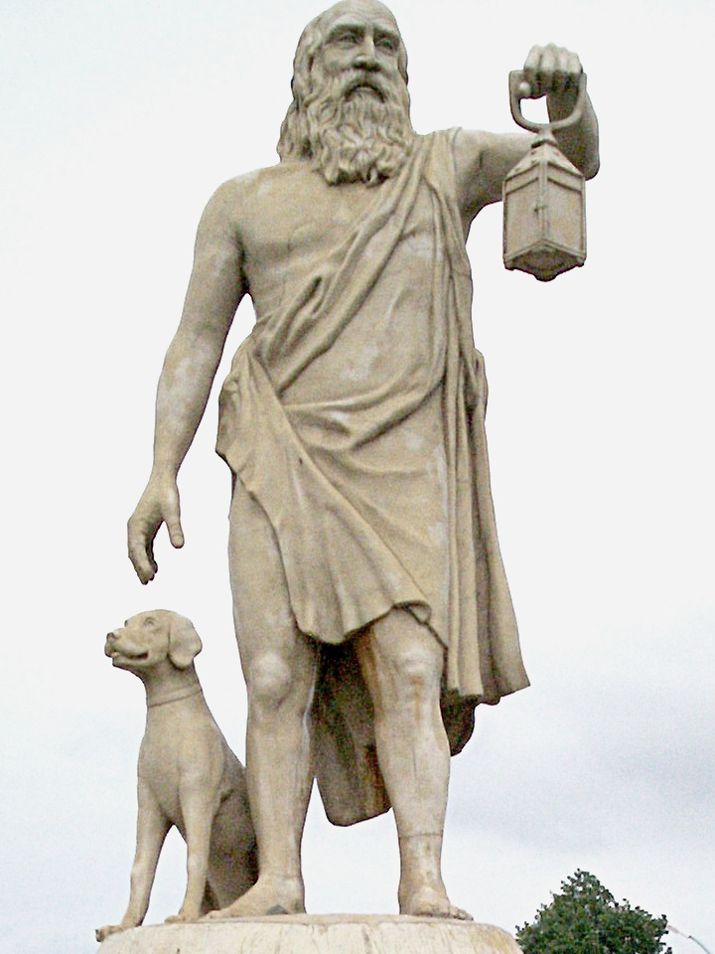
Diogenes of Sinope

Slide 21
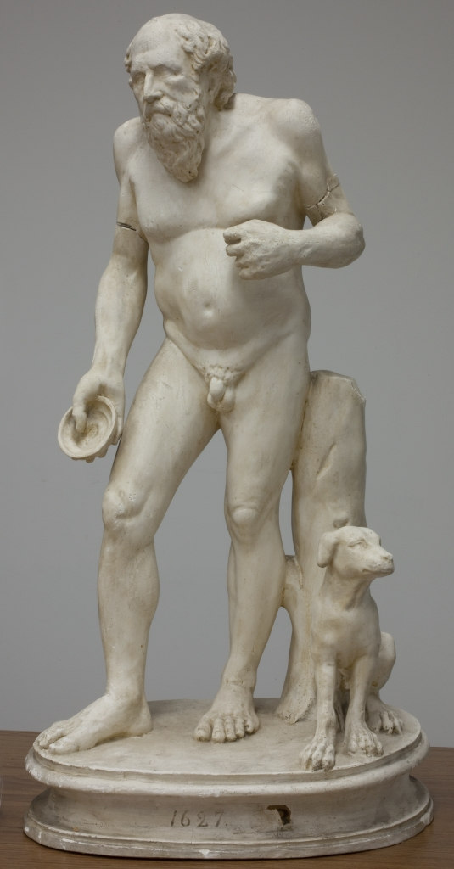
Diogenes of Sinope

Slide 22
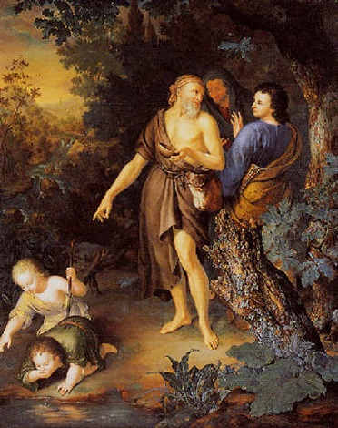
Diogenes of Sinope

Slide 23
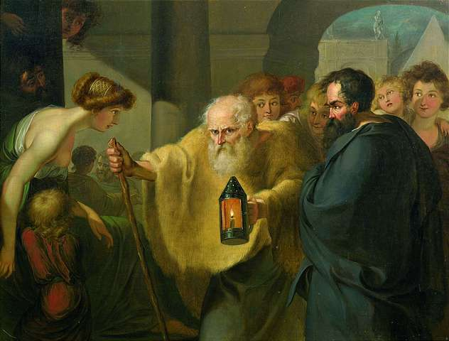
Diogenes of Sinope

Slide 24
Cosmopolitanism
Κοσμοπολίτης [cosmopolites] – citizen of the World

Slide 25
Legacy of Cynicism:

Slide 26
Legacy of Cynicism:
Stoicism

Slide 27
Legacy of Cynicism:
Stoicism
Anarchism

Slide 28
Legacy of Cynicism:
Stoicism
Anarchism
modern cynicism

Slide 29
Video: What Do Cynical People Really Want?

Slide 30
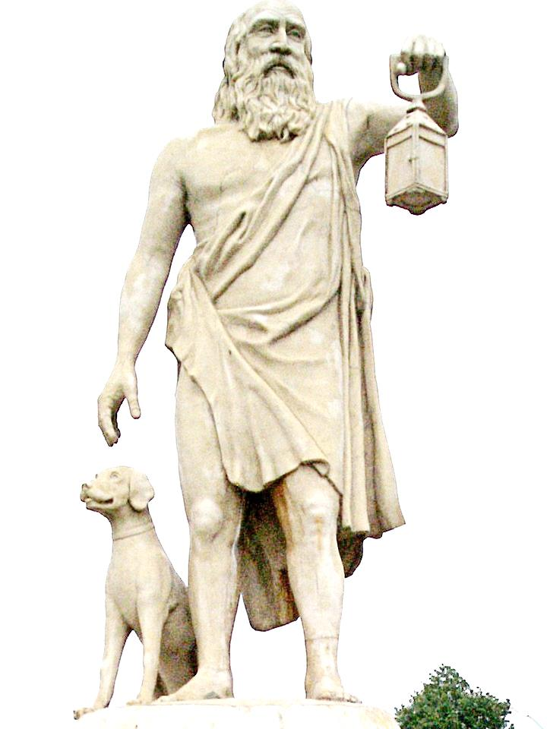
Cynicism in brief:
founders: Diogenes of Sinope, Antisthenes
purpose: live in accord with the Nature
how to reach it?
arete (moral virtue)
askezis
self-sufficiency
courage of speech
Eudaimonia (living truly free life)
legacy of Cynicism:
Stoicism
Anarchism

Slide 31
Stoicism

Slide 32
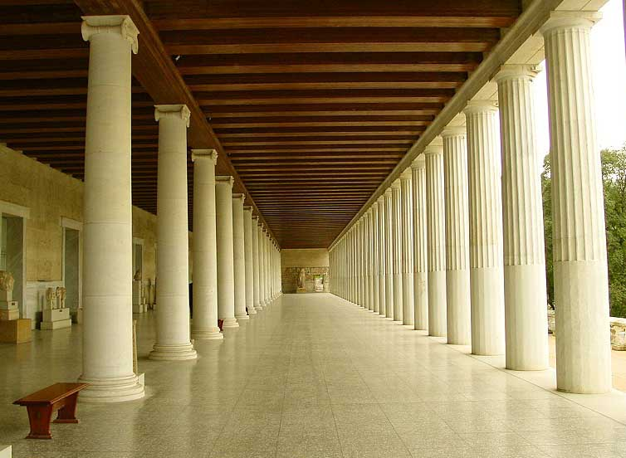
Στοὰ Ποικίλη [Stoa Poikile]

Slide 33
Stoicism

Slide 34
Stoicism:
Early Stoa (ca. 300 B.C.E.) – Zeno of Citium

Slide 35
Stoicism:
Early Stoa (ca. 300 B.C.E.) – Zeno of Citium
Middle Stoa (late II and I century B.C.E.)
– Panaetius, Posidonius

Slide 36
Stoicism:
Early Stoa (ca. 300 B.C.E.) – Zeno of Citium
Middle Stoa (late II and I century B.C.E.)
– Panaetius, Posidonius
Late Stoa (I through II century C.E.) - Seneca, Cicero, Musonius Rufus, Epictetus and Marcus Aurelius

Slide 37
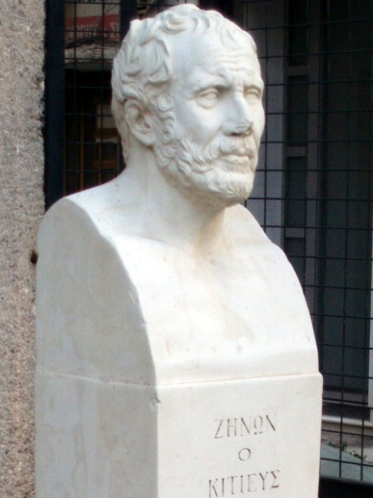
Zeno of Citium

Slide 38
Cynicism Stoicism
Ethics

Slide 39
Socrates
Cynicism Stoicism
Logic
Ethics

Slide 40
Socrates
Cynicism Stoicism
Plato
Logic
Ethics
Physics

Slide 41
τόποι [topoi]:
Logic
Physics
Ethics

Slide 42
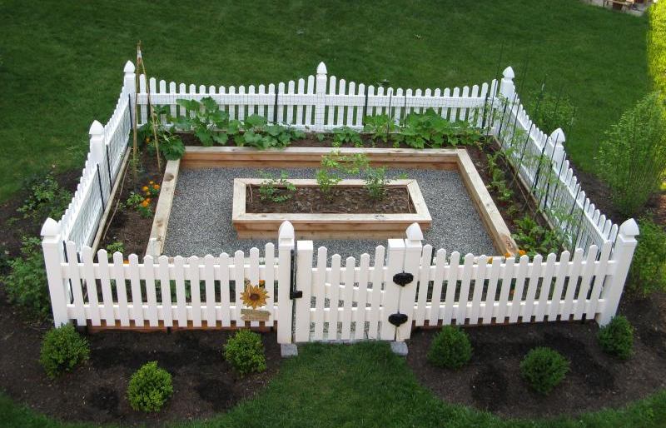
Stoic „garden of philosophy”

Slide 43
Stoic „garden of philosophy”
Logic

Slide 44
Stoic „garden of philosophy”
Physics
Logic

Slide 45
Stoic „garden of philosophy”
Ethics
Physics
Logic

Slide 46
Stoic Physics:

Slide 47
Stoic Physics:
Cosmos = God

Slide 48
Stoic Physics:
Cosmos = God
Pneuma – divine essence

Slide 49
Stoic Physics:
Cosmos = God
Pneuma – divine essence
Aether – divine fire

Slide 50
Stoic Physics:
Cosmos = God
Pneuma – divine essence
Aether – divine fire
Logos

Slide 51
Stoic Physics:
Cosmos = God
Pneuma – divine essence
Aether – divine fire
Logos
(Everything is determined!)

Slide 52
Stoic Ethics:

Slide 53
Stoic Ethics:
„Follow the Nature!”

Slide 54
Stoic Ethics:
„Follow the Nature!”
οἰκείωσις [oikeiôsis]

Slide 55
Stoic Ethics:
„Follow the Nature!”
οἰκείωσις [oikeiôsis]
cardinal virtues

Slide 56
Cardinal virtues:
temperance
courage
justice
practical widsom

Slide 57
ἀπάθεια [apatheia]

Slide 58
ἀπάθεια [apatheia]
live in accord with Nature

Slide 59
Roman Stoicism:
Cicero
Marcus Aurelius

Slide 60
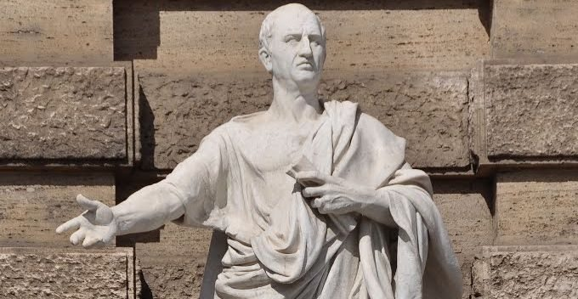
Marcus Tullius Cicero

Slide 61
„Paradoxa Stoicorum”

Slide 62
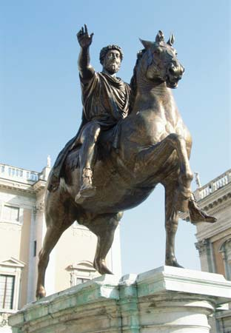
Marcus Aurelius

Slide 63
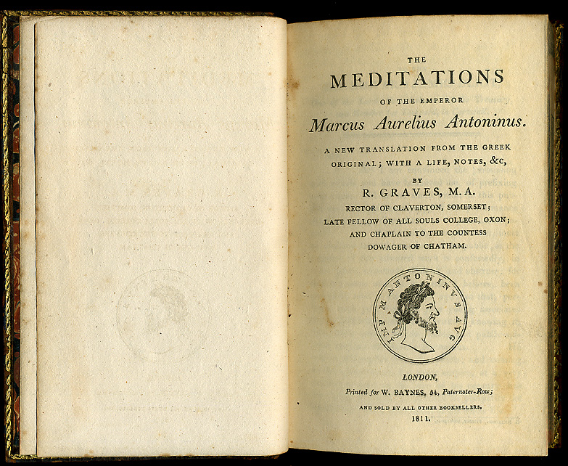
„Meditations”

Slide 64
Video: 5 Key Principles Of Stoicism Explained

Slide 65
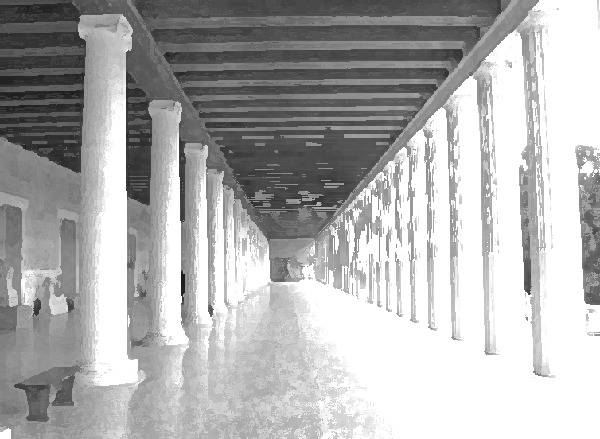
Stoicism in brief:
thinkers: Zeno of Citium; Seneca; Cicero; Marcus Aurelius
Influence of: Cynicism, Socrates and Plato
3 topoi: Logic, Physics and Ethics
Stoic Physics:
Cosmos as God (Logos), Pneuma, Aether
Stoic Ethics:
Follow the Nature!
cardinal virtues
purpose of live: apatheia
avoiding bad emotions
ability to live in accord with Nature

Slide 66
Epicureanism

Slide 67
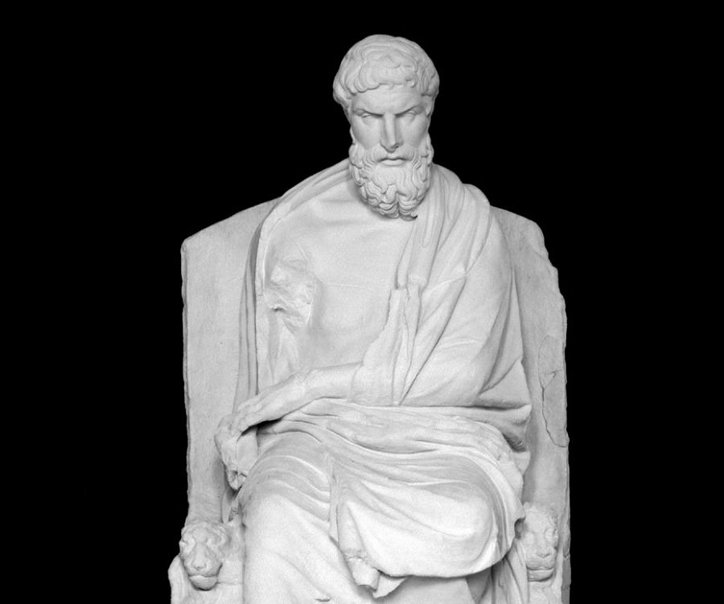
Epicurus of Samos (341–270 B.C.)

Slide 68
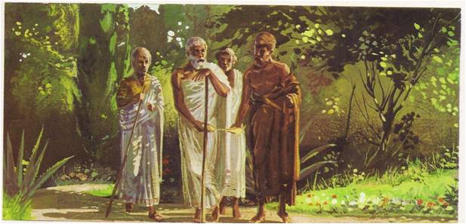
Epicurus of Samos in the Garden

Slide 69
Epicurean Physics:
materialism
Cosmos = atoms + void
There is no soul!
There are no gods!
Death is annihilation

Slide 70
Epicurus’ arguments against fear of death:
1. Death is annihilation.
2. The living have not yet been annihilated.
3. Death does not affect the living.
4. Death is not bad for the living.
5. For something to be bad for somebody, that person has to exist, at least.
6. The dead do not exist.
7. Therefore, death is not bad for the dead.
8. Therefore death is bad for neither the living nor the dead.

Slide 71
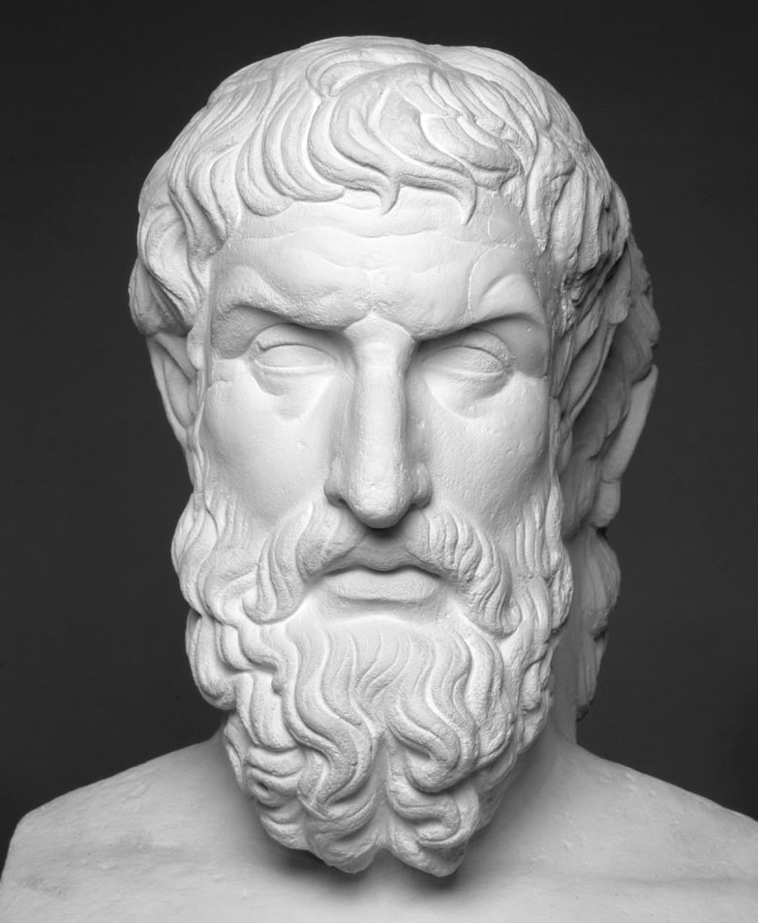
„While we are, there is no death.
When there is death, there will be no us.”

Slide 72
Epicurean Ethics:

Slide 73
Epicurean Ethics:
general purpose of life: pleasure

Slide 74
Epicurean Ethics:
general purpose of life: pleasure
εὐδαιμονία [eudaimonia]

Slide 75
Epicurean Ethics:
general purpose of life: pleasure
active pleasures
εὐδαιμονία [eudaimonia]

Slide 76
Epicurean Ethics:
general purpose of life: pleasure
active pleasures
εὐδαιμονία [eudaimonia]
(painful and short)

Slide 77
Epicurean Ethics:
general purpose of life: pleasure
active pleasures passive pleasures
εὐδαιμονία [eudaimonia]
(painful and short)

Slide 78
Epicurean Ethics:
general purpose of life: pleasure
active pleasures passive pleasures
εὐδαιμονία [eudaimonia]

Slide 79
Epicurean Ethics:
general purpose of life: pleasure
active pleasures passive pleasures
εὐδαιμονία [eudaimonia]
Hedonism?

Slide 80
Video: A History of Disbelief

Slide 81
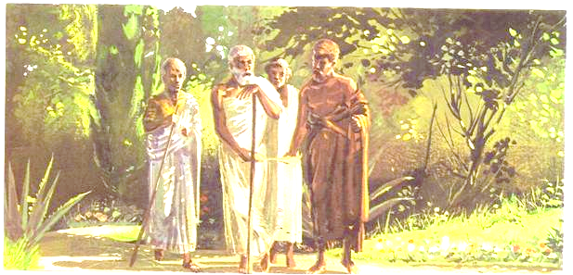
Epicureanism in brief:
founder: Epicurus of Samos
Epicurean materialism:
Cosmos = atoms + void
There is no soul!
There are no gods!
Epicurean Ethics:
general purpose of life: pleasure
types of pleasures: active and passive
Legacy of Epicureanism:
problem of the Evil
question about existence of God

Slide 82
Useful sources:
Internet Encyclopedia of Philosophy (http://www.iep.utm.edu/)
The Stoic: 9 Principles to Help You Keep Calm in Chaos (http://99u.com/articles/24401/a-makers-guidebook-9-stoic-principles-to-nurture-your-life-and-work)
Videos:
What Do Cynical People Really Want? - https://www.youtube.com/watch?v=ohrQCzZsgIw
Cicero dies - https://www.youtube.com/watch?v=4Ed8vNcMif0
The Philosophy Of Stoicism - 5 Key Principles Of Stoicism Explained - https://www.youtube.com/watch?v=dhrKg8_ltyQ
A History of Disbelief Epicurus,Lucretius,Aristotle,Cicero and Seneca -https://www.youtube.com/watch?v=xreBgJ0nrAU

