Slide 1
Freedom of Expression Case-law of the European Court of Human Rights

Slide 2
Council of Europe, ECHR, ECtHR: Overview
Freedom of expression in the Convention
General principles of interpreting the Convention and Article 10
Freedom of expression in a political debate
Freedom of artistic expression

Slide 3
I. The Council of Europe: overview
The Council of Europe (French: Conseil de l'Europe):
an international organisation whose aim is to uphold:
human rights,
democracy,
rule of law in Europe
and promote European culture.
It has been founded in 1949 by 10 western-Europe states.

Slide 4
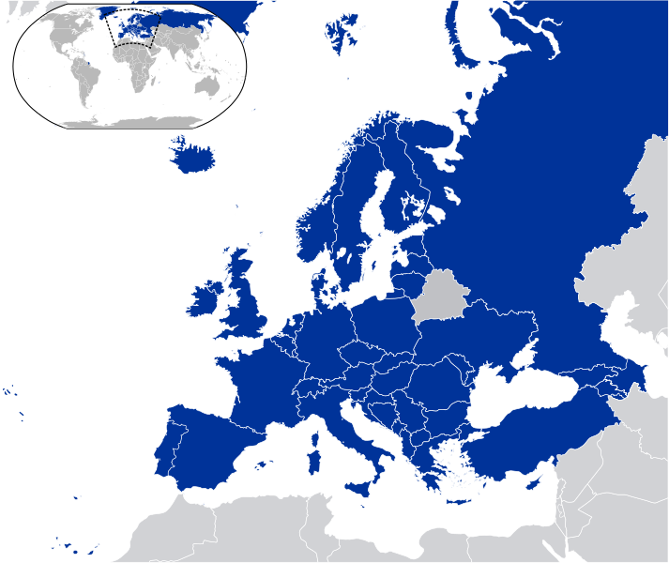
47 member states
Covers approximately 820 million people

Slide 5
Convention for the Protection of Human Rights and Fundamental Freedoms (ECHR)
Drafted in 1950, entered into force on 3 September 1953.
Sets the European standard for the protection of human rights
Neccessary requirement for a membership in the CoE.
Binding force of the Convention, part of the legal system of each member state.
Judicial control by the European Court of Human Rights (ECtHR).
Two forms of application: by state or by individual.
Over 700 000 of application since establishment of ECtHR (1959)

Slide 6
Judgments by the Convention’s article
Judgments by the state
Source: Overview 1959-2016 ECHR
http://www.echr.coe.int/Documents/Overview_19592016_ENG.pdf
Number of judgments finding violation of the Art. 10.:
656 / 19 570 (3,3%)

Slide 7
Source: Overview 1959-2016 ECHR
http://www.echr.coe.int/Documents/Overview_19592016_ENG.pdf

Slide 8
Judgments of the ECtHR: execution
Member states (and not individuals) are obliged to execute judgments, what is monitored by the Comittee of Ministers
Execution includes:
Paying compensation for damages, imposed by the ECtHR;
Eliminating individual consequences of the questioned state’s decision (particularly, a member state court’s verdict)
General prevention for the future (changing law or legal practice)
Both negative and positive duties
Addresses mainly vertical relations (state – individual), yet to some extent also horizontal (individual – individual) are considered

Slide 9
A structure of Convention
Art. 1: general obligation to secure the rights under the Convention
Section I (Rights and Freedoms): material provisions (Art. 2 – Art. 18)
Section II (European Court of Human Rights): procedural provisions (Art. 19 – Art. 51)
Section III: miscellaneous provisions (Art. 52 – Art. 59)

Slide 10
II. Freedom of expression (Art. 10).
Dynamic interpretation of the Convention.
Freedom of expression (FE): a „superfreedom”?
Kamiński: FE goes just after:
right to life;
freedom from tortures and inhuman or degrading treatment;
right to liberty and personal security

Slide 11
The scope of protection
Protection of the FE varies in different spheres, according to:
Relationship of the expression to democratic process;
The Convention is regarded as not politically neutral, but constitutively bound with a democratic order.
Subject (author of a speech act);
Topic;
Type of a speech act;
Medium of communication.

Slide 12
Article 10 of ECHR: Freedom of expression
1. Everyone has the right to freedom of expression. This right shall include freedom to hold opinions and to receive and impart information and ideas without interference by public authority and regardless of frontiers. This Article shall not prevent States from requiring the licensing of broadcasting, television or cinema enterprises.
In fact, freedom to hold opinions is already covered by the Art. 9
Expression („informations and opinions”) does not neccessarily take verbal form

Slide 13
Article 10 of ECHR: Freedom of expression
2. The exercise of these freedoms, since it carries with it duties and responsibilities, may be subject to such formalities, conditions, restrictions or penalties as are prescribed by law and are necessary in a democratic society,
in the interests of national security, territorial integrity or public safety,
for the prevention of disorder or crime,
for the protection of health or morals,
for the protection of the reputation or rights of others,
for preventing the disclosure of information received in confidence,
or for maintaining the authority and impartiality of the judiciary.
LEGALITY
NECCESSITY
PURPOSIVENESS
2. The exercise of these freedoms, since it carries with it duties and responsibilities, may be subject to such formalities, conditions, restrictions or penalties as are prescribed by law and are necessary in a democratic society, in the interests of national security, territorial integrity or public safety, for the prevention of disorder or crime, for the protection of health or morals, for the protection of the reputation or rights of others, for preventing the disclosure of information received in confidence, or for maintaining the authority and impartiality of the judiciary.

Slide 14
Other relevant regulations
Art. 17. Prohibition of abuse of rights
Nothing in this Convention may be interpreted as implying for any State, group or person any right to engage in any activity or perform any act aimed at the destruction of any of the rights and freedoms set forth herein or at their limitation to a greater extent than is provided for in the Convention.
Art. 18. Limitation on use of restrictions on rights
The restrictions permitted under this Convention to the said rights and freedoms shall not be applied for any purpose other than those for which they have been prescribed.
Art. 8: Right to respect for private and family life
Art. 9: Freedom of thought, conscience and religion

Slide 15
III. Basic principles of interpreting the Convention developed by the ECtHR
Handyside vs. UK
Richard Handyside, proprietor of "Stage 1" publishers, purchased British rights of The Little Red Schoolbook, written by Søren Hansen and Jesper Jensen and published, as of 1976, in several European (including Denmark, France, West Germany, Italy) as well as non-European countries.
The book was advertised as intended for children ages 12 and above. Its chapter on Pupils contained a 26-page section concerning sex, in which it presented numerous controversial opinions on pornography (presented as benign and useful form of entertainment), masturbation, abortion and illegal drug use.
In 1971, Handyside sent out several hundred review copies of the book, together with a press release, to a selection of publications from national and local newspapers to educational and medical journals. He also placed advertisements for the book. The book became subject of extensive press comment, both favourable and not.
In aftermath, over 1,000 copies of the book were provisionally seized together and ultimately destroyed pursuant to the Obscene Publication Acts. Still about 18,800 copies of a total print of 20,000 copies were missed and subsequently sold. On 8 April, a Magistrates’ Court issued two summonses against Handyside for having in his possession obscene books for publication for gain. On 1 July 1971, Handyside was found guilty of both offences and fined £25 on each summons and ordered to pay £110 costs. His appeal was rejected.
Mr. Handyside lodged an application to the ECtHR, alleging a violation of his right to freedom of expression under Article 10 of the Convention and right to peaceful enjoyment of his property under Article 1 of Protocol No. 1 to the Convention.

Slide 16
Principles expressed in Handyside
Member states are main warranters of rights prescribed in the Convention
(Subsidiary and supplementary role of the ECtHR)
The docrtine of „margin of appreciation”
Allows the Court to reconcile practical differences in implementing the articles of the Convention. The member state should secure „a just balance between the protection of the general interest of the community and the respect due to fundamental human rights while attaching particular importance to the latter”.
One-dimensional nature of the doctrine: not applicable if there already exsists a common European standard.

Slide 17
Other principles of interpreting the ECHR
An alledged violation of Convention should be decided against principles of democratic society. (Such principles form relevant standards for decision)
For a decision on violation of the Convention, it does not matter which particular power in the member state (legislative, executive, judiciary) has performed an act of violation.
The demand of legality of limitations:
Both legislation and judge-made law
Accessible and precise

Slide 18
Principles of interpeting Art. 10.
Internal hierarchy of the Article 10:
General principle (section 1)
Exceptions (section 2) Exceptiones non sunt extendendae
A greater scope of FE for the press, according to its public function
Passive or active duty?
Direct or indirect violation?

Slide 19
Özgür Gündem vs. Turkey
Özgür Gündem was a daily newspaper the main office of which was located in Istanbul. It was a Turkish-language publication with an estimated national circulation of up to 45,000 copies and a further unspecified international circulation. It was published from 30 May 1992 until April 1994.
The case concerns the allegations of the applicants that Özgür Gündem was the subject of serious attacks and harassment which forced its eventual closure and for which the Turkish authorities are directly or indirectly responsible.
Some noticed attacks: Seven persons connected with Özgür Gündem killed by “unknown perpetrators”; acts of fire-raising; attacks on newsagents and even newspaper boys; a bomb attack and other incidents.

Slide 20
Özgür Gündem vs. Turkey
The Court concludes that the respondent State has failed to take adequate protective and investigative measures to protect Özgür Gündem's exercise of its freedom of expression and that it has imposed measures on the newspaper, through the search-and-arrest operation of 10 December 1993 and through numerous prosecutions and convictions in respect of issues of the newspaper, which were disproportionate and unjustified in the pursuit of any legitimate aim. As a result of these cumulative factors, the newspaper ceased publication. Accordingly, there has been a breach of Article 10 of the Convention.

Slide 21
IV. FE within a political debate
Oberschlick v. Austria No. 2:
The applicant, a journalist, was the editor of a periodical. He reproduced a speech made by Mr Haider, the leader of the Austrian Freedom Party, a party of the far-right. The speech argued that all soldiers in World War Two, including German soldiers, fought for peace and freedom. He argued that people should be grateful to all soldiers who fought for having founded today's democratic society. He also suggested that only those who had risked their lives in the war were entitled to exercise freedom of speech.
The applicant commented that Haider „was not a Nazi but was an idiot [Trottel]”. Haider brought an action for criminal defamation and for insult against the applicant. The applicant was found guilty of having insulted Haider and ordered to pay a fine. The court of first instance held that the word idiot could only be used as a disparagement and could never be used for any objective criticism.

Slide 22
Oberschlick No. 2
The Court found the violation of Art. 10.
It stated that the politician „clearly intended to be provocative and consequently to arouse strong reactions”. It therefore held: “the applicant’s words … may certainly be considered polemical, [but] they did not on that account constitute a gratuitous personal attack as the author provided an objectively understandable explanation for them derived from the politician’s speech …” The word “idiot” “[did] not seem disproportionate to the indignation knowingly aroused” by Haider.
Dissending opinions of two justices: an insult should never be protected under the Convention.

Slide 23
FE and politics: some conclusions
Politicians are by principle less protected against insult, defamation etc. – when compared to provate citizens, they should accept critique to a much wider extent.
Members of government may be even less protected than other politicians.
ECtHR is sceptical toward regulations of some member states, which are aimed at protection of heads of state. ECtHR perceives them as historical legal relicts.
Protection of private life of politicians (a problem of credibility).
Protection of officials: between politicians and citizens

Slide 24
A worth and protection of political debate
Due to its central role for democracy, FE in this field is strongly protected. A „margin of apprecation” is radically low here.
Exceptions are allowed for protection of, amog others: the interests of national security, territorial integrity or public safety. Still, the need for restriction must be proved and a threat must be actual, not merely hypothetical.
The problem of using the term „Kurdistan” and suggesting to create a sovereign Kurdish state

Slide 25
Information and opinion
Can you expect from a person formulation her own opinion that she proves her words?
The docrtine of „sufficient factual basis”.

Slide 26
V. Freedom of artistic expression (FAE)
The Convention does not treat explicitly on the freedom of artistic expression – it is protected together with any other forms of expression, by the general principle from Art. 10.1.
„Duties and responsibilities” clause applicable. (The exercise of these freedoms, since it carries with it duties and responsibilities, may be subject to such formalities, conditions, restrictions or penalties…)
The margin of appreciation: how wide? Otto-Preminger-Institut v. Austria (1994)

Slide 27
Borderlines for the FAE
Public morality („the protection of health or morals”): the limitation from Art. 10.2.
Religious beliefs („Everyone has the right to freedom of thought, conscience and religion”): the human right from Art. 9.1.
Art. 19.2. Freedom to manifest one’s religion or beliefs shall be subject only to such limitations as are prescribed by law and are necessary in a democratic society in the interests of public safety, for the protection of public order, health or morals, or for the protection of the rights and freedoms of others.

Slide 28
Criteria for distinguishing artistic expression
Can we agree on a definition of artistic expression, or offer any criteria to distinguish it from non-artistic (thus, often excercising lower level of protection) forms of expression?

Slide 29
Criteria for deciding the alleged violation of Art. 10
Was there an information or warning about explicit, obscene or scandalous content available for potential audience?
How and where the artistic expression was presented? Was the access open or limited?

