Slide 1
Harmonisation of substantive criminal law in the EU

Slide 2
Treaty of Lisbon – legal basis of harmonisation
Article 82
Judicial cooperation in criminal matters in the Union shall be based on the principle of mutual recognition of judgments and judicial decisions and shall include the approximation of the laws and regulations of the Member States in the areas referred to in paragraph 2 (criminal procedure rules) and in Article 83 (substantive criminal law).

Slide 3
Treaty of Lisbon – legal basis of harmonisation
Article 83
1. The European Parliament and the Council may, by means of directives adopted in accordance with the ordinary legislative procedure, establish minimum rules concerning the definition of criminal offences and sanctions in the areas of particularly serious crime with a cross-border dimension resulting from the nature or impact of such offences or from a special need to combat them on a common basis.

Slide 4
Treaty of Lisbon – legal basis of harmonisation
Article 83
These areas of crime are the following:
terrorism,
trafficking in human beings and sexual exploitation of women and children,
illicit drug trafficking,
illicit arms trafficking,
money laundering,
corruption,
counterfeiting of means of payment,
computer crime,
organised crime.

Slide 5
Treaty of Lisbon – legal basis of harmonisation
Article 83
2. If the approximation of criminal laws and regulations of the Member States proves essential to ensure the effective implementation of a Union policy in an area which has been subject to harmonisation measures, directives may establish minimum rules with regard to the definition of criminal offences and sanctions in the area concerned. Such directives shall be adopted by the same ordinary or special legislative procedure as was followed for the adoption of the harmonisation measures in question

Slide 6
Positive and negative integration
Negative harmonisation – side effect of four freedoms
Positive harmonisation
Framework decisions – only one framework decision left in a substantive crminal law area: Council Framework Decision 2008/913/JHA of 28 November 2008 on combating certain forms and expressions of racism and xenophobia by means of criminal law
Directives: relatively new instrument in the EU substantive criminal law area (after the Lisbon Treaty)

Slide 7
Negative integration/harmonisation
Case C-55/94, Reinhard Gebhard v. Consiglio dell’Ordine degli Avvocati e Procuratori di Milano,1995
37 It follows, however, from the Court' s case-law that national measures liable to hinder or make less attractive the exercise of fundamental freedoms guaranteed by the Treaty must fulfil four conditions: they must be applied in a non-discriminatory manner; they must be justified by imperative requirements in the general interest; they must be suitable for securing the attainment of the objective which they pursue; and they must not go beyond what is necessary in order to attain it.

Slide 8
Why is there a need to harmonise substantive crminal law?
1. Complimentary measure to mutual recognition of decisions in criminal matters (harmonised criminal law makes it easier to accept foreign decisions in criminal cases and execute them; enhances mutual trust, particular importance in cases where double criminality principle is not applicable).
2. Protection of EU financial interests and effectiveness of EU policies (EU Directive on the protection of the euro, PIF Directive – combating fraud).
3. Safeguarding citizens well-being in the area of freedom, security and justice and basic values of the EU (e.g. fight against terrorism, human trafficking, sexual exploitation of children).
4. Strenghtening the ability to effectively combat crime at national level in cases of transnational criminality.

Slide 9
Framework decision 2008/913
Council Framework Decision 2008/913/JHA of 28 November 2008 on combating certain forms and expressions of racism and xenophobia by means of criminal law
Definitions of offences
Liability of legal persons (article 5 – 6)
Effective investigative measures (article 7-8)

Slide 10
Is racism/anti-Semitism/disrimination still a problem in Europe?
What do you think?
Do you know any examples of racism/xenofobia/discrimination?
Is there any changes in the society?
What is a hate speach? Is it something similar to racism etc.?
Do the companies like Facebook [Meta], X or other have obligations to fight against hate speech? What about posts on those platforms?

Slide 11
Framework decision 2008/913
Offences concerning racism and xenophobia
1. Each Member State shall take the measures necessary to ensure that the following intentional conduct is punishable:
(a) publicly inciting to violence or hatred directed against a group of persons or a member of such a group defined by reference to race, colour, religion, descent or national or ethnic origin;
(b) the commission of an act referred to in point (a) by public dissemination or distribution of tracts, pictures or other material;
(c) publicly condoning, denying or grossly trivialising crimes of genocide, crimes against humanity and war crimes as defined in Articles 6, 7 and 8 of the Statute of the International Criminal Court, directed against a group of persons or a member of such a group defined by reference to race, colour, religion, descent or national or ethnic origin when the conduct is carried out in a manner likely to incite to violence or hatred against such a group or a member of such a group;
(d) publicly condoning, denying or grossly trivialising the crimes defined in Article 6 of the Charter of the International Military Tribunal appended to the London Agreement of 8 August 1945, directed against a group of persons or a member of such a group defined by reference to race, colour, religion, descent or national or ethnic origin when the conduct is carried out in a manner likely to incite to violence or hatred against such a group or a member of such a group.

Slide 12
Framework decision 2008/913
Article 3
Criminal penalties
1. Each Member State shall take the necessary measures to ensure that the conduct referred to in Articles 1 and 2 is punishable by effective, proportionate and dissuasive criminal penalties.
2. Each Member State shall take the necessary measures to ensure that the conduct referred to in Article 1 is punishable by criminal penalties of a maximum of at least between 1 and 3 years of imprisonment.

Slide 13
New initiative
„On 9 December 2021, the Commission adopted a Communication on 'A more inclusive and protective Europe: extending the list of EU crimes to hate speech and hate crime' which aims to trigger a Council Decision extending to hate crime and hate speech the current list of so-called ‘EU crimes’ as laid down in Art 83 TFEU. Such decision would enable the Commission, in a second stage, to strengthen the legal framework on tackling hate speech and hate crime across the EU.”
https://commission.europa.eu/strategy-and-policy/policies/justice-and-fundamental-rights/combatting-discrimination/racism-and-xenophobia/extending-eu-crimes-hate-speech-and-hate-crime_en

Slide 14
New initiative
„As a second step, the Commission may propose the adoption of directives establishing minimum rules on the definitions and sanctions of hate speech and hate crime to be adopted by the European Parliament and the Council in line with the ordinary legislative procedure.”
Rights of the minorities should be more protected.
There are several plans/programms:
EU Anti-racism Action Plan 2020-2025
Union of Equality: LGBTIQ Equality Strategy 2020-2025
EU strategy on Combating Antisemitism and Fostering Jewish Life (2021-2030)

Slide 16
Hate speach against LGBTQ community
E.g.: Russia: https://www.reuters.com/article/us-russia-lgbt-crime-idUSKBN1DL2FM
Poland (vice Minister of Justice): https://twitter.com/marcinwarchol/status/1609282119724834817?lang=en
https://edition.cnn.com/interactive/2020/10/world/lgbt-free-poland-intl-scli-cnnphotos/ ← LGBTQ+ „free zones” in Poland
https://www.france24.com/en/europe/20230516-homophobic-attacks-in-france-rose-almost-30-percent-last-year-lgbtq-group-says <-- increasing numer of homophobic attack

Slide 17
Holocaust denial
https://www.europarl.europa.eu/RegData/etudes/BRIE/2021/698043/EPRS_BRI(2021)698043_EN.pdf
See also: https://hudoc.echr.coe.int/eng#{%22itemid%22:[%22001-72786%22]}
Witsch v. Germany

Slide 18
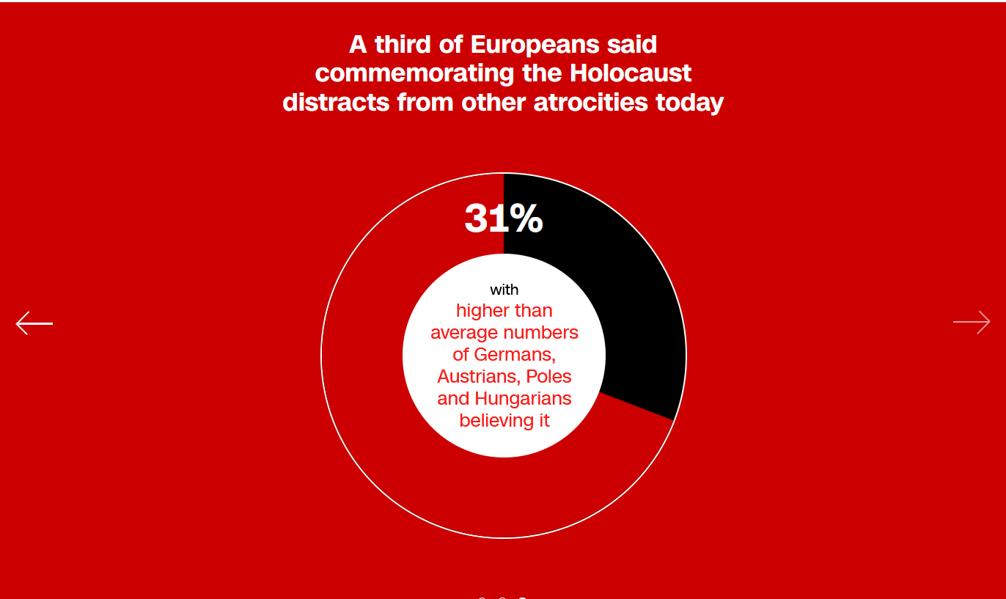
Antisemitism in Erope – CNN report
https://edition.cnn.com/interactive/2018/11/europe/antisemitism-poll-2018-intl/
A third of Europeans said that Jews use the Holocaust to advance their own positions or goals.
12% of young Austrian haven’t heard about Holocaust
https://edition.cnn.com/interactive/2018/11/europe/antisemitism-poll-2018-intl/

