Slide 1
EU Criminal Law
Gender based violence in the EU – substantive criminal law harmonisation

Slide 2
Gender based violence
Gender-based violence is violence directed against a person because of that person's gender or violence that affects persons of a particular gender disproportionately.
Violence against women is understood as a violation of human rights and a form of discrimination against women and shall mean all acts of gender-based violence that result in, or are likely to result in
physical harm,
sexual harm,
psychological,
or economic harm
or suffering to women.
It can include violence against women, domestic violence against women, men or children living in the same domestic unit. Although women and girls are the main victims of GBV, it also causes severe harm to families and communities.
https://commission.europa.eu/strategy-and-policy/policies/justice-and-fundamental-rights/gender-equality/gender-based-violence/what-gender-based-violence_en

Slide 3
Gender based violence in the EU
The survey findings concern issues such as:
The prevalence of violence: 1 in 3 women in the EU have experienced physical violence, sexual violence, or threats in their adulthood.
Sexual violence and rape: 1 in 6 women in the EU have experienced sexual violence, including rape, in their adulthood.
Violence at home: Home is not always safe for many women: 1 in 5 women have faced physical or sexual violence from their partner, a relative, or another member of their household.
Sexual harassment at work: 1 in 3 women have been sexually harassed at work. Younger women report a higher prevalence, with 2 in 5 having experienced sexual harassment in their workplaces.
The non-reporting of violence: Although a majority of women who have experienced violence have spoken to a person close to them about this, only 1 in 5 have contacted a healthcare or social service provider, and just 1 in 8 have reported the incident to the police.
https://fra.europa.eu/en/news/2024/one-three-women-eu-have-experienced-violence#:~:text=The%20prevalence%20of%20violence%3A%201,including%20rape%2C%20in%20their%20adulthood.

Slide 4
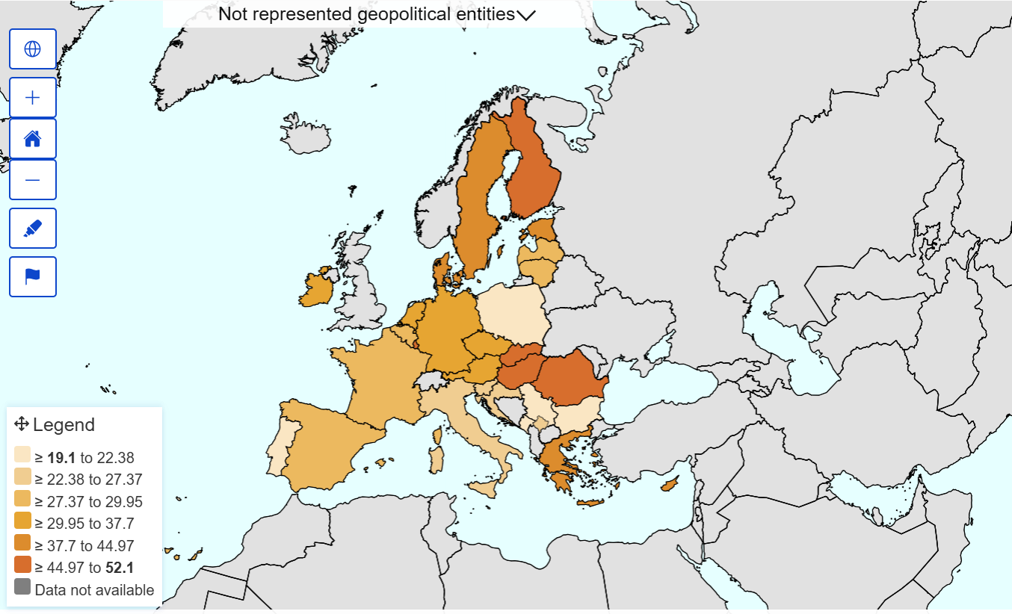
Phisical, sexual and psychological violence

Slide 5
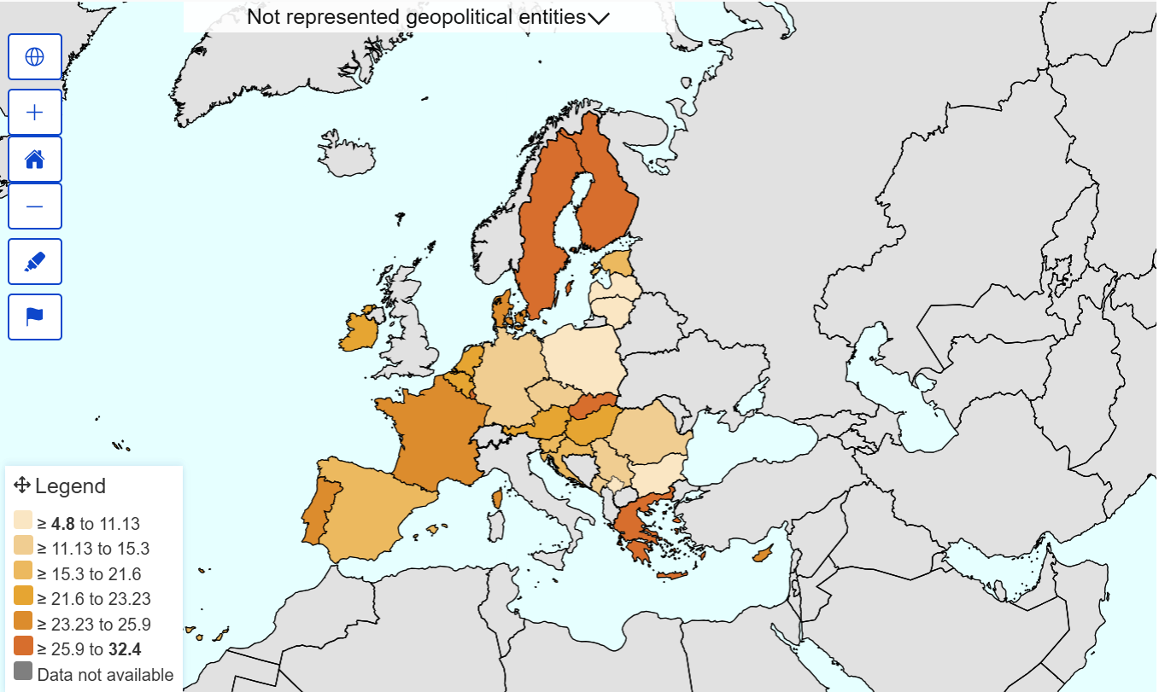
Stalking

Slide 6
Gender-based violence and EU
EU ratifed the Istanbul Convention
OPINION 1/19 OF THE COURT (Grand Chamber); 6 October 2021:
https://curia.europa.eu/juris/document/document.jsf?text=&docid=247081&pageIndex=0&doclang=EN&mode=lst&dir=&occ=first&part=1&cid=11501
https://eur-lex.europa.eu/legal-content/EN/TXT/?uri=legissum:4301302#:~:text=The%20convention%20was%20signed%20on,EU%20on%201%20October%202023.
Istambul Convention entered into force October 1, 2023
Council of Europe Convention on preventing and combating violence against women and domestic violence
https://www.coe.int/en/web/istanbul-convention/home?

Slide 7
Istambul convention – article 1
The purposes of this Convention are to:
protect women against all forms of violence, and prevent, prosecute and eliminate violence against women and domestic violence;
contribute to the elimination of all forms of discrimination against women and promote substantive equality between women and men, including by empowering women;
design a comprehensive framework, policies and measures for the protection of and assistance to all victims of violence against women and domestic violence;
promote international co-operation with a view to eliminating violence against women and domestic violence;
provide support and assistance to organisations and law enforcement agencies to effectively co-operate in order to adopt an integrated approach to eliminating violence against women and domestic violence.
2 In order to ensure effective implementation of its provisions by the Parties, this Convention establishes a specific monitoring mechanism.

Slide 8
Definitions – article 3
“violence against women” is understood as a violation of human rights and a form of discrimination against women and shall mean all acts of gender-based violence that result in, or are likely to result in, physical, sexual, psychological or economic harm or suffering to women, including threats of such acts, coercion or arbitrary deprivation of liberty, whether occurring in public or in private life;
“domestic violence” shall mean all acts of physical, sexual, psychological or economic violence that occur within the family or domestic unit or between former or current spouses or partners, whether or not the perpetrator shares or has shared the same residence with the victim;

Slide 9
Substantive criminal law provisions
Article 32 – Civil consequences of forced marriages
Parties shall take the necessary legislative or other measures to ensure that marriages concluded under force may be voidable, annulled or dissolved without undue financial or administrative burden placed on the victim.
Article 33 – Psychological violence
Parties shall take the necessary legislative or other measures to ensure that the intentional conduct of seriously impairing a person’s psychological integrity through coercion or threats is criminalised.
Article 34 – Stalking
Parties shall take the necessary legislative or other measures to ensure that the intentional conduct of repeatedly engaging in threatening conduct directed at another person, causing her or him to fear for her or his safety, is criminalised.
Article 35 – Physical violence
Parties shall take the necessary legislative or other measures to ensure that the intentional conduct of committing acts of physical violence against another person is criminalised.

Slide 10
Substantive criminal law provisions
Article 37 – Forced marriage
1. Parties shall take the necessary legislative or other measures to ensure that the intentional conduct of forcing an adult or a child to enter into a marriage is criminalised.
2. Parties shall take the necessary legislative or other measures to ensure that the intentional conduct of luring an adult or a child to the territory of a Party or State other than the one she or he resides in with the purpose of forcing this adult or child to enter into a marriage is criminalised.
Article 38 – Female genital mutilation
Parties shall take the necessary legislative or other measures to ensure that the following intentional conducts are criminalised:
excising, infibulating or performing any other mutilation to the whole or any part of a woman’s labia majora, labia minora or clitoris;
coercing or procuring a woman to undergo any of the acts listed in point a;
inciting, coercing or procuring a girl to undergo any of the acts listed in point a.

Slide 11
PACE resolution about forced marriages
https://assembly.coe.int/nw/xml/XRef/Xref-XML2HTML-EN.asp?fileid=25016
Every day throughout the world, 39 000 young girls are married before reaching the age of majority. More than one third of them are younger than 15. Forced marriages between adults are also frequent. All countries in Europe are affected by these harmful practices, whether in the form of forced marriages concluded in Europe, forced marriages of European nationals or residents concluded elsewhere, or persons forced to marry before arriving in Europe. These human rights violations affect above all women and girls, but they also affect men and boys.
https://www.nytimes.com/2018/06/01/opinion/sunday/child-marriage-delaware.html <-- Forced marriges is not a „third world” problem. In may USA states it is possible for rapist to marry raped girl (if she is under 18 years old) and be free of punishment

Slide 12
Female genital mutilation
FGM consists of the (partial or complete) removal of the external female genitalia, and the infliction of other injuries to the female genitalia for no medical reasons. There are several variations, including partial or complete removal of the clitoris, of the labia minora and majora, the narrowing of the vaginal opening by joining the two sides of the wound, leaving only a small opening for urine and menstrual fluids, and any other non-medical injury such as scraping, incising, pricking or burning. FGM causes pain, infection, problems with sexual intercourse, problems with urination, problems with childbirth, and death.
It is estimated that at least 600,000 women in Europe have undergone female genital mutilation and 200 million women worldwide. If the practice continues at the current pace, 68 million girls will be mutilated between 2015 and 2030 in 25 countries where FGM is routinely practiced and data is available.
https://ec.europa.eu/commission/presscorner/detail/en/qanda_21_402

Slide 13
Substantive criminal law provisions
Article 39 – Forced abortion and forced sterilisation
Parties shall take the necessary legislative or other measures to ensure that the following intentional conducts are criminalised:
A) performing an abortion on a woman without her prior and informed consent;
B) performing surgery which has the purpose or effect of terminating a woman’s capacity to naturally reproduce without her prior and informed consent or understanding of the procedure.
Article 40 – Sexual harassment
Parties shall take the necessary legislative or other measures to ensure that any form of unwanted verbal, non-verbal or physical conduct of a sexual nature with the purpose or effect of violating the dignity of a person, in particular when creating an intimidating, hostile, degrading, humiliating or offensive environment, is subject to criminal or other legal sanction.

Slide 14
Substantive criminal law provisions
Article 36 – Sexual violence, including rape
Parties shall take the necessary legislative or other measures to ensure that the following intentional conducts are criminalised:
A) engaging in non-consensual vaginal, anal or oral penetration of a sexual nature of the body of another person with any bodily part or object;
B) engaging in other non-consensual acts of a sexual nature with a person;
C) causing another person to engage in non-consensual acts of a sexual nature with a third person.
2 Consent must be given voluntarily as the result of the person’s free will assessed in the context of the surrounding circumstances.
3 Parties shall take the necessary legislative or other measures to ensure that the provisions of paragraph 1 also apply to acts committed against former or current spouses or partners as recognised by internal law.

Slide 15
M.C. v. Bulgaria
162. The Court also notes that the member States of the Council of Europe, through the Committee of Ministers, have agreed that penalising non-consensual sexual acts, “[including] in cases where the victim does not show signs of resistance”, is necessary for the effective protection of women against violence (see paragraph 101 above) and have urged the implementation of further reforms in this area.
163. In international criminal law, it has recently been recognised that force is not an element of rape and that taking advantage of coercive circumstances to proceed with sexual acts is also punishable. The International Criminal Tribunal for the former Yugoslavia has found that, in international criminal law, any sexual penetration without the victim's consent constitutes rape and that consent must be given voluntarily, as a result of the person's free will, assessed in the context of the surrounding circumstances (see paragraphs 102-07 above). While the above definition was formulated in the particular context of rapes committed against the population in the conditions of an armed conflict, it also reflects a universal trend towards regarding lack of consent as the essential element of rape and sexual abuse.

Slide 16
M.C. v. Bulgaria
164. As submitted by the intervener, the evolving understanding of the manner in which rape is experienced by the victim has shown that victims of sexual abuse – in particular, girls below the age of majority – often provide no physical resistance because of a variety of psychological factors or because they fear violence on the part of the perpetrator.
165. Moreover, the development of law and practice in that area reflects the evolution of societies towards effective equality and respect for each individual's sexual autonomy.
166. In the light of the above, the Court is persuaded that any rigid approach to the prosecution of sexual offences, such as requiring proof of physical resistance in all circumstances, risks leaving certain types of rape unpunished and thus jeopardising the effective protection of the individual's sexual autonomy. In accordance with contemporary standards and trends in that area, the member States' positive obligations under Articles 3 and 8 of the Convention must be seen as requiring the penalisation and effective prosecution of any non-consensual sexual act, including in the absence of physical resistance by the victim.
https://hudoc.echr.coe.int/fre?i=001-61521

Slide 17
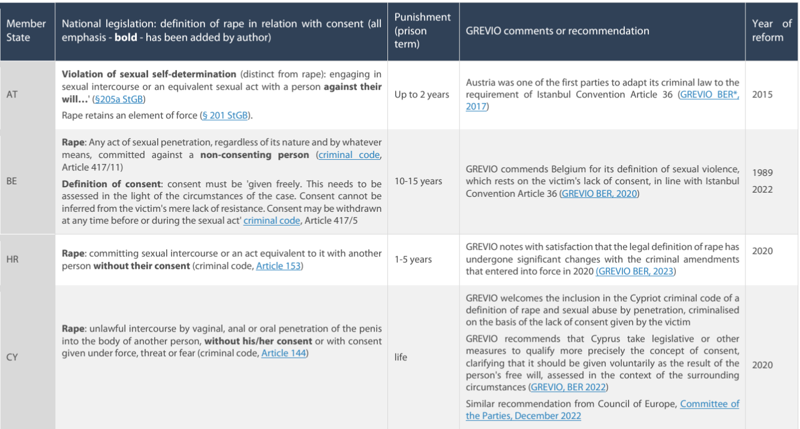

Slide 18
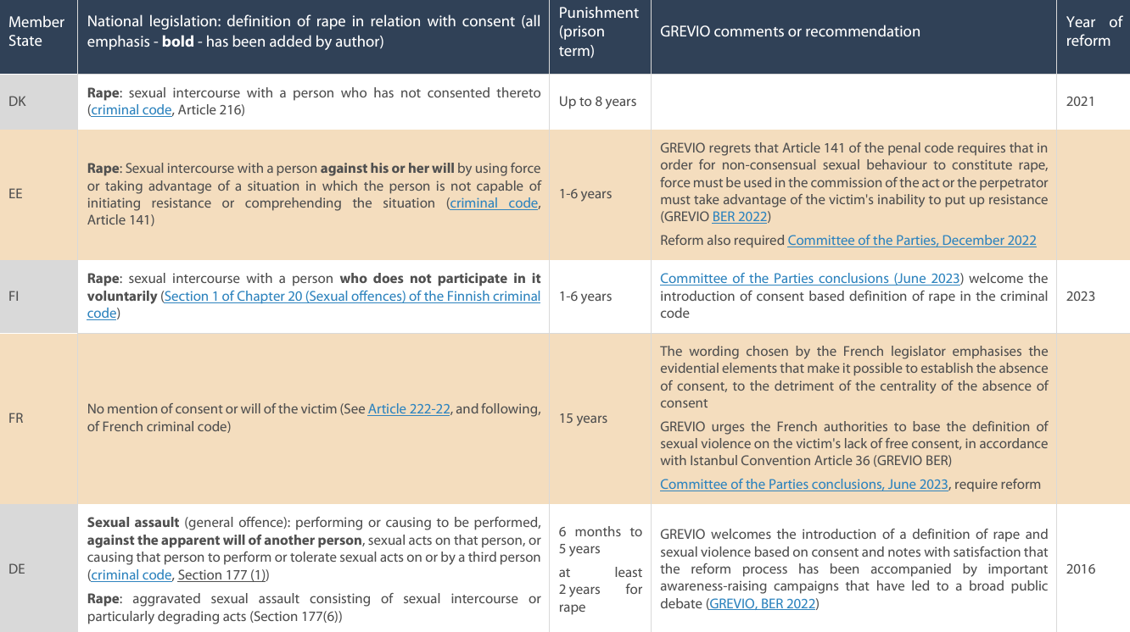

Slide 19
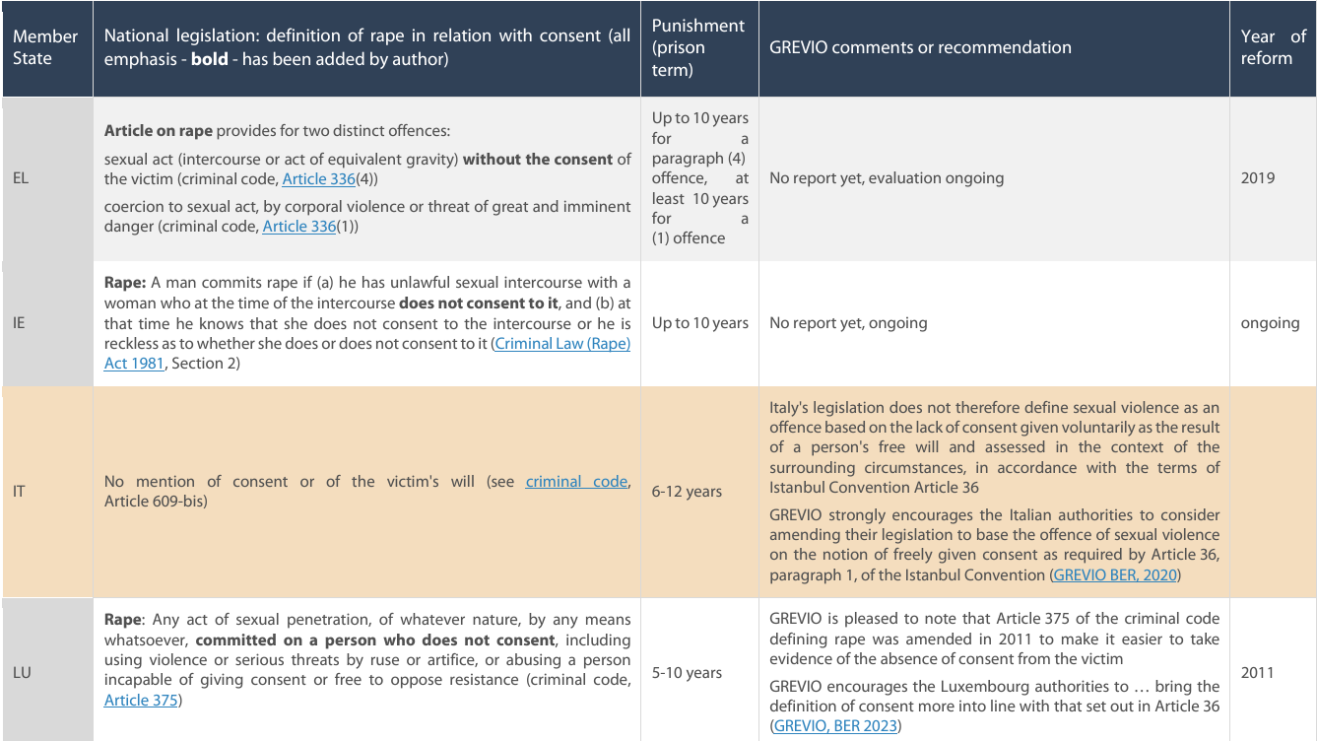

Slide 20
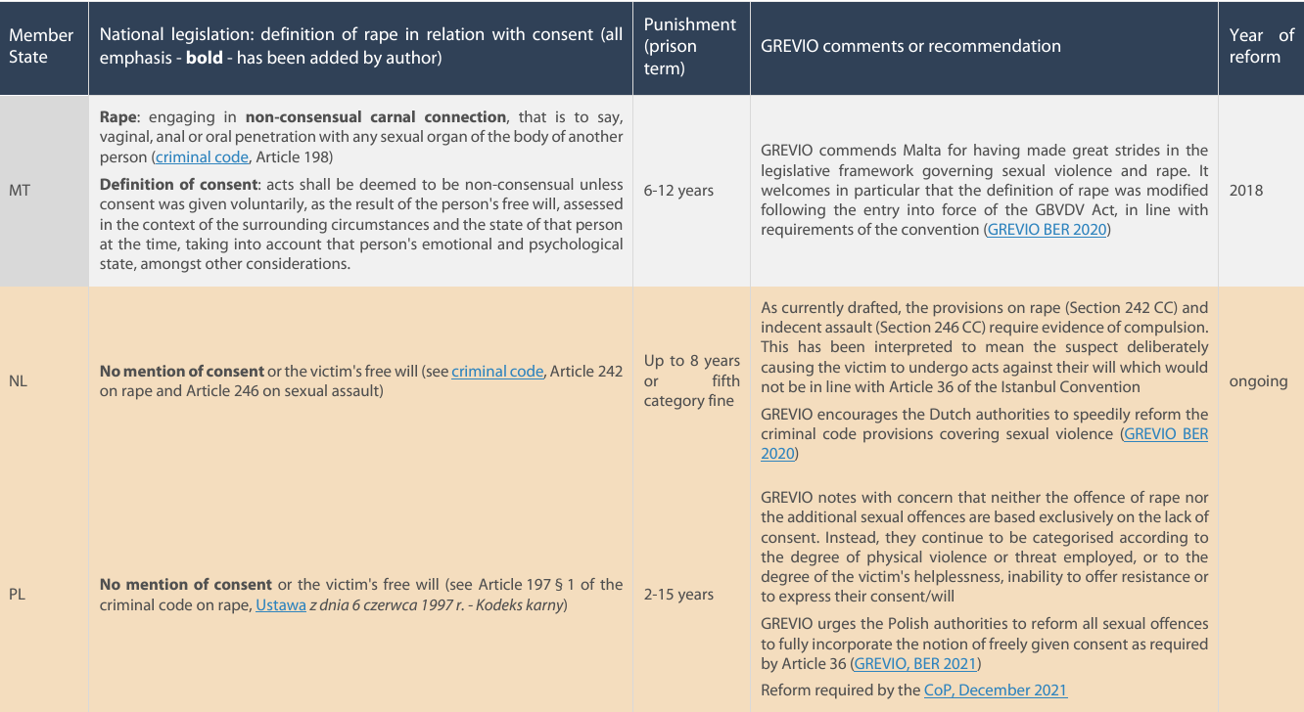

Slide 21
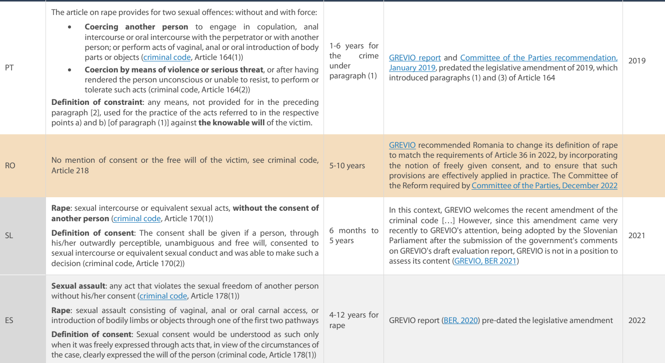

Slide 22
https://www.europarl.europa.eu/RegData/etudes/IDAN/2024/757618/EPRS_IDA(2024)757618_EN.pdf

Slide 23
How rape should be prosecuted?
Article 55 – Ex parte and ex officio proceedings
1 Parties shall ensure that investigations into or prosecution of offences established in accordance with Articles 35, 36, 37, 38 and 39 of this Convention shall not be wholly dependant upon a report or complaint filed by a victim if the offence was committed in whole or in part on its territory, and that the proceedings may continue even if the victim withdraws her or his statement or complaint.
2 Parties shall take the necessary legislative or other measures to ensure, in accordance with the conditions provided for by their internal law, the possibility for governmental and nongovernmental organisations and domestic violence counsellors to assist and/or suport victims, at their request, during investigations and judicial proceedings concerning the offences established in accordance with this Convention.

Slide 24
Directive 2024/1385
Directive 2024/1385 of 14 May 2024 on combating violence against women and domestic violence
(5) In light of the specificities related to the offences of violence against women and domestic violence, it is necessary to lay down a comprehensive set of rules which address the persisting problem of violence against women and domestic violence in a targeted manner and cater to the specific needs of victims of such violence. The existing provisions at Union and national level have proven to be insufficient to effectively combat and prevent violence against women and domestic violence. In particular, while Directives 2011/36/EU (3) and 2011/93/EU (4) of the European Parliament and of the Council, which concentrate on specific forms of such violence, and Directive 2012/29/EU of the European Parliament and of the Council (5), which lays down the general framework for victims of crime, provide some safeguards for victims, meaning, for the purposes of this Directive, victims of violence against women and domestic violence, they do not address their specific needs.
(6) Violence against women and domestic violence can be exacerbated where it intersects with discrimination based on a combination of sex and any other ground or grounds of discrimination as referred to in Article 21 of the Charter, namely race, colour, ethnic or social origin, genetic features, language, religion or belief, political or any other opinion, membership of a national minority, property, birth, disability, age or sexual orientation (‘intersectional discrimination’). Member States should therefore pay due regard to victims affected by such intersectional discrimination by taking specific measures. Persons affected by intersectional discrimination are at a heightened risk of experiencing gender-based violence. Consequently, Member States should take that heightened level of risk into consideration when implementing the measures provided for by this Directive, especially regarding the individual assessment to identify victims’ protection needs, specialist support to victims and training and information for professionals likely to come into contact with victims.

Slide 25
Directive 2024/1385
Article 2 Definitions
For the purposes of this Directive, the following definitions apply:
(a) ‘violence against women’ means all acts of gender-based violence directed against a woman or a girl because she is a woman or a girl or that affect women or girls disproportionately, that result in or are likely to result in physical, sexual, psychological or economic harm or suffering, including threats of such acts, coercion or arbitrary deprivation of liberty, whether occurring in public or in private life;
(b) ‘domestic violence’ means all acts of physical, sexual, psychological or economic violence that occur within the family or domestic unit, irrespective of biological or legal family ties, or between former or current spouses or partners, whether or not the offender shares or has shared a residence with the victim;
(c) ‘victim’ means any person, regardless of their gender, who has suffered harm directly caused by violence against women or domestic violence, including children who have suffered harm because they have witnessed domestic violence;

Slide 26
Directive 2024/1385
Article 5 Non-consensual sharing of intimate or manipulated material
1. Member States shall ensure that the following intentional conduct is punishable as a criminal offence:
(a) making accessible to the public, by means of information and communication technologies (‘ICT’), images, videos or similar material depicting sexually explicit activities or the intimate parts of a person, without that person’s consent, where such conduct is likely to cause serious harm to that person;
(b) producing, manipulating or altering and subsequently making accessible to the public, by means of ICT, images, videos or similar material making it appear as though a person is engaged in sexually explicit activities, without that person’s consent, where such conduct is likely to cause serious harm to that person;
(c) threatening to engage in the conduct referred to in point (a) or (b) in order to coerce a person to do, acquiesce to or refrain from a certain act.
2. Paragraph 1, points (a) and (b), of this Article does not affect the obligation to respect the rights, freedoms and principles referred to in Article 6 TEU and applies without prejudice to fundamental principles related to the freedom of expression and information and the freedom of the arts and sciences, as implemented in Union or national law.

Slide 27
Directive 2024/1385
Article 6
Cyber stalking
Member States shall ensure that the intentional conduct of repeatedly or continuously placing a person under surveillance, without that person’s consent or a legal authorisation to do so, by means of ICT, to track or monitor that person’s movements and activities, where such conduct is likely to cause serious harm to that person, is punishable as a criminal offence.
Article 8
Cyber incitement to violence or hatred
1. Member States shall ensure that intentionally inciting violence or hatred directed against a group of persons or a member of such a group, defined by reference to gender, by publicly disseminating, by means of ICT, material containing such incitement is punishable as a criminal offence.
2. For the purposes of paragraph 1, Member States may choose to punish only conduct which is either carried out in a manner likely to disturb public order or which is threatening, abusive or insulting.

Slide 28
Directive 2024/1385
Article 10
Penalties
1. Member States shall ensure that the criminal offences referred to in Articles 3 to 9 are punishable by effective, proportionate and dissuasive criminal penalties.
2. Member States shall ensure that the criminal offences referred to in Article 3 are punishable by a maximum term of imprisonment of at least five years.
3. Member States shall ensure that the criminal offences referred to in Article 4 are punishable by a maximum term of imprisonment of at least three years.
4. Member States shall ensure that the criminal offences referred to in Articles 5 and 6, Article 7, first paragraph, points (a), (b) and (d), and Article 8 are punishable by a maximum term of imprisonment of at least one year.

Slide 29
Article 15
Investigation and prosecution
1. Member States shall ensure that persons, units or services investigating and prosecuting acts of violence against women or domestic violence have adequate expertise in those matters and have effective investigative tools at their disposal to effectively investigate and prosecute such acts, especially for the purpose of gathering, analysing and securing electronic evidence in cases of cybercrime as referred to in Articles 5 to 8.
2. Member States shall ensure that reported acts of violence against women or domestic violence are processed and transferred without delay to the competent authorities for the purposes of investigation and prosecution and for the purpose of adopting protection measures pursuant to Article 19, where necessary.
3. Where the competent authorities have reasonable grounds to suspect that a criminal offence might have been committed, they shall, without undue delay, effectively investigate, upon receipt of a complaint or on their own initiative, acts of violence against women or domestic violence. They shall ensure that an official record is filed and preserve a record of relevant findings and evidence in accordance with national law.
4. In order to assist in the voluntary securing of evidence, in particular in cases of sexual violence, the competent authorities shall direct victims, without undue delay, to relevant healthcare professionals or to the support services referred to in Articles 25, 26 and 27 that are specialised in assisting with securing evidence. Victims shall be informed of the importance of collecting such evidence at the earliest possible time.
5. Member States shall ensure that investigations into or the prosecution of acts of rape are not dependent on a victim or the victim’s representative reporting the act, or on a complaint by a victim or the victim’s representative, and that criminal proceedings are not discontinued solely because the report or complaint has been withdrawn.

