Slide 1
Victims rights in the EU law
Lecture VI

Slide 2
Most important legal acts
Directive 2012/29/EU of the European Parliament and of the Council of 25 October 2012 establishing minimum standards on the rights, support and protection of victims of crime, and replacing Council Framework Decision 2001/220/JHA
Directive 2011/36/EU of the European Parliament and of the Council of 5 April 2011 on preventing and combating trafficking in human beings and protecting its victims, and replacing Council Framework Decision 2002/629/JHA
Directive 2011/92/EU of the European Parliament and of the Council of 13 December 2011 on combating the sexual abuse and sexual exploitation of children and child pornography, and replacing Council Framework Decision 2004/68/JHA
Directive (EU) 2017/541 of the European Parliament and of the Council of 15 March 2017 on combating terrorism and replacing Council Framework Decision 2002/475/JHA and amending Council Decision 2005/671/JHA
Council Directive 2004/80/EC of 29 April 2004 relating to compensation to crime victims
Directive 2011/99/EU of the European Parliament and of the Council of 13 December 2011 on the European protection order (EPO)

Slide 3
Most important legal acts
Currently, in the EU institutions, there is a plan to strengthen the rights of the victims of the trafficking of human beings, and sexual exploitation of children.
Important proposition - adding new offence: article 18a "the use of services which are the object of exploitation with knowledge that the person is a victim of an offence concerning trafficking in human beings"
New directive proposition - sexual exploitation of children - lots of changes, and "update" directive from 2011 to current problems (see especially articles 20 and 21
https://eur-lex.europa.eu/legal-content/EN/TXT/?uri=CELEX%3A52022PC0732
https://eur-lex.europa.eu/legal-content/EN/TXT/?uri=COM%3A2022%3A209%3AFIN
New Directive on combating violence against women and domestic violence
Ratification of Council of Europe Convention on preventing and combating violence against women and domestic violence by the EU (28/06/2023; entry into force: 1/10/2023)

Slide 4
Most important legal acts
EU Commision noticed 5 key problems:
1.Victims do not always receive information about their rights, or they receive inadequate information that makes it more difficult or impossible for them to exercise those rights.
2.Vulnerable victims (such as children, older people, persons with disabilities, victims of hate crime and victims in detention) do not always benefit from a timely assessment of their needs for protection and are deprived of effective protection measures, such as protection orders.
3.Vulnerable victims often cannot rely on specialist support, such as extended psychological treatment, and child victims often cannot rely on a targeted approach based on multi-agency cooperation.
4.Victims’ participation in criminal proceedings is often difficult due to a lack of legal advice and guidance and differences in rules on victims’ status in these procedures.
5.Victims’ access to compensation in domestic and cross-border cases is difficult due to the lack of state support when enforcing the ordered compensation from the offender, leading to a risk of secondary victimisation.
There is also a proposal of amending the directive 2012/29
https://eur-lex.europa.eu/legal-content/EN/TXT/?uri=CELEX%3A52023PC0424
Proposal was issued 12/07/2023 – so we do not know if there is any chance in foreseeable future to this document/legal act entry into force.

Slide 5
EU Strategy on victims' rights (2020-2025)
Two-strand approach:
empowering victims of crime
working together for victims’ rights.
It is crucial to empower victims of crime so they can report crime, participate in criminal proceedings, claim compensation and ultimately recover – as much as possible – from consequences of crime.
The strategy presents five key priorities:
(i) effective communication with victims and a safe environment for victims to report crime;
(ii) improving support and protection to the most vulnerable victims;
(iii) facilitating victims’ access to compensation;
(iv) strengthening cooperation and coordination among all relevant actors; and
(v) strengthening the international dimension of victims’ rights.
https://eur-lex.europa.eu/legal-content/EN/TXT/?uri=CELEX:52020DC0258

Slide 6
Victims rights – EU strategy
https://commission.europa.eu/strategy-and-policy/policies/justice-and-fundamental-rights/criminal-justice/protecting-victims-rights_en <-- all necessary information may be found there
Also, there is a platform where information on gender-based violence are collected
https://commission.europa.eu/strategy-and-policy/policies/justice-and-fundamental-rights/gender-equality/gender-based-violence_en

Slide 7
Victim of a crime – definition
Article 2 of the directive 2012/29
1. For the purposes of this Directive the following definitions shall apply:
(a) ‘victim’ means:
(i) a natural person who has suffered harm, including physical, mental or emotional harm or economic loss which was directly caused by a criminal offence;
(ii) family members of a person whose death was directly caused by a criminal offence and who have suffered harm as a result of that person's death.
(b) ‘family members’ means the spouse, the person who is living with the victim in a committed intimate relationship, in a joint household and on a stable and continuous basis, the relatives in direct line, the siblings and the dependants of the victim
Legal persons (e.g. companies) can also be victims of crime.
However, the EU law does not apply to legal persons.

Slide 8
Victim of a crime – definition
Article 2(1) of Directive 2012/29/EU of the European Parliament and of the Council of 25 October 2012 establishing minimum standards on the rights, support and protection of victims of crime, and replacing Council Framework Decision 2001/220/JHA must be interpreted as meaning that that directive does not apply to legal persons or to the State, even if national law confers on them the status of injured party in criminal proceedings.
CJEU Judgment, 1/10/2020, C-603/19

Slide 9
1. A victim is an important source of information about the crime.
2. They should be heard in the proceedings and their statements taken into account.
3. In the case of some offences –the victim decides on investigating and prosecuting an offence
4. Depending on the type of crime, the victim needs assistance (legal, psychological) and protection. It is about respecting the dignity of the victim.
5. From the perspective of EU law, minimum rules on the protection of the rights of victims of crime strengthen the principle of mutual recognition of judgments and inter alia the principle of free movement of persons.
6. Victimology has evolved to recognise the needs of the victim during the criminal justice process.
Why victim’s rights are important?

Slide 10
Restorative justice
Restorative justice refers to “an approach to justice that seeks to repair harm by providing an opportunity for those harmed and those who take responsibility for the harm to communicate about and address their needs in the aftermath of a crime.”
https://www.justice.gc.ca/eng/cj-jp/rj-jr/index.html#:~:text=Restorative%20justice%20refers%20to%20%E2%80%9Can,1

Slide 11
Restorative justice – 5 rules
Invite full participation and consensus.
Give voice to those involved in and affected by a given incident of harm, and invite dialogue among them where appropriate. Outcomes decided upon must feel fair and reasonable to all those participating.
Work towards healing what has been broken.
A restorative response seeks to address the harms – both tangible and intangible – resulting from an incident, and to do what is possible to help meet the needs of any and all affected.
Seek direct accountability.
People causing harm should be held accountable for their actions to the people whom they have hurt. Appropriate reparation should be discussed and expected.
Reintegrate where there has been division.
Harmful actions often create outcasts, alienation, and distrust in the community – and these actions may also be symptoms of such conditions. Where possible, restorative justice will help with reintegration and the repair of relationships.
Strengthen the community and individuals to prevent further harms.
Restorative justice is future-focused and asks the question: “What needs to happen to reduce the chance of people being harmed again?” In this way, the incident itself becomes a catalyst for efforts toward creating a healthier and safer organization or community.

Slide 12
Restorative justice
Restorative Justice is a theory of justice that emphasizes repairing the harm caused by criminal behaviour. It is best accomplished through cooperative processes that allow all willing stakeholders to meet, although other approaches are available when that is impossible.
The main principles of restorative justice have been summarised as follows:
- Crime causes harm and justice should focus on repairing that harm.
- The people most affected by the crime should be able to participate in its resolution.
- The responsibility of the government is to maintain order and of the community to build peace.
http://restorativejustice.org

Slide 13
Secondary victimisation
Secondary victimisation occurs when the victim suffers further harm not as a direct result of the criminal act but due to how institutions and other individuals deal with the victim.
Secondary victimisation may be caused, for instance, by repeated exposure of the victim to the perpetrator, repeated interrogation about the same facts, the use of inappropriate language or insensitive comments made by all those who come into contact with victims.
What are examples of secondary victimisation?

Slide 14
Victim rigths in the EU law
The criminal process must also be fair to the victim of the crime. There are no mandatory rules under EU law on how this fairness must be ensured. The provisions of the directives are quite general and the states have a significant margin of appreciation in the implementation of the provisions.
1. the right to information
2. the right to support
3. the right to participate in the proceedings
4. the right to be heard
5. the right to protection

Slide 15
Right to information
Article 3 Right to understand and to be understood
1. Member States shall take appropriate measures to assist victims to understand and to be understood from the first contact and during any further necessary interaction they have with a competent authority in the context of criminal proceedings, including where information is provided by that authority.
Member states should communicate in simple and accessible language – orally and in writing.
If a victim wants, he or she should be allowed to be accompanied by a person of his/her choice.

Slide 16
Right to information - minimum scope of the letter of rights (article 4)
(a) the type of support they can obtain and from whom, including, where relevant, basic information about access to medical support, any specialist support, including psychological support, and alternative accommodation;
(b) the procedures for making complaints with regard to a criminal offence and their role in connection with such procedures;
(c) how and under what conditions they can obtain protection, including protection measures;
(d) how and under what conditions they can access legal advice, legal aid and any other sort of advice;
(e) how and under what conditions they can access compensation;
(f) how and under what conditions they are entitled to interpretation and translation; → see article 7 of the directive 2012/29
(g) if they are resident in a Member State other than that where the criminal offence was committed, any special measures, procedures or arrangements, which are available to protect their interests in the Member State where the first contact with the competent authority is made;
(h) the available procedures for making complaints where their rights are not respected by the competent authority operating within the context of criminal proceedings;
(i) the contact details for communications about their case;
(j) the available restorative justice services;
(k) how and under what conditions expenses incurred as a result of their participation in the criminal proceedings can be reimbursed.

Slide 17
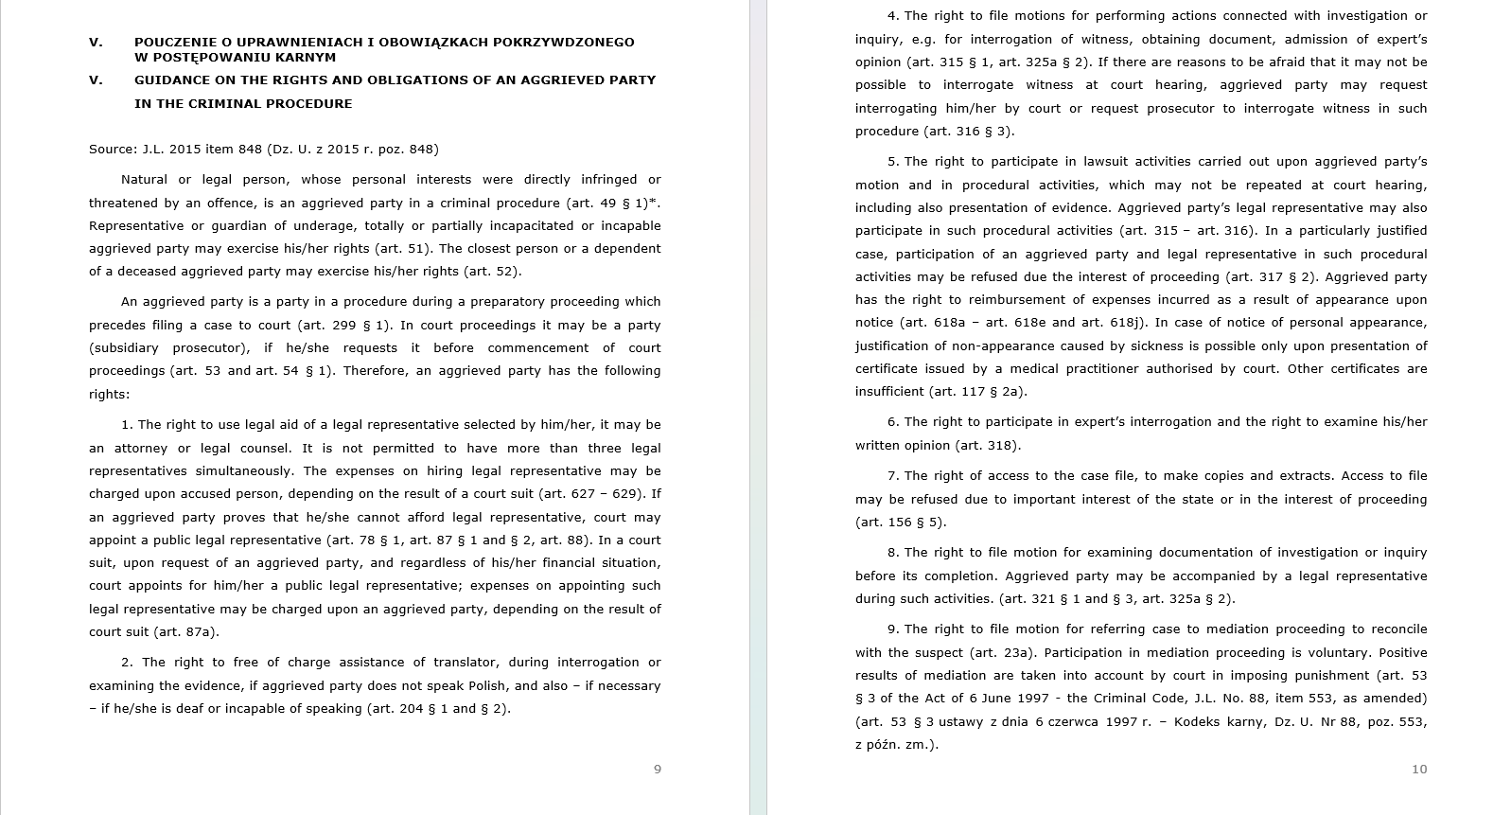

Slide 18
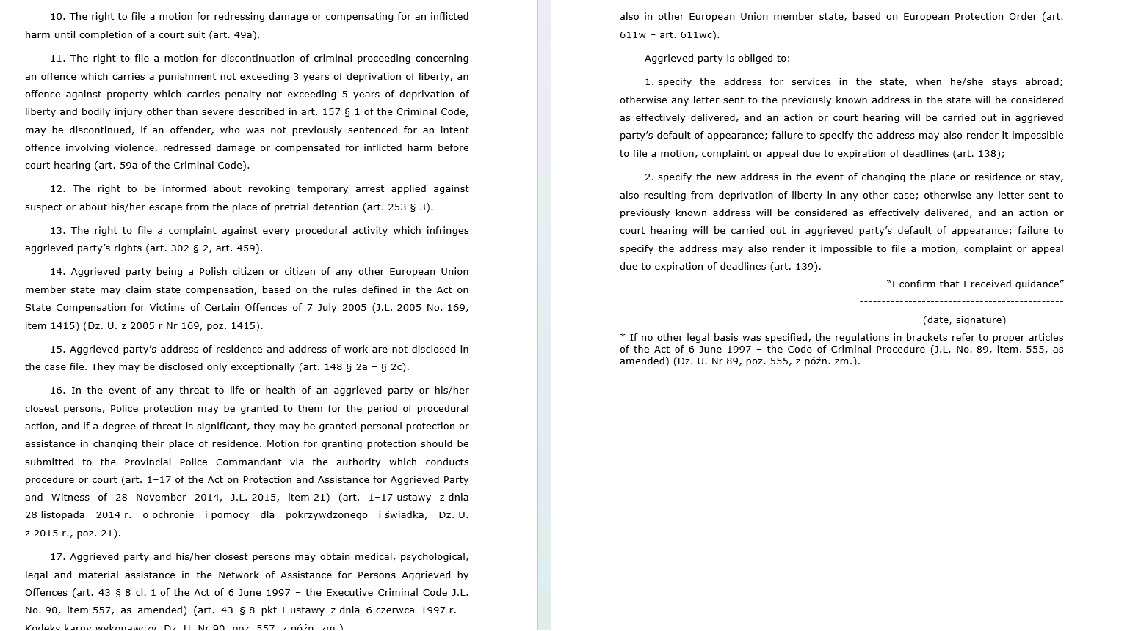

Slide 19
Right to information – article 6
Right to receive information about their case
1. Member States shall ensure that victims are notified without unnecessary delay of their right to receive the following information about the criminal proceedings instituted as a result of the complaint with regard to a criminal offence suffered by the victim and that, upon request, they receive such information:
(a) any decision not to proceed with or to end an investigation or not to prosecute the offender;
(b) the time and place of the trial, and the nature of the charges against the offender.
2. Member States shall ensure that, in accordance with their role in the relevant criminal justice system, victims are notified without unnecessary delay of their right to receive the following information about the criminal proceedings instituted as a result of the complaint with regard to a criminal offence suffered by them and that, upon request, they receive such information:
(a) any final judgment in a trial;
(b) information enabling the victim to know about the state of the criminal proceedings, unless in exceptional cases the proper handling of the case may be adversely affected by such notification.

Slide 20
Right to information – article 6
Right to receive information about their case
5. Member States shall ensure that victims are offered the opportunity to be notified, without unnecessary delay, when the person remanded in custody, prosecuted or sentenced for criminal offences concerning them is released from or has escaped detention. Furthermore, Member States shall ensure that victims are informed of any relevant measures issued for their protection in case of release or escape of the offender.
6. Victims shall, upon request, receive the information provided for in paragraph 5 at least in cases where there is a danger or an identified risk of harm to them, unless there is an identified risk of harm to the offender which would result from the notification.

Slide 21
The right to support
Two types of support:
During the criminal proceedings/during the trial
Outside the trial e.g. pschological support

Slide 22
The right to support – article 8
1. Member States shall ensure that victims, in accordance with their needs, have access to confidential victim support services, free of charge, acting in the interests of the victims before, during and for an appropriate time after criminal proceedings. Family members shall have access to victim support services in accordance with their needs and the degree of harm suffered as a result of the criminal offence committed against the victim.
3. Member States shall take measures to establish free of charge and confidential specialist support services in addition to, or as an integrated part of, general victim support services, or to enable victim support organisations to call on existing specialised entities providing such specialist support. Victims, in accordance with their specific needs, shall have access to such services and family members shall have access in accordance with their specific needs and the degree of harm suffered as a result of the criminal offence committed against the victim.
4. Victim support services and any specialist support services may be set up as public or non-governmental organisations and may be organised on a professional or voluntary basis.

Slide 23
The right to support – article 8
1. Member States shall ensure that victims, in accordance with their needs, have access to confidential victim support services, free of charge, acting in the interests of the victims before, during and for an appropriate time after criminal proceedings. Family members shall have access to victim support services in accordance with their needs and the degree of harm suffered as a result of the criminal offence committed against the victim.
3. Member States shall take measures to establish free of charge and confidential specialist support services in addition to, or as an integrated part of, general victim support services, or to enable victim support organisations to call on existing specialised entities providing such specialist support. Victims, in accordance with their specific needs, shall have access to such services and family members shall have access in accordance with their specific needs and the degree of harm suffered as a result of the criminal offence committed against the victim.
4. Victim support services and any specialist support services may be set up as public or non-governmental organisations and may be organised on a professional or voluntary basis.

Slide 24
The right to support – article 8
1. Victim support services, as referred to in Article 8(1), shall, as a minimum, provide:
(a) information, advice and support relevant to the rights of victims including on accessing national compensation schemes for criminal injuries, and on their role in criminal proceedings including preparation for attendance at the trial;
(b) information about or direct referral to any relevant specialist support services in place;
(c) emotional and, where available, psychological support;
(d) advice relating to financial and practical issues arising from the crime;
(e) unless otherwise provided by other public or private services, advice relating to the risk and prevention of secondary and repeat victimisation, of intimidation and of retaliation.

Slide 25
The right to support – article 9
3. Unless otherwise provided by other public or private services, specialist support services referred to in Article 8(3), shall, as a minimum, develop and provide:
(a) shelters or any other appropriate interim accommodation for victims in need of a safe place due to an imminent risk of secondary and repeat victimisation, of intimidation and of retaliation;
(b) targeted and integrated support for victims with specific needs, such as victims of sexual violence, victims of gender-based violence and victims of violence in close relationships, including trauma support and counselling.

Slide 26
The right to participate in criminal proceedings
Two forms of participation:
Active participation – call evidence, right to appeal; the scope of active participation of a victim depends on national law and national regulation.
The directive 2012/29 refers only to the right to be heard as a form of active participation
„Passive” participation – right to be present and observe the criminal trial/criminal proceedings

Slide 27
The right to participate in criminal proceedings
Right to be heard – article 10
Rights in the event of a decision not to prosecute (right to review a decision not to prosecute) – article 11
Right to safeguards in the context of restorative justice services – article 12
Right to legal aid – article 13
Right to reimbursement of expenses – article 14
Right to the return of property – article 15
Right to decision on compensation from the offender in the course of criminal proceedings – Article 16
Article 17 – cross-border rights of the victim

Slide 28
The right to be heard
Article 10
Right to be heard
1. Member States shall ensure that victims may be heard during criminal proceedings and may provide evidence. Where a child victim is to be heard, due account shall be taken of the child's age and maturity.
2. The procedural rules under which victims may be heard during criminal proceedings and may provide evidence shall be determined by national law.

Slide 29
The right to protection
Recital 53
The risk of secondary and repeat victimisation, of intimidation and of retaliation by the offender or as a result of participation in criminal proceedings should be limited by carrying out proceedings in a coordinated and respectful manner, enabling victims to establish trust in authorities. Interaction with competent authorities should be as easy as possible whilst limiting the number of unnecessary interactions the victim has with them through, for example, video recording of interviews and allowing its use in court proceedings. As wide a range of measures as possible should be made available to practitioners to prevent distress to the victim during court proceedings in particular as a result of visual contact with the offender, his or her family, associates or members of the public. To that end, Member States should be encouraged to introduce, especially in relation to court buildings and police stations, feasible and practical measures enabling the facilities to include amenities such as separate entrances and waiting areas for victims. In addition, Member States should, to the extent possible, plan the criminal proceedings so that contacts between victims and their family members and offenders are avoided, such as by summoning victims and offenders to hearings at different times.

Slide 30
The right to protection
(54) Protecting the privacy of the victim can be an important means of preventing secondary and repeat victimisation, intimidation and retaliation and can be achieved through a range of measures including non-disclosure or limitations on the disclosure of information concerning the identity and whereabouts of the victim. Such protection is particularly important for child victims, and includes non-disclosure of the name of the child. However, there might be cases where, exceptionally, the child can benefit from the disclosure or even widespread publication of information, for example where a child has been abducted. Measures to protect the privacy and images of victims and of their family members should always be consistent with the right to a fair trial and freedom of expression, as recognised in Articles 6 and 10, respectively, of the European Convention for the Protection of Human Rights and Fundamental Freedoms.

Slide 31
The right to protection
(55) Some victims are particularly at risk of secondary and repeat victimisation, of intimidation and of retaliation by the offender during criminal proceedings. It is possible that such a risk derives from the personal characteristics of the victim or the type, nature or circumstances of the crime. Only through individual assessments, carried out at the earliest opportunity, can such a risk be effectively identified. Such assessments should be carried out for all victims to determine whether they are at risk of secondary and repeat victimisation, of intimidation and of retaliation and what special protection measures they require.

Slide 32
The right to protection
(56) Individual assessments should take into account the personal characteristics of the victim such as his or her age, gender and gender identity or expression, ethnicity, race, religion, sexual orientation, health, disability, residence status, communication difficulties, relationship to or dependence on the offender and previous experience of crime.
They should also take into account the type or nature and the circumstances of the crime such as whether it is a hate crime, a bias crime or a crime committed with a discriminatory motive, sexual violence, violence in a close relationship, whether the offender was in a position of control, whether the victim's residence is in a high crime or gang dominated area, or whether the victim's country of origin is not the Member State where the crime was committed.

Slide 33
The right to protection
(57) Victims of human trafficking, terrorism, organised crime, violence in close relationships, sexual violence or exploitation, gender-based violence, hate crime, and victims with disabilities and child victims tend to experience a high rate of secondary and repeat victimisation, of intimidation and of retaliation. Particular care should be taken when assessing whether such victims are at risk of such victimisation, intimidation and of retaliation and there should be a strong presumption that those victims will benefit from special protection measures.

Slide 34
The right to protection
(58) Victims who have been identified as vulnerable to secondary and repeat victimisation, to intimidation and to retaliation should be offered appropriate measures to protect them during criminal proceedings. The exact nature of such measures should be determined through the individual assessment, taking into account the wish of the victim. The extent of any such measure should be determined without prejudice to the rights of the defence and in accordance with rules of judicial discretion. The victims' concerns and fears in relation to proceedings should be a key factor in determining whether they need any particular measure.

Slide 35
The right to protection – article 20
Right to protection of victims during criminal investigations
Without prejudice to the rights of the defence and in accordance with rules of judicial discretion, Member States shall ensure that during criminal investigations:
(a) interviews of victims are conducted without unjustified delay after the complaint with regard to a criminal offence has been made to the competent authority;
(b) the number of interviews of victims is kept to a minimum and interviews are carried out only where strictly necessary for the purposes of the criminal investigation;
(c) victims may be accompanied by their legal representative and a person of their choice, unless a reasoned decision has been made to the contrary;
(d) medical examinations are kept to a minimum and are carried out only where strictly necessary for the purposes of the criminal proceedings.

Slide 36
The right to protection – article 22
Individual assessment of victims to identify specific protection needs
1. Member States shall ensure that victims receive a timely and individual assessment, in accordance with national procedures, to identify specific protection needs and to determine whether and to what extent they would benefit from special measures in the course of criminal proceedings, as provided for under Articles 23 and 24, due to their particular vulnerability to secondary and repeat victimisation, to intimidation and to retaliation.
2. The individual assessment shall, in particular, take into account:
(a) the personal characteristics of the victim;
(b) the type or nature of the crime; and
(c) the circumstances of the crime.

Slide 37
The right to protection – article 23
Right to protection of victims with specific protection needs during criminal proceedings
The following measures shall be available during criminal investigations to victims with specific protection needs identified in accordance with Article 22(1):
(a) interviews with the victim being carried out in premises designed or adapted for that purpose;
(b) interviews with the victim being carried out by or through professionals trained for that purpose;
(c) all interviews with the victim being conducted by the same persons unless this is contrary to the good administration of justice;
(d) all interviews with victims of sexual violence, gender-based violence or violence in close relationships, unless conducted by a prosecutor or a judge, being conducted by a person of the same sex as the victim, if the victim so wishes, provided that the course of the criminal proceedings will not be prejudiced.

Slide 38
The right to protection – article 23
Right to protection of victims with specific protection needs during criminal proceedings
3. The following measures shall be available for victims with specific protection needs identified in accordance with Article 22(1) during court proceedings:
(a) measures to avoid visual contact between victims and offenders including during the giving of evidence, by appropriate means including the use of communication technology;
(b) measures to ensure that the victim may be heard in the courtroom without being present, in particular through the use of appropriate communication technology;
(c) measures to avoid unnecessary questioning concerning the victim's private life not related to the criminal offence; and
(d) measures allowing a hearing to take place without the presence of the public.

Slide 39
Directive 2011/36
Additional regulation in the directive 2011/36 (trafficking of human beings)
assistance and support - article 11
protection of a victim during criminal proceedings - article 12 /right to counsel/
2. Member States shall ensure that victims of trafficking in human beings have access without delay to legal counselling, and, in accordance with the role of victims in the relevant justice system, to legal representation, including for the purpose of claiming compensation. Legal counselling and legal representation shall be free of charge where the victim does not have sufficient financial resources.
special regulation for child victims of human trafficking - articles 13-16

Slide 40
Directive 2011/36
Additional regulation in the directive 2011/36 (trafficking of human beings)
assistance and support - article 11
protection of a victim during criminal proceedings - article 12 /right to counsel/
2. Member States shall ensure that victims of trafficking in human beings have access without delay to legal counselling, and, in accordance with the role of victims in the relevant justice system, to legal representation, including for the purpose of claiming compensation. Legal counselling and legal representation shall be free of charge where the victim does not have sufficient financial resources.
special regulation for child victims of human trafficking - articles 13-16

Slide 41
Directive 2011/93
Article 18
General provisions on assistance, support and protection measures for child victims
1. Child victims of the offences referred to in Articles 3 to 7 shall be provided assistance, support and protection in accordance with Articles 19 and 20, taking into account the best interests of the child.
2. Member States shall take the necessary measures to ensure that a child is provided with assistance and support as soon as the competent authorities have a reasonable-grounds indication for believing that a child might have been subject to any of the offences referred to in Articles 3 to 7.
3. Member States shall ensure that, where the age of a person subject to any of the offences referred to in Articles 3 to 7 is uncertain and there are reasons to believe that the person is a child, that person is presumed to be a child in order to receive immediate access to assistance, support and protection in accordance with Articles 19 and 20.

Slide 42
Directive 2011/93
Article 18
General provisions on assistance, support and protection measures for child victims
1. Child victims of the offences referred to in Articles 3 to 7 shall be provided assistance, support and protection in accordance with Articles 19 and 20, taking into account the best interests of the child.
2. Member States shall take the necessary measures to ensure that a child is provided with assistance and support as soon as the competent authorities have a reasonable-grounds indication for believing that a child might have been subject to any of the offences referred to in Articles 3 to 7.
3. Member States shall ensure that, where the age of a person subject to any of the offences referred to in Articles 3 to 7 is uncertain and there are reasons to believe that the person is a child, that person is presumed to be a child in order to receive immediate access to assistance, support and protection in accordance with Articles 19 and 20.

Slide 43
Directive 2017/541
Article 25
Protection of victims of terrorism
Member States shall ensure that measures are available to protect victims of terrorism and their family members, in accordance with Directive 2012/29/EU. When determining whether and to what extent they should benefit from protection measures in the course of criminal proceedings, particular attention shall be paid to the risk of intimidation and retaliation and to the need to protect the dignity and physical integrity of victims of terrorism, including during questioning and when testifying.
- see also articles 18 and 19.

Slide 44
Victim’s rights in the context of rights of the accused
A criminal trial must be fair to the accused and the victim. The question arises - how to ensure this fairness?
The interests of the accused and the victim are in opposition to each other.
Whose interest is more important in criminal proceedings?

Slide 45
Victim’s rights in the context of rights of the accused
A. Klip believes that Directive 2012/29 is biased and grants more rights to the victim at the detriment of the rights of the accused. The interests of the participants in the proceedings have not been properly balanced.
The assumption that the victim is the victim is also problematic. „The question is weather or not this may violate the presumption of innocence of the accused and affect the fairness of the proceedings, as the accused will be confronted with an additional accuser on top of prosecution. Nowhere in the Directve is it reflected that an aleged victim might not be (the) victim of the accused”.
A. Klip, European Criminal Law, p. 332

Slide 46
Directive 2011/36
4. Without prejudice to the rights of the defence, and according to an individual assessment by the competent authorities of the personal circumstances of the victim, Member States shall ensure that victims of trafficking in human beings receive specific treatment aimed at preventing secondary victimisation by avoiding, as far as possible and in accordance with the grounds defined by national law as well as with rules of judicial discretion, practice or guidance, the following:
(a) unnecessary repetition of interviews during investigation, prosecution or trial;
(b) visual contact between victims and defendants including during the giving of evidence such as interviews and cross-examination, by appropriate means including the use of appropriate communication technologies;
(c) the giving of evidence in open court; and
(d) unnecessary questioning concerning the victim’s private life.

Slide 47
Directive 2011/93
3. Without prejudice to the rights of the defence, Member States shall take the necessary measures to ensure that in criminal investigations relating to any of the offences referred to in Articles 3 to 7:
(a) interviews with the child victim take place without unjustified delay after the facts have been reported to the competent authorities;
(b) interviews with the child victim take place, where necessary, in premises designed or adapted for this purpose;
(c) interviews with the child victim are carried out by or through professionals trained for this purpose;
(d) the same persons, if possible and where appropriate, conduct all interviews with the child victim;
(e) the number of interviews is as limited as possible and interviews are carried out only where strictly necessary for the purpose of criminal investigations and proceedings;
(f) the child victim may be accompanied by his or her legal representative or, where appropriate, by an adult of his or her choice, unless a reasoned decision has been made to the contrary in respect of that person.

Slide 48
Gambino and Hyka, C‑38/18,
41. In that regard, it is clear from the case-law of the European Court of Human Rights that principles of fair trial require that in appropriate cases the interests of the defence are balanced against those of witnesses or victims called upon to testify (ECtHR, 26 March 1996, Doorson v. Netherlands, CE:ECHR:1996:0326JUD002052492, § 70, and ECtHR, 5 October 2006, Marcello Viola v. Italy, CE:ECHR:2006:1005JUD004510604, § 51).
42. In that context, those who have the responsibility for deciding the guilt or innocence of an accused ought, in principle, to be able to hear witnesses in person and assess their trustworthiness. The assessment of the trustworthiness of a witness is a complex task which usually cannot be achieved by a mere reading of his or her recorded words (ECtHR, 5 July 2011, Dan v. Moldova, CE:ECHR:2011:0705JUD000899907, § 33, and ECtHR, 29 June 2017, Lorefice v. Italy, CE:ECHR:2017:0629JUD006344613, § 43).
43. Thus an important aspect of fair criminal proceedings is the ability for the accused to be confronted with the witnesses in the presence of the judge who ultimately decides the case. The principle of immediacy is an important guarantee in criminal proceedings in which the observations made by the court about the demeanour and credibility of a witness may have important consequences for the accused. Therefore, a change in the composition of the trial court after the hearing of an important witness should normally lead to the rehearing of that witness (ECtHR, 9 March 2004, Pitkänen v. Finland, CE:ECHR:2004:0309JUD003050896, § 58, and ECtHR, 18 March 2014, Beraru v. Romania, CE:ECHR:2014:0318JUD004010704, § 64).

Slide 49
Right to compensation
COUNCIL DIRECTIVE 2004/80/EC of 29 April 2004 relating to compensation to crime victims
„Community law guarantees to a natural person the freedom to go to another Member State, the protection of that person from harm in the Member State in question, on the same basis as that of nationals and persons residing there, is a corollary of that freedom of movement. Measures to facilitate compensation to victims of crimes should form part of the realisation of this objective”.
Crime victims in the European Union should be entitled to fair and appropriate compensation for the injuries they have suffered, regardless of where in the European Community the crime was committed.

Slide 50
Right to compensation
Compensation to crime victims
Directive sets up a system of cooperation to facilitate access to compensation to victims of crimes in cross-border situations, which should operate on the basis of Member States' schemes on compensation to victims of violent intentional crime, committed in their respective territories. Therefore, a compensation mechanism should be in place in all Member States.
https://eur-lex.europa.eu/legal-content/EN/TXT/?uri=celex:32004L0080

Slide 51
Right to compensation
Article 1
Member States shall ensure that where a violent intentional crime has been committed in a Member State other than the Member State where the applicant for compensation is habi-tually resident, the applicant shall have the right to submit the application to an authority or any other body in the latter Member State.
Article 2
Compensation shall be paid by the competent authority of the Member State on whose territory the crime was committed.

Slide 52
Right to compensation
Article 3
Member States shall establish or designate one or several authorities or any other bodies - ‘assisting authority or authorities’ – the role is to provide information for the victims and in case of transnational case - forward applications abroad to respective authorities of another Member State
Member States shall establish or designate one or several authorities or any other bodies to be responsible for deciding upon applications for compensation - ‘deciding authority or authorities’.
https://e-justice.europa.eu/content_compensation_to_crime_victims-448-es-en.do?member=1

Slide 53
Right to compensation
The system should ensure that crime victims could always turn to an authority in their Member State of residence and should ease any practical and linguistic difficulties that occur in a cross-border situation.
In Poland e.g. you can address yourself to the district prosecutor who serves as assisting authority. His/her role is to advise and forward application to the competent authority in other Member State.

Slide 54
Case C‑79/11
It is clear from the order for reference that an ‘administrative’ offence, such as that which lead to an action being brought on the basis of Legislative Decree No 231/2001, is a separate offence which has no direct causal link with the harm that was caused by the criminal act committed by a natural person and is the subject of a claim for compensation. According to the Tribunale di Firenze, under a system such as that established by Legislative Decree No 231/2001, a legal person’s liability is categorised as ‘administrative’, ‘indirect’ and ‘subsidiary’ and is different from the liability in criminal law of a natural person who committed the unlawful acts which directly caused the harm suffered and from whom, as stated at paragraph 40 above, compensation may be sought in the course of criminal proceedings.
Consequently, persons harmed as a result of an administrative offence committed by a legal person, such as the person charged under the system established by Legislative Decree No 231/2001, cannot be regarded, for the purposes of the application of Article 9(1) of the Framework Decision, as the victims of a criminal act who are entitled to obtain a decision, in criminal proceedings, on compensation by that legal person.
It follows from the foregoing considerations that the answer to the question referred is that Article 9(1) of the Framework Decision must be interpreted as meaning that, under a system governing the liability of legal persons such as that at issue in the main proceedings, that provision does not preclude a situation in which the victim of a criminal act is not entitled to seek compensation for the harm directly caused by that act in the course of criminal proceedings from the legal person who committed an administrative offence.

Slide 55
Other judgments of the CJEU (victims’ rights)
C‑507/10, 21/12/2012
Articles 2, 3 and 8(4) of Council Framework Decision 2001/220/JHA of 15 March 2001 on the standing of victims in criminal proceedings, must be interpreted as not precluding provisions of national law, such as Articles 392(1a), 398(5a) and 394 of the Italian Code of Criminal Procedure, which, first, do not impose on the Public Prosecutor any obligation to apply to the competent court so that a victim who is particularly vulnerable may be heard and give evidence under the arrangements of the incidente probatorio during the investigation phase of criminal proceedings and, second, do not give to that victim the right to bring an appeal before a court against that decision of the Public Prosecutor rejecting his or her request to be heard and to give evidence under those arrangements.
C‑483/09 and C‑1/10,Criminal proceedings against Valentín Salmerón Sánchez
1. Articles 2, 3 and 8 of Council Framework Decision 2001/220/JHA of 15 March 2001 on the standing of victims in criminal proceedings must be interpreted as not precluding the mandatory imposition of an injunction to stay away for a minimum period, provided for as an ancillary penalty by the criminal law of a Member State, on persons who commit crimes of violence within the family, even when the victims of those crimes oppose the application of such a penalty.
2. Article 10(1) of Framework Decision 2001/220 must be interpreted as permitting Member States, having regard to the particular category of offences committed within the family, to exclude recourse to mediation in all criminal proceedings relating to such offences.

Slide 56
Other judgments of the CJEU (victims’ rights)
C‑205/09, Emil Eredics, Mária Vassné Sápi,
1. Articles 1(a) and 10 of Council Framework Decision 2001/220/JHA of 15 March 2001 on the standing of victims in criminal proceedings must be interpreted as meaning that the concept of ‘victim’ does not extend to legal persons for the purposes of the promotion of mediation in criminal proceedings in Article 10(1).
2. Article 10 of the Framework Decision 2001/220 must be interpreted as not requiring Member States to make recourse to mediation possible for all offences the substantive components of which, as defined by national legislation, correspond essentially to those of offences for which mediation is expressly provided by that legislation.
C-404/07, Győrgy Katz v István Roland Sós.
The answer to the question referred must be that Articles 2 and 3 of the Framework Decision are to be interpreted as not obliging a national court to permit the victim to be heard as a witness in criminal proceedings instituted by a substitute private prosecution such as that in issue in the main proceedings. However, in the absence of such a possibility, it must be possible for the victim to be permitted to give testimony which can be taken into account as evidence.

Slide 57
Other judgments of the CJEU (victims’ rights)
C‑205/09, Emil Eredics, Mária Vassné Sápi,
1. Articles 1(a) and 10 of Council Framework Decision 2001/220/JHA of 15 March 2001 on the standing of victims in criminal proceedings must be interpreted as meaning that the concept of ‘victim’ does not extend to legal persons for the purposes of the promotion of mediation in criminal proceedings in Article 10(1).
2. Article 10 of the Framework Decision 2001/220 must be interpreted as not requiring Member States to make recourse to mediation possible for all offences the substantive components of which, as defined by national legislation, correspond essentially to those of offences for which mediation is expressly provided by that legislation.
C-404/07, Győrgy Katz v István Roland Sós.
The answer to the question referred must be that Articles 2 and 3 of the Framework Decision are to be interpreted as not obliging a national court to permit the victim to be heard as a witness in criminal proceedings instituted by a substitute private prosecution such as that in issue in the main proceedings. However, in the absence of such a possibility, it must be possible for the victim to be permitted to give testimony which can be taken into account as evidence.

Slide 58
Other judgments of the CJEU (victims’ rights)
And Maria Pupion case – first judgment considering the problem of rights of the victim in criminal proceedings.
https://eur-lex.europa.eu/legal-content/EN/TXT/?uri=CELEX%3A62003CJ0105
Articles 2, 3 and 8(4) of Council Framework Decision 2001/220/JHA of 15 March 2001 on the standing of victims in criminal proceedings must be interpreted as meaning that the national court must be able to authorise young children, who, as in this case, claim to have been victims of maltreatment, to give their testimony in accordance with arrangements allowing those children to be guaranteed an appropriate level of protection, for example outside the trial and before it takes place.
The national court is required to take into consideration all the rules of national law and to interpret them, so far as possible, in the light of the wording and purpose of the Framework Decision.

Slide 59
European Protecion Order – definitions – article 2
(1) ‘European protection order’ means a decision, taken by a judicial or equivalent authority of a Member State in relation to a protection measure, on the basis of which a judicial or equivalent authority of another Member State takes any appropriate measure or measures under its own national law with a view to continuing the protection of the protected person;
(2) ‘protection measure’ means a decision in criminal matters adopted in the issuing State in accordance with its national law and procedures by which one or more of the prohibitions or restrictions referred to in Article 5 are imposed on a person causing danger in order to protect a protected person against a criminal act which may endanger his life, physical or psychological integrity, dignity, personal liberty or sexual integrity;
(3) ‘protected person’ means a natural person who is the object of the protection resulting from a protection measure adopted by the issuing State;
(4) ‘person causing danger’ means the natural person on whom one or more of the prohibitions or restrictions referred to in Article 5 have been imposed;

Slide 60
European Protecion Order
Article 5
Need for an existing protection measure under national law
A European protection order may only be issued when a protection measure has been previously adopted in the issuing State, imposing on the person causing danger one or more of the following prohibitions or restrictions:
(a) a prohibition from entering certain localities, places or defined areas where the protected person resides or visits;
(b) a prohibition or regulation of contact, in any form, with the protected person, including by phone, electronic or ordinary mail, fax or any other means; or
(c) a prohibition or regulation on approaching the protected person closer than a prescribed distance.

Slide 61
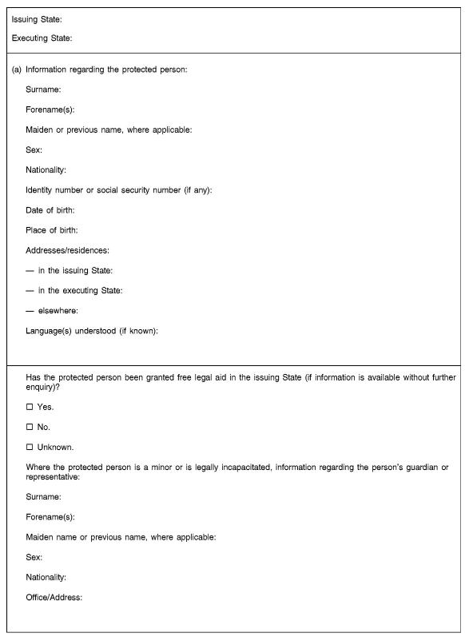
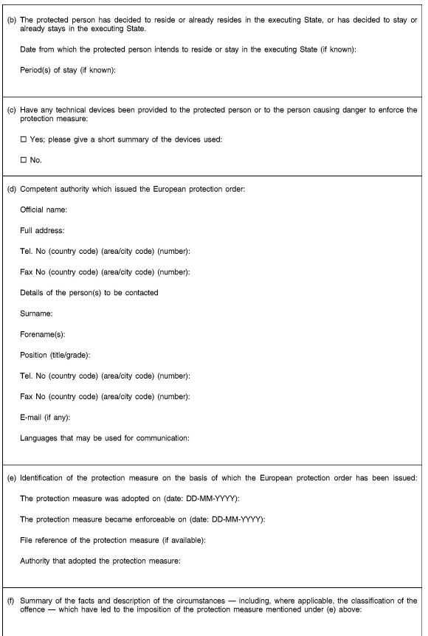

Slide 62
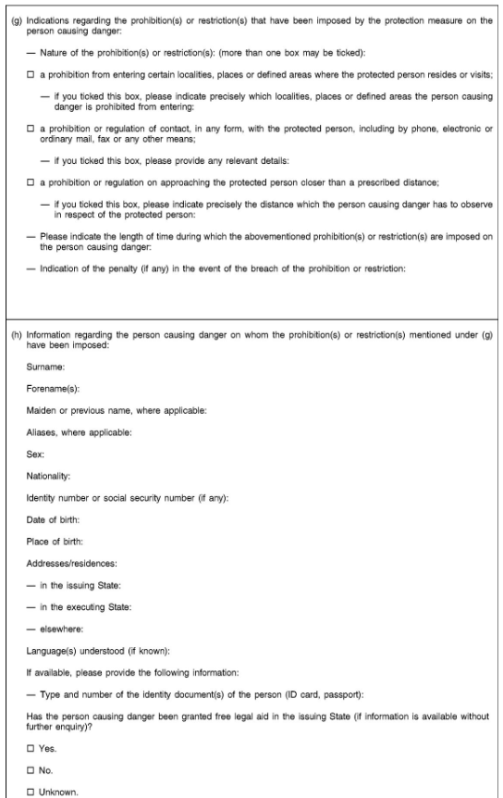
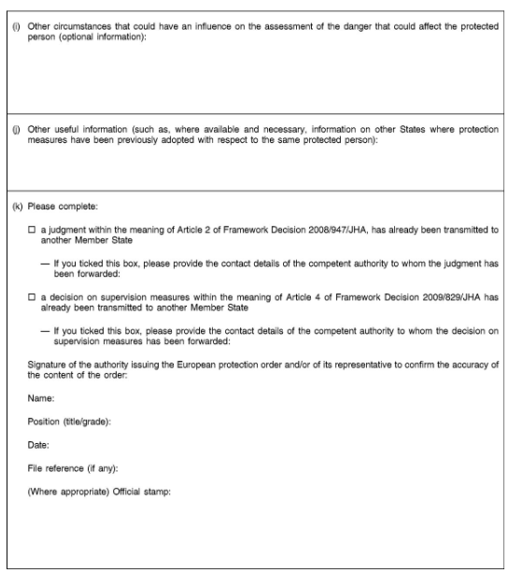
https://eur-lex.europa.eu/legal-content/EN/TXT/HTML/?uri=CELEX%3A32011L0099

