Slide 1
EU Criminal Law VIII
Directive 2016/343

Slide 2
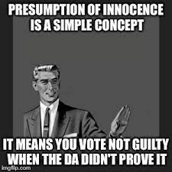
Rights of the suspect/accused
information
Time to prepare defence
Legal aid
Right to examin/call witness/evidence
Interpretor

Slide 3
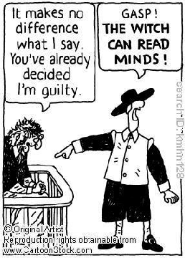
Directive 2016/343
Directive 2016/343 establishes two separate guarantees for a suspect/accused person:
- presumption of innocence
- right to be present during the trial ((or when the trial in absentia is possible to conduct)

Slide 4
Presumption of innocence
European Convention
Article 6.2. Everyone charged with a criminal offence shall be presumed innocent until proved guilty according to law.
Charter of Fundamental Rights
Article 48 Presumption of innocence and right of defence
Everyone who has been charged shall be presumed innocent until proved guilty according to law.
Respect for the rights of the defence of anyone who has been charged shall be guaranteed.

Slide 5
Presumption of innocence
Presumption of innocence requires the judge to carry out the trial without any preconceived opinion on the defendant’s guilt.
Public statemnets/opinions/suggestions to accused guilt before final judgment are forbidden.
State/national law should prevent any prejudgment in the media that pre-empts the judicial determination of guilt
In dubio pro reo rule
Right to remain silent
Right to not incriminate oneself
Burden of proof

Slide 6
Directive 2016/343
Article 3
Presumption of innocence
Member States shall ensure that suspects and accused persons are presumed innocent until proved guilty according to law.
Scope of presumption of innocence:
in criminal cases (every criminal case) → remember about Engel criteria (https://policehumanrightsresources.org/engel-and-others-v-the-netherlands-application-nos-5100-71-5101-71-5102-71-5354-72-5370-72)
to every accused
The binding force of the presumption of innocence does not even end with the defendant’s death, but continues to be effective, so that, for example, a court is not permitted to make any statements on a defendant’s guilt after his suicide without this guilt having been ascertained in a formal trial.

Slide 7
Engel criteria
The classification of the offence under national law, which the ECtHR considers to be merely a starting point for ascertaining whether a penalty is of a ‘criminal nature’.
The nature of the offence. According to the case-law of the ECtHR, in order to determine whether a tax offence of an administrative nature is in fact of a criminal nature, regard is to be had to factors such as:
(a) the addressee of the provision imposing the penalty, so that if that provision is directed at the general public and not at a well-defined group of persons, it will usually be of a ‘criminal nature’;
(b) the aim of that provision, since the offence will not be of a ‘criminal nature’ if the penalty provided for is intended only to compensate for pecuniary damage, and it will be of a ‘criminal nature’ if it is established for the purposes of punishment and deterrence; and
(c) the legal interest protected by the national provision imposing the penalty, which will be criminal in nature if its aim is to protect legal interests whose protection is normally guaranteed by provisions of criminal law.
The nature and degree of severity of the penalty. Penalties involving the loss of liberty are, in themselves, criminal in nature and the same applies to pecuniary penalties where non-compliance can result in imprisonment as a substitute or which entail an entry in the criminal record.

Slide 8
Presumption of innocence
Not only courts/judges are obliged to respect the presumption of innocence but also media, society etc.
Presumption of innocence must be effective and defendant dignity should be publicly respected.
What about „media” trail? And „public” criminal cases?

Slide 9
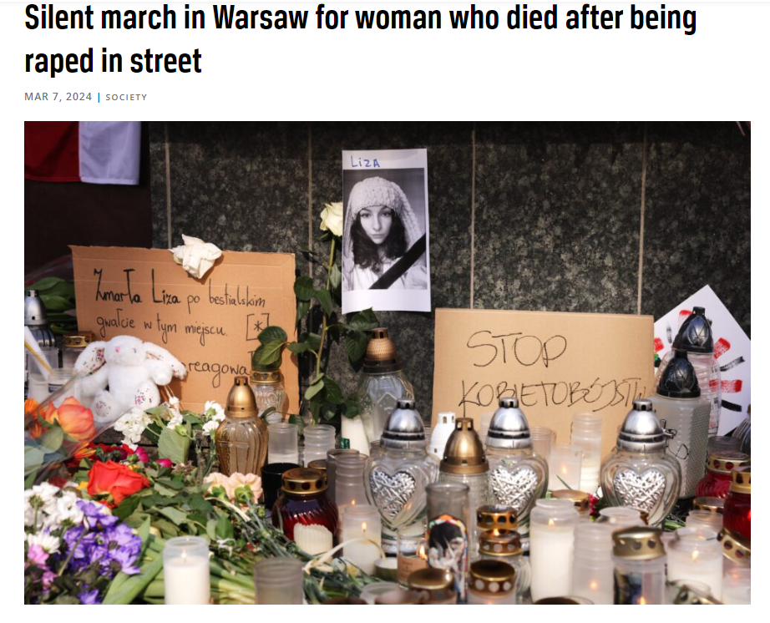
https://notesfrompoland.com/2024/03/07/silent-march-in-warsaw-for-woman-who-died-after-being-raped-in-street/

Slide 10
Presumption of innocence
Article 4
Public references to guilt
1. Member States shall take the necessary measures to ensure that, for as long as a suspect or an accused person has not been proved guilty according to law, public statements made by public authorities, and judicial decisions, other than those on guilt, do not refer to that person as being guilty. This shall be without prejudice to acts of the prosecution which aim to prove the guilt of the suspect or accused person, and to preliminary decisions of a procedural nature, which are taken by judicial or other competent authorities and which are based on suspicion or incriminating evidence.
2. Member States shall ensure that appropriate measures are available in the event of a breach of the obligation laid down in paragraph 1 of this Article not to refer to suspects or accused persons as being guilty, in accordance with this Directive and, in particular, with Article 10.
3. The obligation laid down in paragraph 1 not to refer to suspects or accused persons as being guilty shall not prevent public authorities from publicly disseminating information on the criminal proceedings where strictly necessary for reasons relating to the criminal investigation or to the public interest.

Slide 11
Presumption of innocence
Article 5
Presentation of suspects and accused persons
1. Member States shall take appropriate measures to ensure that suspects and accused persons are not presented as being guilty, in court or in public, through the use of measures of physical restraint.
2. Paragraph 1 shall not prevent Member States from applying measures of physical restraint that are required for case-specific reasons, relating to security or to the prevention of suspects or accused persons from absconding or from having contact with third persons.

Slide 12
https://notesfrompoland.com/2024/03/07/silent-march-in-warsaw-for-woman-who-died-after-being-raped-in-street/

Slide 13
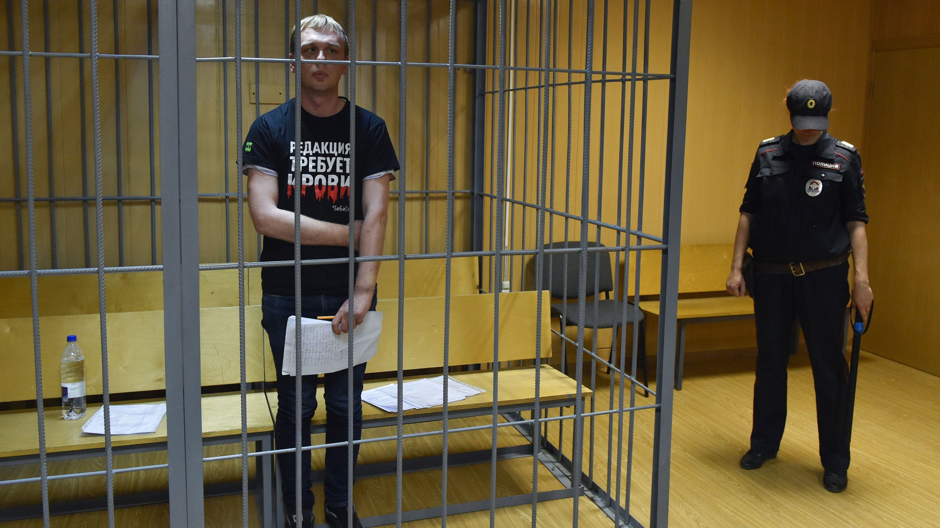
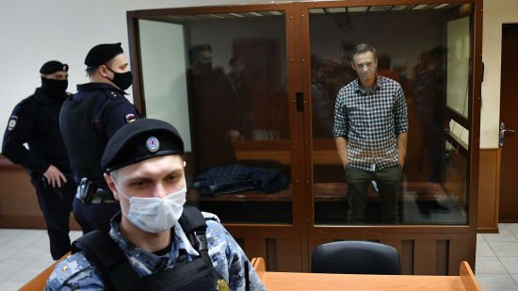
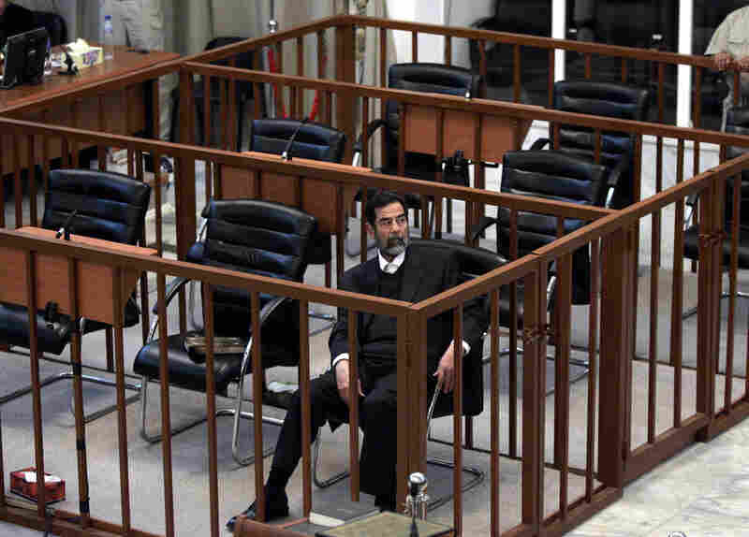

Slide 14
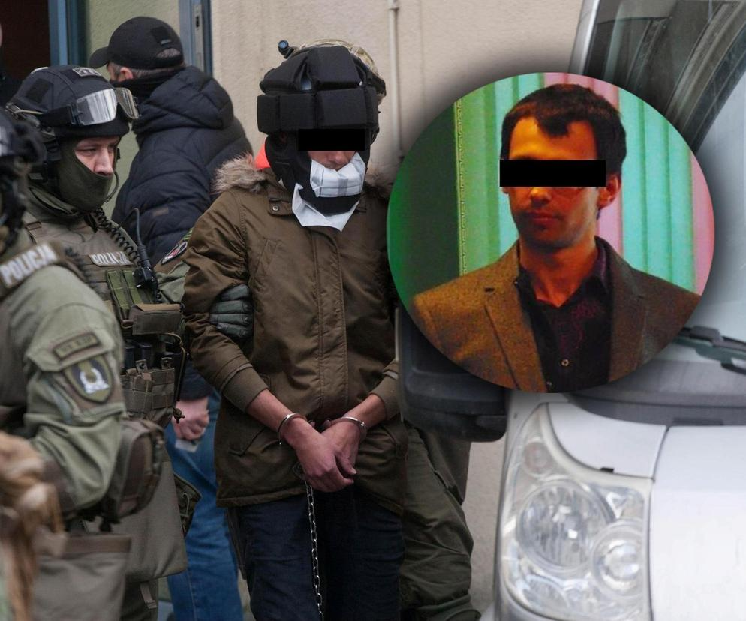
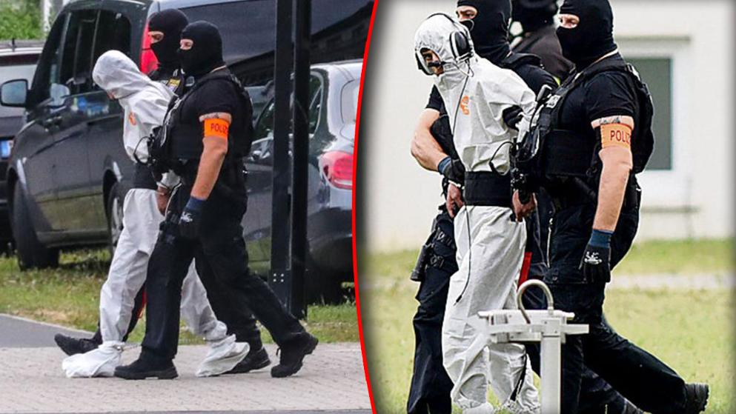

Slide 15
Burden of proof and in dubio pro reo rule
Article 6
Burden of proof
1. Member States shall ensure that the burden of proof for establishing the guilt of suspects and accused persons is on the prosecution. This shall be without prejudice to any obligation on the judge or the competent court to seek both inculpatory and exculpatory evidence, and to the right of the defence to submit evidence in accordance with the applicable national law.
2. Member States shall ensure that any doubt as to the question of guilt is to benefit the suspect or accused person, including where the court assesses whether the person concerned should be acquitted.

Slide 16
Burden of proof and in dubio pro reo rule
The burden of proof is usually on the person who brings a claim in a dispute. It is often associated with the Latin maxim semper necessitas probandi incumbit ei qui agit, a translation of which is: "the necessity of proof always lies with the person who lays charges”.
The burden of proof lies on the public prosecutor who should present incriminating evidence.
Problem in the EU legal system: different models of criminal proceedings and sometimes the court is also obliged to present/look for incriminating evidence due to the objective truth principle.

Slide 17
Burden of proof and in dubio pro reo rule
(22) The burden of proof for establishing the guilt of suspects and accused persons is on the prosecution, and any doubt should benefit the suspect or accused person. The presumption of innocence would be infringed if the burden of proof were shifted from the prosecution to the defence, without prejudice to any ex officio fact-finding powers of the court, to the independence of the judiciary when assessing the guilt of the suspect or accused person, and to the use of presumptions of fact or law concerning the criminal liability of a suspect or accused person. Such presumptions should be confined within reasonable limits, taking into account the importance of what is at stake and maintaining the rights of the defence, and the means employed should be reasonably proportionate to the legitimate aim pursued. Such presumptions should be rebuttable and in any event, should be used only where the rights of the defence are respected.
(23) In various Member States not only the prosecution, but also judges and competent courts are charged with seeking both inculpatory and exculpatory evidence. Member States which do not have an adversarial system should be able to maintain their current system provided that it complies with this Directive and with other relevant provisions of Union and international law.

Slide 18
In dubio pro reo rule and proof beyond reasonable doubt
In criminal cases, the prosecution is required to prove the defendant’s guilt beyond a reasonable doubt. This means that the evidence presented must be so convincing that no reasonable person could have any doubts about the defendant’s guilt.
Reasonable doubt is not mere possible doubt or speculation; instead, it’s a doubt based on reason that would govern or control a person in the more weighty affairs of life.
In dubio pro reo and proof beyond reasonable doubt are two concepts of the „standard of proof”
The standard of proof is the degree to which a party must prove its case to succeed.

Slide 19
Right to not incriminate
Right to remain silent
Article 7
Right to remain silent and right not to incriminate oneself
1. Member States shall ensure that suspects and accused persons have the right to remain silent in relation to the criminal offence that they are suspected or accused of having committed.
2. Member States shall ensure that suspects and accused persons have the right not to incriminate themselves.

Slide 20
Right to remain silent
36 Furthermore, while the questions referred mention Articles 47 and 48 of the Charter, which enshrine, inter alia, the right to a fair trial and the presumption of innocence, the request for a preliminary ruling also refers to the rights guaranteed in Article 6 of the ECHR. Whilst the ECHR does not constitute, for as long as the European Union has not acceded to it, a legal instrument which has been formally incorporated into the EU legal order, it must nevertheless be recalled that, as Article 6(3) TEU confirms, fundamental rights recognised by the ECHR constitute general principles of EU law. Furthermore, Article 52(3) of the Charter, which provides that the rights contained in the Charter which correspond to rights guaranteed by the ECHR are to have the same meaning and scope as those laid down by the ECHR, is intended to ensure the necessary consistency between those respective rights without adversely affecting the autonomy of EU law and that of the Court of Justice (see, to that effect, judgment of 20 March 2018, Garlsson Real Estate and Others, C‑537/16, EU:C:2018:193, paragraphs 24 and 25).

Slide 21
Right to remain silent
37 According to the Explanations relating to the Charter of Fundamental Rights (OJ 2007 C 303, p. 17), the second paragraph of Article 47 of the Charter corresponds to Article 6(1) of the ECHR and Article 48 of the Charter is ‘the same’ as Article 6(2) and (3) of the ECHR. When interpreting the rights guaranteed by the second paragraph of Article 47 and of Article 48 of the Charter, the Court must, therefore, take account of the corresponding rights guaranteed by Article 6 of the ECHR, as interpreted by the European Court of Human Rights, as the minimum threshold of protection (see, to that effect, judgments of 21 May 2019, Commission v Hungary (Usufruct over agricultural land), C‑235/17, EU:C:2019:432, paragraph 72; of 6 October 2020, La Quadrature du Net and Others, C‑511/18, C‑512/18 and C‑520/18, EU:C:2020:791, paragraph 124; and of 17 December 2020, Centraal Israëlitisch Consistorie van België and Others, C‑336/19, EU:C:2020:1031, paragraph 56).

Slide 22
Right to remain silent
38 In that regard, the European Court of Human Rights has observed that, even though Article 6 of the ECHR does not explicitly mention the right to silence, that right is a generally recognised international standard which lies at the heart of the notion of a fair trial. By providing the accused with protection against improper coercion by the authorities, that right contributes to avoiding miscarriages of justice and to securing the aims of Article 6 ECHR (see, to that effect, ECtHR, 8 February 1996, John Murray v. the United Kingdom, CE:ECHR:1996:0208JUD001873191, § 45).
39 Since protection of the right to silence is intended to ensure that, in criminal proceedings, the prosecution establishes its case without resorting to evidence obtained through methods of coercion or oppression in defiance of the will of the accused (see, to that effect, ECtHR, 17 December 1996, Saunders v. the United Kingdom, CE:ECHR:1996:1217JUD001918791, § 68), this right is infringed, inter alia, where a suspect is obliged to testify under threat of sanctions and either testifies in consequence or is sanctioned for refusing to testify (see, to that effect, ECtHR, 13 September 2016, Ibrahim and Others v. the United Kingdom, CE:ECHR:2016:0913JUD005054108, § 267).

Slide 23
Right to remain silent
40 The right to silence cannot reasonably be confined to statements of admission of wrongdoing or to remarks which directly incriminate the person questioned, but rather also covers information on questions of fact which may subsequently be used in support of the prosecution and may thus have a bearing on the conviction or the penalty imposed on that person (see, to that effect, ECtHR, 17 December 1996, Saunders v. United Kingdom, CE:ECHR:1996:1217JUD001918791, § 71, and 19 March 2015, Corbet and Others v. France, CE:ECHR:2015:0319JUD000749411, § 34).
41 That said, the right to silence cannot justify every failure to cooperate with the competent authorities, such as a refusal to appear at a hearing planned by those authorities or delaying tactics designed to postpone it.
CJEU C‑481/19, 2 February 2021

Slide 24
Article 7 of the Directive 2016/343
3. The exercise of the right not to incriminate oneself shall not prevent the competent authorities from gathering evidence which may be lawfully obtained through the use of legal powers of compulsion and which has an existence independent of the will of the suspects or accused persons.
4. Member States may allow their judicial authorities to take into account, when sentencing, cooperative behaviour of suspects and accused persons.
5. The exercise by suspects and accused persons of the right to remain silent or of the right not to incriminate oneself shall not be used against them and shall not be considered to be evidence that they have committed the criminal offence concerned.

Slide 25
Article 7 of the Directive 2016/343
Evidence which has an existence independent of the will of the suspects or accused persons.
Documents
Fingerprints
DNA
Hairs
Etc.
The accused/suspect is not obligated to actively cooperate with the criminal proceedings authority and produce incriminating evidence. However, incriminating evidence may sometimes exist without their will, and they are obliged to allow its collection by the criminal proceedings authority.

Slide 26
Article 7 of the Directive 2016/343
6. This Article shall not preclude Member States from deciding that, with regard to minor offences, the conduct of the proceedings, or certain stages thereof, may take place in writing or without questioning of the suspect or accused person by the competent authorities in relation to the offence concerned, provided that this complies with the right to a fair trial.
Recital no. 30:
The right to remain silent and the right not to incriminate oneself should not preclude Member States from deciding that, with regard to minor offences, such as minor road traffic offences, the conduct of the proceedings, or certain stages thereof, may take place in writing or without questioning of the suspect or accused person by the competent authorities in relation to the offence concerned, provided that this complies with the right to a fair trial.

Slide 27
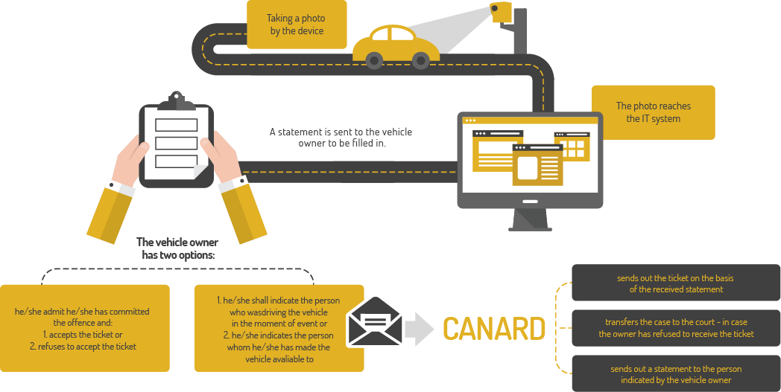

Slide 28
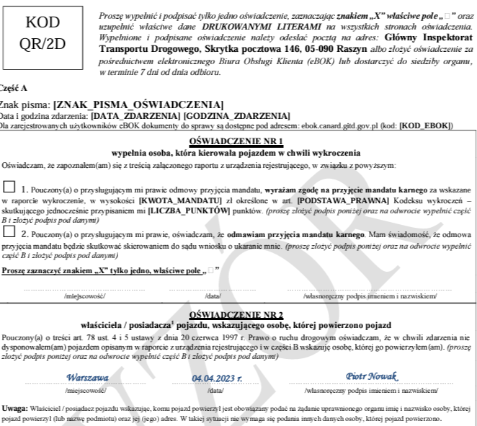

Slide 29
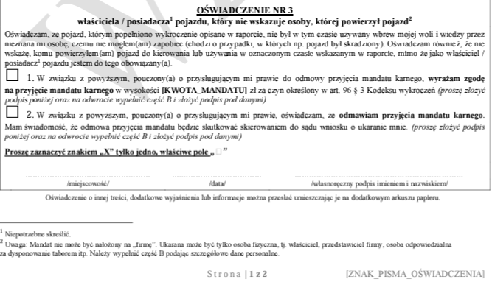

Slide 30
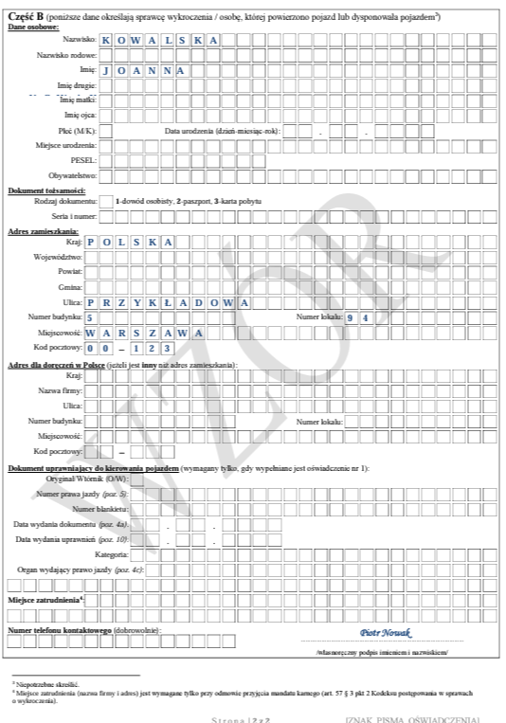

Slide 31
Weh v. Austria
49. Before turning to the facts of the present case, the Court reiterates that in proceedings originating in an individual application it has to confine itself, as far as possible, to an examination of the concrete case before it (see for instance, J.B., cited above, § 63). Consequently, it is only called upon to decide whether, in the circumstances of the present case, the applicant's right to silence and his right not to incriminate himself were violated.
50. The heart of the applicant's complaint is that he was punished for failure to give information which may have incriminated him in the context of criminal proceedings for speeding. However, neither at the time when the applicant was requested to disclose the driver of his car nor thereafter were these proceedings conducted against him.
51. Thus, the present case is not one concerned with the use of compulsorily obtained information in subsequent criminal proceedings (see the cases referred to above, paragraph 43).

Slide 32
Weh v. Austria
52. Moreover, the present case differs from the group of cases in which persons, against whom criminal proceedings were pending or were at least anticipated, were compelled on pain of a penalty to give potentially incriminating information. In J.B. (cited above) mixed tax-evasion and tax-assessment proceedings had already been opened against the applicant when he was requested to provide information on investments made by him. In Funke and in Heaney and McGuinnes (both cited above) criminal proceedings were anticipated, though they had not been formally opened, at the time the respective applicants were required to give potentially incriminating information. In Funke the customs authorities had a specific suspicion against the applicant, in Heaney and McGuinness the applicants had been arrested on suspicion of terrorist offences.
53. In the present case the proceedings for speeding were conducted against unknown offenders, when the authorities requested the applicant under section 103 § 2 of the Motor Vehicles Act to disclose who had been driving his car on 5 March 1995. There were clearly no proceedings for speeding pending against the applicant and it cannot even be said that they were anticipated as the authorities did not have any element of suspicion against him.

Slide 33
Weh v. Austria
54. There is nothing to show that the applicant was “substantially affected” so as to consider him being “charged” with the offence of speeding within the autonomous meaning of Article 6 § 1 (see Heaney and McGuinness, cited above, § 41, with a reference to Serves, also cited above, p. 2172, § 42). It was merely in his capacity as the registered car owner that he was required to give information. Moreover, he was only required to state a simple fact – namely who had been the driver of his car – which is not in itself incriminating.
55. In addition, although this is not a decisive element in itself, the Court notes that the applicant did not refuse to give information, but exonerated himself in that he informed the authorities that a third person had been driving at the relevant time. He was punished under section 103 § 2 of the Motor Vehicles Act only on account of the fact that he had given inaccurate information as he had failed to indicate the person's complete address. Neither in the domestic proceedings nor before the Court did he ever allege that he had been the driver of the car at the time of the offence.

Slide 34
Weh v. Austria
56. The Court reiterates that it is not called upon to pronounce on the existence or otherwise of potential violations of the Convention (see mutatis mutandis, Soering v. the United Kingdom, judgment of 7 July 1989, Series A no. 161, p. 35, § 90). It considers that, in the present case, the link between the applicant's obligation under section 130 § 2 of the Motor Vehicles Act to disclose the driver of his car and possible criminal proceedings for speeding against him remains remote and hypothetical. However, without a sufficiently concrete link with these criminal proceedings the use of compulsory powers (i.e. the imposition of a fine) to obtain information does not raise an issue with regard to the applicant's right to remain silent and the privilege against self-incrimination.

Slide 35
De Lege v. Netherlands
(i) The right to a fair trial under Article 6 § 1 of the Convention
60. The right to a fair trial under Article 6 § 1 is an unqualified right. However, what constitutes a fair trial cannot be the subject of a single unvarying rule but must depend on the circumstances of the particular case (see O’Halloran and Francis v. the United Kingdom [GC], nos. 15809/02 and 25624/02, § 53, ECHR 2007‑III). The Court’s primary concern under Article 6 § 1 is to evaluate the overall fairness of the criminal proceedings (see, among many other authorities, Beuze v. Belgium [GC], no. 71409/10, § 120, 9 November 2018).
61. Compliance with the requirements of a fair trial must be examined in each case, having regard to the development of the proceedings as a whole and not on the basis of an isolated consideration of one particular aspect or one particular incident, although it cannot be excluded that a specific factor may be so decisive as to enable the fairness of the trial to be assessed at an earlier stage in the proceedings (see, inter alia, Ibrahim and Others v. the United Kingdom [GC], nos. 50541/08 and 3 others, § 251, 13 September 2016, and Beuze, cited above, §§ 121-22).
62. The Court has found that cases concerning tax reassessments – or tax fines – differ from the hard core of criminal law for the purposes of the Convention, and that, consequently, the guarantees of Article 6 under its criminal head will not necessarily apply with their full stringency (see Jussila, cited above, § 43; Segame SA v. France, no. 4837/06, § 59, ECHR 2012; Chap Ltd v. Armenia, no. 15485/09, §§ 41 and 44, 4 May 2017; and, in the context of a complaint under Article 4 of Protocol No. 7, A and B v. Norway [GC], nos. 24130/11 and 29758/11, § 133, 15 November 2016).

Slide 36
De Lege v. Netherlands
(ii) General approach to the privilege against self-incrimination
63. The Court has held that the right to remain silent and the right not to incriminate oneself are generally recognised international standards which lie at the heart of the concept of a fair procedure under Article 6 of the Convention. Their rationale lies, inter alia, in the protection of the accused against improper compulsion by the authorities, thereby contributing to the avoidance of miscarriages of justice and to the fulfilment of the aims of Article 6 (see Ibrahim and Others, cited above, § 266).
64. The privilege against self-incrimination does not protect against the making of an incriminating statement per se but against the obtaining of evidence by coercion or oppression. In this latter context, the Court held as follows in its judgment in Ibrahim and Others (cited above, § 267, with further references):
“... The Court, through its case-law, has identified at least three kinds of situations which give rise to concerns as to improper compulsion in breach of Article 6. The first is where a suspect is obliged to testify under threat of sanctions and either testifies in consequence ... or is sanctioned for refusing to testify ... The second is where physical or psychological pressure, often in the form of treatment which breaches Article 3 of the Convention, is applied to obtain real evidence or statements ... The third is where the authorities use subterfuge to elicit information that they were unable to obtain during questioning ...”

Slide 37
De Lege v. Netherlands
65. For an issue to arise from the perspective of the protection against self-incrimination, therefore, an applicant must firstly have been subject to some form of coercion or compulsion by the authorities (see, for example, Serves v. France, 20 October 1997, § 47, Reports 1997-VI, and Bykov v. Russia [GC], no. 4378/02, § 102, 10 March 2009). Secondly, for a case to fall within the scope of protection of the right not to incriminate oneself, either that compulsion must have been applied for the purpose of obtaining information which might incriminate the person concerned in pending or anticipated criminal proceedings against him or her, or the case must concern the use of incriminating information compulsorily obtained outside the context of criminal proceedings in a subsequent criminal prosecution (see Weh v. Austria, no. 38544/97, §§ 42-43, 8 April 2004; see also Wanner v. Germany (dec.), no. 26892/12, § 24, 23 October 2018).

Slide 38
De Lege v. Netherlands
66. The underlying principle for this is the fact that the right not to incriminate oneself presupposes, in particular, that the prosecution in a criminal case seek to prove their case against the accused without resorting to evidence obtained through methods of coercion or oppression in defiance of the will of the accused. In this sense the right is closely linked to the presumption of innocence contained in Article 6 § 2 of the Convention (see Saunders, cited above, § 68).
67. The right not to incriminate oneself is primarily concerned, however, with respecting the will of an accused person to remain silent. As commonly understood in the legal systems of the Contracting Parties to the Convention and elsewhere, it does not extend to the use in criminal proceedings of material which may be obtained from the accused through the use of compulsory powers but which has an existence independent of the will of the suspect such as, inter alia, documents acquired pursuant to a warrant, breath, blood and urine samples and bodily tissue for the purpose of DNA testing (see Saunders, cited above, § 69; Kalnėnienė v. Belgium, no. 40233/07, § 52, 31 January 2017; Sršen v. Croatia (dec.), no. 30305/13, § 44, 22 January 2019; and El Khalloufi v. the Netherlands (dec.), no. 37164/17, §§ 38-40, 26 November 2019). However, where such evidence has been obtained by a measure which breaches Article 3, the privilege against self-incrimination remains applicable (see also Jalloh, cited above, §§ 105, 108 and 115-16).

Slide 39
De Lege v. Netherlands
68. In cases where the privilege against self-incrimination is applicable (ibid., §§ 110‑13), the Court has held – noting that the right not to incriminate oneself is not absolute (see Heaney and McGuinness v. Ireland, no. 34720/97, § 47, ECHR 2000‑XII; Weh, cited above, § 46; and O’Halloran and Francis, cited above, § 53) – that the degree of compulsion applied will be incompatible with Article 6 where it destroys the very essence of the privilege (see John Murray v. the United Kingdom, 8 February 1996, § 49, Reports 1996‑I). Not all direct compulsion will destroy the very essence of the privilege against self-incrimination and thus lead to a violation of Article 6. In examining whether, in a given procedure, compulsion has extinguished the very essence of this privilege, the Court will consider, in particular, the nature and degree of the compulsion, the existence of any relevant safeguards in the procedure and, crucially, the use to which any material so obtained is put (see, for instance, Allan v. the United Kingdom, no. 48539/99, § 44, ECHR 2002‑IX; Jalloh, cited above, § 101; and Ibrahim and Others, cited above, § 269).

Slide 40
De Lege v. Netherlands
74. In order for an issue to arise from the perspective of the privilege against self-incrimination, there must first be some form of coercion or compulsion exerted on the person concerned. Second, either that person must be facing existing or anticipated criminal proceedings – that is to say, a “criminal charge” within the autonomous meaning of Article 6 § 1 – or incriminating information compulsorily obtained outside the context of criminal proceedings must be used in a subsequent criminal prosecution (see paragraph 65 above). These may be considered the two prerequisites for the applicability of the privilege against self-incrimination (see, for instance, Eklund v. Finland (dec.), no. 56936/13, § 51, 8 December 2015).
75. Where these prerequisites are met, it is necessary to determine whether the use of evidence obtained by means of coercion or compulsion should nevertheless be considered as falling outside the scope of protection of the privilege against self-incrimination. As can be seen from the Court’s case‑law, the right not to incriminate oneself is primarily concerned with respecting the will of an accused person to remain silent. When methods of coercion are used with the aim of having an accused person answer questions or make statements, either orally or in writing, the will to remain silent is clearly not respected and the privilege against self-incrimination thus applies. The privilege does not, however, extend to the use in criminal proceedings of materials obtained from an accused through methods of coercion when these materials have an existence independent of his or her will (see paragraph 67 above).

Slide 41
De Lege v. Netherlands
76. Where the use of documentary evidence obtained under threat of penalties in the context of financial-law matters is concerned, it may further be deduced from the Court’s case-law (see paragraphs 69-73 above) that such use does not fall within the scope of protection of the privilege against self‑incrimination where the authorities are able to show that the compulsion is aimed at obtaining specific pre-existing documents – thus, documents that have not been created as a result of the very compulsion for the purpose of the criminal proceedings – which documents are relevant for the investigation in question and of whose existence those authorities are aware. That situation is to be distinguished from that where the authorities attempt to compel an individual to provide evidence of offences he or she has allegedly committed by forcing him or her to supply documents which they believe must exist, although they are not certain of it (see Funke, § 44, and J.B. v. Switzerland, § 69, both cited above). The Court has described such a situation as “fishing expeditions”. The Court considers that in that context a parallel may be drawn with testimonial evidence: when a person makes a statement which incriminates him or her, he or she is similarly providing the authorities with information of whose existence those authorities were not yet aware. Where the making of that statement came about as a result of coercion or compulsion, an issue arises under the privilege against self-incrimination, since, as set out above (see paragraph 66), it is incumbent on the prosecution in a criminal case to prove their case without recourse to evidence obtained through such methods.

Slide 42
De Lege v. Netherlands
77. Lastly, it follows from the case-law that, regardless of whether or not the authorities are aware of the existence of documentary or other real evidence, if this has been obtained by methods in breach of Article 3, its use will always fall within the scope of the privilege against self-incrimination (see paragraph 67 above).
78. If the prerequisites for the applicability of the privilege against self‑incrimination are met (see paragraph 74 above), and the use of evidence obtained through coercion or compulsion does fall within the scope of protection of that privilege (see paragraphs 75-76 above), it is necessary to examine whether the procedure did not extinguish the “very essence” of the privilege, that is to say, to determine the manner in which the overall fairness of the proceedings was affected. For this purpose, it will be necessary to have regard, in turn, to the factors set out in paragraph 68 above: the nature and degree of compulsion used to obtain the evidence; the existence of any relevant safeguards in the procedure; and the use to which any material so obtained is put.

Slide 43
Right to be present during a trial
Article 8
Right to be present at the trial
1. Member States shall ensure that suspects and accused persons have the right to be present at their trial.
2. Member States may provide that a trial which can result in a decision on the guilt or innocence of a suspect or accused person can be held in his or her absence, provided that:
(a) the suspect or accused person has been informed, in due time, of the trial and of the consequences of non-appearance; or
(b) the suspect or accused person, having been informed of the trial, is represented by a mandated lawyer, who was appointed either by the suspect or accused person or by the State.
3. A decision which has been taken in accordance with paragraph 2 may be enforced against the person concerned.

Slide 44
Right to be present during a trial
Article 8
Right to be present at the trial
4. Where Member States provide for the possibility of holding trials in the absence of suspects or accused persons but it is not possible to comply with the conditions laid down in paragraph 2 of this Article because a suspect or accused person cannot be located despite reasonable efforts having been made, Member States may provide that a decision can nevertheless be taken and enforced. In that case, Member States shall ensure that when suspects or accused persons are informed of the decision, in particular when they are apprehended, they are also informed of the possibility to challenge the decision and of the right to a new trial or to another legal remedy, in accordance with Article 9.
5. This Article shall be without prejudice to national rules that provide that the judge or the competent court can exclude a suspect or accused person temporarily from the trial where necessary in the interests of securing the proper conduct of the criminal proceedings, provided that the rights of the defence are complied with.
6. This Article shall be without prejudice to national rules that provide for proceedings or certain stages thereof to be conducted in writing, provided that this complies with the right to a fair trial.

Slide 45
Right to be present during a trial
Article 9
Right to a new trial
Member States shall ensure that, where suspects or accused persons were not present at their trial and the conditions laid down in Article 8(2) were not met, they have the right to a new trial, or to another legal remedy, which allows a fresh determination of the merits of the case, including examination of new evidence, and which may lead to the original decision being reversed. In that regard, Member States shall ensure that those suspects and accused persons have the right to be present, to participate effectively, in accordance with procedures under national law, and to exercise the rights of the defence.

Slide 46
Right to be present during a trial
Presence at the trial signifies the possibility of active participation. The CJEU expands the scope of Article 8 of Directive 2016/343 to include evidentiary proceedings as well. Participating in the trial, the accused or their defense counsel must have the opportunity to question witnesses, and more generally, Article 8 of the directive implies the right to participate in witness examinations.
If the accused did not participate in a part of the trial, such as the witness examination, it is not always necessary to repeat the entire process (Article 9 of Directive 2016/343) - it may be sufficient, for example, to repeat the examination at a hearing in such a way that the accused/defense counsel can participate.

Slide 47
Right to be present during a trial (C-688/18)
39 The question referred for a preliminary ruling concerns, first, the situation in which an accused person deliberately waives his right to appear at one of the hearings held in connection with his trial.
40 In the light of the very wording of Article 8(2) of Directive 2016/343, it must be noted that, in a case such as that in the main proceedings, both the conditions laid down in point (a) of that provision and those referred to in point (b) were complied with.
41 Furthermore, it is apparent from the order for reference that UW’s waiver of his right to take part in the hearing was attended by minimum safeguards commensurate with its seriousness and that that waiver does not run counter to any important public interest.
42 In those circumstances, it must be held that Article 8(2) of Directive 2016/343 does not preclude national legislation which provides that the right of an accused person to be present at his trial is not infringed where that person has decided, unequivocally, not to appear at one of the hearings held in connection with his trial, provided that he has been informed that that hearing will be held and has been represented, at that hearing, by a mandated lawyer.

Slide 48
Right to be present during a trial (C-688/18)
43 The referring court’s question concerns, in the second place, the situation in which the accused person was unable to appear at hearings held in connection with his trial for a reason beyond his control, namely because of illness.
44 According to recital 34 of Directive 2016/343, if, for reasons beyond their control, suspects or accused persons are unable to be present at the trial, they should have the possibility to request a new date for the trial within the time frame provided for in national law.
45 The referring court asks the Court, first, about the situation in which the accused person, who was unable, for a reason beyond his control, to appear at a hearing held in connection with his trial and who was informed of steps taken in his absence during that hearing, stated that he would not call the lawfulness of the steps taken into question in reliance on that absence and that he did not want them to be repeated in his presence.
46 In that context, it is important to note that such a position may be regarded as constituting an unequivocal waiver of the right to be present at the hearing concerned.

Slide 49
Right to be present during a trial (C-688/18)
47 Secondly, the referring court refers to the situation in which the accused person stated that he wished to have the steps taken when he was absent repeated in his presence, which led to the conducting of a further examination of a witness, in which the accused person was given the opportunity to participate fully.
48 In that regard, a person who has had repeated in his presence the steps taken during hearings at which he was unable to appear, cannot be regarded as having been absent from his trial.

Slide 50
Right to be present during a trial (C-688/18)
49 In the light of the foregoing considerations, the answer to the question referred is that Article 8(1) and (2) of Directive 2016/343 must be interpreted as not precluding national legislation which provides, in a situation where the accused person has been informed, in due time, of his trial and of the consequences of not appearing at that trial, and where that person was represented by a mandated lawyer appointed by him, that his right to be present at his trial is not infringed where:
– he decided unequivocally not to appear at one of the hearings held in connection with his trial; or
– he did not appear at one of those hearings for a reason beyond his control if, following that hearing, he was informed of the steps taken in his absence and, with full knowledge of the situation, decided and stated either that he would not call the lawfulness of those steps into question in reliance on his non-appearance, or that he wished to participate in those steps, leading the national court hearing the case to repeat those steps, in particular by conducting a further examination of a witness, in which the accused person was given the opportunity to participate fully.

Slide 51
Right to be present during a trial (C- C‑347/21)
36. In order to ensure observance of the right to a fair trial and the rights of the defence, the examination of the incriminating witness must, however, be repeated in such a way as to give the accused person an adequate opportunity to challenge the incriminating testimony and to question the author thereof.
37. To that end, it is sufficient to carry out an additional examination during which the accused person has the opportunity freely to question the witness, without it being necessary to repeat, in its entirety, the examination which has taken place in his or her absence, since the invalidation of procedural steps taken during that examination does not appear to be necessary in the light of the requirements set out in the preceding paragraph.
38. It is important, nevertheless, that before the additional examination, the accused person should be sent a copy of the minutes of the examination of the incriminating witness that was carried out in his or her absence. It is only on condition that he or she is aware of the content and progress of the questioning of the witness during that previous examination that the accused person is fully in a position to question that witness, if necessary, based on the statements made during that examination.

