Slide 1
Fundamentals of Law and Government
Basic Concepts
Part 2

Slide 2
Sovereignty
What is sovereignty?
Is there definition of sovereignty?
What is a difference between authority and sovereignty?
Why do we need sovereignty?

Slide 3
Who was sovereign in the Middle Ages, and who is sovereign now?
Are theories of sovereignity changing?
What are personal, parliamentary, and popular sovereignty?

Slide 4
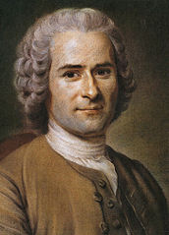
Jean-Jacques Rousseau (28.06.1712 – 2.07.1778)

Slide 5
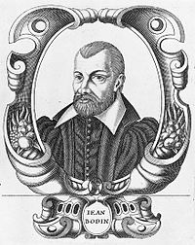
Jean Bodin (1530–1596)

Slide 6
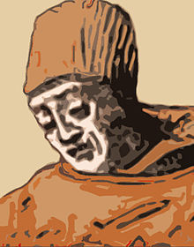
Marsilius Of Padua (italian Marsilio Or Marsiglio Da Padova; Born Marsilio Dei Mainardini or Marsilio Mainardini, c. 1275 – C. 1342)

Slide 7
State
What is state?
What is the difference between government and the state?
What are the components of state?

Slide 8
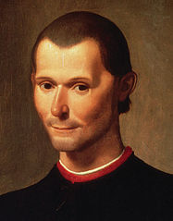
Niccolò Machiavelli (3.05.1469 – 21.06.1527 Niccolò di Bernardo dei Machiavelli)

Slide 9
What are the functions of state?
Are functions of state all the same around the world?
And what about anarchy?

Slide 10
Nation
What is nation?
What separates nation from ethnic group?
Is there one definition of nation?

Slide 11
When were first nations created?
What does it mean to have a nationality?
What is patriotism?
What is nationalism?
Do we really need the nations?

Slide 12
Citizenship
What is citizenship?
How to acquire citizenship?
Are there different ways to acquire citizenship?

Slide 13
What is ius sanguinis?
What is ius soli?
What is iure matrimonii?
Are there people excluded from citizenship?

Slide 14
Are there different types of government - citizen relationships?
What are the interactions between government and citizens?
What it means to be a citizen – do we have duties as a citizens?

