Slide 1
INGOs II
dr Łukasz Prus

Slide 2
HR INGOs
HUMAN RIGHTS INTER NON-GOVERNMENTAL ORGANIZATIONS

Slide 3
HR INGOs have led the promotion and universalization of human rights norms,
even though the formal creation and promotion of human rights law is carried out by states
acting in concert and separately within and outside the ambit of the UN.

Slide 4
Definition of HRINGOs
A private international association
which devotes (spends) significant resources to the promotion and protection of HR,
Which is independent of both governmental and political groups that seek political power, and does not itself seek such power
L. Wiseberg, Protecting Human Rights Activists and NGOs: What more can be done?, Human Rights Quarterly 1991, No 13

Slide 5
This definition is meant to distinguish HR INGOs from political parties,
government-sponsored or political party-based organizations
and politically-organized,
respectively, that only use HR rhetoric for partisan ends.

Slide 6
Many organizations around the world
dedicate their efforts to protecting human rights and ending human rights abuses.
HR INGOs monitor the actions of governments and
pressure them to act according to human rights principles

Slide 7
Examples of HRINGOs
  Amnesty International
  Human Rights Watch
  International Commission of Jurists (ICJ)
  Lawyers Committee for Human Rights,
  Article 19 (this organization takes its name from Article 19 of the Universal Declaration of Human Rights, which says, that „everyone has the right to freedom of opinion and expression (…)”)
  Interrights

Slide 8
  European Human Rights Advocacy Center
  Fair Trials International
  Mental Disability Advocacy Center
  Reporters without Borders
  Open Society Justice Initiative

Slide 9
Human Rights Action Center
Simon Wiesenthal Center

Slide 10
The International League for the Rights of Man
Now the International League for Human Rights
Is the oldest such organization, founded in New York in 1942

Slide 11
At various times it has focused on
victims of torture
Religious intolerance
Roger Baldwin the founded the The International League for the Rights of Man
He also founded the American Civil Liberties Union – civil rights organization

Slide 12
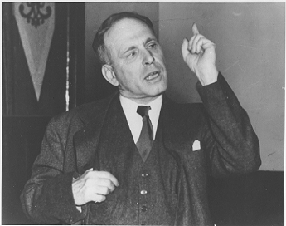

Slide 13
the International League for Human Rights itself was responsible for establishing in New York the Lawyers Committee for Intentional HR,
now known as the Lawyers Committee for Human Rights
Another of the more important INGOs, in 1975
the Lawyers Committee for Human Rights claims promote the HR standards contained in the International Bill of Rights

Slide 14
The New York-based Human Rights Watch
Human Rights Watch was founded by Robert L. Bernstein
as a private American INGO in 1978,
under the name Helsinki Watch, to monitor the Soviet Union

Slide 15
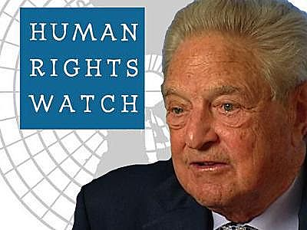

Slide 16
HRW has developed into the most dominant American INGOs working to expose violations of basic liberal freedoms
HRW publish reports on HR abuses US or other countries

Slide 17
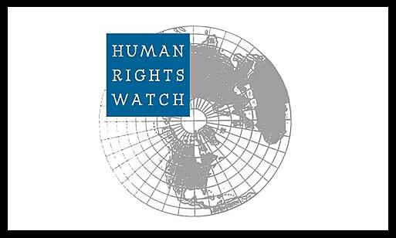

Slide 18
Two other leading HR INGOs are located in Europe
In the UK and Switzerland
The Geneva-based International Commission of Jurists (ICJ)
was founded in 1952 to promote the rule of law throughout the world

Slide 19
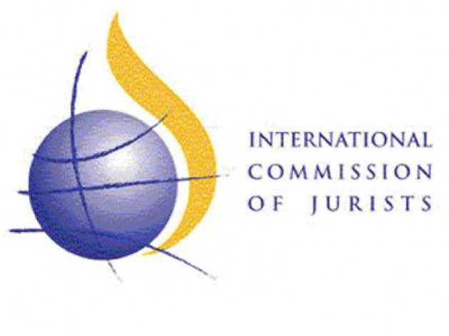

Slide 20
The ICJ has been accused of being a tool of the West in the Cold War,
Spending considerable resources exposing the failures of Soviet bloc.
The ICJ was initially funded by the Central Intelligence Agency.
The ICJ was established following the 1952 ‘International Congress of Jurists’ in West Berlin.

Slide 21
The Congress was organized by the ‘Investigating Committee of Free Jurists (ICJF)’,
a group of German jurists committed to investigating human rights abuses carried out in the Soviet Zone of post-war Germany
One of the founders Dr. Walter Linse was arrested by East German intelligence agents and delivered to the KGB.
Today it is regarded as a bona fide INGOs, concerning with rule of law questions in the South

Slide 22
Last but not least
The London-based Amnesty-International (AI),
The most powerful HR INGOs
Is today synonymous with the HR movement and has inspired the creation of many similar HR groups around the world

Slide 23
It was lunched by Peter Benenson, a British lawyer, writing in the May 1961 issues of the Observer and Le Monde
“Forgotten Prisoners”
The recipient of the 1977 Nobel Peace Prize, AI claim that its object is to contribute to the observance HR
Through campaigns to free prisoners of conscience

Slide 24
To ensure fair trails within reasonable like for political prisoners,
To abolish death penalty
Torture
And other cruel treatment of prisoners

Slide 25
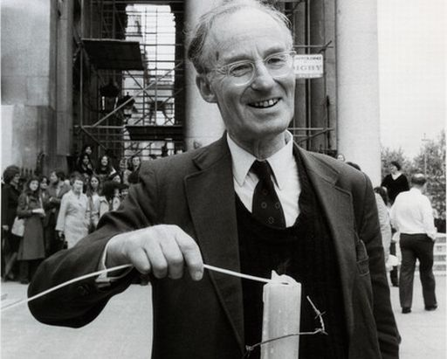

Slide 26
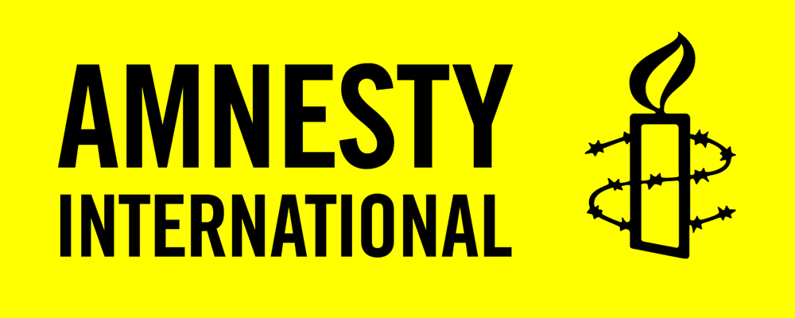

Slide 27
Prisoner of conscience is a term coined by Peter Benenson in a 28 May 1961 article ("The Forgotten Prisoners") for Observer
This term can refer to anyone imprisoned because of their race, sexual orientation, religion, or political views.
It also refers to those who have been imprisoned and/or persecuted for the non-violent expression of their held beliefs

Slide 28
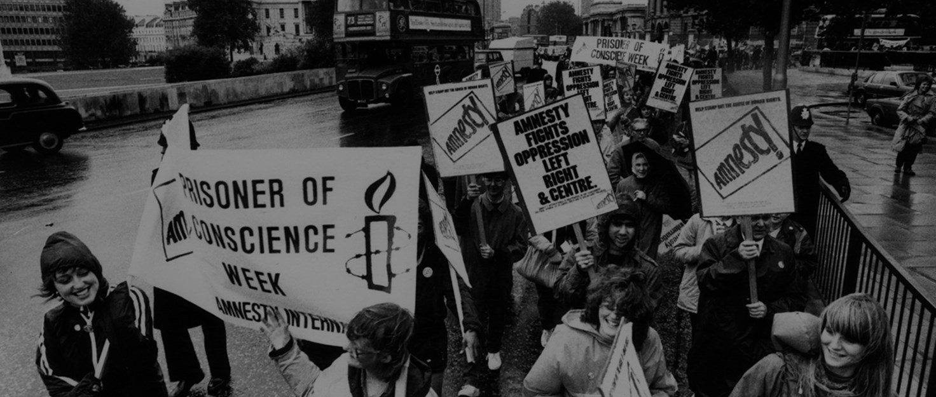

Slide 29
HR INGOs methods
Why HR INGOs may have impact:
they do not make political decisions
INGOs are responsible before the society and their sponsors
INGOs are transmitter of views of the society and minority to the government
Most important features of INGOs dealing with human rights
Credibility
Public trust and confidence
Responsiveness
Independence
Dynamism

Slide 30
Depending on mission and scope of operation HR INGOs use different methods in order to protect human rights.
Traditionally and basic methods
Investigation
Monitoring
Advocacy
Strategic litigation
Education

Slide 31
Investigation usually takes place in a Third World country,
while monitoring (reporting) and advocacy aim at reforming policies of industrial democracies and intergovernmental agencies to trigger bilateral and multilateral action against the repressive state.

Slide 32
Some HR INGOs now go beyond this denunciatory framework
and work to foster and strengthen processes and institutions –
rule of law, and constitutions, judiciaries, legislatures, and electoral machineries – that ensure the protection of civil and political rights.

Slide 33
Although the ideological commitment of these INGOs seems clear through their mandates and work, they nevertheless cast themselves as nonideological
For example, AI refused to condemn apartheid as a political system or to adopt Nelson Mandela, the century’s most prominent prisoner, as a prisoner of conscience

Slide 34
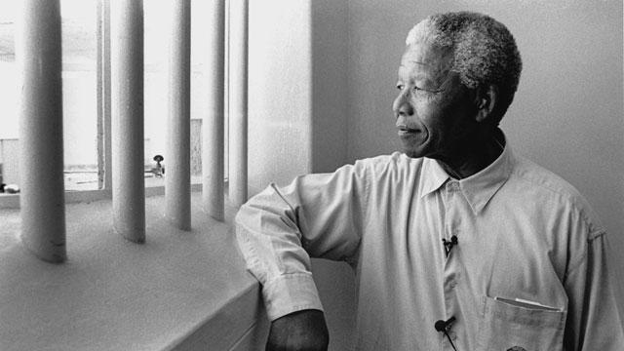

Slide 35
HR INGOs – role of watchdog
controlling the government and other institutions (also private institutions)
Watchdog organizations are non-profit groups that view their role as critically monitoring the activities of governments or other organiztions
and alerting the public when they
detect actions that go against the public interest

Slide 36
Monitoring:
Day to day monitoring (e.g. freedom of speech)
Controlling compliance with certain standards (e.g. controlling prisons in certain area)
Preparation of reports on compliance with human rights on the basis of monitoring
Results:
reports,
interventions,
raising awareness,
accountability
Examples: HRW report on violations of human rights in Russian-Georgian conflict

Slide 37
Purposes of monitoring
to help people (monitoring + intervention)
to have independent data and be a source for media
to compel (enforce) the government to change the law or practice
to show violations to international community (e.g. cluster ammunition in conflict in Georgia)
or prepare reports to international bodies (e.g. EU, UN, Council of Europe)

Slide 38
Barriers to monitoring
Sometimes need of cooperation with government (e.g. controlling prisons)
Serious monitoring requires human resources, time and money
You cannot expect results immediately – it is rather long-term investment
Monitoring in conflict zones may be risky
Sometimes HR INGOs may need a special status at a certain international organization, e.g. consultative status at the Council of Europe

Slide 39
Advocacy means arguing on behalf of a certain issue, idea or person
Changing the attitude of government
Showing the problem
Convincing the society
Advocacy means fighting for something, but without an intent to be elected for public position

Slide 40
Example of advocacy
Cluster Munition Coalition
is an international coalition working and campaigning against the use and production,
Cluster munitions are a type of explosive weapon
Methods:
  Signing letters and petitions
  Building international coalitions
  Informing the public opinion on the problem

Slide 41
  Convincing famous persons to support activities
  Public events and protests
  Organization of conferences and other events
  Engaging people into actions

Slide 42
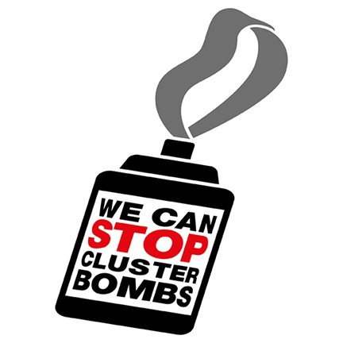

Slide 43


Slide 44
advocacy – typical topics
  Abolishing death penalty
  Release of political prisoners
  Counteracting HIV/AIDS
  Abuse of human rights by corporations
  Anti-terrorism legislation and human rights
  Domestic violence

Slide 45
Strategic litigation (strategic judicial cases) means trying to secure legal judgments that
cases have an enormous impact outside the courtroom (e.g. by dismantle an entrenched system that affects many people).
The objective of strategic litigation is to make significant changes in law or legal practice through litigation (court/judicial conflict)

Slide 46
Aim of strategic litigation
effect of scale - with one case you may resolve the whole problem
different additional functions (raising awareness, education on rights, involvement of civil society)
it does not replace legislative reforms but may speed them up
elimination of unjust gaps (loopholes) in the legal system
best education for human rights lawyer

Slide 47
Steps in strategic litigation
Selection of a case
Identification of a problem
Representation of victim in court
Informing the public opinion on the character of the case
Monitoring of an enforcement of judgment by the government

Slide 48
Methods
Representation of victims
Standing for HRNGOs as amicus curiae (friend of the court) – someone who is not a who is not a party, but who assists a court by offering information that bears on the case.
Possibility to submit third-paty intervention
Unlawful detention complaints and others complaints
Action for damages
  Unlawful detention complaints

Slide 49
  Famous strategic litigation
  - Brown v. Board of Education of Topeka (segregation in schools)
  -D.H. and others v. Czech Republic (discrimination of Roma children in schools)
  Bączkowski and others v. Poland (ban of assembly organized by minority groups)
  Nachova and others v. Bulgaria (burden of proof in racially motivated killings)

Slide 51
Education on human rights is an important element of INGOs’ activities
Education is a priority for many organizations.
In some countries it is the only method to advance human rights
You can educate on: human rights’ standards or skills how to advance human rights (for other INGOs or activists)
Human rights’ education may be subject of manipulation
  e.g. „Compass” handbook,
  situation in CIS countries – so called „horizontal” approach to human rights

Slide 52
Education has only indirect and long-term impact on human rights’ protection
Special educational methods:
  Law clinics (e.g. at universities)
  Education through personal involvement (workshops, actions, individual small projects)
  Monitoring projects with the personal involvement of students (e.g. Court Watch project)

Slide 54
Amnesty International
AI is the largest INGOs in the field of human rights in the world.
It has more than 2 million members
There are 50 nationally organized sections
The International Secretariat in London has more than 300 staff from over 50 countries

Slide 55
Just over four decades ago
two Portuguese students raised a toast to freedom
which resulted in the two students being sentenced to seven years imprisonment.
This occurence horrified British lawyer Peter Benenson.
He wrote to The Observer calling for an international campaign to persuade authorities around the world with protests about the "forgotten prisoners”
That's how Amnesty International came into being

Slide 56
“We are people from across the world standing up for humanity and human rights. Our purpose is to protect people wherever justice, freedom, truth and dignity are denied.
We investigate and expose abuses, educate and mobilize the public, and help transform societies to create a safer, more just world."
AI raises awarness through campaigning, the distribution of publications and through human rights education and promotion.

Slide 57
The principal object of AI is to mobilize public opinion in defence of those men and women who are imprisoned because their ideas are unacceptable to their governments.
From its founding in 1961 until the early 1990s AI focused its work on the HR of prisoners.
AI moved from this prisoner orientation to expand its scope of work, so as to include the prevention and ending of grave abuses of the rights to physical and mental integrity, freedom of expression,

Slide 58
Freedom from discrimination
within the context of its work to promote all HR
Examples of subjects of recent work on economic, social, and cultural rights include:
The right to food (in North Korea and Zimbabwe)
The right to mental health (in Bulgaria and Romania)
The right to health (in Rwanda, Argentina, and Congo)

Slide 59
Housing rights (in Angola, Israel, the Occupied Territories)
Well-known AI techniques:
Raporting
Letter-writing campaigns
Trial observation
Research missions
Draft reports are checked and double-checked before being released

Slide 60
For many years, the Soviet Union accused AI of being CIA-supported,
Whereas military dictatorships in Latin America called it a Communist umbrella organization
AI does not accept any government financial or other support for its HR activities

Slide 61
Final policy decisions are made by the International Council
Formal authority is International Executive Committee whereas the International Secretariat,
Headed by a secretary-general, is responsible for the organization day-to-day activities.

Slide 63
Interights
The International Centre for the Legal Protection of HR
Is a nongovernmental international HR organization
Registered as a charity in England and Wales, and based in London.
Interrights owes its foundation in 1982 to the coming together of a group of academics, lawyers, and human rights activists

Slide 64
who diagnosed a gap in human rights litigation in the absence of any nongovernmental body pursuing international cases
Interights is governed by a board of directors who have expertise in either regional or thematic focus areas or in management, finance, and communications.

Slide 65
Moreover the International Advisory Council, whose members are all leading experts in the field of international human rights law,
assists the board and staff in setting the overall legal direction of Interights.
Since Interights founding, its activities and programs have changed to rise to new challenges such as the war on terror
Interights work is sometimes in politically sensetive areas, it sees itself as apolitical

Slide 66
Interights activies are carried out under regional programs for Africa, Europe, the Middle East, and South Asia
Coordinated with thematic programs highlighting particular key rights, including economic and social rights (rights to education and health),
Equality, and security and the rule of law.

Slide 67
Interights offers legal assistance and representation on strategic human rights litigation.
Strategic human rights litigation has gradually become Interights main focus.
Interrights acts in 70-80 % of its cases as advisers, with the remainder involving the submission of amicus curiae

Slide 69
HRW
Created in 1978 as Helsinki Watch, HRW became arguably the world most influential HR INGOs
HRW is dedicated to protecting the HR of people around the world
They stand with victims and activists to ring to justice, to prevent discrimination, to uphold political freedom and to protect people from inhumane conduct in wartime

Slide 70
They investigate and expose HR violations and hold accountable.
Monitoring how governments meet their constitutional and international requirements lies at the heart of such activism.
In 2007 HRW spent $27 million on program service and $ 8 million on support service

Slide 71
https://careers.hrw.org/?_ga=1.231972567.997742288.1491771683
https://www.youtube.com/watch?v=XmdZBdrFNrE
https://www.youtube.com/watch?v=ghUSEHe7Wug

Slide 73
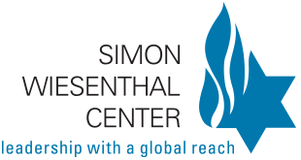

Slide 74
The Simon Wiesenthal Center
The Simon Wiesenthal Center is HR INGOs researching the Holocaust and hate in a historic and contemporary context.
At the end of World War II, thousands of Nazis who participated in the systematic murder of some 6,000,000 Jews and millions of Gypsies, Poles and other peoples, escaped to countries around the globe, where many still live in freedom

Slide 75
Simon Wiesenthal, a survivor of the Nazi death camps, dedicated his life to documenting the crimes of the Holocaust and to hunting down the perpetrators still at large.
As founder and head of the Jewish Documentation Center in Vienna, the freelance Nazi hunter,
usually with the cooperation of the Israeli, Austrian, former West German and other governments, ferreted out nearly 1,100 Nazi war criminals,

Slide 76
including Adolf Eichmann, the administrator of the slaughter of the Jews;
Franz Murer, "The Butcher of Wilno,"
and Erich Rajakowitsch, in charge of the "death transports" in Holland.

Slide 77
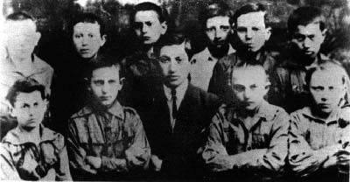
Simon Wiesenthal pictured in 1923 with a group of Boy Scouts of which he was the leader in Buczacz, Poland. Only one of these boys survived the Holocaust

Slide 78
