Slide 1
INGOs III
dr Łukasz Prus

Slide 2
Non-state actors
Environmental International Non-Governmental Organizations
EINGOs

Slide 3
Non-state actors/EINGOs have played a central role in developing international environmental law
Since the latter half of the nineteenth century,
The scientific community and then EINGOs have mobilised the forces of public opinion and
have sought to the progressive development of international law.

Slide 4
Over the past few decades, 6 categories of non-state actors have emerged as important actors:
The scientific community
Non-profit-making environmental groups (NGOs and INGOs)
Private companies
And business concerns
Legal organisations
Academic community
individuals

Slide 5
EINGOs emerged due to frustration with
governments lack of initiative to address
the extent of environmental degradation
In past two decades, INGOs have developed scientific expertise and lobbying skills

Slide 6
EINGOS
They can lobby (eg. FAO, WHO)
Collects data
seek to influence law
Identify issues requiring international legal action (water/air pollution, waste management)
They participate as observers in international organisations
And in treaty negotiations

Slide 7
Monitor compliance with environmental law
pay media attention for environmental protection
Exposing environmental harm
INGOs act outside institutions to mobilize public opinion
Globalization may enhance the power of INGOs to mobilize effective consumer actions

Slide 8
INGOs act as watchdogs in the process of adoption and implementation of international environmental law.
They participate, formally and informally in the international implementation of principles and rules adopted at the regional and global levels
During the negotiations for the Kyoto Protocol, more than 200 NGOs were accredited as observers

Slide 9
INGOs sometimes form alliances among themselves and
with intergovernmental organizations
to help implement international environmental law

Slide 10
In 1988,
UN Environmental Programme
the World Wide Fund for Nature (WWF)
And International Union for Conservation of Nature
Formed the World Conservation Monitoring Center to collect and provide information services on conservation
and sustainable use of biological resources.

Slide 11
EINGOs may be able to participate in dispute settlement procedures either
As parties
Or as amicus curiae (friend of the court - someone who is not a party to a case, but who assists a court by offering information that bears on the case

Slide 12
In the U.S. shrimp/turtle case at the WTO,
INGOs briefs initially were attached as exhibits to the U.S. submission,
But a revised version of one of the briefs was submitted independently by a group of NGOs
and was accepted by the panel
Despite protests of some governements

Slide 13
Examples of EINGOs
  Greenpeace
  World Wide Fund for Nature (WWF)
  Green Cross International
  Friends od the Earth
  Green Actors of West Africa (GAWA)
  Water For People
  Earthwatch Institute
  ClientEarth
  Forest Stewardship Council
  Rainforest Alliance
  Rainforest Foundation Fund
  Rainforest Trust

Slide 14
  International Union for Conservation of Nature
  Founded in 1948, the International Union for Conservation of Nature (IUCN) is the world’s oldest and largest global environmental organisation.
  In the past, it has been called the International Union for Protection of Nature (1948-1958)
  And the World Conservation Union (1990-2008)

Slide 15


Slide 16
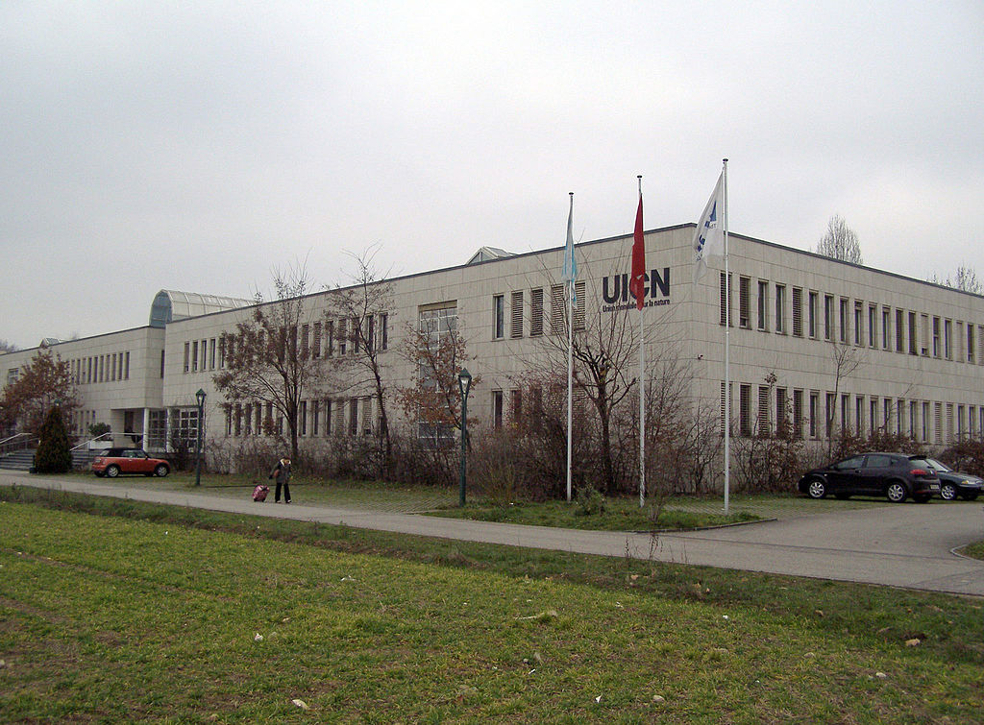

Slide 17
  What is IUCN?
  International organization working in the fielf of nature conservation and
  sustainable use of natural resources
  An orgnisation with hybrid membership:
  80 States
  115 Agencies
  850 NGOs

Slide 18
Mission is to influence, assist societies the world to conserve nature and to ensure that any use of natural resources is equitable and ecologically

Slide 19
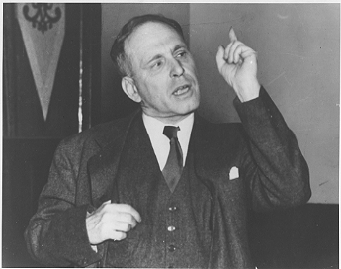

Slide 20
the International League for Human Rights itself was responsible for establishing in New York the Lawyers Committee for Intentional HR,
now known as the Lawyers Committee for Human Rights
Another of the more important INGOs, in 1975
the Lawyers Committee for Human Rights claims promote the HR standards contained in the International Bill of Rights

Slide 21
The New York-based Human Rights Watch
Human Rights Watch was founded by Robert L. Bernstein
as a private American INGO in 1978,
under the name Helsinki Watch, to monitor the Soviet Union

Slide 22
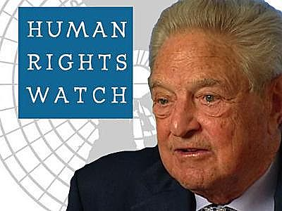

Slide 23
HRW has developed into the most dominant American INGOs working to expose violations of basic liberal freedoms
HRW publish reports on HR abuses US or other countries

Slide 24
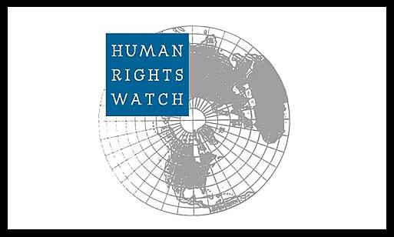

Slide 25
Two other leading HR INGOs are located in Europe
In the UK and Switzerland
The Geneva-based International Commission of Jurists (ICJ)
was founded in 1952 to promote the rule of law throughout the world

Slide 26
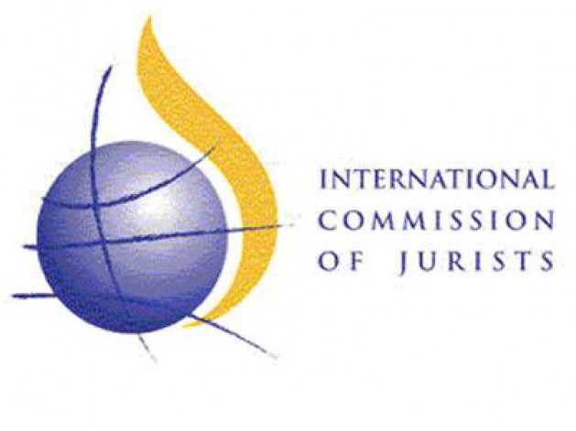

Slide 27
The ICJ has been accused of being a tool of the West in the Cold War,
Spending considerable resources exposing the failures of Soviet bloc.
The ICJ was initially funded by the Central Intelligence Agency.
The ICJ was established following the 1952 ‘International Congress of Jurists’ in West Berlin.

Slide 28
The Congress was organized by the ‘Investigating Committee of Free Jurists (ICJF)’,
a group of German jurists committed to investigating human rights abuses carried out in the Soviet Zone of post-war Germany
One of the founders Dr. Walter Linse was arrested by East German intelligence agents and delivered to the KGB.
Today it is regarded as a bona fide INGOs, concerning with rule of law questions in the South

Slide 29
Last but not least
The London-based Amnesty-International (AI),
The most powerful HR INGOs
Is today synonymous with the HR movement and has inspired the creation of many similar HR groups around the world

Slide 30
It was lunched by Peter Benenson, a British lawyer, writing in the May 1961 issues of the Observer and Le Monde
“Forgotten Prisoners”
The recipient of the 1977 Nobel Peace Prize, AI claim that its object is to contribute to the observance HR
Through campaigns to free prisoners of conscience

Slide 31
To ensure fair trails within reasonable like for political prisoners,
To abolish death penalty
Torture
And other cruel treatment of prisoners

Slide 32
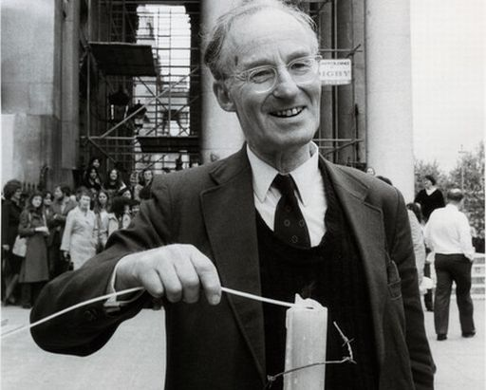

Slide 33
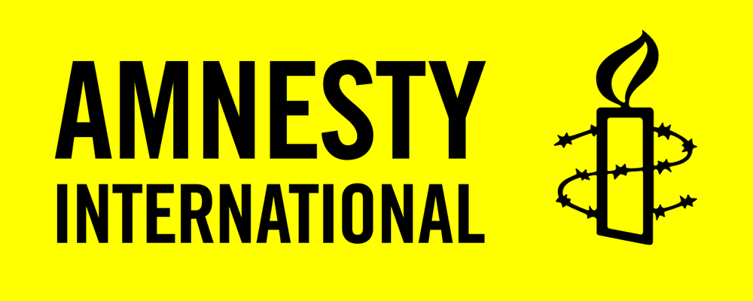

Slide 34
Prisoner of conscience is a term coined by Peter Benenson in a 28 May 1961 article ("The Forgotten Prisoners") for Observer
This term can refer to anyone imprisoned because of their race, sexual orientation, religion, or political views.
It also refers to those who have been imprisoned and/or persecuted for the non-violent expression of their held beliefs

Slide 35
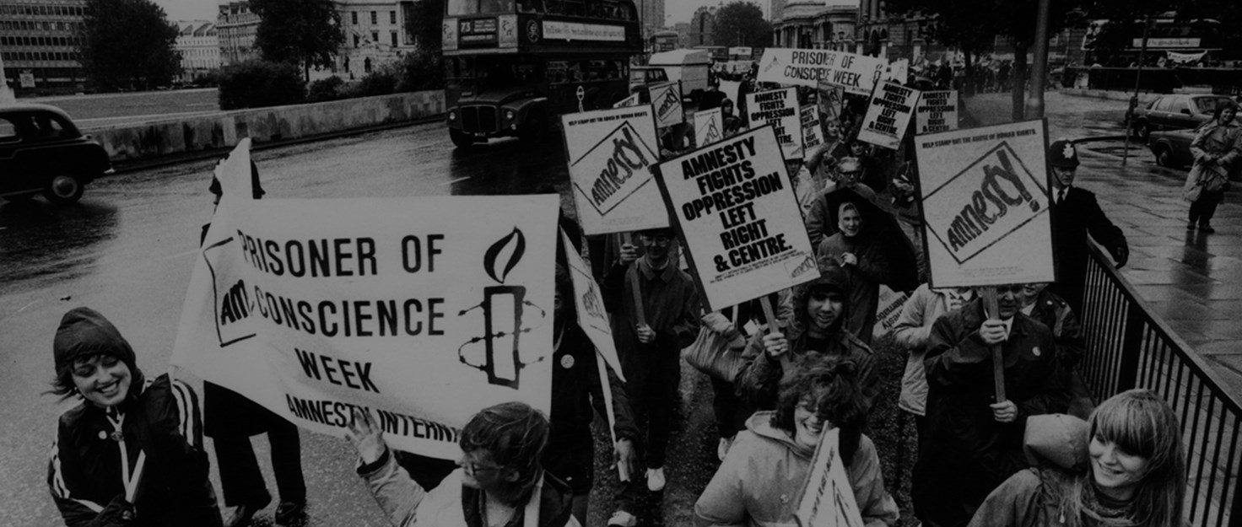

Slide 36
HR INGOs methods
Why HR INGOs may have impact:
they do not make political decisions
INGOs are responsible before the society and their sponsors
INGOs are transmitter of views of the society and minority to the government
Most important features of INGOs dealing with human rights
Credibility
Public trust and confidence
Responsiveness
Independence
Dynamism

Slide 37
Depending on mission and scope of operation HR INGOs use different methods in order to protect human rights.
Traditionally and basic methods
Investigation
Monitoring
Advocacy
Strategic litigation
Education

Slide 38
Investigation usually takes place in a Third World country,
while monitoring (reporting) and advocacy aim at reforming policies of industrial democracies and intergovernmental agencies to trigger bilateral and multilateral action against the repressive state.

Slide 39
Some HR INGOs now go beyond this denunciatory framework
and work to foster and strengthen processes and institutions –
rule of law, and constitutions, judiciaries, legislatures, and electoral machineries – that ensure the protection of civil and political rights.

Slide 40
Although the ideological commitment of these INGOs seems clear through their mandates and work, they nevertheless cast themselves as nonideological
For example, AI refused to condemn apartheid as a political system or to adopt Nelson Mandela, the century’s most prominent prisoner, as a prisoner of conscience

Slide 41
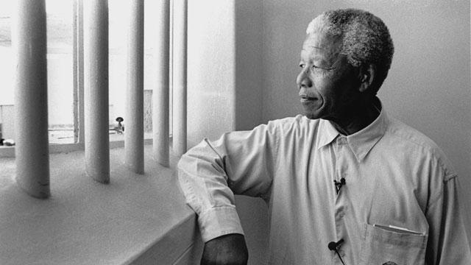

Slide 42
HR INGOs – role of watchdog
controlling the government and other institutions (also private institutions)
Watchdog organizations are non-profit groups that view their role as critically monitoring the activities of governments or other organiztions
and alerting the public when they
detect actions that go against the public interest

Slide 43
Monitoring:
Day to day monitoring (e.g. freedom of speech)
Controlling compliance with certain standards (e.g. controlling prisons in certain area)
Preparation of reports on compliance with human rights on the basis of monitoring
Results:
reports,
interventions,
raising awareness,
accountability
Examples: HRW report on violations of human rights in Russian-Georgian conflict

Slide 44
Purposes of monitoring
to help people (monitoring + intervention)
to have independent data and be a source for media
to compel (enforce) the government to change the law or practice
to show violations to international community (e.g. cluster ammunition in conflict in Georgia)
or prepare reports to international bodies (e.g. EU, UN, Council of Europe)

Slide 45
Barriers to monitoring
Sometimes need of cooperation with government (e.g. controlling prisons)
Serious monitoring requires human resources, time and money
You cannot expect results immediately – it is rather long-term investment
Monitoring in conflict zones may be risky
Sometimes HR INGOs may need a special status at a certain international organization, e.g. consultative status at the Council of Europe

Slide 46
Advocacy means arguing on behalf of a certain issue, idea or person
Changing the attitude of government
Showing the problem
Convincing the society
Advocacy means fighting for something, but without an intent to be elected for public position

Slide 47
Example of advocacy
Cluster Munition Coalition
is an international coalition working and campaigning against the use and production,
Cluster munitions are a type of explosive weapon
Methods:
  Signing letters and petitions
  Building international coalitions
  Informing the public opinion on the problem

Slide 48
  Convincing famous persons to support activities
  Public events and protests
  Organization of conferences and other events
  Engaging people into actions

Slide 49
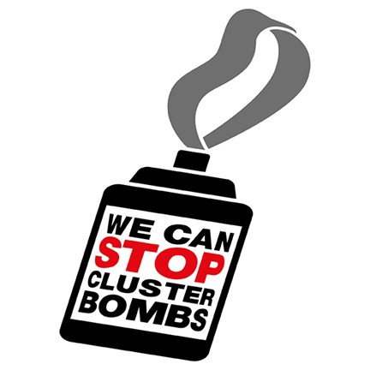

Slide 50


Slide 51
advocacy – typical topics
  Abolishing death penalty
  Release of political prisoners
  Counteracting HIV/AIDS
  Abuse of human rights by corporations
  Anti-terrorism legislation and human rights
  Domestic violence

Slide 52
Strategic litigation (strategic judicial cases) means trying to secure legal judgments that cases have an enormous impact outside the courtroom (e.g. by dismantle an entrenched system that affects many people).
Strategic litigation is a method that can bring significant changes in the law, practice or public awareness via taking carefully-selected cases to court.
The objective of strategic litigation is to make significant changes in law or legal practice through litigation (court/judicial conflict)

Slide 53
Aim of strategic litigation
effect of scale - with one case you may resolve the whole problem
different additional functions (raising awareness, education on rights, involvement of civil society)
it does not replace legislative reforms but may speed them up
elimination of unjust gaps (loopholes) in the legal system
best education for human rights lawyer

Slide 54
Steps in strategic litigation
Selection of a case
Identification of a problem
Representation of victim in court
Informing the public opinion on the character of the case
Monitoring of an enforcement of judgment by the government

Slide 55
Methods
Representation of victims
Standing for HRNGOs as amicus curiae (friend of the court) – someone who is not a who is not a party, but who assists a court by offering information that bears on the case.
Possibility to submit third-paty intervention
Unlawful detention complaints and others complaints
Action for damages
  Unlawful detention complaints

Slide 56
  Famous strategic litigation
  - Brown v. Board of Education of Topeka (segregation in schools)
  -D.H. and others v. Czech Republic (discrimination of Roma children in schools)
  Bączkowski and others v. Poland (ban of assembly organized by minority groups)
  Nachova and others v. Bulgaria (burden of proof in racially motivated killings)

Slide 57
CASE STUDY

Slide 58
Education on human rights is an important element of INGOs’ activities
Education is a priority for many organizations.
In some countries it is the only method to advance human rights
You can educate on: human rights’ standards or skills how to advance human rights (for other INGOs or activists)
Human rights’ education may be subject of manipulation
  e.g. „Compass” handbook,
  situation in CIS countries – so called „horizontal” approach to human rights

Slide 59
Education has only indirect and long-term impact on human rights’ protection
Special educational methods:
  Law clinics (e.g. at universities)
  Education through personal involvement (workshops, actions, individual small projects)
  Monitoring projects with the personal involvement of students (e.g. Court Watch project)

Slide 60
Amnesty International
AI is the largest INGOs in the field of human rights in the world.
It has more than 2 million members
There are 50 nationally organized sections
The International Secretariat in London has more than 300 staff from over 50 countries

Slide 61
Just over four decades ago
two Portuguese students raised a toast to freedom
which resulted in the two students being sentenced to seven years imprisonment.
This occurence horrified British lawyer Peter Benenson.
He wrote to The Observer calling for an international campaign to persuade authorities around the world with protests about the "forgotten prisoners”
That's how Amnesty International came into being

Slide 62
“We are people from across the world standing up for humanity and human rights. Our purpose is to protect people wherever justice, freedom, truth and dignity are denied.
We investigate and expose abuses, educate and mobilize the public, and help transform societies to create a safer, more just world."
AI raises awarness through campaigning, the distribution of publications and through human rights education and promotion.

Slide 63
The principal object of AI is to mobilize public opinion in defence of those men and women who are imprisoned because their ideas are unacceptable to their governments.
From its founding in 1961 until the early 1990s AI focused its work on the HR of prisoners.
AI moved from this prisoner orientation to expand its scope of work, so as to include the prevention and ending of grave abuses of the rights to physical and mental integrity, freedom of expression,

Slide 64
Freedom from discrimination
within the context of its work to promote all HR
Examples of subjects of recent work on economic, social, and cultural rights include:
The right to food (in North Korea and Zimbabwe)
The right to mental health (in Bulgaria and Romania)
The right to health (in Rwanda, Argentina, and Congo)

Slide 65
Housing rights (in Angola, Israel, the Occupied Territories)
Well-known AI techniques:
Raporting
Letter-writing campaigns
Trial observation
Research missions
Draft reports are checked and double-checked before being released

Slide 66
For many years, the Soviet Union accused AI of being CIA-supported,
Whereas military dictatorships in Latin America called it a Communist umbrella organization
AI does not accept any government financial or other support for its HR activities

Slide 67
Final policy decisions are made by the International Council
Formal authority is International Executive Committee whereas the International Secretariat,
Headed by a secretary-general, is responsible for the organization day-to-day activities.

Slide 69
Interights
The International Centre for the Legal Protection of HR
Is a nongovernmental international HR organization
Registered as a charity in England and Wales, and based in London.
Interrights owes its foundation in 1982 to the coming together of a group of academics, lawyers, and human rights activists

Slide 70
who diagnosed a gap in human rights litigation in the absence of any nongovernmental body pursuing international cases
Interights is governed by a board of directors who have expertise in either regional or thematic focus areas or in management, finance, and communications.

Slide 71
Moreover the International Advisory Council, whose members are all leading experts in the field of international human rights law,
assists the board and staff in setting the overall legal direction of Interights.
Since Interights founding, its activities and programs have changed to rise to new challenges such as the war on terror
Interights work is sometimes in politically sensetive areas, it sees itself as apolitical

Slide 72
Interights activies are carried out under regional programs for Africa, Europe, the Middle East, and South Asia
Coordinated with thematic programs highlighting particular key rights, including economic and social rights (rights to education and health),
Equality, and security and the rule of law.

Slide 73
Interights offers legal assistance and representation on strategic human rights litigation.
Strategic human rights litigation has gradually become Interights main focus.
Interrights acts in 70-80 % of its cases as advisers, with the remainder involving the submission of amicus curiae

Slide 75
HRW
Created in 1978 as Helsinki Watch, HRW became arguably the world most influential HR INGOs
HRW is dedicated to protecting the HR of people around the world
They stand with victims and activists to ring to justice, to prevent discrimination, to uphold political freedom and to protect people from inhumane conduct in wartime

Slide 76
They investigate and expose HR violations and hold accountable.
Monitoring how governments meet their constitutional and international requirements lies at the heart of such activism.
In 2007 HRW spent $27 million on program service and $ 8 million on support service

Slide 77
https://careers.hrw.org/?_ga=1.231972567.997742288.1491771683
https://www.youtube.com/watch?v=XmdZBdrFNrE
https://www.youtube.com/watch?v=ghUSEHe7Wug

Slide 79
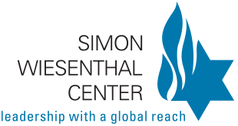

Slide 80
The Simon Wiesenthal Center
The Simon Wiesenthal Center is HR INGOs researching the Holocaust and hate in a historic and contemporary context.
At the end of World War II, thousands of Nazis who participated in the systematic murder of some 6,000,000 Jews and millions of Gypsies, Poles and other peoples, escaped to countries around the globe, where many still live in freedom

Slide 81
Simon Wiesenthal, a survivor of the Nazi death camps, dedicated his life to documenting the crimes of the Holocaust and to hunting down the perpetrators still at large.
As founder and head of the Jewish Documentation Center in Vienna, the freelance Nazi hunter,
usually with the cooperation of the Israeli, Austrian, former West German and other governments, ferreted out nearly 1,100 Nazi war criminals,

Slide 82
including Adolf Eichmann, the administrator of the slaughter of the Jews;
Franz Murer, "The Butcher of Wilno,"
and Erich Rajakowitsch, in charge of the "death transports" in Holland.

Slide 83
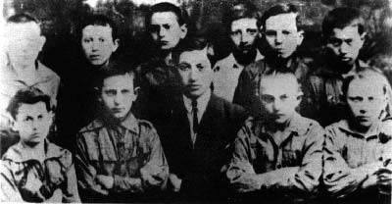
Simon Wiesenthal pictured in 1923 with a group of Boy Scouts of which he was the leader in Buczacz, Poland. Only one of these boys survived the Holocaust

Slide 84
