Slide 1
INGOs
dr Łukasz Prus

Slide 2
dr Łukasz Prus
Section of Comparative Public Administration
Faculty of Law, Administration and Economics at the University of Wrocław
lukasz.prus@uwr.edu.pl

Slide 3
Non-Governmental Organizations (NGOs),
Non-profit Organizations (NPOs),
Non-profit sector,
third sector,
voluntary sector,
civil society organizations,
charitable sector,
and social economy
International Non-Governmental Organizations (INGOs)

Slide 4
Definition of INGOs
NGOs was used in the public administration literature
while the term NPOs was used in the political science and international relations literature
NGOs, NPOs, and the third sector synonymously as a kind of simplification in their research of collaboration between business and NGOs in Poland

Slide 5
The term NGO used to define the organizations that neither
related to government
nor traditional for-profit organizations
that support the projects of public interests
and improving the quality of people’s lives

Slide 6
However, the contradictions in defining INGOs are an element of their increasingly importance,
and put them under attacks regarding the accountability

Slide 7
INGOs are specific type of NGOs that engaged in cross-border social, humanitarian relief and development interventions
such as:
CARE - Cooperative for Assistance and Relief Everywhere

Slide 8
ACTED - Agency for Technical Cooperation and Development
Oxfam - Oxford Committee for Famine Relief
World Vision,
Danish Refugee Counsel (DRC)
Norwegian Refugee Council
Mercy Corps,
and Caritas

Slide 9
Humanitarian action
Three Historical Periods
1) The XIX century until World War I
2) the early XX century through to end the Cold War
3) the last quarter-century

Slide 10
The International Committee of Red Cross and the Protection of War Victims
The inauguration of war-related international humanitarian was in the 1863 with the establishment of the ICRC and the emergence of international humanitarian law.

Slide 11
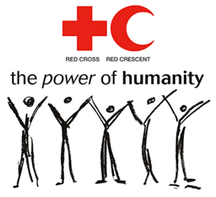

Slide 12
During the battle of Solferino
the Swiss businessman Henry Dunant witnessed wounded soldiers callously abandoned on the battlefield to die,

Slide 13
Which prompted him to propose the creation of relief societies with trained volunteers to assist injured combatants in times of war.
Within a few years the grassroots campaign produced the ICRC
Dunnat was awarded the first Nobel Prize in 1901

Slide 14
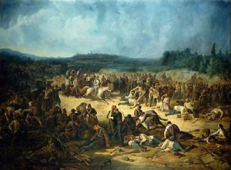

Slide 15
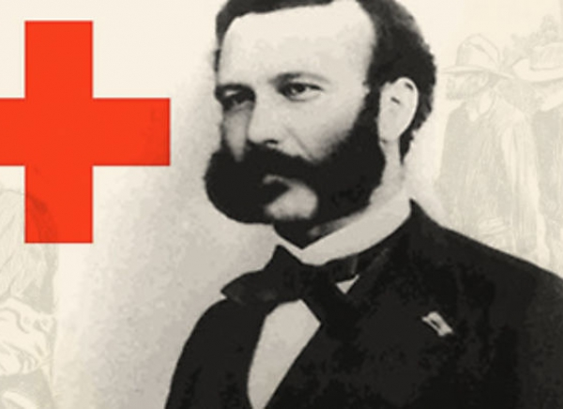

Slide 16
ICRC
International Committee of the Red Cross/ International Red Cross and Red Crescent Movement

Slide 17


Slide 18
The ICRC occupies an unusual position and thus is treated as a separate type of organization –
- in a category by itself

Slide 19
Founded in 1863, it is the oldest international humanitarian organization
It is also the largest organization outside of the UN system
A private organization with a board of governors of prominent Swiss citizens,
The ICRC is like NGOs in that receives both private and public contributions,
but governments typically provide 90 % of its annual budget, which in 2012 was about $1.2 billion

Slide 20
It considers itself neither an IGO nor an INGOs because it is the custodian the Geneva Conventions and has a specific recognition in international humanitarian law, for which is the custodian

Slide 22
After The XIX century:
Humanitarianism next great leaps forward – ironically but predictably – resulted from the two World Wars
In terms of institution-building many familiar NGOs and IGOs emerged in reaction to the forces of destruction unleashed by those cataclysms.

Slide 23
In response to the refugees caused by the Russian Revolution (1917),
The League of Nations established the Highs Commissioner for Russian Refugees
NGOs were running ahead of states in relief, and two sisters,
Eglantyne Jebb and Dorothy Buxton founded Save the Children to handle Russian crisis

Slide 24
Later the Nazi regime led the famous refugee Albert Einstein to found the International Rescue Committee
However, after WW II a new generation of agencies arose to assist victims;
they subsequently developed a global reach, and many still exist

Slide 25
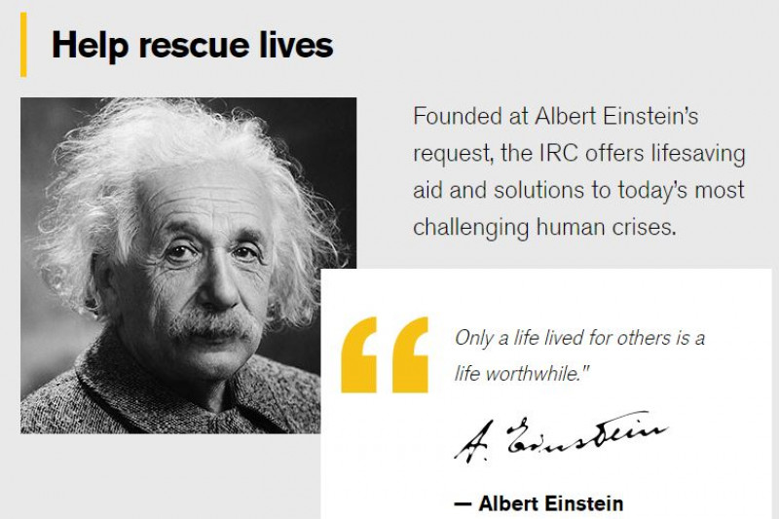

Slide 26
It was the spectre of rampant inhumanity throughout WW II,
not the triumph of humanitarian ideas, that led to hope from a different future.

Slide 27
The Holocaust,
massive displacements,
fire bombings, and
ultimately the use of nuclear weapons
led diplomats and activists to call for protecting civilians.

Slide 28
Growth intergovernmental and nongovernmental machinery continued.
The United Nations Children Fund (UNICEF)
was created in 1946 to provide aid to European children affected by World War II.

Slide 29
In 1953 it became a permanent part of the UN, and the UN General Assembly extended UNICEF’s mandate indefinitely
UNICEF has formal agreements with hundreds of NGOs

Slide 30
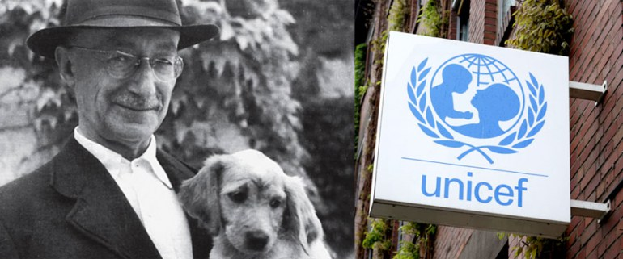
UNICEF was created on the initiative of dr. Ludwik Rajchman

Slide 31
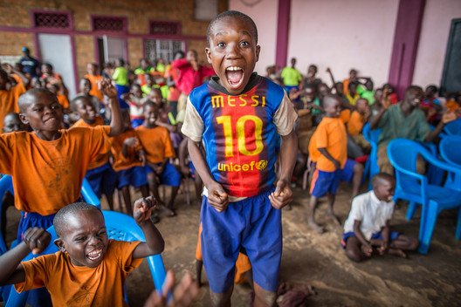

Slide 32
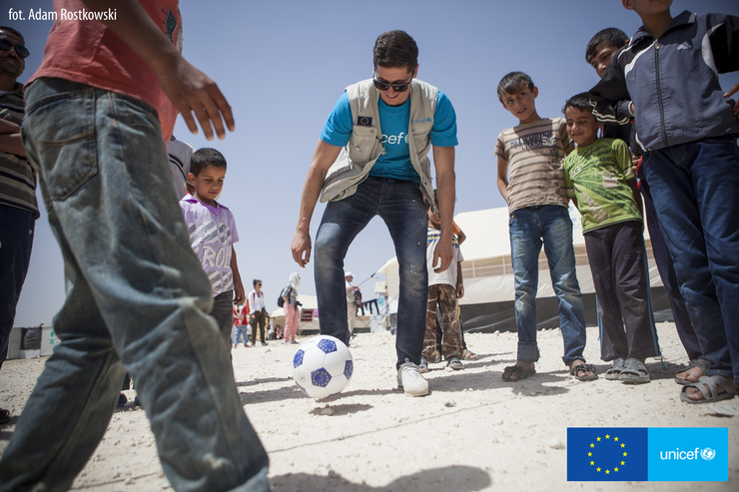

Slide 33
In 1942 a group of Quakers founded the Oxford Committee of Famine Relief (later shortened to OXFAM)
To respond to the appalling famine in Greece during which perhaps half of the children died.
Shortly after the end of WW II, Lutherans World Relief, Church World Service, and Caritas came into being – founded by Lutherans, the US National Council of Churches, and the Vatican, respectively.

Slide 34
The new upheavals that followed in the 1970s and 1980s led in the West to the creation of voluntary organizations by people influenced by the events of the year 1968 –
especially student revolts in several countries and the political and cultural ideas they expressed.

Slide 35
Political shift with the thawing and ultimate end of the Cold War opened the last chapter in the history of the international humanitarian system
One of its keys distinguishing characteristics is the dramatic expansion of “suppliers” in terms of numbers and diversity of organizations

Slide 36
The 2012 global bottom line that approaches $ 18 billion would strike most Masters in Business Administration as a substantial business, especially in light of growth:
a fivefold increase in humanitarian aid (from $800 million in 1989 to some 4.4 billion in 1999)

Slide 37
Moreover, since the terrorist attacks of the 9/11, many countries, especially the US through its counterinsurgency doctrine,
have viewed counterterrorism and humanitarianism as crime-fighting partners, regarding failed states as sanctuaries and staging platforms for terrorists

Slide 38
Humanitarian organizations can become part of winder “hearts and minds” campaigns,
attempting to convince local populations of the righteousness of armies invading in the name of freedom.

Slide 39
WHO Comes to the Rescue?
Among those that exert influence on the ground from outside a war zone are:
INGOs
The ICRC – Red Cross
The UN system
Bilateral aid agencies
External military forces
For-profit firms
And the media

Slide 40
INGOs are often envisioned as the quintessential humanitarian actor and are a crucial source of support for those suffering from wars.
They include such familiar associations as:
CARE Cooperative for Assistance and Relief Everywhere, formerly Cooperative for American Remittances to Europe
Oxfam
Save Children
Doctors of the World
Doctors Without Borders
World Vision
Catholic Relief Services

Slide 41
The delivery of emergency relief is dominated by about fifteen to twenty major INGOs or federations of national NGOs that have annual budgets of at least
$100 million and as large as $ 1 billion and
work in at least eight to ten countries.
Extreme variety, in the size of their operations and their approach to issues, makes generalizations about INGOs problematic
Why?
E.g.
Across-the-boarded characterizations are difficult between giants like CARE and much smaller operations

Slide 42
Nonetheless, it is fair to say that the hallmark of INGOs their link to grassroots and their action orientation.
Many are involved not just in the delivery of succor but also advocacy, legal protection efforts, and attempts at local conflict management.

Slide 43
They are reputed to be more no bureaucratic, flexible,
and creative than their governmental or intergovernmental organizations,
and they certainly are less constrained by legal formalities and diplomatic niceties.

Slide 44
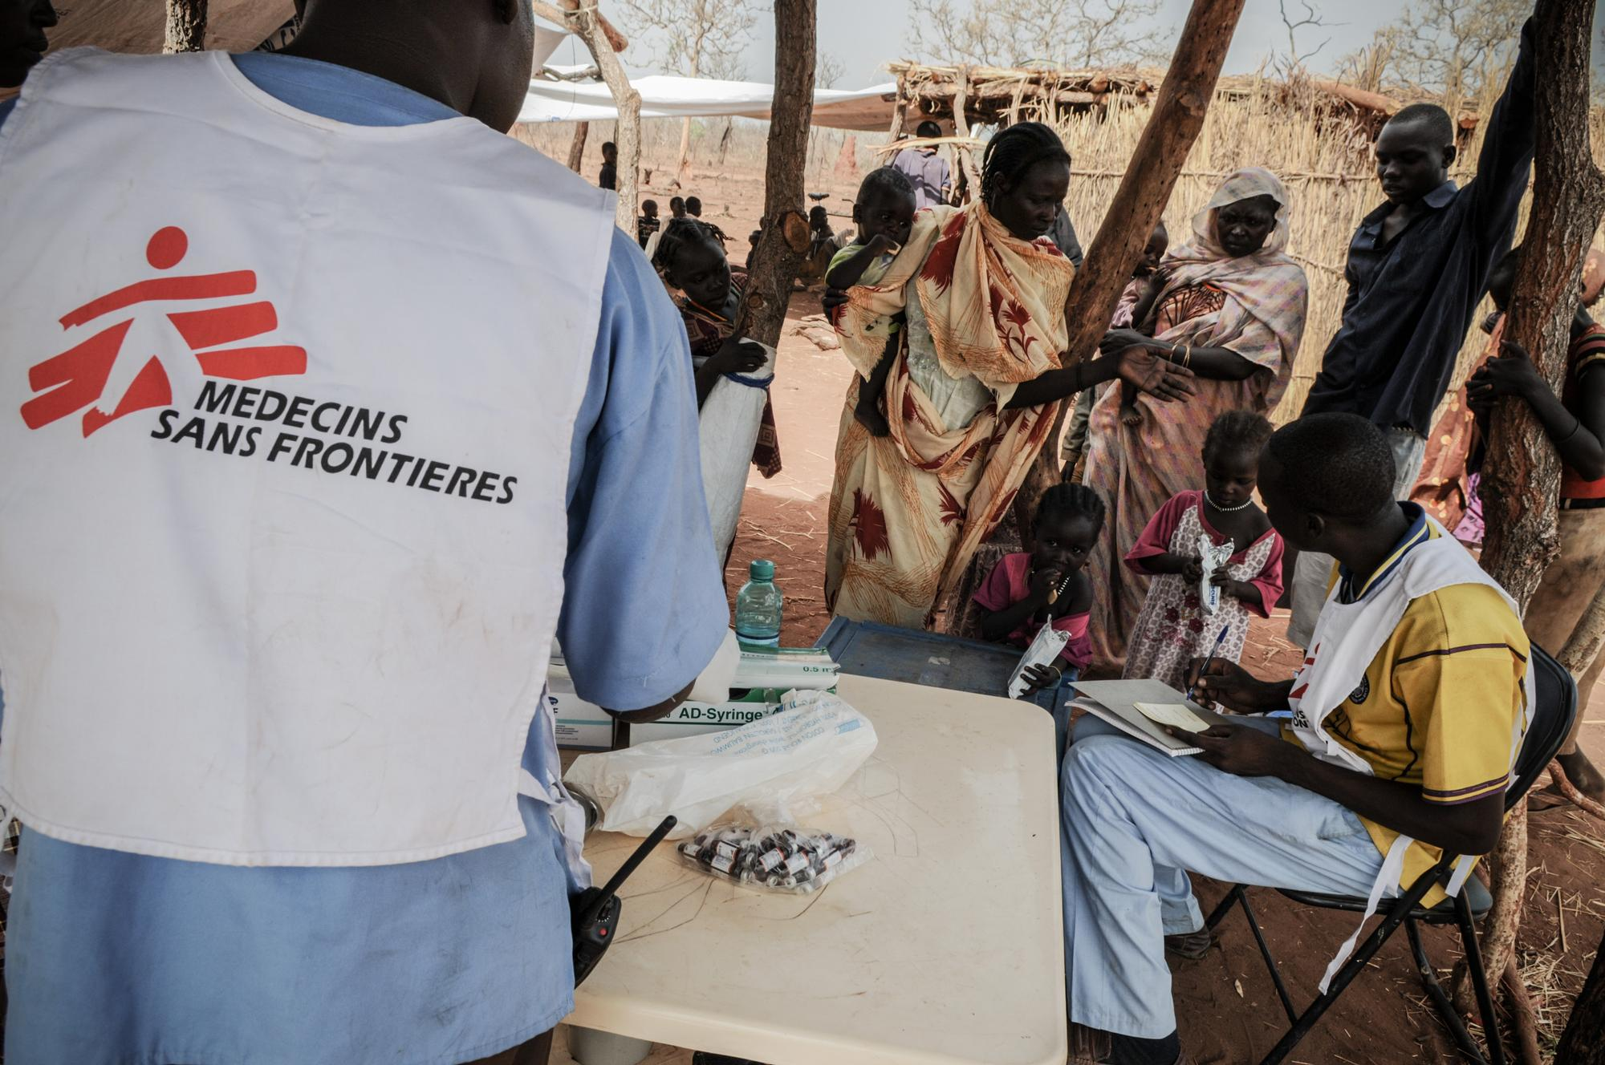

Slide 45
Medecins Sans Frontieres
Doctors Without Borders was founded in 1971 in France by a group of doctors and journalists in the wake of war and famine in Biafra.
The Nigerian Civil War (6 July 1967 – 15 January 1970).
Small group of French doctors have just returned from working in Biafra and were determined to find a way to respond rapidly and effectively to public health emergencies, without any political, economic and religious influences.

Slide 46
Medecins Sans Frontieres
In southern Nigeria, the province of Biafra had seceded.
This minuscule territory was surrounded by the Nigerian army and the Biafran people were decimated by famine.
The French Red Cross issued an appeal for volunteers

Slide 47
A team of six set off on the ICRC mission to Biafra:
two doctors—Max Recamier and Bernard Kouchner
as well as two clinicians
and two nurses.
Being thrown into such a bloody conflict was a real shock for these fledgling doctors, who found themselves having to provide war surgery in hospitals that were regularly targeted by the Nigerian armed forces

Slide 48
French doctor Bernard Kouchner also witnessed events, particularly the huge number of starving children.
He criticised the Red Cross for their seemingly complicit behaviour.
Doctors, led by Kouchner, concluded that a new aid organisation was needed that would ignore political/religious boundaries and prioritise the welfare of victims

Slide 49
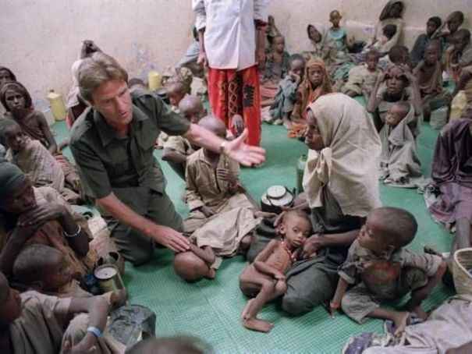

Slide 50
Their aim was to establish an independent organisation that focuses on delivering emergency medicine aid quickly and effectively
DWB was created in the belief that all people should have access to healthcare regardless of gender, race, religion, creed or political affiliation, and that people’s medical needs outweigh respect for national boundaries

Slide 51
What they Provide?
1) Massive vaccination campaigns - epidemics often develop in acute emergency situations,
where a large number of weakened people live in close proximity to each other and in poor sanitary conditions,
massive vaccination campaigns are launched to help prevent the spread of diseases like Yellow fever or cholera

Slide 52
What they Provide?
2) Training and supervision of medical personnel –
Sometimes, well-trained doctors and nurses flee (escape) the crisis area and those left behind lack adequate training or experience.
In these cases, DWB provides additional training and supervision on subjects ranging from primary health care to drug prescription, diagnosis, and psycho-social care

Slide 53
What they Provide?
3) Water and sanitation improvement - DWB employs specialists construct sanitary facilities using water sources
4) Data collection - To keep track of the health of people living in a crisis area, it is important to register medical data
These data are generally registered, in order to help determine certain medical facts

Slide 54
What they Provide?
5) Feeding – DWB regularly monitors the food situation in the areas where it works.
Seriously malnourished children must be administered food under medical supervision.
For this purpose, DWB sets up therapeutic feeding centers (TFCs), where children can stay with their mothers and still get the nutrients that they need.

Slide 55
What they Provide?
6) Distribution of drugs and medical supplies - The supply of drugs and medical materials can be cut off by fighting, dangerous conditions, road destruction, lack of transport vehicles or lack of funds.
7) Mental health care - The death of loved ones, terror, witnessing massacres, and suffering from hunger, thirst, and cold are but a few of the traumatic events that give rise to serious mental and physical difficulties.

Slide 56
What they Provide?
6) Distribution of drugs and medical supplies - The supply of drugs and medical materials can be cut off by fighting, dangerous conditions, road destruction, lack of transport vehicles or lack of funds.
7) Mental health care - The death of loved ones, terror, witnessing massacres, and suffering from hunger, thirst, and cold are but a few of the traumatic events that give rise to serious mental and physical difficulties.

Slide 57
What they Provide?
trauma victims can suffer protracted insomnia, aggression, headaches, listlessness, and other physiological and psychosocial symptoms.
DWB started its first mental health program in 1991 and psychosocial care has become a component of many MSF emergency and long-term projects.

Slide 58
What they Provide?
8) Rehabilitation of hospitals and clinics - Hospitals and clinics are often devastated through destruction, wear and tear, or looting. Where necessary, MSF assumes the task of rehabilitating these buildings.
9) HIV / AIDS care and prevention - DWB has launched pilot HIV / AIDS treatment programs in several countries to care for HIV positive patients with anti-retrovirals and to prevent mother-to-child transmission of HIV.

Slide 59
DWB Charter
All of its members agree to honour the following principles:
DWB provides assistance to populations in distress, to victims of natural or man-made disasters and to victims of armed conflict.
They do so irrespective of race, religion, creed or political convictions.
DWB observes neutrality in the name of universal medical ethics and the right to humanitarian assistance and claims full and unhindered freedom in the exercise of its functions

Slide 60
As volunteers, members understand the risks and dangers of the missions they carry out and make no claim for themselves or their assigns for any form of compensation other than that which the association might be able to afford them
DWB decision to offer assistance in any country or crisis is based on an independent assessment of people’s needs
The principles of impartiality and neutrality are not synonymous with silence.
When DWB witnesses extreme acts of violence against individuals or groups, the organisation may speak out publicly

Slide 61
Total incoming resources of 1.44 billion euros for 2015 were 163 million euros more than in 2014.
Donors include EU
Sweden
Belgium
Germany
Denmark,
France
Switzerland
Norway
Canada

Slide 62
In 2015, 7,800 health professionals, logistics specialists and administrative staff of all nationalities left on field assignments to join over 31,000 locally hired staff working in medical programmes in 69 countries.
Medical staff
Office staff

Slide 63
DWB hire:
Medical doctors
Nurses
psychologists,
Psychiatrists
HR coordinators
Administrators
Applicants need to be able to speak either English or French.

Slide 64
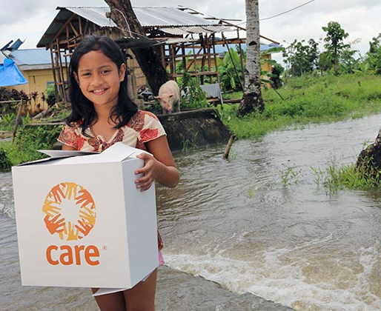

Slide 65
Cooperative Assistance and Relief Everyewhere (CARE)
Fighting poverty. Defending dignity.
CARE is one of the world’s largest humanitarian organizations fighting global poverty.
CARE work in 95 countries
CARE was founded in the United States in 1945 to send ‘CARE packages’ –
packages of food and basic supplies – to millions of people in Europe in danger of starvation following World War Two.

Slide 66
From help in Europe to Relief Everywhere
Originally CARE stood for Cooperative for American Remittances to Europe,
but in 1993 this was changed to Cooperative for Assistance and Relief Everywhere
Over the years, their work has expanded as they have taken on some of the worlds biggest problems
With Europe on the road to recovery, CARE found itself increasingly involved in Asia – first in Japan and then in the Philippines, Korea, India and Pakistan.
By the early 1950s, operations had been established in a number of Latin American countries, followed by Africa in the early 1960s.

Slide 67
Today, CARE focusing on global issues like HIV and AIDS, women’s empowerment, adaptation to climate change, development and relief.
Some of the projects CARE
Humanitarian Crisis:
CARE's response to the humanitarian crisis in Gaza began within hours of the first bombings on Dec. 27, 2008.
They are providing emergency humanitarian aid, lifesaving medical supplies, food, blankets, heaters and shelter materials to hospitals, families and feeding centers.

Slide 68
African Hunger- Food shortages are affecting millions of people in 25 countries. According to UNICEF, 1 million children and pregnant women in South America are malnoursihed
Tsunami Relief- CARE helped restore access to clean water. CARE is ensuring that disaster-stricken communities can look forward to a healthier future.

Slide 69



Slide 70
The CARE organization offices are located in Quebec.
CARE around the world:
- Latin America and Carribean
- West Africa
- Middle East and Europe
- Asia
- East and Central Africa
- Southern Africa

