Slide 1
International Non-Governmental Sport Organizations
dr Łukasz Prus

Slide 2
On the one hand,
in era of growing politization and governance of sport is interesting to note that
transnational governing bodies/organizations of sport e.g. FIFA are not accountable to any government.
On the other hand, relation between theory of organization and sport is a great picture, which illustrates organizational phenomenon.

Slide 3
Various terms:
Global Sports Organisations (GSO)
Sport Governing Bodies (SGB)
International Federations (IF)
International Sport Organisations (ISO)
International Non‐Governmental Sport Organisations (INGSOs)

Slide 4
GSO are INGOs that govern sport and sport events.
INGSOs are the legitimate bodies to promote and develop their sport.
INGSOs can be defined as “private authorities”,
in the sense that they are private institutions
that exercise what is perceived as “legitimate authority” at a global level in sport sector.

Slide 5
INGSOs is the main regulatory bodies of the sports world
but at the European level, the ‘Bosman ruling’ forced EU involvement in sport sector.
Governing networks in sport are based on a model created
in the last few decades of the 19th century by the Football Association (FA),
the governing body of the game in England to this day.

Slide 6
This implies that INGOs are the supreme governing bodies (authorities) of sport
since they stand on the top of a vertical chain of commands (chain of power),
running from continental,
to national,
to local organisations.

Slide 7
INGSOs have traditionally known
a large autonomy and in that sense,
they were subject to almost complete self-governance.
Public authorities at national level have had very little impact on their functioning.

Slide 8
The sporting network was even able to exercise its self- governance without any significant interference from states or other actors and,
cherishing its political autonomy,
the sports world generally avoid state intervention in its activities.

Slide 9
Our government had to give up twice time in conflict with FIFA (2006 and 2008).
The FIFA threatened that if the government wanted to reform the national federation,
it would exclude us from international games.

Slide 10
Headquarters?
This is mostly Switzerland,
where they are settled into a legal system
that gives them enormous protection against internal and external examination.

Slide 11
Political autonomy
Legal autonomy
Financial autonomy
Supervised autonomy

Slide 12
Political autonomy
Separation of sport and public authority.
The International Olympic Committee (IOC), was founded in 1894 by Pierre de Coubertin.
Since its creation, the IOC has been the supreme authority on all questions regarding the Olympic Movement,
a complex system created to regulate the Olympic Games.

Slide 13
de Coubertin strongly believed that politicians could only violate sports integrity stating that:
“the beam formed by the goodwill of all members of an autonomous sport,
relaxes when the giant figure of this dangerous and imprecise figure called State appears”
(de Coubertin, 1909)

Slide 14
Thhe word “autonomy” appears for the first time in the Olympic Charter only in 1949:
in order to be recognised by the IOC, the National Olympic Committees (NOCs) must be free from any interference from national authorities

Slide 15
Both FIFA and the IOC have been very influential on the creation of other INGSOs and hence,
the sports world generally prevent (eschews) state intervention in its activities.

Slide 16
Legal autonomy
Autonomy to adopt rules and norms that
have a legal impact in a legal framework imposed by the State,
be it at national or at international level.

Slide 17
Most of INGSOs are located in Switzerland
As non-profit associations.
Except the World Anti-Doping Agency which is incorporated as a foundation.

Slide 18
Non-profit associations fall under the provision of the Swiss Civil Code (articles 60) which provides minimum requirements for an association to be created, such as
writing and adopting statutes,
having an ideal objective and
resources.

Slide 19
The Council of Europe already recognised this conceptualisation of autonomy
in the early 1990s through the European Sports Charter (1992).
The Charter stipulates that “voluntary sports organisations have the right
to establish autonomous decision-making processes within the law” (Council of Europe, 1992).

Slide 20
Legal autonomy of INGSO in EU.
In some cases, the legal autonomy of sport has been challenged
by the decisions of the Court of Justice of the EU (CJEU).

Slide 21
Case study
CJEU
Free movement of workers within the EU not only applies to the action of public authorities
but extends also to rules of any other nature aimed at regulating gainful employment in a collective manner.

Slide 22
Free movement of workers within the EU applies to rules laid down by sporting associations such as URBSFA, FIFA or UEFA, which determine the terms on which professional sportsmen can engage in gainful employment
It is clear that Mr Bosman had entered into a contract of employment with a club in another Member State with a view to exercising gainful employment in that State.

Slide 23
Since the situation in issue in the main proceedings cannot be classified as purely internal.
About existence or not of an obstacle to freedom of movement for workers.

Slide 24
Provisions which preclude or deter
a national/citizen of a Member State from leaving his country of origin
in order to exercise his right to freedom of movement therefore
constitute an obstacle/barrieres to that freedom even if they apply without regard to the nationality of the workers concerned.

Slide 25
Cross-border transfer rules adopted by Union of European Football Associations (UEFA) and Belgian Football Federation
provide that a professional footballer may not pursue his activity with
a new club established in another Member State
unless it has paid his former club a transfer fee agreed upon between the two clubs or determined in
accordance with the regulations of the sporting associations, constitute an barrieres to freedom of movement for workers.

Slide 26
Decisions violated EU’s internal market principles.
Some decisions of these organizations violates internal EU market principles,
specially the freedom of movement of workers in the EU.
The CJEU has dealt with the freedom of movement and sport in numerous cases, most notably in the ‘Bosman case’.

Slide 27
TOP 10 Bosmans:
Steve McManaman - Liverpool to Real Madrid, 1999
Edwin van der Sar - Ajax to Juventus 1999
Sol Campbell - Spurs to Arsenal, 2001
Cafu - Roma to AC Milan 2003
Michael Ballack - Bayern Munich to Chelsea, 2006
Andrea Pirlo - AC Milan to Juventus, 2011
Robert Lewandowski - Borussia Dortmund to Bayern Munich, 2014
Zlatan… ☺ PSG to Mentchester United, 2016

Slide 28
Financial autonomy
In the past, sport relied heavily on public financial suport.
However, with the commercialization of sport came the growing independence of sports organisations.

Slide 29
A key factor in that regard has been the breakthrough of sports broadcasting (rights to tv transmission).
Example
The 2010 FIFA World Cup made EUR 1,802 million through the sale of television rights, and EUR 802 million via marketing rights. Overall, South Africa 2010 accounted for 87 per cent of FIFA’s total revenue during the 2007-2010 period

Slide 30
Functional autonomy
Autonomy can also be explained in a functionalist perspective.
Sports organisations adopt technical sports provisions,
the sport provisions sensu stricto,
which regulates rule of game.

Slide 31
FIFA govern rules (provisions) for football on global basis.
The most obvious example of such a rule is perhaps the offside rule in football.

Slide 32
The functional autonomy of sports organisations has been strengthened in recent years
by the development of a system of sports arbitration
which has contributed to the emergence of a body of global sports law/lex sportiva.

Slide 33
The sports world has devised its own legal system
which enables it to settle disputes within
its own network and according to its own laws instead of in national or European courts.

Slide 34
The importance of sports arbitration has increased significantly after the establishment of the Court of Arbitration for Sport (CAS),
an arbitral institution created by the IOC in 1983 which is competent to resolve all types of disputes of a private nature relating to sport.

Slide 35
Another illustration of the tension between lex sportiva and ordinary state law is the potential issue of “double sanctions”
a sports sanction and a public sanction.

Slide 36
Offender may be sanctioned by two different legal systems according to the context.
Suspicious behaviour on the field or, as it was the case for the two Badminton players at the London Olympic Games,
“not using one's best efforts to win a match”
can be interpreted as a lack of fair-play,
but it can also potentially be sanctioned by a breach of sports rules (i.e, the disqualification of two players for “throwing matches”).
Accordingly, manipulation of the outcome of a game may also be brought before ordinary courts

Slide 37
Supervised autonomy
Limited legal competences regarding sports and
because of the recognised autonomous status of sports governing bodies at the European level ,
the EU does not have the power to intervene strongly in the sector.

Slide 38
However after the ‘Bosman ruling’, the sports world realised that EU law could have far-
-reaching consequences for their activities and embarked on a campaign directed towards the EU.

Slide 39
Networks
Administration (management) takes place in a network run by
regional or global organizations,
which are an umbrella for national federations.

Slide 40
The national associations are members of the Fédération Internationale de Football Association ("FIFA"),
an association governed by Swiss law,
which organizes football at world level.
FIFA is divided into confederations for each continent, whose regulations require its approval.

Slide 41
Under FIFA are five continental organisations:
AFC (Asian Football Confederation), CAF (Confédération Africaine de Football), CONCACAF (Confederation of North, Central American and Caribbean Association Football), CONMEBOL (Confederación Sudamericana de Fútbol), OFC (Oceania Football Confederation) and UEFA (Union of European Football Associations of Union Européenne de Football Association

Slide 42
The confederation for Europe is UEFA, also an association governed by Swiss law.
Its members are the national associations of some 50 countries, including in particular those of the Member States which, under the UEFA.
Each football match organized under the auspices of a national association must be played between two clubs which are members of that association or of secondary or subsidiary associations affiliated to it.

Slide 43
The team fielded by each club consists of players who are registered by the national association to play for that club.
Every professional player must be registered as such with his national association and is entered as the present or former employee of a specific club.

Slide 44
All the organisations in the network are in their own geographical/ functional sphere of competence responsible for the regulation of football but they have to “report”
to the organisations that stand above them in the network.
Hierarchic structure of those networks.
Such networks are called pyramid networks
because their hierarchic organisational structure visually resembles the shape of a pyramid.

Slide 45
However, when we regard INGSOs as the main regulatory bodies of the sports world, their erosion – or rather delegation – of power mirrors the recent evolutions in societal governance quite perfectly.
With regard to stakeholders, in recent years, we witnessed an increasing influence of athletes in the development of policies in INSGOs.
NBA lockout –
The role of players and clubs to grow

Slide 46
Deos INGSOs financially, politically, legally, functionally autonomous enough to implement ‘good’ governance?
Professional sports lack transparency
Ethical scandals in the sports world shows that it is no longer possible for sport organisations to be run as a “closed book”.
Consequently, transparency is regarded as one of the top level topics concerning good governance in INGSOs
https://www.youtube.com/watch?v=p_CKYdhAuUk

Slide 47
https://www.youtube.com/watch?v=tkop8bgMs9M
Accountability
Why?
A lack of accountability arrangements constitutes a breeding ground for
  Corruption
  Concentration of power
  Lack of democracy and effectiveness

Slide 48
Usually explained in 3 ways:
A democratic means to monitor and control government conduct
(2) To prevent the concentration of power (checks and balances)
(3) It induces the executive branch to learn
  executive body of SGB should be accountable to the Member federations!
  Member federations have an important watchdog function

Slide 50
Classifying International sport governing bodies:
1) Single sport (solo and team)
    a) global – FIFA
    B) national/regional – UEFA
2)Multisport
    A) global – International Olympic Committee
    B) national/regional – national Olympic Commitiees
Notes:
1 For many sports, there is one recognized IGBs for the sporrt. THIS one body is responsible for for the development and control of that sport including its rules of game. FIFA govern the rules for football on global basis.
2 Second type are event-oriented organizations which organisations which organize multisports games.

Slide 51
Classifying International sport governing bodies:
3) Third type are function-orientated specialists bodies
These INGSOs (GSOs) are concerned with:
technical issues of sport,
law
arbitration,
doping,
technological developments increasingly affecting sport.

Slide 52
For example,
the World Anti-Doping Agency (WADA)
Established in 1999 as an international independent agency funded equally by the sports movements and governments
WADA key activities include scientific research, education, development of anti-doping capacities

Slide 53
Typology of
Global Sport Organisations (GSO)
Team Sports Bodies
Solo Sports Governing Bodies
Sport Event Governing Body/ Multisport governing bodies
Specialist Bodies
FIS
IOC
WADA
FIFA
IHF
IAAF
FIMS
...
...
ICAS
...
Forster & Pope (2004)

Slide 54
Typology of
International Non-Governmental Sport Organizations (INGSOs)
Sport Governing Bodies
Sport Event Governing Bodies
Special Task Bodies
Representative Bodies
Team Sports
Bodies
Solo Sports
Bodies
Bodies of Olympic /Paralympic Events
Bodies of Non-Olympic Events
Governing Relevance
Informational Relevance
Sport Bodies
Stakeholder Bodies
FIFA
FIS
IOC
IWGA
WADA*
FIMS
ASOIF
Supporters Direct
IHF
IAAF
FISU
IPC
CGF
ICAS
ICSSPE
FIFPro
...
...
...
...
Global Level
...
UEFA
EAA
OCA
EUPEA
EOC
FARE
EHF
UEG
ANOCA
...
EPFL
...
...
...
Continental / Regional Level
...
PGA
Other
Notes:
* = Hybrid Organisation; IHF = Int. Handball Federation; EAA = European Athletics Association; UEG = European Union of Gymnastics; IWGA = Int. World Games Association; FISU = Int. University Sports Federation; OCA = Olympic Council of Asia; ANOCA = Association of National Olympic Committees of Africa; CGF = Commonwealth Games Federation; ICAS = International Council of Arbitration for Sport; FIMS = Int. Federation of Sports Medicine; ICSSPE = Int. Council of Sports Science and Physical Education; EUPEA = European Physical Education Association; ASOIF = Association of Summer Olympic Associations; S 20 = Sponsors Voice Germany

Slide 55
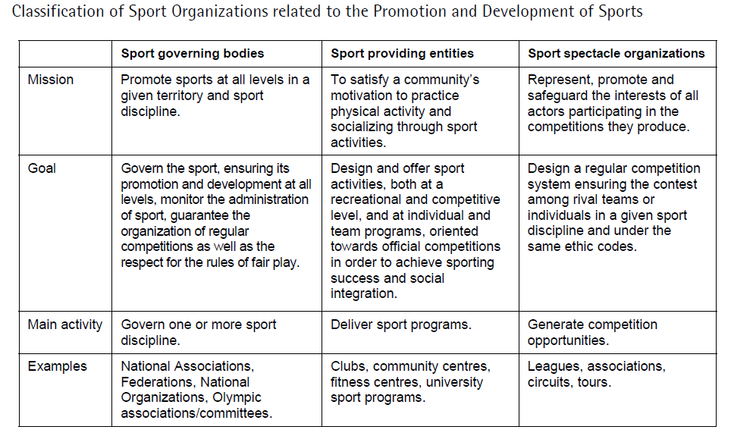

Slide 56


Slide 57


Slide 58
Background and history
Doping - the use and abuse of performance enhancing substances in elite sport
Motivations for Use of DOPING
    To enhance performance
      Increased strength, endurance, alertness, aggression
      Decreased reaction time, fatigue, anxiety, muscle tremor
    Belief that others are using PES (performance enhancing substances)
    Coping with pain and injury rehabilitation

Slide 59
1928 – International Association of Athletics Federations, bans doping (use of stimulants)
1966 – FIFA & Union Cycliste Internationale introduce drug testing at championships
1968 – drug testing first used in Olympic Games
1976 – IOC bans anabolic steroids
1979 – testing for illegal drugs by IOC begins
1986 – IOC bans blood doping
1999 – World Anti-Doping Agency (WADA) founded
2000 - first Olympics testing for EPO

Slide 60
In 1886, a Welsh cyclist have died after drinking a blend of cocaine, caffeine and strychnine, in the Bordeaux–Paris race.
This was included in the 1997 International Olympic Committee study on the Historical Evolution of Doping Phenomenon, and listed as the presumed first death due to doping during a competition.
Top three in 1998 Tour de France 'were doping’
The top three riders in the 1998 edition of the Tour de France were all taking
the banned blood booster erythropoetin (EPO)

Slide 61
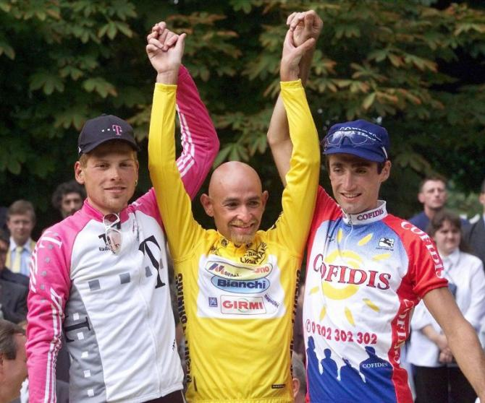
Jan Urlich, Marco Pantani, Bobby Julich

Slide 62
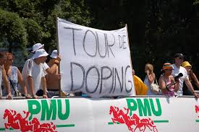

Slide 63
After the events that shook the world of cycling in the summer of 1998,
the International Olympic Committee (IOC) decided to convene a World Conference on Doping,
bringing together all parties involved in the fight against doping.
The First World Conference on Doping in Sport held, in Lausanne, Switzerland, on February 2-4, 1999, produced the Lausanne Declaration on Doping in Sport.
This document provided for the creation of an independent international anti-doping agency to be operational for the Games of the XXVII Olympiad in Sydney in 2000

Slide 64
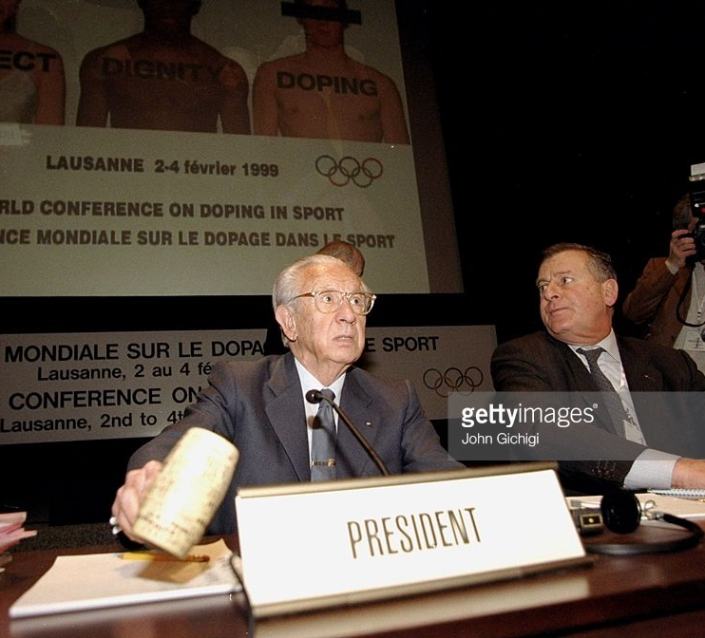

Slide 65
The World Anti-Doping Agency was established (following the Lausanne World Conference on Doping in Sport in 1999) to promote and
coordinate at international level the fight against doping in sport in all forms.
WADA is a Swiss private law Foundation
https://www.youtube.com/watch?v=XsTYYGELvFc
https://www.youtube.com/watch?v=9y1VYw5LWDc

Slide 66
WADA cooperates with IGOs, governments, and NGOs, INGOs, and sports movements fighting against doping in sport and is responsible for:
The World Anti-Doping Program, including the World Anti-Doping Code;
Coordinating a comprehensive anti-doping program at international level;
Research into drugs in sport;
Education and Ethics; and
The independent observers program.

Slide 67
https://www.youtube.com/watch?v=ZxkULBtpF3s
https://www.youtube.com/watch?v=rWyGWu186zY

Slide 68
WADA is composed of a Foundation Board, an Executive Committee and several Committees.
The 38-member Foundation Board is WADA’s supreme decision-making body.
It is composed equally of representatives from the Olympic Movement and governments.
The Foundation Board delegates the actual management and running of the Agency, including the performance of activities and the administration of assets, to the Executive Committee, WADA’s ultimate policy-making body.
The 12-member Executive Committee is also composed equally of representatives from the Olympic Movement and governments.
WADA's Presidency – a volunteer position – alternates between the Olympic Movement and governments.
WADA’s Committees act as advisory committees and provide guidance for the Agency’s programs

Slide 69
The World Anti-Doping Program
The purpose of the World Anti-Doping Program is to:
Protect the Athletes' fundamental right to participate in doping-free sport and thus promote health, fairness and equality for Athletes worldwide; and
Ensure harmonized, coordinated anti-doping programs at the international and national level with regard to detection, prevention of doping.

Slide 70
Structures of the
The World Anti-Doping Program includes 3 main elements:
Level 1 = The Code
The Code is a principles based document outlining the fundamental elements that need to be in place to address anti-doping in sport. These principles ensure the clarification and harmonisation of doping control rules.
Level 2 = The International Standards
The International Standards provide the technical detail applicable to relevant organisations.
Level 3 = Models of Best Practice
Prepared by WADA these are example documents to assist organisations with the adoption of the Code. For examples a model anti-doping policy for sport

Slide 71
Purpose of Harmonisation of Anti-Doping Rules.
The major purpose for seeking harmonisation is to help create the international level playing field that our athlete’s want so much.
The Code
The Code is intended to be specific enough to achieve complete harmonisation on issues where uniformity is required, yet be general enough in other areas to permit flexibility on how agreed upon anti-doping principles are implemented.
The WADC will ensure a consistent and harmonised approach within and across sports

Slide 72
The Code is divided into 4 parts
PART 1 – DOPING CONTROL
PART 2 – EDUCATION AND RESEARCH
PART 3 – ROLES AND RESPONSIBILITIES
PART 4 – ACCEPTANCE AND COMPLIANCE
https://www.youtube.com/watch?v=swiuXvlP_ps

Slide 73
WHAT ARE THE STEPS FOR AN ORGANIZATION TO BECOME CODE COMPLIANT?
Step 1: Acceptance
Agree to the principles of the Code and agree to implement and comply with the Code.
Step 2: Implementation
Amend organization rules and policies to include the mandatory articles and principles of the Code.
Step 3: Enforcement
Enforce amended organization's rules and policies in accordance with the Code.

Slide 74
Key Issues – the Code
The Definition of Doping
Under Article 1 of the Code, Doping is defined as the occurrence of one or more of the Anti-Doping Rule Violations set out under the Code.

Slide 75
Anti-doping rule violations
The rule violations include:
Presence
Use
Refusal
Violation of Athlete Whereabouts requirements
Tampering
Possession
Trafficking
Administration

Slide 76
In relation to the imposition of basic sanctions
In order to achieve harmonisation across sports a 2-year sanction will apply for a first offence and
a life sanction will apply for a second offence.
The mandatory imposition of the basic sanction of 2 years and life (for a second offence) will have big implications for some sports (eg. Swimming and cycling).
As a result international federations such as UCI will have to amend their current doping rules to ensure that they comply with the 2 year sanction for a first offence, rather than the six-eight month sanctions for the use of EPO.

Slide 77
Athletes are responsible for any banned substance in their sample regardless of how it got there.
The violation occurs whether or not the Athlete intentionally or unintentionally used a Prohibited Substance or was negligent or otherwise at fault.
Proof of Doping
The burden of proof is placed on the athlete in the first instance to contest a positive test result.
If the athlete is successful in rebutting the presumption that the analysis was conducted in accordance with the international standard then the burden shifts to the NADO to establish that the departure did not lead to the positive test result.

Slide 78
https://www.youtube.com/watch?v=sWhudwnE3Fg

Slide 79
ADAMS
https://www.youtube.com/watch?v=bv9wdohU_vg
WADA has an obligation to coordinate anti-doping activities and to
provide a mechanism to assist stakeholders with their implementation of the Code.
The Anti-Doping Administration & Management System (ADAMS) was developed for this purpose.
It is a Web-based database management system that simplifies the daily activities of all stakeholders and athletes involved in the anti-doping system

Slide 81
International Standards
Standard for The Prohibited List.
Standard for Therapeutic Use Exemptions.
Standard for Testing
Standard for Laboratories.

Slide 82
Models of Best Practice
These model rules and regulations will be prepared by WADA & will contain all of the detail (including reference to International Standards) necessary to conduct an effective and comprehensive anti-doping program.
Future models could be developed for national anti-doping programs, results management, testing, education programs, etc.
Model Rules of Best Practice for IFs are now available on the WADA website.
These model rules cover all aspects of doping control including the mandatory articles from the Code as well as additional provisions (ie relating to sanctions – imposition of fines to NFs for multiple positive findings) which sports may wish to consider

Slide 83
Models of Best Practice
These model rules and regulations will be prepared by WADA & will contain all of the detail (including reference to International Standards) necessary to conduct an effective and comprehensive anti-doping program.
Future models could be developed for national anti-doping programs, results management, testing, education programs, etc.
Model Rules of Best Practice for IFs are now available on the WADA website.
These model rules cover all aspects of doping control including the mandatory articles from the Code as well as additional provisions (ie relating to sanctions – imposition of fines to NFs for multiple positive findings) which sports may wish to consider

