Slide 1
European Legal History: Inheritance Law

Slide 2
Inheritance law
Inheritance, also called succession,the devolution of property on an heir or heirs upon the death of the owner. The term inheritance also designates the property itself. In modern society the process is regulated in minute detail by law. In the civil law of the continental European pattern, the pertinent branch is generally called the law of succession. In Anglo-American common law it was customary to distinguish between descent of real estate and distribution of personal estate. The rules applicable to the two kinds of property have been fused, but no common, overall name is yet universally accepted.

Slide 3
Specifics of Roman Inheritance law
Significant development during imperial period
Competition of two systems: civil and pretorian law
Remarkable evolutions from agnatic to cognatic succession system
Subject of keen interest among lawyers – almost ¼ of Iustinian’s codifications contains regulations about inheritance law
Large number of responsa that contains answers to questions about inheritance law suggest, that this particular branch of law was living subject of everyday law practice
Main goal of inheritance law was to maintain existing property regime and at the same time ensure broad ability to transfer property mortis causa

Slide 4
Succesion
Succession takes effect in a result of the death of a person which had the ability to transfer his possessions.
The possibility of inheritance is called an „appointment to inheritance” (delatio hereditatis).
While the closest heirs (called domestic heirs) mere appointment was sufficient to become an heir. External heirs needed additional act of acquisition of estate. In classic law the formal act of cretio was required, in later times even informal acquisition (for example in a way of executing the legacies) sufficed

Slide 5
Appointment to inheritance may be the result of:
will of the deceased expressed in the form of a testament (testate succession)
in case of lack of testament or situation that testament was defective where where the case of statutory succession or intestate succession,
In case that domestic heirs wasn’t disinherited and didn’t get anything from the will – to protect closest family members there was a case of contra testate succession

Slide 6
Residuary estate (hereditas)
An estate - the non-material things (one of the first and most important).
It included both material things and the rights, but with its acquisition involved responsibility for the debts of the previous owner.
Its acquisition led to general succession (as opposed to the singular succession) Succession didn’t involved rights and obligations of a personal nature. Position in family wasn’t –as well – hereditary.
Relatively easier to acquier ownership via prescription (no good faith requirement and shorter amount of time required)

Slide 7
Principles of Roman inheritance law
Heres in poenam non succedit.
Nemo pro parte testatus, pro parte intestatus decedere potest
Semel heres, semper heres
Testamentary freedom (causa Curiana – verba or voluntas)
Nasciturus pro iam habetur, quotiens de commodis eius agitur.

Slide 8
Two systems of succession
Basic system of testate and intestate successions was regulated in civil law by the Law of Twelve Tables and survived until Justinian’s legislation.
Formalism and narrow scope led to creation of competitive system of pretorian succession – bonorum possessio.
Both systems survived until Novel 118 and 127 led to creation of singular system in postclassical law.

Slide 9
Bonorum possessio
Possessio bonorum started as a way initiate possession of the estate property for a class of persons for the time of succession trial – the person most likely to become an heir (supporting civil law).
Praetor also began to give possession of the property to the ius civile heirs, who for some reason lost theirs title or to person outside of the circle, which was considered rightly legitimized (completing civil law).
Over time, in order to reduce the anachronistic intestate succession laws of inheritance praetor admitted possession to certain individuals against civil heirs – for example to emancipated son before his uncle (correcting civil law).

Slide 10
Testate succession
Made through a will
Freedom of dividing of property – testator could freely change or cancel previous testament or create new one
Immorality of inheritance agreements
Testate succession precede statutory succession – statutory heirs inherit estate only in case of absence or waiver made by testamentary heirs

Slide 11
Capacity to create a testament
It was the ability to create a will (qualified type of legal capacity).
It was possessed by:
Roman citizens of sui iuris status, that wasn’t limited to their ability to act (eg. due to their age)
Latins and peregrins with ius commercium
Persons on alieni iuris status in case of certain type of their personal estates (bona materna/peculium castrense)
- state slaves in case of half of the value of their peculium

Slide 12
Capacity to become a testamentary heir
Ability to inherit an estate from testament was possessed even by:
Slaves - liberated in will
Nasciturus - unborn child, if it was born alive
Churches, charities and associations in classical law

Slide 13
Type of wills in ius civile
Testamentum calatis commitis (twice a year at a people assembly it was possible to declare will in front of pontifex maximus)
Testamentum in procintu (declaration made in front of the army ready for battle- it was only availble for for the soldiers during the war)
These forms fallen into disuse (Cicero mentions them only in the context of the past)

Slide 14
Testamentum per aes et libram - one of the forms of use of the abstract nature of the mancipatio. Testator during his lifetime made special „sell” of his estate to special confidant (familiae emptor) who was obliged to give the estate after testator death to designated heirs. Whole act required presence of 5 witnesses and libripens, who weight symbolic payment. In classic law the second stage of act was created (nuncupatio) which allowed to designated heirs orally or in writing which reduced role of familae emptor to a special witness.

Slide 15
Wills in pretorian law
Due to a number of civil law formalities wills often proved to be invalid.
Praetor announced that he will provide possessio bonorum to a person who will submit a testament wearing seals of seven witnesses. This type of testament was always written.

Slide 16
Wills in postclassical law
Normal wills (private):
Testementum tripertitum
Testamentum per holographam scripturam
Privileged forms:
Testamentum pestis tempore conditium
Testamentum miitis
Testamentum ruri conditum
Restrictive forms:
Testament osoby głuchniemej
Testament osoby niewidomej
Public forms:
Testmentum principi oblatum
Testamentum apud acta conditum

Slide 17
Normal types of wills
Prepared in form of single act (oral or written), in one place, in the same time.
Testementum tripertitum - combined the principles of civil law (simultaneous presence), pretorian law (seals of 7 witnesses) and imperial law(signature of the testator and witnesses), introduced by Theodosius II in 439 AD
Testamentum per holograph scripture - a testament personally written and signed by the testator, introduced Constitution Valentinian III in 466 AD

Slide 18
Priviledged types of wills
Their principle is more liberal form in comparison to normal forms.
Examples:
* A will drawn up during the epidemic (not requiring the simultaneous presence of witnesses)
*Testament of a soldier - Emperor Trajan declared that any testament made by soldier - oral or written – even without meeting all of the formal requirements had the legal effect.

Slide 19
Restrictive forms of wills
Characterized by the additional formal requirements.
Examples: Testament of the blind (requiring signing by 7 witnesses and a local official - tabularius, in the absence of this second requirement signs of 8 witnesses was required) Testament of deaf person – such document could be made only personally by the testator

Slide 20
Public forms of wills
The participation of the public factor was required in these forms:
Testament submissed to the Emperor (testamentum principi oblatum)
Testament made to the protocol of judicial or municipal authorities (apud acta testamentum conditum)

Slide 21
Legal effects of will: invalidity and ineffectivness
The invalidity of the will (testamentum nullum) – will was invalid from the beginning because of:
It didn’t meet the formal requirements
That the testator or the heir did not have the testamentary capacity
Omission of a son under the authority

Slide 22
Ineffectiveness of the will (testamentum rumptum) - the invalidity is the result:
Birth of a statutory heir in the will is not taken into account
Capitis deminutio of the testator (with the exception of slavery as a result of military campagin - fictio Legis Corneliae )
In the case of rejection of will by testamentary heirs

Slide 23
Codicil
It was not always possible to maintain the full requirements of the will in case of the content and form and in some cases dispositions mortis causa were put in ordinary letters.
There was some limitations: it was not possible to establish an heir or make disinheritance via this kind of letter.
Other dispositions can be maintained in force when the codicil was confirmed by the testament, and in the absence of confirmation only effective type of dispositions was fidei-commision/trusts.
Codicillary clause allowed the maintenance of a will burdened with formal or material defects as a codicil.

Slide 24
Types of regulations in wills
The establishment of an heir (general succession)
Singular dispositions (legacies and trusts)
Disinheritance of a statutory heir
Substitution
Other regulations such as the liberation of the slaves, the establishment of guardians for minors and women

Slide 25
Estabilishment of an heir
Initially by the solemn and emphatic formula that needed to be first sentence of will: for example - Casius heres esto!
Since the beginning of the fourth century every sentences that contained will of testator to estabilish certain person as an heir was sufficent.

Slide 26
Substitution (substitutio)
The institution of the conditional appointment enabled by the testator to determine who will be the heir in case his heir did not want or could not acquire the estate, and in some cases allowed to indicate the heir heir.
Types:
common substitution (deceased invoked a number of substitutes for each other - ending substitution usually by estabilishing slave as an heir)
Pupilary substitution - the heir, who was the person sui iuris and a child - in the event of his death before becoming an adult
Quasi pupilary substition - Ascendant (father) could establish an heir for his descendent (son), who was mentally ill

Slide 27
Disinheritance
Disinheritance was not a negative assessment of the heir but a specific instrument to regulate succesion in more freely manner- not including the statutory heirs in the will without disinheriting them could lead to the invalidity of the will of the formal reasons.
Disinheritance was made:
* In relation to the son by name
* In relation to other sui heredes - also by using the general formula what allowed to disinherit them all at once
Institution of unworthiness (indignitas) - the concept was born in imperial law and defined negative assessment of behavior of the heirs in relation to the deceased. This institution allowed to take estate from unworthy heir in favour of imperial treasury.

Slide 28
Legal effects of acquisition of estate
General succession of the deceased ("fusion" of the estates of deceased and heir)
Taking over the debts of the deceased (liability from personal estate)
Acceptance with full liability (in the form indistinguishable from today's acceptance with the benefit of inventory), which could lead to a number of adverse effects of property.
This led to two adjustments:
Separatio bonorum - in the interests of creditors
Beneficium inventarii - in the interests of heirs

Slide 29
Collocatio bonorum
This institution allowed to take part in inheritance for the emancipated children if they add their estates to deceased estate. Examples of estates:
*Dowry
*Items that son had received from his father as a soldier or official
* Received donations (unless the testator declared that they will not added to inheritance)

Slide 30
In ancient Rome, the inheritance of whole or fractional part of estate was associated with liability for the debts of deceased. On the other hand, it was possible to partially donate part of estate without liability for the debts. There were two variations of such partial decree: legacies and trusts.

Slide 31
Legacies: the only form of singular disposition known in ancient Roman law. The establishment of the legacy was carried out in a formal way with certain words, strictly defined by law Legacy burdened only testamentary heir, so it had to be placed in will.

Slide 32
Legacies
sine modo
praeceptionem
Per vindicationem
Per damnationem

Slide 33
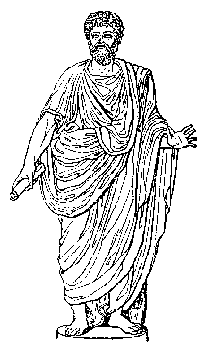
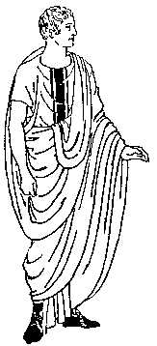
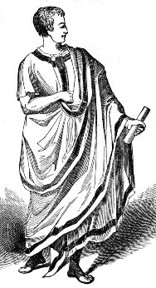
Legacy per vindicationem
Legatee become owner of the thing in
the moment of death of testator
Transfer ownership to legatee
Heir has legal obligation to give object of legacy to legatee
TESTATOR
LEGATEE
HEIR

Slide 34
Legacy per damnationem
Claim to heir to receive ownership of a thing
Obligation to give something to legatee
Legatee
Heir

Slide 35
Limitations of legacies
Lex voconia (169 BC) –no one can acquire by legacy more than an heir
Lex falcidia (40 BC) – legacies could be more than ¾ of the deceased estate after deducting of the debts , this ¼ of free from debts and legacies estate was inherited by heirs, legacies that exceed that limit were invalid
L

Slide 36
Trusts- informal requests to make a donation of property to designated person issued by the testator to someone who received some benefit from the will Differences between trusts and legacies:
Trusts does not necessarily have to be placed in a will – could be oral or in codicil
Trusts could burden not only heir but also legatee
Trust didn’t gave rise to legal obligation, it was only moral duty to complete them

Slide 37
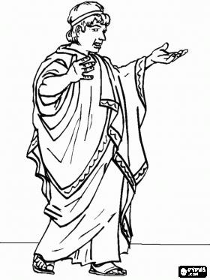
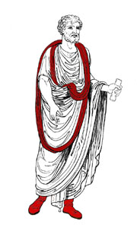
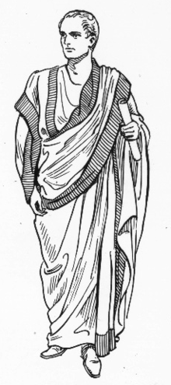
Uniwersal trust
Ordered trustee to give the whole estate to third person (beneficiary)
Testator
Trustee
Beneficiary

Slide 38
Functions and importance of singular dispositions
can ensure the basic needs for disinherited family members and children born out of wedlock
could improved disadvantageous position of spouses
reward the services of friends
ensure future carrier of children by gifts to important persons

Slide 39
Three systems of statutory succession
1) Agnatic (Law of Twelve Tables)
2)Agnatic-cognatic (pretorian law)
3) Cognatic (Iustian’s Novellae)

Slide 40
Agnatic system – three degrees of proximity
Sui heredes – people under authority of testator:
Sons
Dauthers
Wife in marriage cum manu
They inherited estate in:
* heads (in capitia) – in the same line * strains (in stripes) – in different lines

Slide 41
Second class: Proximi agnati
The closest relative from the side of testator in the nearest degree of kinship: • brother • sister • son emancipated

Slide 42
Third class: Gentiles
Persons belonging to the same family as the deceased. They had a common ancestor and had the same surname.

Slide 43
Agnatic-cognatic system
Inheritance contanined four classes: I. unde liberi - all relatives of deceased regardless that they were under his authority at the time of death:
Children
Grandchildren
Great-grandchildren
Emancipated children
Wife didn’t inherit in this class!

Slide 44
Second class: Unde legitimi
All persons entitled under ius civile:
• sui heredes
• proxima agnati
• gentiles

Slide 45
Third class: Unde cognati
All related to deceased by blood to 6 th grade without exception and to the 7 th grade for great-grandchildren of siblings.
Closer relatives precluded further ones.

Slide 46
Forth class: unde vir et uxor – in the absence of relatives in last class the spouse in marriage sine manu inherited the estate. Wife in marriage cum manu inherited in second class as a agnatic daughter.

Slide 47
Cognatic system
Inheritance by the bonds of blood. It contained 4 classes of proximity:
Descendents of deceased
Ascendants of deceased
Half siblings
Cognate relatives

Slide 48
Descendents of deceased
All the descendants without distincions of sex and being under the authority:
Children
Grandchildren
Great-grandchildren
Ascendants of deceased
Siblings from the same parents
Children of these siblings

