Slide 1
The concept and functions of law
Legal Language
Maciej Pichlak PhD
Department of Legal Theory and Philosophy of Law
University of Wroclaw
Maciej.Pichlak@uwr.edu.pl

Slide 2
The law’s empire
'We live in and by the law. It makes us what we are: citizens and employees and doctors and spouses and people who owe things. It is sword, shield and menace: we insist on our wage, or refuse to pay our rent, or are forced to forfeit penalties, or are closed up in jail, all in the name of what our abstract and ethereal sovereign, the law, has decreed. (...) We are subjects of law's empire, liegemen to its methods and ideals, bound in spirit while we debate what we must therefore do.'
Ronald Dworkin, Law's Empire

Slide 3
The idea and the purpose of law
https://www.youtube.com/watch?v=NifItiFuF3M

Slide 4
Social functions of law #1
To guide a human conduct
To provide publicly ascertainable standards of behaviour
To secure order and peace
To justify acts of coercion
To legitimize a domination of ruling class over other classes

Slide 5
Social functions of law #2
Gustav Radbruch: Justice, certainty, purposiveness
-------------------------------------------------------------------
Joseph Raz
preventing undesirable behaviour and securing desirable behaviour (criminal law, tort law)
providing facilities for private arrangements between individuals (civil law)
provisions of services and the redistribution of goods (administrative law, tax law)
settling unregulated disputes (courts and tribunals)
------------------------------------------------------------------
Stabilization and innovation
Organization
Protection
Repression and prevention (education)

Slide 6
LAW
legal science
(jurisprudence)‏
normative system
legal practices

Slide 7
„Sources” of legal order
LAW
Legislation
Legal
doctrine
Legal
practice

Slide 8
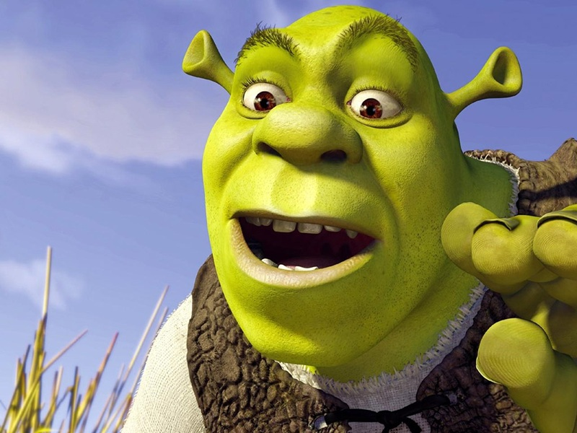
Law as a multi-layered system
„Shrek Principle”
'Typical' rules, that is legal provisions which are formulated in legal texts
(or other traditional sources of law), creates only a 'surface-level' of law.
Next to this level, law includes also other components.
Concepts of legal system and legal order

Slide 9
Legal culture
A set of beliefs, attitudes and customs related to the valid law.
Legal culture sensu largo and sensu stricto (culture of legal professionals).
Legal culture sensu stricto is created by legal practices, legal science, and legislation

Slide 10
Components of legal culture
methodical element (methods of legal reasoning)‏
conceptual element (basic concepts of law)‏
normative element (general legal principles)‏
general doctrines‏

Slide 11
Methodical component
Rules of validity
Rules of interpretation
[Rules of collisions]

Slide 12
Normative component: legal principles
‘Typical' rules
validity: formal criteria ('test of pedigree')‏
application: 'all or nothing' fashion
Principles
are a part of 'institutional morality'
validity: 'institutional acceptance'
application: 'more or less' fashion (dimension of weight)‏

Slide 13
„Deep culture” and identity of law
Alternative interpretations of deep culture:
- Deontological (basic principles)
- Teleological (telos - moral ideal of law)
- Formal (basic formal qualities of law)

Slide 14
Law as a multi-layered system
Discursive and practical knowledge
Components of legal culture and their discursive expressions.
The role of deeper layers:
they are preconditions of legal practice
they define the limits of law
they are a yardstick for criticism of law

