Slide 1
Limited liability companies
Barlit Anton

Slide 2
Legal regulation
The Polish Commercial Companies Code came into force in 2001 and replaced the Commercial Code of 1934.

Slide 3
Partnerships and companies under the commercial law
The term “partnerships and companies under the commercial law” covers six types of partnerships and companies regulated in the Code. These include:
1. a registered partnership (spółka jawna);
2. a professional partnership (spółka partnerska);
3. a limited partnership (spółka komandytowa);
4. a limited joint stock partnership (spółka komandytowo-akcyjna);
5. a limited liability company (spółka z ograniczoną odpowiedzialnością);
6. a joint – stock company (spółka akcyjna).

Slide 4
Companies
Under the Polish law there are two companies, namely a limited liability company (LTD company) and a joint stock company.
Limited Liability Companies
Joint Stock Companies

Slide 5
In Polish company law a limited liability company may be formed by one or more persons for any legitimate purpose, although it can not be formed by another sole-shareholder limited liability company as the single promoter.
The shareholders of companies are liable only to render duties stipulated in the articles of association or in the statutes, and they are not liable for the obligations of the company. The basic duty of the shareholders is to make contributions to the company’s share capital.

Slide 6
A limited liability company may have the lowest share capital of 5.000 zlotys (about 1.200 Euro) and the minimum value of one share is 50 PLN. The share capital can be divided into shares of equal or unequal value.. The shareholders should pay the entire share capital of a limited liability company prior to its filing for the entry into the court register. No share documents are issued by a limited liability company, shareholders are registered in the stock ledger kept by the management board of a company, such a ledger is to be filed in the court register and updated following each share transfer.

Slide 7
Powers
A company is given the same powers, rights, and privileges as an individual. Companies may, in their own name, acquire rights, including ownership of immovable property and other rights in rem, incur obligations, sue and be sued.

Slide 8
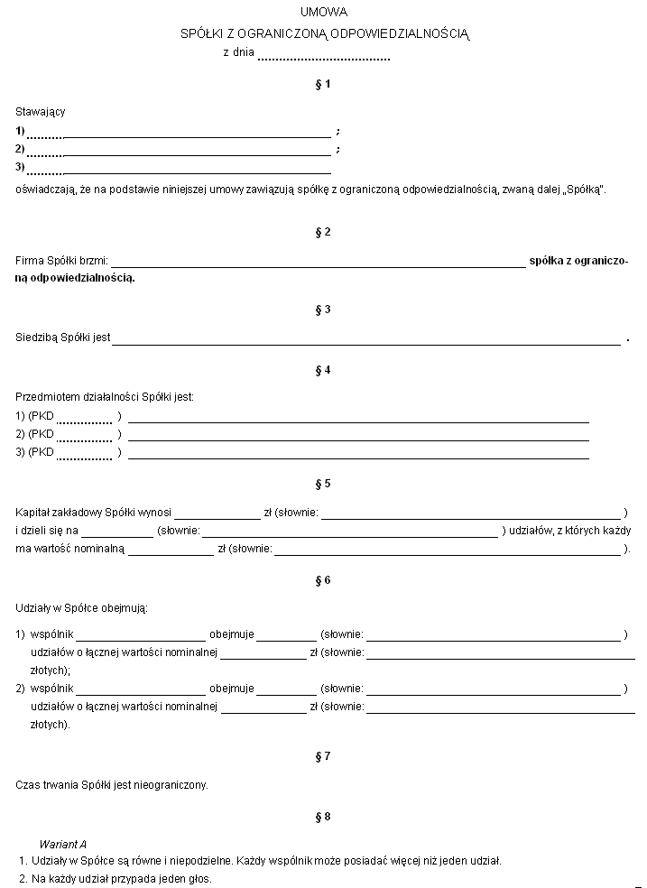
Incorporation
The first step to incorporating a limited liability company is the execution of the Articles of Association in the form of a notarial deed (before a notary in Poland), as well as a declaration on subscription of the shares.

Slide 9
The Company’s Articles of Association must provide for the following:
the business name and registered office of the Company;
the object of the Company's activity, as specified in the Polish Classification of Activities (PKD), substantially similar to the NACE classification;
the duration of the Company, whenever established for a definite period of time (indefinite period is a rule);
the amount of the share capital;
a provision as to whether a shareholder may hold more than one share;
the number and nominal value of shares subscribed for by each shareholder.

Slide 10
The final steps are to make contributions to the Company's share capital and toprepare an application to register the Company by the registry court in the so-called business register of the National Court Register. The application is prepared on special forms for which additional attachments are required, including:
- two copies of the Articles of Association;
- statement signed by all members of the Board certifying that the
Company’s entire share capital has been paid up;
- the list of shareholders signed by all members of the Board of
Directors;
- specimens of signatures of the members of the Board of Directors
made before a notary public;
- names, surnames and addresses of the members of the Board of
Directors,
- a document confirming the Company’s rights to the premises or
real estate, where the Company has its registered office.

Slide 11
Purpose | May be established for any purpose allowed by law (including conducting a business) unless other is provided by acts.
Founders | May be established by one or more individuals or legal persons or legal persons or organisational unit without legal personality which was granted a legal capacity on the basis of a specified act (for example partnerships). However, it may not be established solely by another single-member limited liability company.
Minimum capital | 5,000 PLN
Legal personality | A limited liability company is a legal entity.
Company liability | The Company is liable for its debts and obligations with its whole property without any limitations.

Slide 12
Additional requirements for foreign investors | N/A
Shareholder and management board liability | The shareholders are not liable for the company’s obligations, they bear a risk up to the value of shares contributed.
Organs of a company | Superior authority of a company is Shareholders Meeting. Company is represented by a Management Board (consisting at least of one person) according to principles laid down in a company deed or a company charter. A company may be also represented by proxy.In limited liability company a Supervisory Board may be optionally appointed. In limited liability companies whose initial capital exceeds PLN 500.000 and the number of share holders exceeds twenty five the Supervisory Board or audit commission shall be compulsory.

Slide 13
Conclusion
The Polish limited liability company is the most common type of commercial company in Poland. After all the incorporation documents are in order, the company is registered at the National Court Register (KRS). It can have one or more shareholders and requires a minimum share capital of 5,000 PLN with the nominal value of a share no lower than 50 PLN. The Polish limited liability company has a management board formed of one or more members. The company must pay the corporate income tax and VAT.

