Slide 1
Main Actors in Criminal Justice System
dr Artur Kowalczyk
artur.kowalczyk@uwr.edu.pl

Slide 2
Participants to the criminal proceedings
victim
suspect
defendant (accused)
NGOs
court
(judges, lay judges)
victim’s counsel
police
prosecutor
ombudsman
defence counsel (attorney)
experts / expert witnesses
witnesses
interpreters
translators

Slide 3
Participants to the criminal proceedings
PRE-TRIAL
COURT PROCEEDINGS
INVESTIGATING JUDGE* (EXAMINING MAGISTRATE)
PROSECUTOR *
DECISION MAKERS:
POLICE
COURT
PARTIES:
SUSPECT
VICTIM**
DEFENDANT
PROSECUTION
PUBLIC / PRIVATE
*both or only one of them depending on the legal system
** a party to the proceesings only in some legal systems

Slide 4
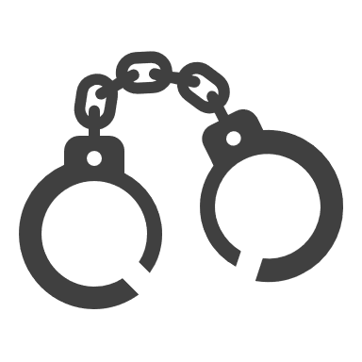
1. The Court

Slide 5
Types of courts
Two concepts as to who decision-makers in criminal justice system should be:
1) professionals, legally educated,
2) „ordinary” people, without legal education.
Two types of courts:
1) court as a specialized institution,
2) jury.

Slide 6
Appointment of the judges
Judges should be independent and impartial – no individual or office should be able to tell a judge how to conduct a trial or decide on a case
To ensure the independence of the judges it is necessary to regulate the procedure fot their appointment
There are four main methods:
1) direct election,
2) election by the assembly (parliament),
3) appointment by the head of state,
4) co-option by the judiciary.

Slide 7
Other safeguards to protect the independence of the judiciary
Judges cannot be transferred from one position to another against their will
Judges cannot be dismissed unless by the the way of diciplinary procedure
The remuneration of judges must be sufficiently high, in the light of the socio-economic context, in particular with regard to the average salary
Usually judges cannot engage in political activities, cannot be members of political parties etc.

Slide 8
Structure of the courts
Usually there are several (2-3) levels of courts
2 levels is the minimum – there must be a court of first instance and appelate court
3 levels are more common, especially in countries with bigger population (France, Germany, Spain), but not only (also Czech Republic or Denmark)
2 levels – countries with smaller population (e.g. Slovakia, Malta)
the division of competences between these courts usually depends on the type of criminal case

Slide 9
The Supreme Court:
Hears extraordinary appeals
Structure of the courts
Higher court:
1) Hears certain cases,
2) Hears appeals of the middle court
Middle court:
1) Hears certain cases,
2) Hears appeals of the lower court
Lower court:
hears most cases
Often, a higher court that has jurisdiction to hear a specific category of cases is also an appeal court for judgments of a lower court.
Above the "ordinary" levels of the judiciary there is usually a supreme court, which is a special court that hears extraordinary appeals

Slide 10
France
Police courts (tribunaux de police) – competent to hear petty offence cases,
Correctional courts (tribunaux correctionnels) – competent to hear misdemeanour cases,
Criminal tribunals (cours criminelles) – competent to hear crimes for which the upper limit of the penalty is 15 to 20 years of imprisonment,
Jury tribunals (cours d’assises) – competent to hear other most serious crimes
The court of appeal (cour d’appel – in the case of an appeal from the first two mentioned courts) or the jury tribunal (in other cases) is competent to adjudicate in the second instance.
The highest court instance is the Court of Cassation (Cour de cassation), which deals with the recognition of extraordinary appeals.

Slide 11
Germany
District courts (Amtsgericht – AG),
Regional courts (Landgericht – LG)
Higher regional courts (Oberlandesgericht – OLG)
In principle, the court of the lowest instance (AG) has jurisdiction to hear criminal cases at first instance. An exception to this rule is cases where the law provides for the jurisdiction of LG or OLG
Jurisdiction of LG - when the expected sentence will be more than 4 years of imprisonment or that the accused can be expected to be sentenced to a security measure in the form of placement in a psychiatric institution
Jurisdiction of OLG - the most serious acts that are of a terrorist nature or are detrimental to state security

Slide 12
England and Wales
Magistrates’ courts - magistrates are trained, volunteer members of the local community who make decisions in criminal and family cases in Magistrates’ courts and the Family Court. The most complex cases in Magistrates’ courts are heard by District Judges.
Crown Court – located in over 70 centres across England and Wales
The Crown Court acts as both a court of first instance and a court of appeal: apart from certain offences, it hears appeals from the decisions of the Magistrates’ Courts,
Courts with a purely appellate function include:
High Court of Justice, which consists of three divisions, including the King’s Bench Division, which hears appeals on points of law from the decisions of the Magistrates’ Courts,
Court of Appeal, which criminal division hears appeals from the decisions of the Crown Court.

Slide 13
England and Wales
The Crown Court, Court of Appeal and High Court of Justice are the Senior Courts of England and Wales, while the highest court is the Supreme Court of the United Kingdom.
The Supreme Court, established in 2009, took over the judicial powers previously held by the House of Lords. It hears appeals – only in cases of great public importance – from decisions of the Court of Appeal and, to a very limited extent, from decisions of the High Court.

Slide 14
Poland
There are three levels of common courts in Poland
The lowest level court is the district court (sąd rejonowy). More than 300 such courts operate across the country.
The next two levels are made of 48 regional courts (sąd okręgowy) and 11 courts of appeal (sąd apelacyjny).
The majority of criminal cases are heard in the first instance by district courts. Only a limited number of exhaustively designated serious offenses are tried in regional courts in the first instance.
Courts of Appeal exercise only appellate function.

Slide 15
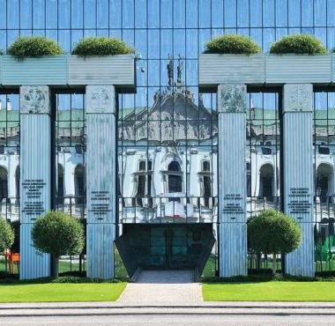
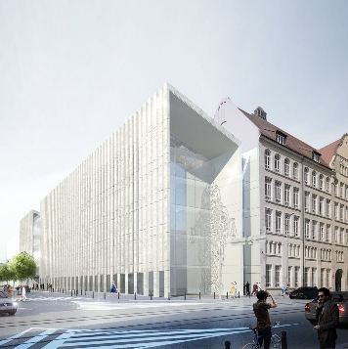
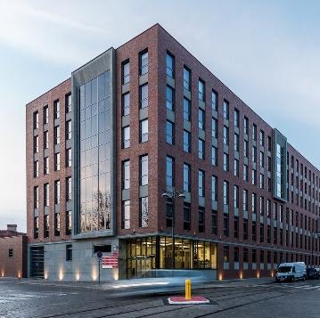
Supreme Court
Courts of Appeal
Regional Courts
Competent to hear cassation appeals and other matters delegated to it by law., i.e. resolutions on legal issues.
Competent to hear appeals against judgments issued by the regional courts.
Competent to:
1) adjudicate in cases specified in the Code of Criminal Procedure,
2) hear appeals against judgments issued by the distric courts.
Competent to adjudicate at first instance in all cases, with the exception of cases transferred to the jurisdiction of another court.
District Courts

Slide 16
2. The prosecution

Slide 17
Role of the prosecutor
1. Key actor at pre-trial stage:
may supervise the activities of the police and other services
decides on certain coercive measures during investigation (unless it is restricted to the court or investigating judge)
may decide to close the case (discontinuaton of the proceedings) or - in some legal systems - to apply certain penal measures instead of penalty
decides whether the case should go to trial
2. Represents the prosecution against defendant at trial.

Slide 18
Principle of Mandatory/Discretionary Prosecution
Mandatory prosecution closely connected to principle of official prosecution
(= regardless of the wishes of the victim)
The difference lies in whether it is mandatory that the prosecutor prosecutes in case of every crime committed or the prosecutor can decide to prosecute or not to prosecute when there is no purpose in prosecution for various reasons
Very different attitudes among the legal systems
Minor cases (Germany)
Possession of small amounts of drugs (Poland)
Fulfilling certain obligations which are not penal in their nature (France)
General right of assessment by the prosecutor (USA) – broad discretion

Slide 19
Evolution of the role of the prosecutor
TRADITIONAL ROLES:
legal arm of the police during investigation
decision to charge
prosecution against defendant during trial
NEW ROLES:
prosecutor as decision-maker
“prosecutor as judge”
“judge by another name”
discretionary prosecution

Slide 20
England and Wales
In England and Wales, prosecution was historically a matter for the police. The police would conduct their own procesutions in the lower courts where they would present cases themselves. In higher courts the police instructed counsel (barrister) to present the case in court.
In the 1980s it was decided that it is undesirable for the police to both investigate and prosecute – 1) substantial differences in prosecution practises around the country, 2) lack of objectivity
Crown Prosecution Service (CPS) was created in 1985 (!)
Main task of the CPS is to bring and support prosecutions in courts. This service is made up of Crown Prosecutors and is headed by the Director of Public Prosecutions, appointed by the Attorney General, who is a member of the government.

Slide 21
Germany
The public prosecutor's office (Staatsanwaltschaft) exists at the federal and state level,
the state prosecutor's offices not hierarchically subordinate to the federal prosecutor's office. The structure of the public prosecutor's office is linked to the judicial system; these offices are most often established at the state courts (LG)
The units are supervised by the general public prosecutor's office at the relevant higher regional court, which in turn is subordinate to the Minister of Justice of the relevant state

Slide 22
Poland
One of the main reasons for criticism of the prosecutor's office in Poland is its connection to the executive power.
Minister of Justice (member of the government, usually a politician) also holds the office of Attorney General,
Attorney General is not just an honorary position – he or she has authority over the National Public Prosecutor, public prosecutors of universal prosecutorial bodies, regional prosecutorial bodies and various specific prosecutorial commissions

Slide 23
3. Defence

Slide 24
Suspect/defendant (accused)
The suspect is a party to the investigation
After bringing an indictment to the court the suspect becomes the defendant (= the accused)
The accused (or suspect) is presumed innocent until his/her guilt has been proven and confirmed by a legally final judgment
The suspect/defendant is not required to prove his/her innocence or testify against him(her)self → nemo tenetur principle (nemo se ipsum accusare tenetur = no one has to incriminate himself)
The suspect/defendant has rights of defence, i.e. access to a lawyer

Slide 25
Becoming a suspect
Some countries provide the capacity and powers of the suspect based on the formal decision of the prosecutor or the police (e.g. Poland) but some rely rather on factual changes in proceedings (e.g. Italy, Germany)
It seems that a better solution is to link the whole package of rights of the suspect, including the right to remain silent and the right to defence, with actions taken by the investigative authorities

Slide 26
Poland
Polish CCP provides that as a suspect (podejrzany) can be defined a person, with regard to whom a decision presenting charges has been issued, or who, without the issuance of such a decision, has been informed about charges in connection with the initiation of the person’s interrogation in the capacity of suspect
Unless the prosecutor or the police officially decide that a person should be charged with having committed an offense and unless they formally issue such a decision, that person cannot be called the suspect

Slide 27
Germany
In German criminal proceedings one becomes a suspect (Beschuldigte) when the criminal proceedings authorities suspect that he or she has committed a crime (subjective element) and at the same time there is a specific act on their part which indicates that they intend to conduct proceedings against this person as a suspect (objective element)

Slide 28
Right of access to a lawyer
It is a crucial right at the early stage of investigation
The suspect’s statements at the initial innterrogation may determine the further course of the proceedings
On the other hand in many jurisdictions there are certain exceptions from the right of immediate access to a lawyer, e.g. in proceedings concerning terrorist acts – such exceptions may be only temporary and have to be justified by other important values, such as the need to prevent the loss of life

Slide 29
Directive 2013/48/EU
Directive 2013/48/EU of the European Parliament and of the Council of 22 October 2013 on the right of access to a lawyer in criminal proceedings is a crucial act which provides all suspects and defendants in the EU with the right to be effectively assisted by the lawyer from the early moment of investigation
The right of access to a lawyer itself is enriched by additional guarantees such as the right to talk to a lawyer privately prior to the interrogation

Slide 30
Right to legal aid
Legal aid is the lawyer’s assitance paid for by the state.
In modern criminal justice systems people who cannot pay for their lawyer are granted with one by the state. Legal aid is provided temporarily for free in the course of proceedings but if the defendant gets convicted, he or she may be obliged to give the amount of lawyer’s remuneration back to the state.

Slide 31
Directive 2016/1919/EU
Directive (EU) 2016/1919 of the European Parliament and of the Council of 26 October 2016 on legal aid for suspects and accused persons in criminal proceedings
It allows the EU Member States to provide legal aid after applying:
means test → only to the defendants who are unable to afford a lawyer
merits test → only in serious cases
both tests at the same time

Slide 32
Defence counsel in criminal proceedings
It is very important to understand that the defence lawyer’s job in the criminal process is to represent the interests of the defendant, not of the society
That is why the defence attorney is bound by the attorney-client privilege and may not disclose any incriminating information about the suspect to the authorities
That does not make the defence attorney an accomplice to the crime – this role is designed to equate chances between the prosecution (and the whole state) and an individual

Slide 33
Mandatory participation of the defence counsel
In most countries the participation of the defence counsel in proceedings is mandatory in certain cases, e.g.:
when the defendant suffers from a mental illness
in most serious cases (in Poland cases concerning fellonies)
when there are other obstacles to the defendant’s self-defence such as being deaf, mute or blind
In Italy it is mandatory that every suspect and accused has a defence lawyer from the moment the investigation is directed against a specific suspect
If being represented by a lawyer is mandatory and the defendant does not appoint one, one will be appointed by the state

Slide 34
Who might be a defence counsel?
The most common expression used is „attorney-at-law” → it is a lawyer qualified to autonomously represent people in courts of law
General requirements in most countries are:
to graduate from a University with a master’s degree in law
to complete an additional traineeship at the bar (in Poland it lasts 3 years)
to pass an exam and get admitted to the bar
The bar is an association of attorneys-at-law

Slide 35
Who might be a defence counsel?
You might also come across a distinction between a solicitor and a barrister in the context of the English law
A solicitor is an attorney who gives legal advice mostly outside the court
A barrister is an attorney whose sole task is to represent people in court
In criminal proceedings you would usually need a barrister
In Poland only an attorney (adwokat) or legal advisor (radca prawny) can become a defence lawyer (since 2015)

Slide 36
4. Victim

Slide 37
Is the victim a party to the proceedings?
The answer varies depending on a particular jurisdiction

Slide 38
Victim in common law countries
Traditionally the victim is not a party to proceedings at any of its stages
The victim is only interrogated as a witness
The victim may be assisted by a counsel but has no significant powers to gain real impact on the course of proceedings
Over time victims are gaining a bit more power especially due to common European standards of their protection – but it does not make them parties to the proceedings

Slide 39
Victim Impact Statement (VIS)
The discussion on the role of the victim in adversarial legal culture is mostly focused on the Victim Impact Statements
This institution applies to the sentencing stage of proceedings
The statement decsribes the impact of the crime on the victim’s life
It may be presented in writing and in some jurisdiction also orally before the court
There is no similar institution in inquisitorial systems, which usually do not have a separate sentencing phase of proceedings; however, they provide the victim with more rights during trial

Slide 40
Victim in continental law countries
The victim is often a party to the investigation
The victim sometimes may even become a party during trial either by initiating it under certain conditions (Poland, France) or by becoming an auxiliary prosecutor supporting the public one (Poland, Germany)
Private prosecutor (in Poland limited to certain type of offences),

Slide 41
Victim as a party of proceedings
Being a party to the proceedings means that significant procedural powers are awarded to the victim:
right of asking questions to witnesses
right to introduce new evidence to the proceedings
right of access to the case dossier
right to compensation (also present in some adversarial procedures)
right to appeal from a judgment

Slide 42
Thank you for your attention

