Slide 1

MARKETING
2024/2025

Slide 2
Identifying Market. Segments and targets
Companies cannot connect with all customers in large, broad, or diverse markets. But they can divide such markets into groups of consumers or segments with distinct needs and wants. A company then needs to identify which market segments it can serve effectively. This decision requires a keen understanding of consumer behavior and careful strategic thinking. To develop the best marketing plans, managers need to understand what makes each segment unique and different. Identifying and satisfying the right market segments is often the key to marketing success.

Slide 3
Bases for segmentation. Consumer Markets
Market segmentation divides a market into well-defined slices. A market segment consists of a group of customers who share a similar set of needs and wants. The marketer’s task is to identify the appropriate number and nature of market segments and decide which one(s) to target.
We use two broad groups of variables to segment consumer markets. Some researchers try to define segments by looking at descriptive characteristics: geographic, demographic, and psychographic. Then they examine whether these customer segments exhibit different needs or product responses. For example, they might examine the differing attitudes of “professionals,”“blue collars,” and other groups toward, say, “safety” as a product benefit.
Other researchers try to define segments by looking at behavioral considerations, such as consumer responses to benefits, usage occasions, or brands. The researcher then sees whether different characteristics are associated with each consumer-response segment. For example, do people who want “quality” rather than “low price” in an automobile differ in their geographic, demographic, and psychographic makeup? Regardless of which type of segmentation scheme we use, the key is adjusting the marketing program to recognize customer differences. The major segmentation variables—geographic, demographic, psychographic, and behavioral segmentation

Slide 4
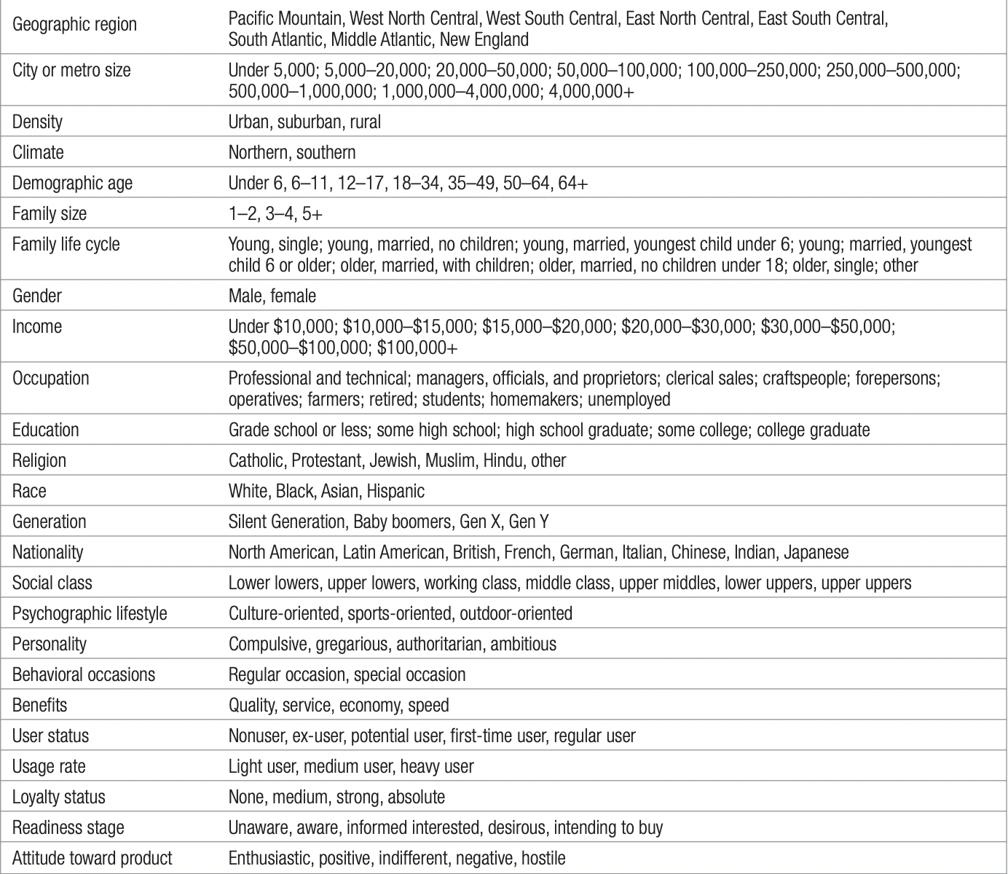
Major Segmentation Variables for Consumer Markets

Slide 5
Geographic Segmentation
Geographic segmentation divides the market into geographical units such as nations, states, regions, counties, cities, or neighborhoods. The company can operate in one or a few areas, or it can operate in all but pay attention to local variations. In that way it can tailor marketing programs to the needs and wants of local customer groups in trading areas, neighborhoods, even individual stores. In a growing trend called grassroots marketing, such activities concentrate on getting as close and personally relevant to individual customers as possible.
Much of Nike’s initial success comes from engaging target consumers through grassroots marketing efforts such as sponsorship of local school teams, expert-conducted clinics, and provision of shoes, clothing, and equipment. Citibank provides different mixes of banking services in its branches depending on neighborhood demographics. Curves, an exercise chain aimed at middleaged women, places paper bags where consumers can place a form asking for more information about Curves in local businesses such as ice cream shops, pizza parlors, and other places where guilt can strike the weight-conscious shopper. Retail firms such as Starbucks, Costco, Trader Joe’s, and REI have all found great success emphasizing local marketing initiatives, but other types of firms have also jumped into action.

Slide 6
Geographic Segmentation
More and more, regional marketing means marketing right down to a specific zip code.4 Many companies use mapping software to pinpoint the geographic locations of their customers, learning, say, that most customers are within a 10-mile radius of the store and are further concentrated within certain zip+4 areas. By mapping the densest areas, the retailer can rely on customer cloning, assuming the best prospects live where most of the customers already come from.
Some approaches combine geographic data with demographic data to yield even richer descriptions of consumers and neighborhoods. Nielsen Claritas has developed a geoclustering approach called PRIZM (Potential Rating Index by Zip Markets) NE that classifies over half a million U.S. residential neighborhoods into 14 distinct groups and 66 distinct lifestyle segments called PRIZM Clusters. The groupings take into consideration 39 factors in five broad categories: (1) education and affluence, (2) family life cycle, (3) urbanization, (4) race and ethnicity, and (5) mobility. The neighborhoods are broken down by zip code, zip+4, or census tract and block group. The clusters have descriptive titles such as Blue Blood Estates, Winner’s Circle, Hometown Retired, Shotguns and Pickups, and Back Country Folks. The inhabitants in a cluster tend to lead similar lives, drive similar cars, have similar jobs, and read similar magazines.

Slide 7
Geographic Segmentation
A number of organizations have applied this service to their marketing. The U.S. Army uses a custom Claritas system to help in recruiting. Sodexho Marriott uses a system to select menu offerings for its nationwide college food program. Wendy’s and PETCO rely on Claritas to help decide where to put new stores. When Ace Hardware launched a customer loyalty program called the Helpful Hardware Club a few years ago, it assigned a Claritas cluster code to every one of the 7 million members. When Ace found that 12 clusters generated most of its business, it targeted them with specific promotions.
Marketing to microsegments has become possible even for small organizations as database costs decline, software becomes easier to use, and data integration increases. Those who favor such localized marketing see national advertising as wasteful because it is too “arm’s length” and fails to address local needs. Those against local marketing argue that it drives up manufacturing and marketing costs by reducing economies of scale and magnifying logistical problems. A brand’s overall image might be diluted if the product and message are different in different localities.

Slide 8
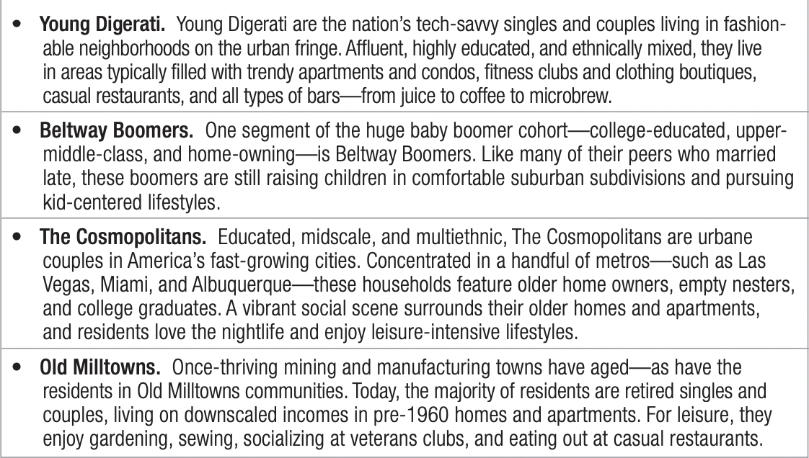
Examples of PRIZM clusters

Slide 9
Demographic Segmentation
In demographic segmentation, we divide the market on variables such as age, family size, family life cycle, gender, income, occupation, education, religion, race, generation, nationality, and social class. One reason demographic variables are so popular with marketers is that they’re often associated with consumer needs and wants. Another is that they’re easy to measure. Even when we describe the target market in nondemographic terms (say, by personality type), we may need the link back to demographic characteristics in order to estimate the size of the market and the media we should use to reach it efficiently.
Now I will show you how to use certain demographic variables to segment markets.

Slide 10
AGE AND LIFE-CYCLE STAGE
Consumer wants and abilities change with age. Toothpaste brands such as Crest and Colgate offer three main lines of products to target kids, adults, and older consumers. Age segmentation can be even more refined. Pampers divides its market into prenatal, new baby (0–5 months), baby (6–12 months), toddler (13–23 months), and preschooler (24 months+). Indirect age effects also operate for some products. One study of kids aged 8–12 found that 91 percent decided or influenced clothing or apparel buys, 79 percent grocery purchases, and 54 percent vacation choices, while 14 percent even made or swayed vehicle decisions.
Nevertheless, age and life cycle can be tricky variables.9 The target market for some products may be the psychologically young. To target 21-year-olds with its boxy Element, which company officials described as a “dorm room on wheels,” Honda ran ads depicting sexy college kids partying near the car at a beach. So many baby boomers were attracted to the ads, however, that the average age of Element buyers turned out to be 42! With baby boomers seeking to stay young, Honda decided the lines between age groups were getting blurred. When it was ready to launch a new subcompact called the Fit, the firm deliberately targeted Gen Y buyers as well as their empty-nest parents

Slide 11
LIFE STAGE
People in the same part of the life cycle may still differ in their life stage. Life stage defines a person’s major concern, such as going through a divorce, going into a second marriage, taking care of an older parent, deciding to cohabit with another person, deciding to buy a new home, and so on. These life stages present opportunities for marketers who can help people cope with their major concerns.

Slide 12
GENDER
Men and women have different attitudes and behave differently, based partly on genetic makeup and partly on socialization. Women tend to be more communal-minded and men more self-expressive and goal-directed; women tend to take in more of the data in their immediate environment and men to focus on the part of the environment that helps them achieve a goal. A research study examining how men and women shop found that men often need to be invited to touch a product, whereas women are likely to pick it up without prompting. Men often like to read product information; women may relate to a product on a more personal level.
According to some studies, women in the United States and the United Kingdom control or influence over 80 percent of consumer goods and services, make 75 percent of the decisions about buying new homes, and purchase outright 60 percent of new cars. Gender differentiation has long been applied in clothing, hairstyling, cosmetics, and magazines. Avon, for one, has built a $6 billion–plus business selling beauty products to women. Marketers can now reach women more easily via media like Lifetime, Oxygen, and WE television networks and scores of women’s magazines and Web sites; men are more easily found at ESPN, Comedy Central, Fuel, and Spike TV channels and through magazines such as Maxim and Men’s Health.
Some traditionally more male-oriented markets, such as the automobile industry, are beginning to recognize gender segmentation and changing the way they design and sell cars. Women shop differently for cars than men; they are more interested in environmental impact, care more about interior than exterior styling, and view safety in terms of features that help drivers survive an accident rather than help avoid one.

Slide 13
EXAMPLE OF VICTORIA’S SECRET
Victoria’s Secret, purchased by Limited Brands in 1982, has become one of the most identifiable brands in retailing through skillful marketing of women’s clothing, lingerie, and beauty products. Most U.S. women a generation ago did their underwear shopping in department stores and owned few items that could be considered “lingerie.” After witnessing women buying expensive lingerie as fashion items from small boutiques in Europe, Limited Brands founder Leslie Wexner felt a similar store model could work on a mass scale in the United States, though it was unlike anything the average shopper would have encountered amid the bland racks at department stores. Wexner, however, had reason to believe U.S. women would relish the opportunity to have a European-style lingerie shopping experience. “Women need underwear, but women want lingerie,” he observed. Wexner’s assumption proved correct: A little more than a decade after he bought the business, Victoria’s Secret’s average customer bought 8 to 10 bras per year, compared with the national average of two. To enhance its upscale reputation and glamorous appeal, the brand is endorsed by high-profile supermodels in ads and fashion shows. Through the years, Victoria’s Secret has often delivered 25 percent or more annual sales growth, selling through its stores, catalogs, and company Web site, and posted $5.1 billion in revenues in 2008.

Slide 14
INCOME
Income segmentation is a long-standing practice in such categories as automobiles, clothing, cosmetics, financial services, and travel. However, income does not always predict the best customers for a given product. Blue-collar workers were among the first purchasers of color television sets; it was cheaper for them to buy these sets than to go to movies and restaurants.
Many marketers are deliberately going after lower-income groups, in some cases discovering fewer competitive pressures or greater consumer loyalty. Procter & Gamble launched two discount-priced brand extensions in 2005—Bounty Basic and Charmin Basic—whose success led to the introduction in 2009 of Tide Basic, although this extension was later withdrawn from the market. At the same time other marketers are finding success with premium-priced products. When Whirlpool launched a pricey Duet washer line, sales doubled their forecasts in a weak economy, due primarily to middle-class shoppers who traded up.

Slide 15
GENERATION
Each generation or cohort is profoundly influenced by the times in which it grows up—the music, movies, politics, and defining events of that period. Members share the same major cultural, political, and economic experiences and have similar outlooks and values. Marketers often advertise to a cohort by using the icons and images prominent in its experiences. They also try to develop products and services that uniquely meet the particular interests or needs of a generational target.
Here is how one bank targeted Gen Y consumers.

Slide 16
EXAMPLE OF PNC’s Virtual Wallet
In early 2007, PNC bank hired design consultants IDEO to study Gen Y—defined by PNC as 18- to 34-year-olds—and help develop a marketing plan to appeal to them. IDEO’s research found this cohort (1) didn’t know how to manage money and (2) found bank Web sites clunky and awkward to use. PNC thus chose to introduce a new offering, Virtual Wallet, that combined three accounts—“Spend” (regular checking), “Reserve” (backup checking that garners interest), and “Grow” (savings)—with a slick personal finance tool. Customers can drag money from account to account on one screen. Instead of seeing a traditional ledger, they view balances on a calendar that displays estimated future cash flow based on when they are paid, when they pay bills, and their spending habits. Customers also can set a “Savings Engine” tool to transfer money to savings when they receive a paycheck and get their account balances by text messages. Despite offering subscribers financial returns that were nothing out of the ordinary, PNC was able to sign up 20,000 mostly Gen Y consumers within the first few months.1

Slide 17
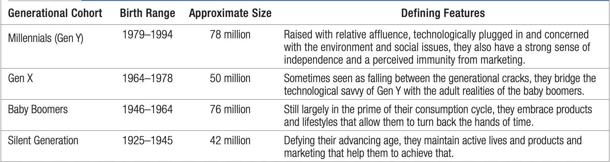
GENERATION
Although the beginning and ending birth dates of any generation are always subjective— and generalizations can mask important differences within the group—here are some general observations about the four main generation cohorts of consumers, from youngest to oldest.
Profiling U.S. Generation Cohorts

Slide 18
Millennials (or Gen Y)
Born between 1979 and 1994, Millennials, also called Gen Y, number 78 million with annual spending power estimated at $187 billion. If you factor in career growth and household and family formation, and multiply by another 53 years of life expectancy, trillions of dollars in consumer spending are at stake over their life spans. It’s not surprising that market researchers and advertisers are racing to get a bead on Gen Y’s buying behavior.
Also known as the Echo Boomers, these consumers have been “wired” almost from birth— playing computer games, navigating the Web, downloading music, connecting with friends via instant messaging and mobile phones. They have a sense of entitlement and abundance from growing up during the economic boom and being pampered by their boomer parents. Yet they are highly socially conscious and concerned about environmental issues. They are selective, confident, and impatient.

Slide 19
Gen X
Often lost in the demographic shuffle, the 50 million or so Gen X consumers, named for a 1991 novel by Douglas Coupland, were born between 1964 and 1978. The popularity of Kurt Cobain, rock band Nirvana, and the lifestyle portrayed in the critically lauded film Slacker led to the use of terms like grunge and slacker to characterize Gen X teens and young adults. It was an unflattering image of a disaffected group with short attention spans and little work ethic.
These stereotypes slowly disappeared. Gen X was certainly raised in more challenging times, when working parents relied on day care or left “latchkey kids” on their own after school, and corporate downsizing led to the threat of layoffs and economic uncertainty. At the same time, social and racial diversity were accepted and technology rapidly changed the way people lived and worked. Although Gen Xers created new norms in educational achievement, they were also the first generation to find surpassing their parents’ standard of living a serious challenge.
These realities had a profound impact. Gen Xers feel self-sufficiency and the ability to handle any circumstance are key. Technology is an enabler for them, not a barrier. Unlike the more optimistic, team-oriented Gen Yers, Gen Xers are more pragmatic and individualistic. As consumers, they are wary of hype and pitches that seem inauthentic or patronizing. Direct appeals where value is clear often works best, especially as Gen Xers become parents raising families.

Slide 20
Baby Boomers
Baby boomers are the approximately 76 million U.S. consumers born between 1946 and 1964. Though they represent a wealthy target, possessing $1.2 trillion in annual spending power and controlling three-quarters of the country’s wealth, marketers often overlook them. In network television circles, because advertisers are primarily interested in 18- to 49-year-olds, viewers over 50 are referred to as “undesirables.”
With many baby boomers moving into their 60s and even the last and youngest wave bearing down on 50, demand has exploded for products to turn back the hands of time. According to one survey, nearly one in five boomers was actively resisting the aging process, driven by the mantra, “Fifty is the new thirty.” As they search for the fountain of youth, sales of hair replacement and hair coloring aids, health club memberships, home gym equipment, skin-tightening creams, nutritional supplements, and organic foods have all soared.

Slide 21
Baby Boomers
Interestingly, because so many members of the Gen Y “Echo Boomers” are living with their boomer parents, parents are being influenced by what demographers are calling a “boom-boom effect.” The same products that appeal to 21-year-olds are appealing to youth-obsessed baby boomers. The multiseason success of MTV’s reality show The Osbournes, starring heavy-metal rocker Ozzy Osbourne and his family, was fueled as much by boomer parents as by their MTVloving kids.
Contrary to conventional marketing wisdom that brand preferences of consumers over 50 are fixed, one study found 52 percent of boomers are willing to change brands, in line with the total population. Although they love to buy things, they hate being sold to, and as one marketer noted, “You have to earn your stripes every day.” But abundant opportunity exists. Boomers are also less likely to associate retirement with “the beginning of the end” and see it instead as a new chapter in their lives with new activities, interests, careers, or even relationships.

Slide 22
Silent Generation
Those born between 1925 and 1945—the “Silent Generation”—are redefining what old age means. To start with, many people whose chronological age puts them in this category don’t see themselves as old. One survey found that 60 percent of respondents over 65 said they felt younger than their actual age. A third aged 65 to 74 said they felt 10 to 19 years younger, and one in six felt at least 20 years younger than their actual age.
Consistent with what they say, many older consumers lead very active lives. As one expert noted, it is if they were having a second middle age before becoming elderly. Advertisers have learned that older consumers don’t mind seeing other older consumers in ads targeting them, as long as they appear to be leading vibrant lives. But marketers have learned to avoid clichés like happy older couples riding bikes or strolling hand-in-hand on a beach at sunset.
Emphasizing their roles as grandparents is universally well-received. Many older consumers not only happily spend time with their grandkids, they often provide for their basic needs or at least occasional gifts. The founders of eBeanstalk.com, which sells children’s learning toys online, thought their business would be largely driven by young consumers starting families. They were surprised to find that up to 40 percent of their customers were older consumers, mainly grandparents. These customers are very demanding, but also more willing to pay full price than their younger counterparts.

Slide 23
RACE AND CULTURE
Multicultural marketing is an approach recognizing that different ethnic and cultural segments have sufficiently different needs and wants to require targeted marketing activities, and that a mass market approach is not refined enough for the diversity of the marketplace. Consider that McDonald’s now does 40 percent of its U.S. business with ethnic minorities. Its highly successful “I’m Lovin’ It” campaign was rooted in hip-hop culture but has had an appeal that transcended race and ethnicity.
The Hispanic American, African American, and Asian American markets are all growing at two to three times the rate of nonmulticultural populations, with numerous submarkets, and their buying power is expanding. Multicultural markets also vary in whether they are first and second (or more) generation, and whether they are immigrants or born and raised in the United States.
The norms, language nuances, buying habits, and business practices of multicultural markets need to be factored into the initial formulation of a marketing strategy, rather than added as an afterthought. All this diversity also has implications for marketing research; it takes careful sampling to adequately profile target markets.

Slide 24
RACE AND CULTURE
Multicultural marketing can result in different marketing messages, media, channels, and so on. Specialized media exists to reach virtually any cultural segment or minority group, though some companies have struggled to provide financial and management support for fully realized programs.
Fortunately, as countries become more culturally diverse, many marketing campaigns targeting a specific cultural group can spill over and positively influence others. An ad for Tide in which an African American man wearing a wedding ring was drying his son off after a bath was well regarded by both African Americans and the market as a whole.
Boost Mobile has leveraged a shared interest in youth culture to create a diverse customer base of young adults made up of 35 percent African Americans, 27 percent Hispanic Americans, and 32 percent Caucasians.28 Next, we consider issues in the three largest multicultural markets—Hispanic Americans, African Americans, and Asian Americans.
QUESTION: What kind of national minorities are there in Your country?

Slide 25
EXAMPLES of ADVERTISEMENTS OR CAMPAIGNS that have targeted national Minoritiers
Heineken's “Open Your World” Campaign: This campaign included advertisements that celebrated diversity and inclusion across Europe, featuring individuals from various ethnic backgrounds sharing their experiences and cultures.
IKEA’s “The Many Faces of Home” Campaign: IKEA launched ads featuring families from diverse backgrounds, including national minorities, emphasizing the importance of home for everyone, regardless of their cultural heritage.
L'Oréal's “My Shade, My Identity” Campaign: L'Oréal has run ads in several European countries showcasing a diverse range of models with varying skin tones and showcasing beauty products tailored for different ethnic groups, including those from minority communities.
Nike's “Equality” Campaign: Nike has created advertisements that discuss social justice topics through the lens of sports, featuring athletes from diverse backgrounds, including national minorities, advocating for equality and inclusion.
Cadbury's “Unity” Campaign: This campaign highlighted different cultural celebrations and diversity within the UK, showing how chocolate can bring people together across cultural divides.
The BBC’s Representation Initiatives: The BBC has launched multiple campaigns promoting diversity in its programming, showcasing stories and characters from national minority backgrounds, aiming to reflect the diversity of the UK.

Slide 26
Psychographic Segmentation
Psychographics is the science of using psychology and demographics to better understand consumers. In psychogafic segmentation, buyers are divided into different groups on the basis of psychological/personality traits, lifestyle, or values. People within the same demographic group can exhibit very different psychographic profiles.
One of the most popular commercially available classification systems based on psychographic measurements is Strategic Business Insight’s (SBI) VALS™ framework. VALS, signifying values and lifestyles, classifies adults into eight primary groups based on responses to a questionnaire featuring 4 demographic and 35 attitudinal questions. The VALS system is continually updated with new data from more than 80,000 surveys per year (You can find out which VALS type you are by going to the SBI Web site.

Slide 27
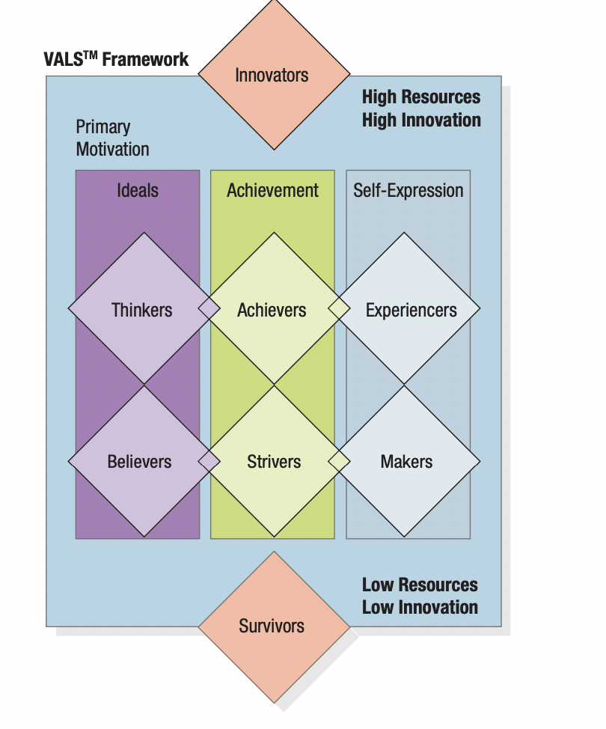
The VALS Segmentation System: An Eight-Part Typology

Slide 28
The VALS Segmentation
The main dimensions of the VALS segmentation framework are consumer motivation (the horizontal dimension) and consumer resources (the vertical dimension). Consumers are inspired by one of three primary motivations: ideals, achievement, and self-expression. Those primarily motivated by ideals are guided by knowledge and principles. Those motivated by achievement look for products and services that demonstrate success to their peers.
Consumers whose motivation is self-expression desire social or physical activity, variety, and risk. Personality traits such as energy, self-confidence, intellectualism, novelty seeking, innovativeness, impulsiveness, leadership, and vanity—in conjunction with key demographics—determine an individual’s resources. Different levels of resources enhance or constrain a person’s expression of his or her primary motivation.

Slide 29
The VALS Segmentation
The four groups with higher resources are:
Innovators—Successful, sophisticated, active, “take-charge” people with high self-esteem. Purchases often reflect cultivated tastes for relatively upscale, niche-oriented products and services.
Thinkers—Mature, satisfied, and reflective people motivated by ideals and who value order, knowledge, and responsibility. They seek durability, functionality, and value in products.
Achievers—Successful, goal-oriented people who focus on career and family. They favor premium products that demonstrate success to their peers.
Experiencers—Young, enthusiastic, impulsive people who seek variety and excitement. They spend a comparatively high proportion of income on fashion, entertainment, and socializing.

Slide 30
The VALS Segmentation
The four groups with lower resources are:
Believers—Conservative, conventional, and traditional people with concrete beliefs. They prefer familiar, U.S.-made products and are loyal to established brands.
Strivers—Trendy and fun-loving people who are resource-constrained. They favor stylish products that emulate the purchases of those with greater material wealth.
Makers—Practical, down-to-earth, self-sufficient people who like to work with their hands. They seek U.S.-made products with a practical or functional purpose.
Survivors—Elderly, passive people concerned about change and loyal to their favorite brands.
Marketers can apply their understanding of VALS segments to marketing planning. For example, Transport Canada, the agency that operates major Canadian airports, found that Actualizers, who desire to express independence and taste, made up a disproportionate percentage of air travelers. Given that segment’s profile, stores such as Sharper Image and Nature Company were expected to do well in the firm’s airports.

Slide 31
Behavioral Segmentation
In behavioral segmentation, marketers divide buyers into groups on the basis of their knowledge of, attitude toward, use of, or response to a product.
NEEDS AND BENEFITS Not everyone who buys a product has the same needs or wants the same benefits from it. Needs-based or benefit-based segmentation is a widely used approach because it identifies distinct market segments with clear marketing implications. Constellation Brands identified six different benefit segments in the U.S. premium wine market ($5.50 a bottle and up)
Enthusiast (12 percent of the market). Skewing female, their average income is about $76,000 a year. About 3 percent are “luxury enthusiasts” who skew more male with a higher income.
Image Seekers (20 percent). The only segment that skews male, with an average age of 35. They use wine basically as a badge to say who they are, and they’re willing to pay more to make sure they’re getting the right bottle. • Savvy Shoppers (15 percent). They love to shop and believe they don’t have to spend a lot to get a good bottle of wine. Happy to use the bargain bin.

Slide 32
Behavioral Segmentation
Traditionalist (16 percent). With very traditional values, they like to buy brands they’ve heard of and from wineries that have been around a long time. Their average age is 50 and they are 68 percent female.
Satisfied Sippers (14 percent). Not knowing much about wine, they tend to buy the same brands. About half of what they drink is white zinfandel.
Overwhelmed (23 percent). A potentially attractive target market, they find purchasing wine confusing.

Slide 33
DECISION ROLES
It’s easy to identify the buyer for many products. In the United States, men normally choose their shaving equipment and women choose their pantyhose; but even here marketers must be careful in making targeting decisions, because buying roles change. When ICI, the giant British chemical company, discovered that women made 60 percent of decisions on the brand of household paint, it decided to advertise its Dulux brand to women.
People play five roles in a buying decision: Initiator, Influencer, Decider, Buyer, and User. For example, assume a wife initiates a purchase by requesting a new treadmill for her birthday. The husband may then seek information from many sources, including his best friend who has a treadmill and is a key influencer in what models to consider. After presenting the alternative choices to his wife, he purchases her preferred model, which ends up being used by the entire family. Different people are playing different roles, but all are crucial in the decision process and ultimate consumer satisfaction.

Slide 34
MARKET TARGETING
There are many statistical techniques for developing market segments Once the firm has identified its market-segment opportunities, it must decide how many and which ones to target. Marketers are increasingly combining several variables in an effort to identify smaller, better-defined target groups. Thus, a bank may not only identify a group of wealthy retired adults but within that group distinguish several segments depending on current income, assets, savings, and risk preferences. This has led some market researchers to advocate a needs-based market segmentation approach.

Slide 35
Effective Segmentation Criteria
Not all segmentation schemes are useful. We could divide buyers of table salt into blond and brunette customers, but hair color is undoubtedly irrelevant to the purchase of salt. Furthermore, if all salt buyers buy the same amount of salt each month, believe all salt is the same, and would pay only one price for salt, this market is minimally segmentable from a marketing point of view. To be useful, market segments must rate favorably on five key criteria:
Measurable. The size, purchasing power, and characteristics of the segments can be measured.
Substantial. The segments are large and profitable enough to serve. A segment should be the largest possible homogeneous group worth going after with a tailored marketing program. It would not pay, for example, for an automobile manufacturer to develop cars for people who are less than four feet tall.
Accessible. The segments can be effectively reached and served
Differentiable. The segments are conceptually distinguishable and respond differently to different marketing-mix elements and programs. If married and unmarried women respond similarly to a sale on perfume, they do not constitute separate segments.
Actionable. Effective programs can be formulated for attracting and serving the segments.

Slide 36
Effective Segmentation Criteria
Michael Porter has identified five forces that determine the intrinsic long-run attractiveness of a market or market segment: industry competitors, potential entrants, substitutes, buyers, and suppliers. The threats these forces pose are as follows:
Threat of intense segment rivalry—A segment is unattractive if it already contains numerous, strong, or aggressive competitors. It’s even more unattractive if it’s stable or declining, if plant capacity must be added in large increments, if fixed costs or exit barriers are high, or if competitors have high stakes in staying in the segment. These conditions will lead to frequent price wars, advertising battles, and new-product introductions and will make it expensive to compete. The cellular phone market has seen fierce competition due to segment rivalry.
Threat of new entrants—The most attractive segment is one in which entry barriers are high and exit barriers are low. Few new firms can enter the industry, and poorly performing firms can easily exit. When both entry and exit barriers are high, profit potential is high, but firms face more risk because poorer-performing firms stay in and fight it out. When both entry and exit barriers are low, firms easily enter and leave the industry, and returns are stable but low. The worst case is when entry barriers are low and exit barriers are high: Here firms enter during good times but find it hard to leave during bad times. The result is chronic overcapacity and depressed earnings for all. The airline industry has low entry barriers but high exit barriers, leaving all carriers struggling during economic downturns.

Slide 37
Effective Segmentation Criteria
Threat of substitute products A segment is unattractive when there are actual or potential substitutes for the product. Substitutes place a limit on prices and on profits. If technology advances or competition increases in these substitute industries, prices and profits are likely to fall. Air travel has severely challenged profitability for Greyhound and Amtrak.
Threat of buyers’ growing bargaining power - A segment is unattractive if buyers possess strong or growing bargaining power. The rise of retail giants such as Walmart has led some analysts to conclude that the potential profitability of packaged-goods companies will become curtailed. Buyers’ bargaining power grows when they become more concentrated or organized, when the product represents a significant fraction of their costs, when the product is undifferentiated, when buyers’ switching costs are low, when buyers are price-sensitive because of low profits, or when they can integrate upstream. To protect themselves, sellers might select buyers who have the least power to negotiate or switch suppliers. A better defense is developing superior offers that strong buyers cannot refuse.
Threat of suppliers’ growing bargaining power -A segment is unattractive if the company’s suppliers are able to raise prices or reduce quantity supplied. Suppliers tend to be powerful when they are concentrated or organized, when they can integrate downstream, when there are few substitutes, when the supplied product is an important input, and when the costs of switching suppliers are high. The best defenses are to build win-win relationships with suppliers or use multiple supply sources

Slide 38
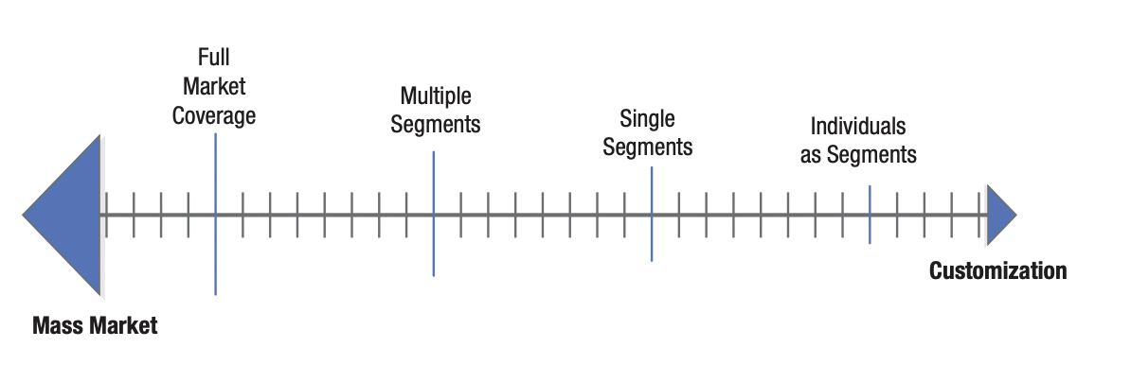
Evaluating and Selecting the Market Segments
In evaluating different market segments, the firm must look at two factors: the segment’s overall attractiveness and the company’s objectives and resources. How well does a potential segment score on the five criteria? Does it have characteristics that make it generally attractive, such as size, growth, profitability, scale economies, and low risk? Does investing in the segment make sense given the firm’s objectives, competencies, and resources? Some attractive segments may not mesh with the company’s long-run objectives, or the company may lack one or more necessary competencies to offer superior value. Marketers have a range or continuum of possible levels of segmentation that can guide their target market decisions.

Slide 39
FULL MARKET COVERAGE
With full market coverage, a firm attempts to serve all customer groups with all the products they might need. Only very large firms such as Microsoft (software market), General Motors (vehicle market), and Coca-Cola (nonalcoholic beverage market) can undertake a full market coverage strategy. Large firms can cover a whole market in two broad ways: through differentiated or undifferentiated marketing.
In undifferentiated or mass marketing, the firm ignores segment differences and goes after the whole market with one offer. It designs a marketing program for a product with a superior image that can be sold to the broadest number of buyers via mass distribution and mass communications. Undifferentiated marketing is appropriate when all consumers have roughly the same preferences and the market shows no natural segments. Henry Ford epitomized this strategy when he offered the Model-T Ford in one color, black.

Slide 40
MULTIPLE SEGMENT SPECIALIZATION
With selective specialization, a firm selects a subset of all the possible segments, each objectively attractive and appropriate. There may be little or no synergy among the segments, but each promises to be a moneymaker. When Procter & Gamble launched Crest Whitestrips, initial target segments included newly engaged women and brides-tobe as well as gay males. The multisegment strategy also has the advantage of diversifying the firm’s risk.
Keeping synergies in mind, companies can try to operate in supersegments rather than in isolated segments. A supersegment is a set of segments sharing some exploitable similarity. For example, many symphony orchestras target people who have broad cultural interests, rather than only those who regularly attend concerts. A firm can also attempt to achieve some synergy with product or market specialization.

Slide 41
SINGLE-SEGMENT CONCENTRATION
With single-segment concentration, the firm markets to only one particular segment. Porsche concentrates on the sports car market and Volkswagen on the small-car market—its foray into the large-car market with the Phaeton was a failure in the United States. Through concentrated marketing, the firm gains deep knowledge of the segment’s needs and achieves a strong market presence. It also enjoys operating economies by specializing its production, distribution, and promotion. If it captures segment leadership, the firm can earn a high return on its investment.
A niche is a more narrowly defined customer group seeking a distinctive mix of benefits within a segment. Marketers usually identify niches by dividing a segment into subsegments. Whereas Hertz, Avis, Alamo, and others specialize in airport rental cars for business and leisure travelers, Enterprise has attacked the low-budget, insurance-replacement market by primarily renting to customers whose cars have been wrecked or stolen. By creating unique associations to low cost and convenience in an overlooked niche market, Enterprise has been highly profitable.

Slide 42
INDIVIDUAL MARKETING
The ultimate level of segmentation leads to “segments of one,” “customized marketing,” or “one-to-one marketing.” Today, customers are taking more individual initiative in determining what and how to buy. They log onto the Internet; look up information and evaluations of product or service offerings; conduct dialogue with suppliers, users, and product critics; and in many cases design the product they want.
Jerry Wind and Arvind Rangaswamy see a movement toward “customerizing” the firm. Customerization combines operationally driven mass customization with customized marketing in a way that empowers consumers to design the product and service offering of their choice. The firm no longer requires prior information about the customer, nor does it need to own manufacturing. It provides a platform and tools and “rents” to customers the means to design their own products. A company is customerized when it is able to respond to individual customers by customizing its products, services, and messages on a one-to-one basis.

Slide 43
ETHICAL CHOICE OF MARKET TARGETS
Marketers must target carefully to avoid consumer backlash. Some consumers resist being labeled. Singles may reject single-serve food packaging because they don’t want to be reminded they are eating alone. Elderly consumers who don’t feel their age may not appreciate products that label them “old.”
Market targeting also can generate public controversy when marketers take unfair advantage of vulnerable groups (such as children) or disadvantaged groups (such as inner-city poor people) or promote potentially harmful products. The cereal industry has been heavily criticized for marketing efforts directed toward children. Critics worry that high-powered appeals presented through the mouths of lovable animated characters will overwhelm children’s defenses and lead them to want sugared cereals or poorly balanced breakfasts. Toy marketers have been similarly criticized.

Slide 44
THANK YOU FOR YOUR ATTENTION

