Slide 1
Political Socio-economic and Legal Thought
classes

Slide 2
Piotr Kantor-Kozdrowicki
piotr.kozdrowicki@uwr.edu.pl
https://prawo.uni.wroc.pl/user/33381
consultations: room 306 (building A)

Slide 3
How to pass the classes?
Every Student needs to write 2 essays
deadline: 31.12.2019
Every Student needs to present one of his/her essays at the classes
start of presentations: 21.10.2019
4-6 presentations at each classes (max 10 minutes long, multimedia recommended)
Attendance
2 absences possible

Slide 4
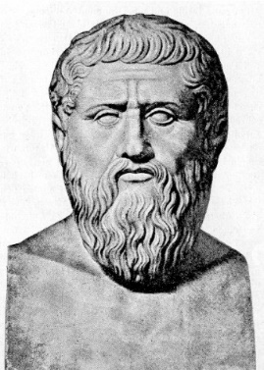
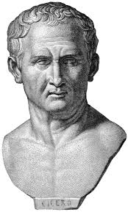
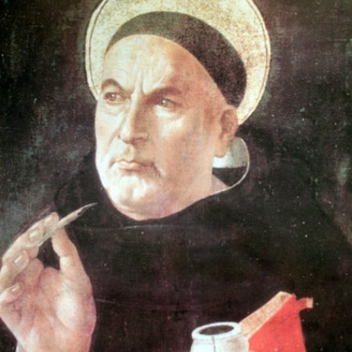
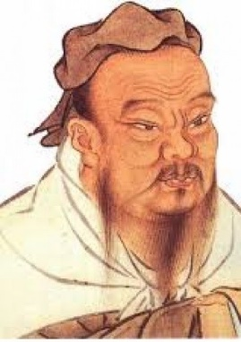
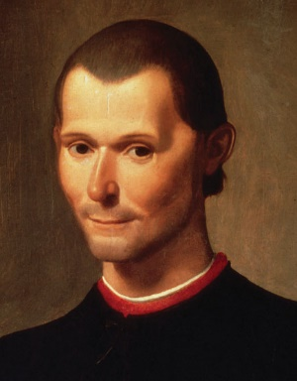
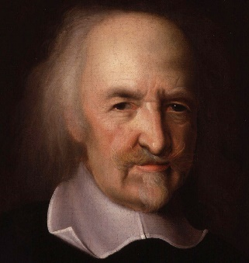
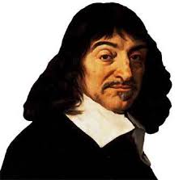
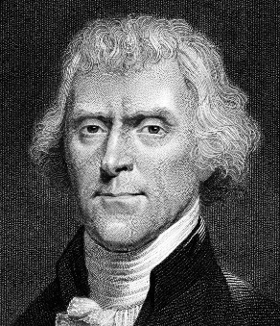
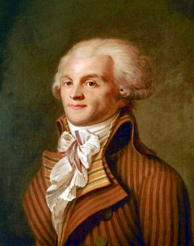
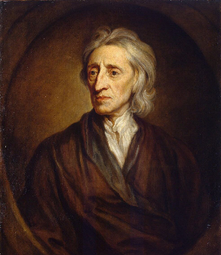
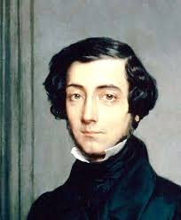
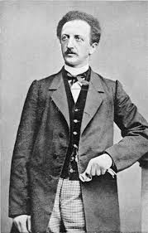
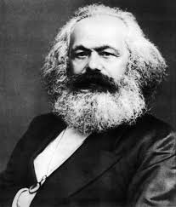
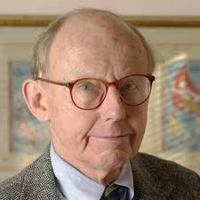
Essays and presentations

Slide 5
Essays and presentations
State
Economy
Law
Bio
Morality
Society

Slide 6
Example: Plato
State:
guided by philosophers
theory of 5 regimes
aristocracy as best political system
democracy as depraved regime, close to the tyranny
Economy:
no private property for lower classes
every good is a property of the State
Law:
can be created only by philosophers
restrictive
Bio:
427—347 B.C.E.
student of Socrates, teacher of Aristotle
author of the Dialogues
Morality:
Justice as the most important value
always to serve the state!
good education
Society:
divided into 3 classes:
Philosophers – rulers
Soldiers – Guards
Citizens – Providers

Slide 7
Tasks until next classes:
1. Every Student needs to chose its own 2 topics
deadline of notifying about chosen topics: 14.10.2019
2. First 4 Students present one of their topics at classes on 21.10
deadline of notifying about presented topics: 14.10.2019

Slide 8
Useful sources:
A History of Western Political Thought, J. S. McCleland, Routledge, London 1998
A History of Political Thought: from Antiquity to the Present, Bruce Haddock, Polity, New York 2008
Internet Encyclopedia of Philosophy - http://www.iep.utm.edu/
YouTube channel The School of Life (some of playlists) - https://www.youtube.com/user/schooloflifechannel/playlists?view=50&sort=dd&shelf_id=22
Thank You!

