Slide 1
Political Socio-economic and Legal Thought
classes

Slide 2
Piotr S. Kozdrowicki
piotr.kozdrowicki@uwr.edu.pl
https://prawo.uni.wroc.pl/user/33381
Teams: gmvkjp0

Slide 3
How to pass the classes?
Every Student needs to write 2 essays
deadline: 31.12.2020
text volume: max 2 standard pages
Every Student needs to present one topic at the classes
start of presentations: 20.10.2020 2-4 presentations at each classes (max 15 minutes long, multimedia obligatory)

Slide 4
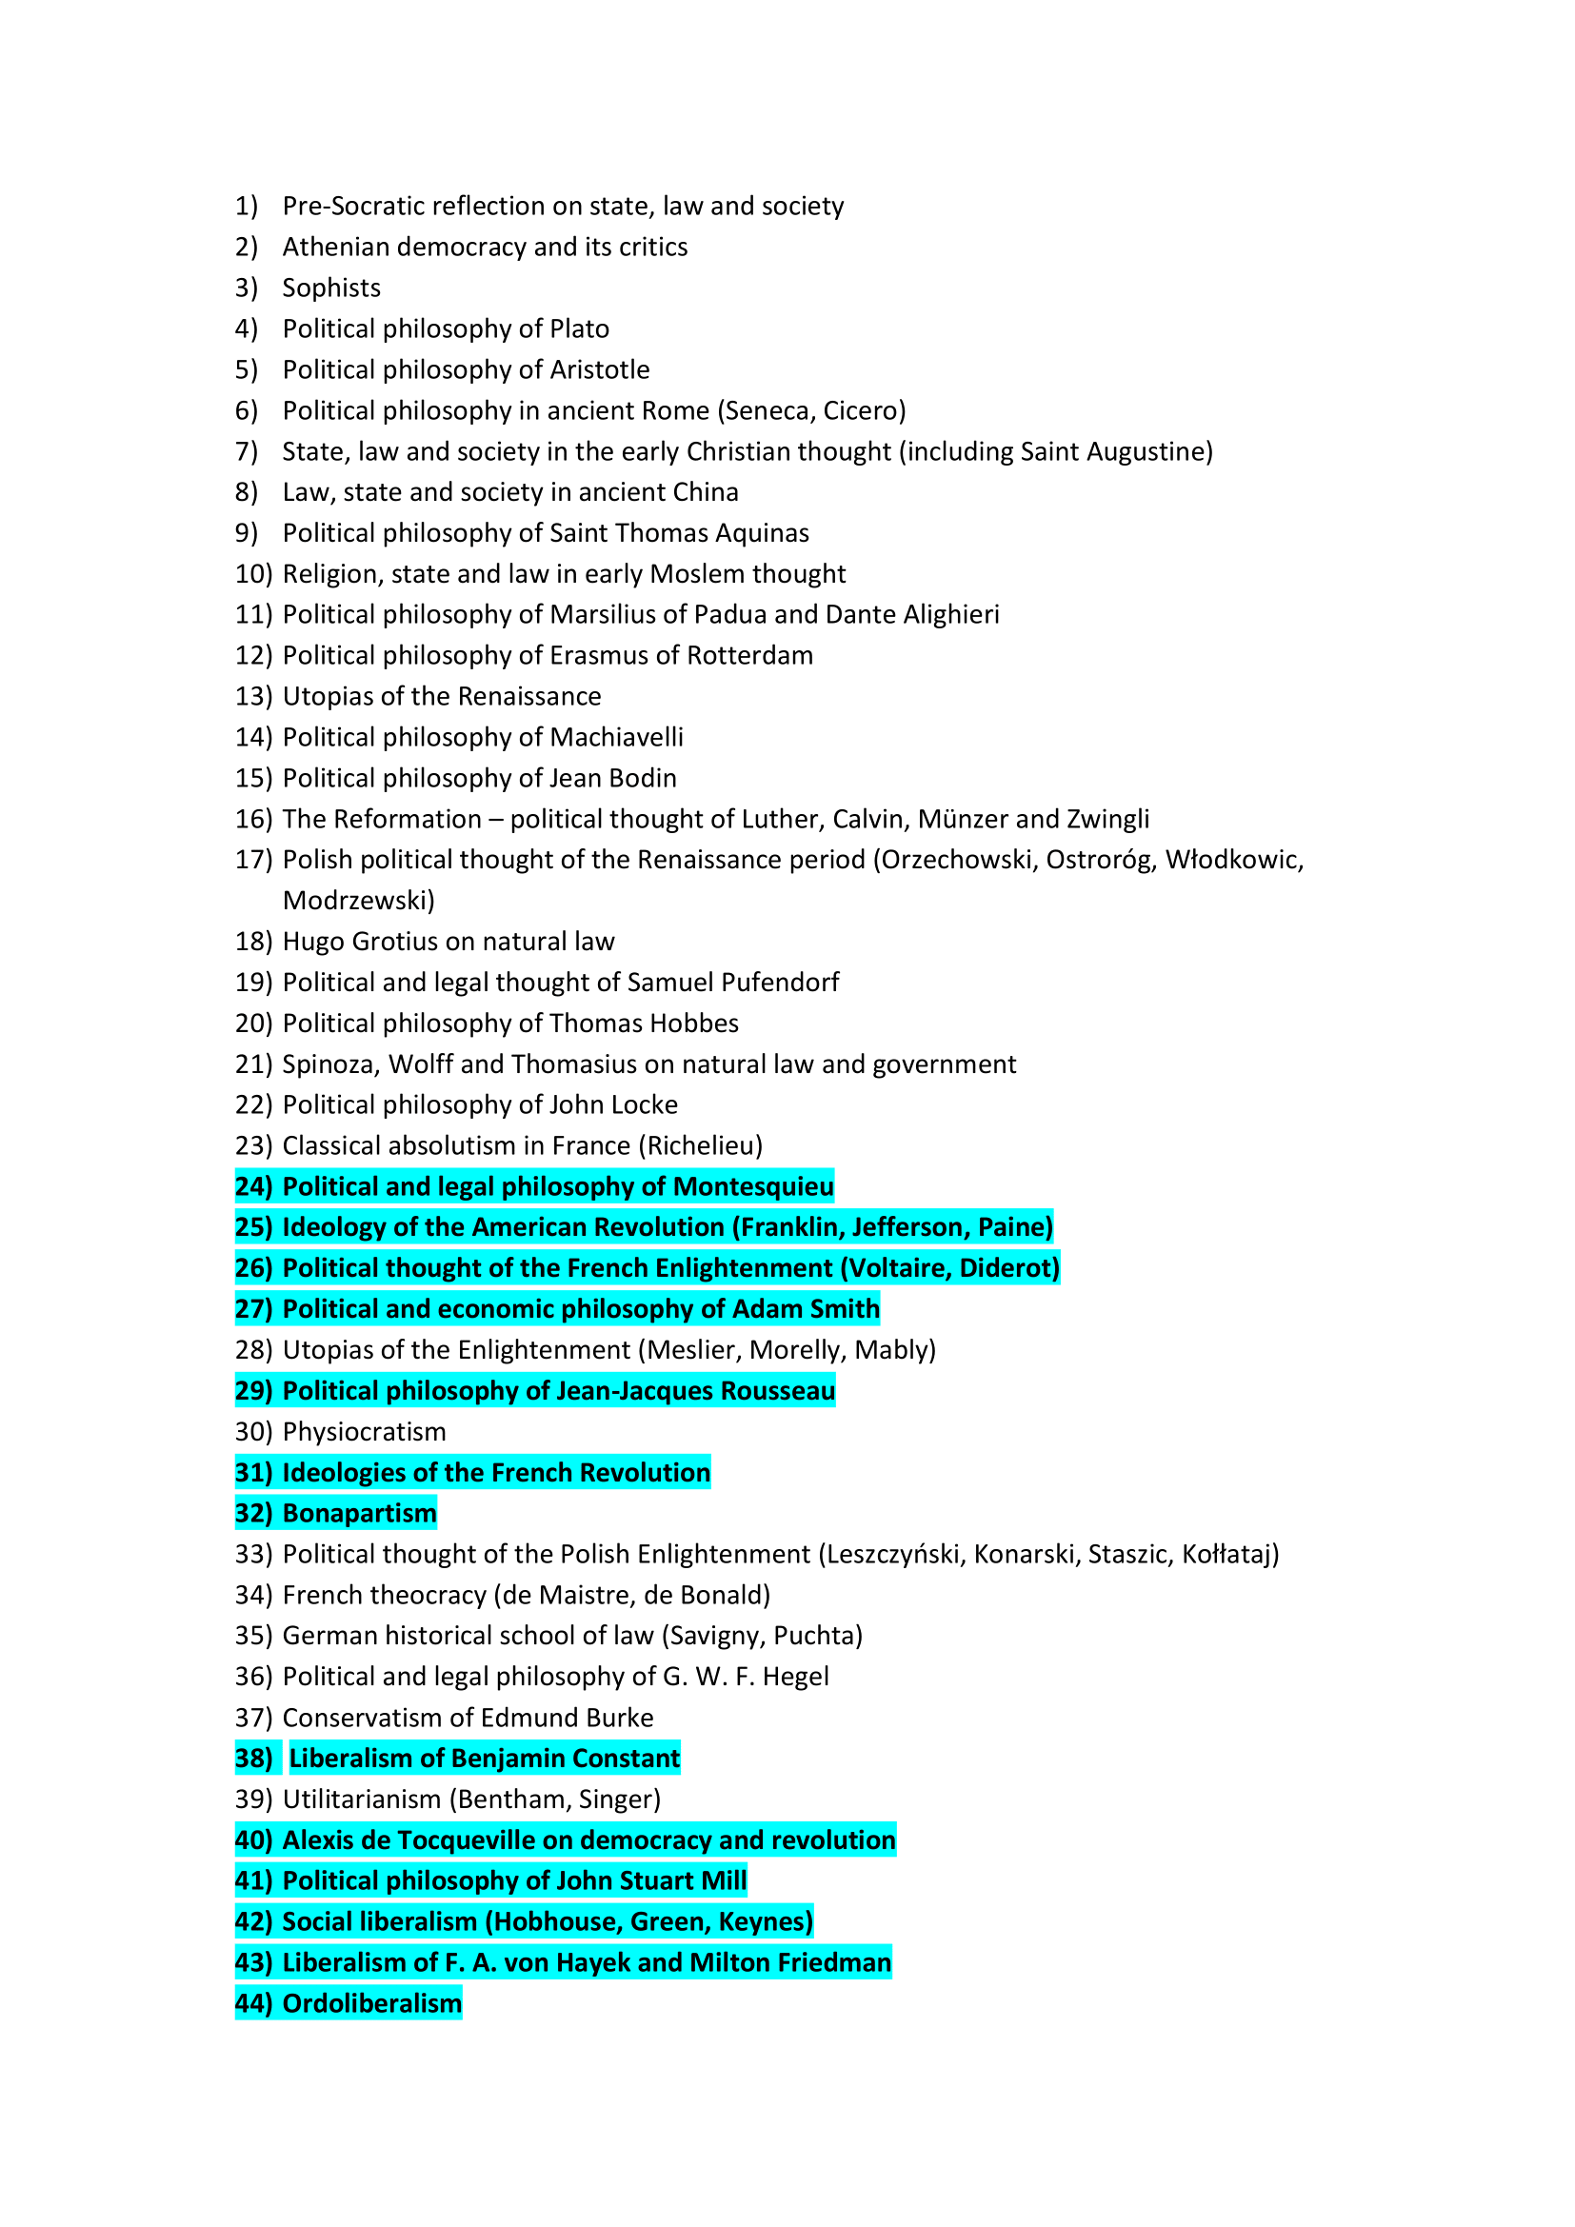
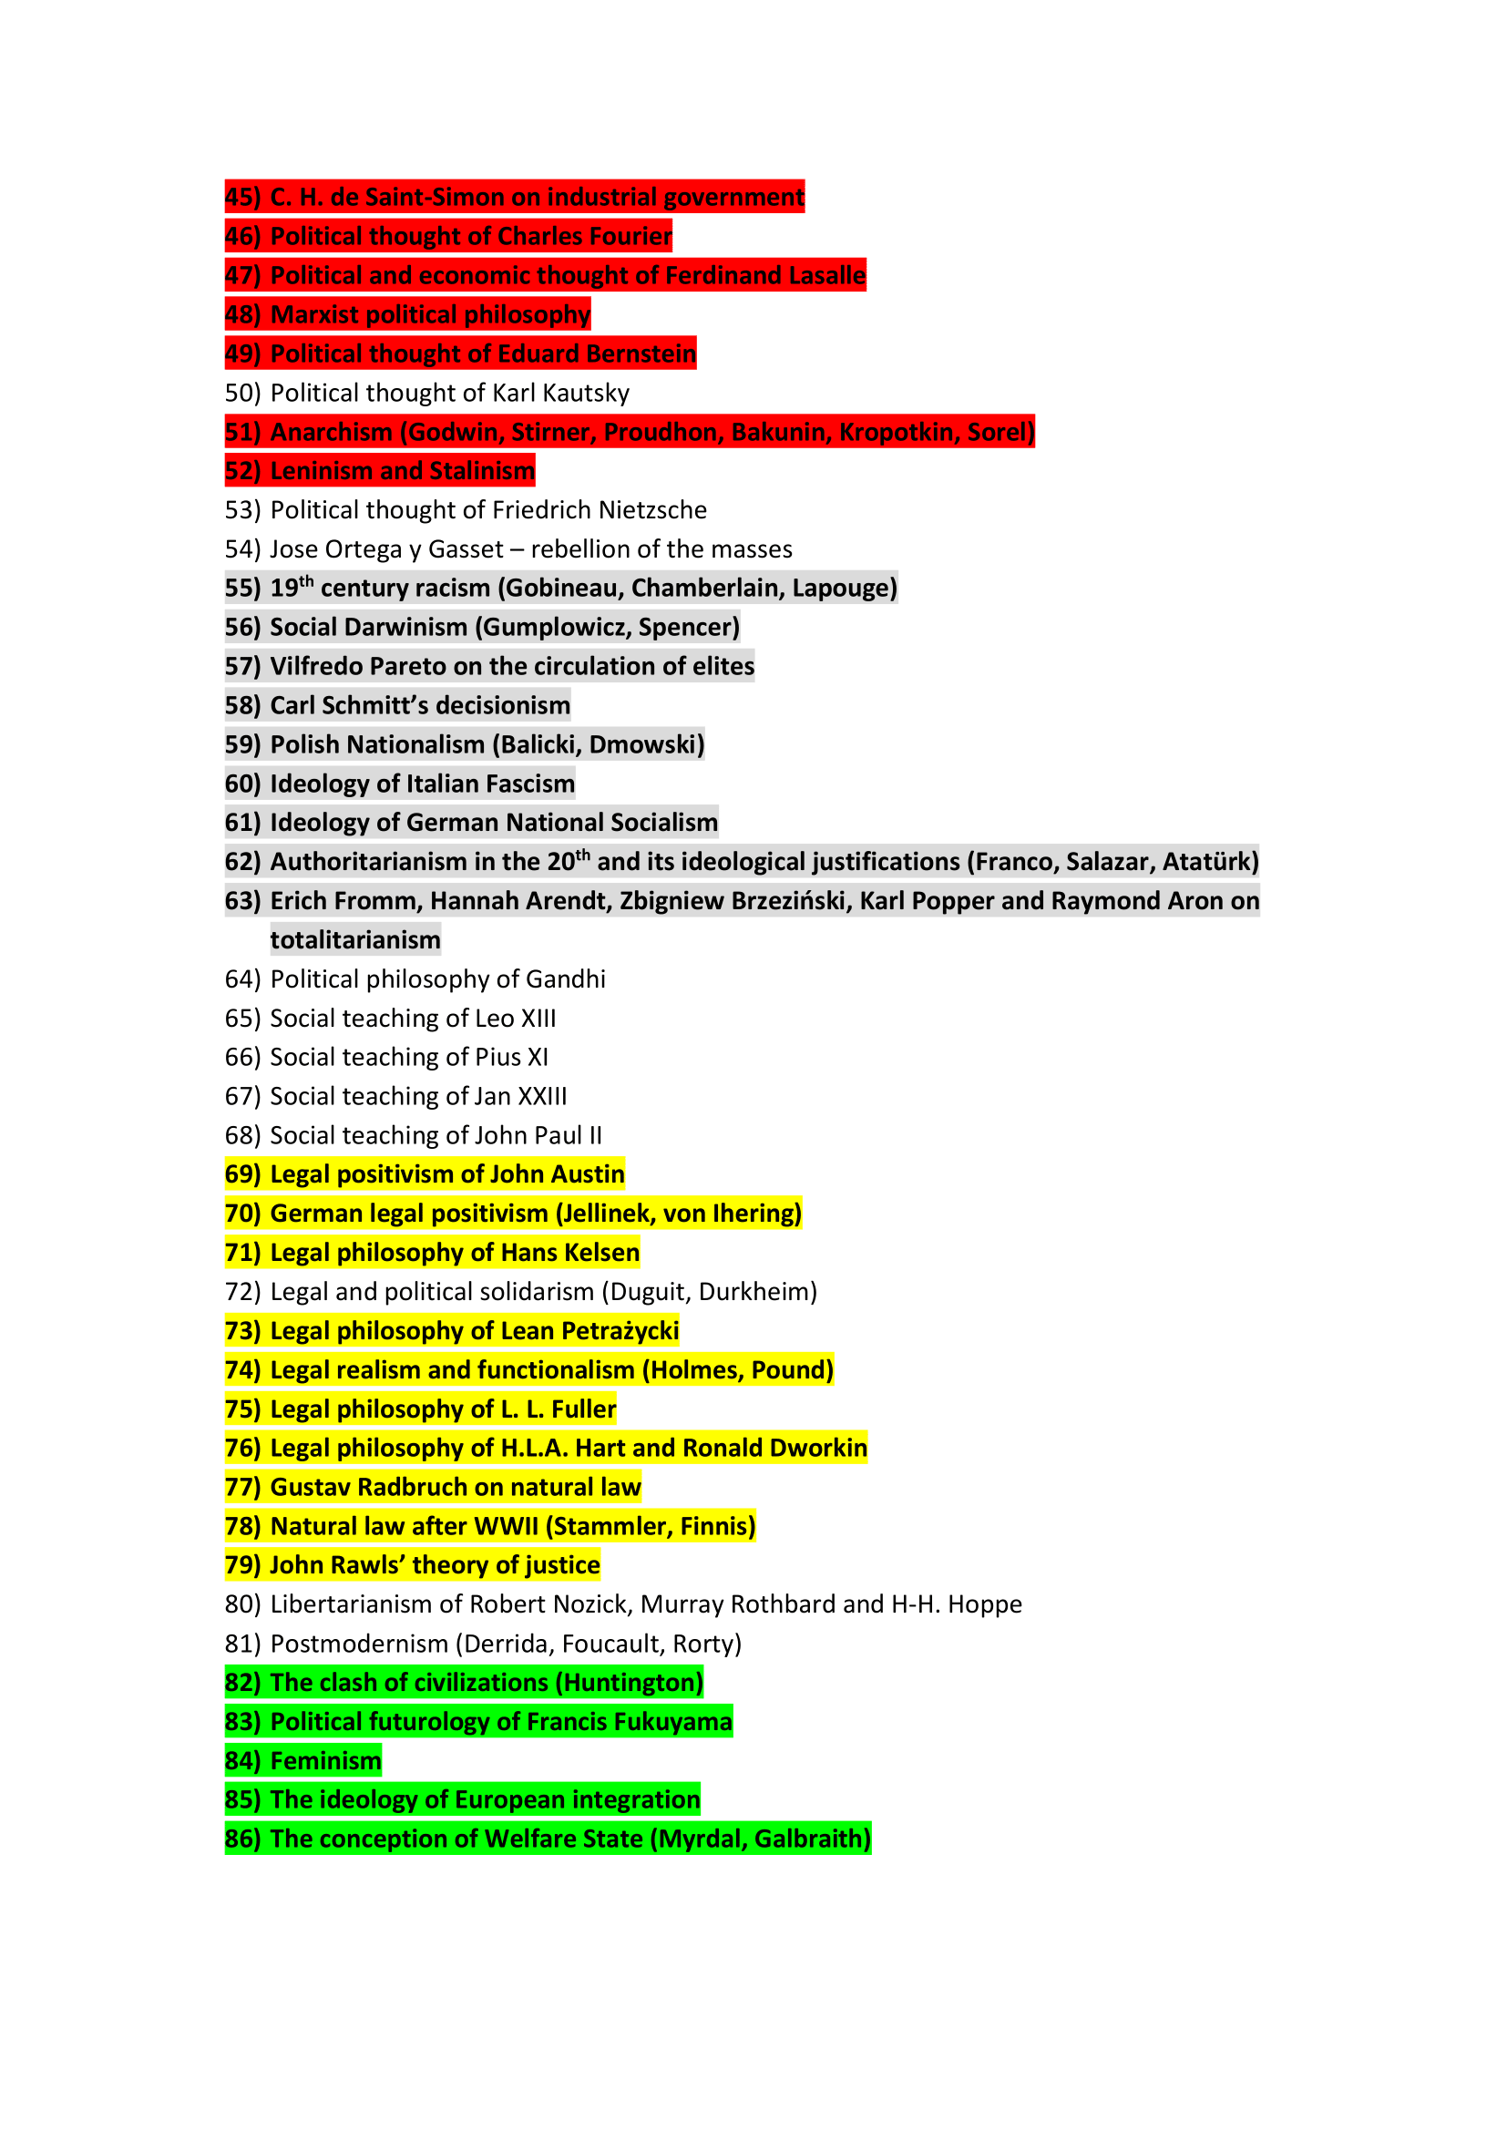
List of topics for the essays:

Slide 5
List of subjects for the presentations:
Populism - 2020-10-13 (led by a teacher)
Enlightenment and liberalism - 2020-10-20
Socialism and communism - 2020-10-27
Racism and totalitarianism - 2020-11-03
Theory and philosophy of law - 2020-11-10
Modern and future ideas - 2020-11-17

Slide 6
Presentations of online Students:
Given online via Teams group
(in accordance with the rules above)
If not possible: additional extra essay

Slide 7
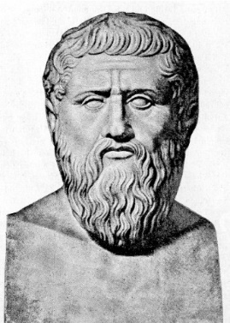
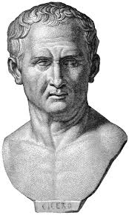
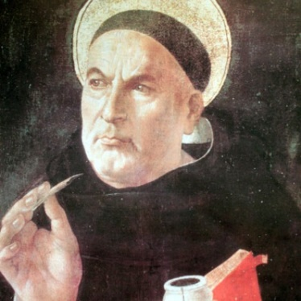
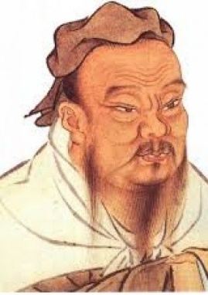
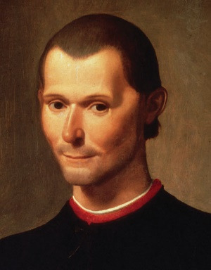
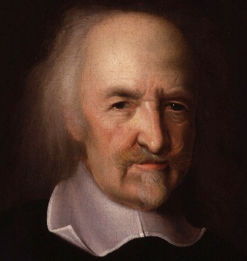
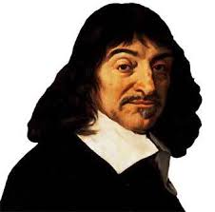
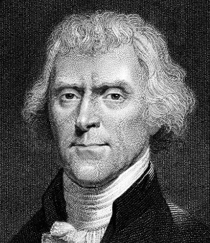
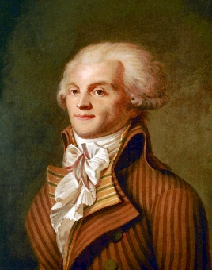
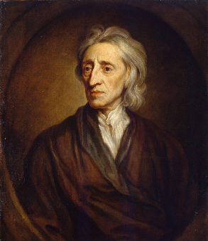
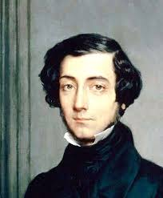
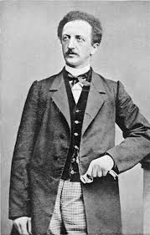
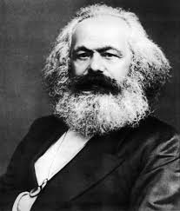
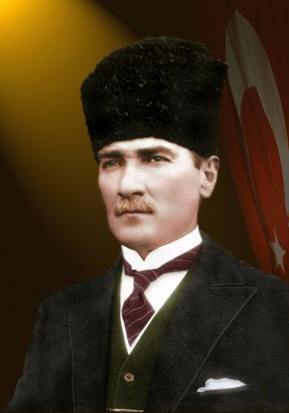
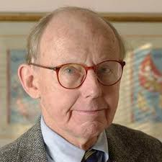
Essays and presentations

Slide 8
Essays and presentations
State
Economy
Law
Bio
Morality
Society

Slide 9
Example: Plato
State:
guided by philosophers
theory of 5 regimes
aristocracy as best political system
democracy as depraved regime, close to the tyranny
Economy:
no private property for lower classes
every good is a property of the State
Law:
can be created only by philosophers
restrictive
Bio:
427—347 B.C.E.
student of Socrates, teacher of Aristotle
author of the Dialogues
Morality:
Justice as the most important value
always to serve the state!
good education
Society:
divided into 3 classes:
Philosophers – rulers
Soldiers – Guards
Citizens – Providers

Slide 10
Tasks until next classes:
1. Every Student needs to chose its own 2 topics
deadline of notifying about chosen topics: 13.10.2020
2. First Students will present one of their topics at classes on 20.10.2020
deadline of notifying about presented topics: 18.10.2020

Slide 11
Useful sources:
A History of Western Political Thought, J. S. McCleland, Routledge, London 1998
A History of Political Thought: from Antiquity to the Present, Bruce Haddock, Polity, New York 2008
Internet Encyclopedia of Philosophy - http://www.iep.utm.edu/
YouTube channel The School of Life (some of playlists) - https://www.youtube.com/user/schooloflifechannel/playlists?view=50&sort=dd&shelf_id=22
Thank You!

