Slide 1
Political, Socio-economic and Legal Thought
Classes 13.10.2020

Slide 2
Piotr S. Kozdrowicki
piotr.kozdrowicki@uwr.edu.pl Teams: gmvkjp0
How to pass the classes?
Write and sent to essays until 31th Dec 2020
Present one of the essays at the classes
List of topics: https://bit.ly/3iSPk2K
Table of selected topics and presentations: https://bit.ly/3lEvFW8

Slide 3
video:
https://www.youtube.com/watch?v=cnzo9qXLFUo

Slide 4
POPULISM
philosophic fundaments,
political origins,
modern interpretations

Slide 5
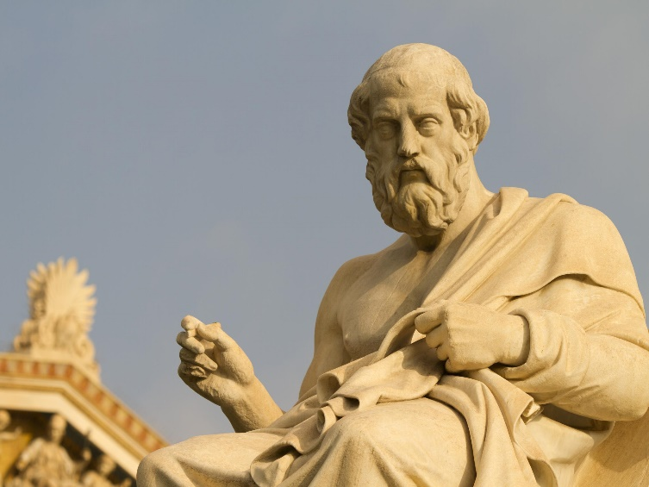
Philosophic fundaments: Plato
five regimes:
I - aristocracy
II - timocracy
III - oligarchy
IV - democracy
V – tyranny
pessimistic, negative vision of society
metaphore of a tyrant „born” from a demagouge
good
bad
← demagouge!

Slide 6
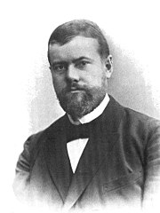
Philosophic fundaments: Max Weber
charismatic leadership
personal charisma
bond between leader and followers
conflict with other types of leadership
siginificant in revolution!

Slide 7
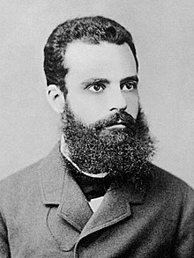
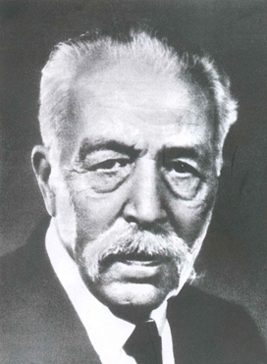
Philosophic fundaments: elite theory
Two parts of society:
the elite
the masses
Circulation of the elites:
elite can be replaced only by another elite!
Elite is good and necessary
Vilfredo Pareto
Gaetano Mosca

Slide 8
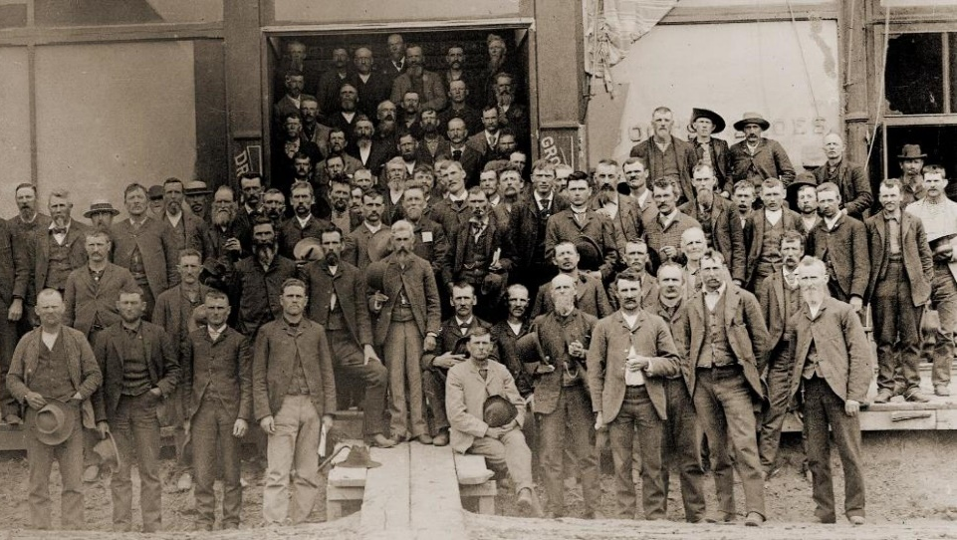
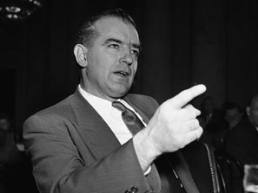
Political origins of populism: USA
The Populist Movement (19th century)
anti-communist movement (20th century)
Joseph McCarthy

Slide 9
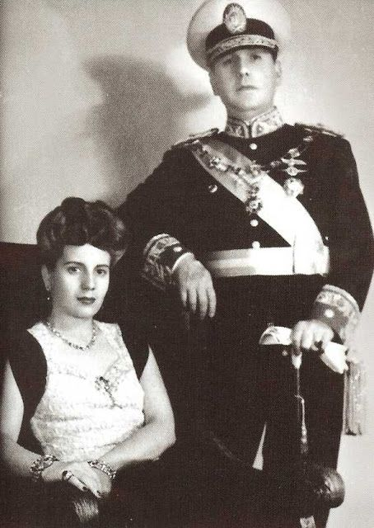
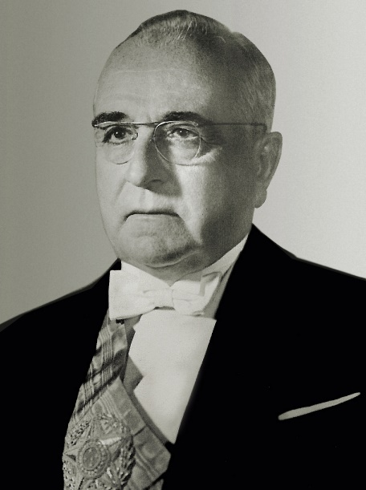
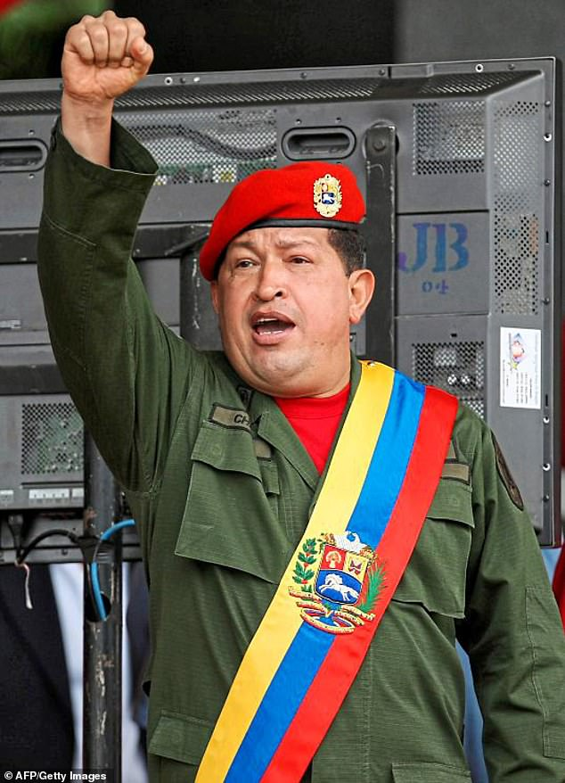
Political origins of populism: Latin America
Juan and Evita
Perón
(Argentina)
Getúlio Dorneles
Vargas
(Brasil)
Hugo Chávez
(Venezuela)

Slide 10
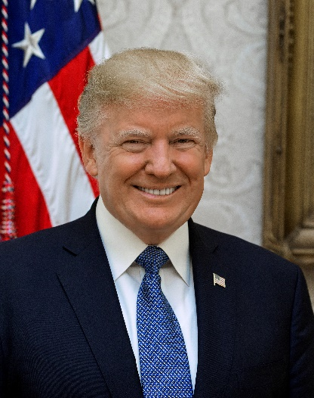
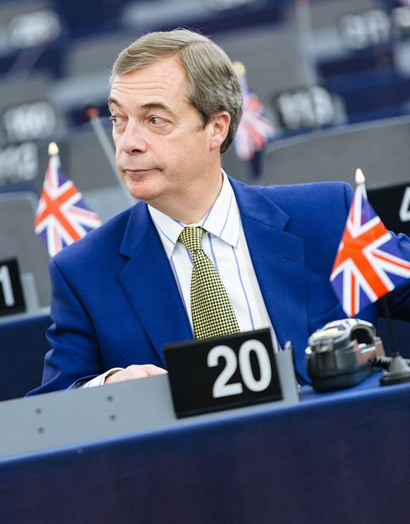
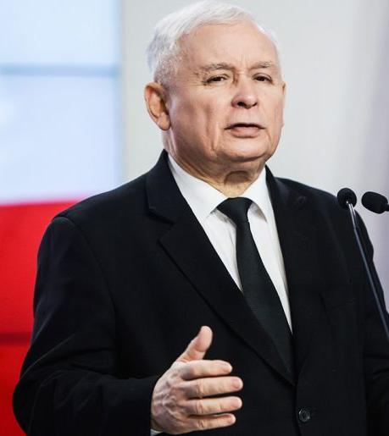
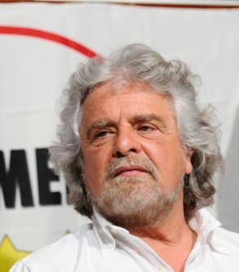
Political origins of populism: today
Donald Trump (USA)
Nigel Farage (UK)
Jarosław Kaczyński (Poland)
Victor Orbán (Hungary)
Marine Le Pen (France)
Beppe Grillo (Italy)

Slide 11
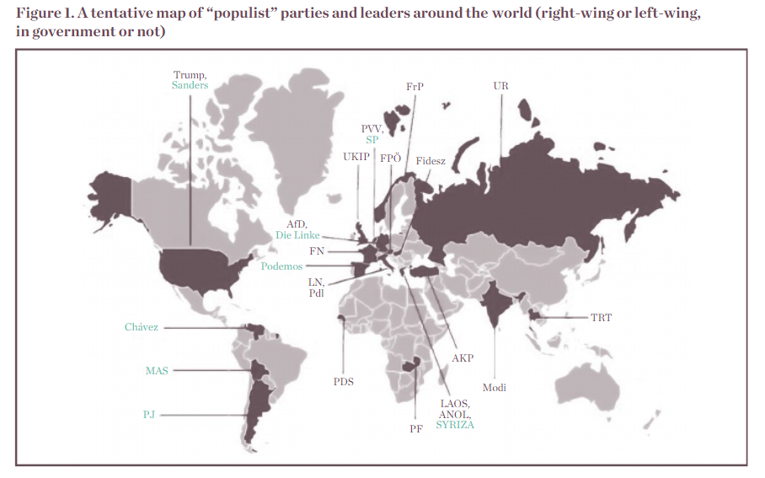
Pinar Dinç, Mapping populism: definitions, cases, and challenges to democracy, Istanbul Policy Center 2016

Slide 12
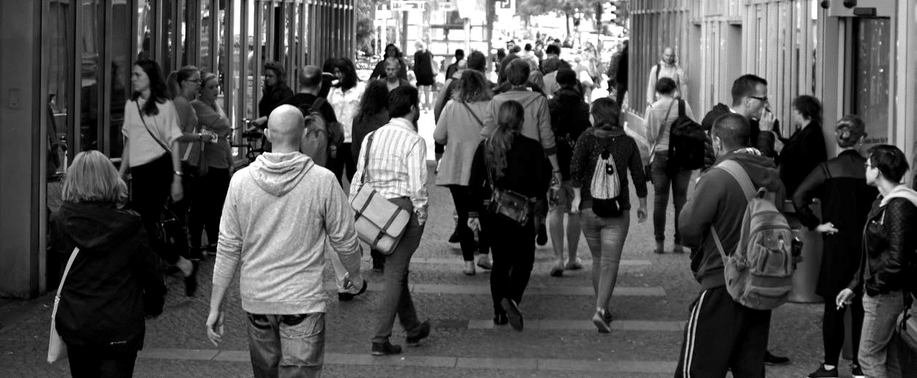
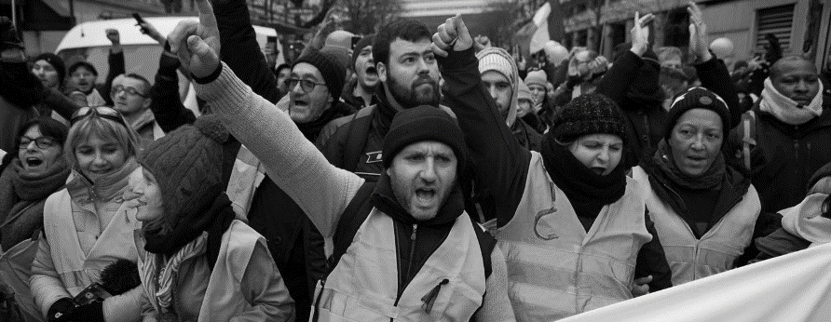
Modern interpretation
core concepts of populism:
1. the people
true rulers, real sovereign
related to „the nation”
2. the elite
corrupted, depraved, evil
enemy of „the people”
3. the general will
against political correctness
only populists express general will

Slide 13
Modern interpretation
types of populism:
cultural populism
reluctance against “enemies”: immigrants, minorities etc.
socio-economic populism
division between the rich and the poor
anti-establishment populism
reluctance against “alien elites”

Slide 14
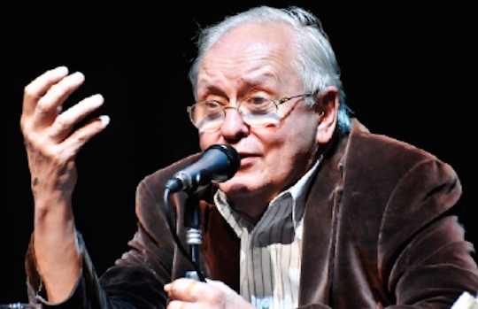
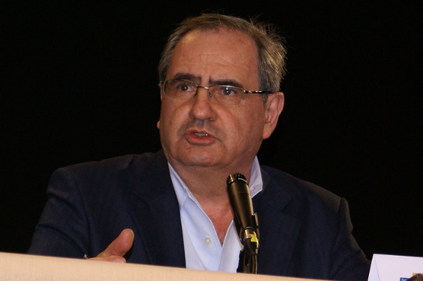
Modern interpretation: positive and negative descriptions
+ just a pure politics
+ radical democracy
+ real dispute
+ mobilize the masses
+ effective strategy
̶ radicality
̶ lies, fake news
̶ irresponsibility
̶ just another elite?
̶ dangerous to the democracy
Ernesto Laclau
Pierre Rosanvallon

Slide 15
video:
https://www.youtube.com/watch?v=Zqj0RKduf5E

Slide 16
Modern interpretation of populism
general characteristic and conlusions
flexibility
„left-wing”, „right-wing” or even „radical centrist” populism
ideology or discursive style?
not a new phenomenon
examples of populist politics visible at every crisis
not only negative connotation
≠ authoritarism!

Slide 17
Sources
literature:
Cas Mudde, Cristóbal Rovira Kaltwasser, Populism. A very short introduction, Oxford University Press 2017
Pinar Dinç, Mapping populism: definitions, cases, and challenges to democracy, Istanbul Policy Center 2016
video:
https://www.youtube.com/watch?v=cnzo9qXLFUo
https://www.youtube.com/watch?v=Zqj0RKduf5E
contact:
piotr.kozdrowicki@uwr.edu.pl

Slide 18
Let’s evaluate!
https://forms.gle/q9imw84rPFiqs8FS6

