Slide 1
Religious
International
Non-Governmental Organizations
dr Łukasz Prus

Slide 2
“Religious”, “spiritual”, or “faith-based” NGOs
Faith-Based Organizations (FBOs)
Spiritual Non-Governmental Organizations
Religious Non-Governmental Organizations (RNGOs)
Religious International
Non-Governmental Organizations (RINGOs)

Slide 3
Background
Definition,
Roles
and Functions of RINGOs
secular and faith-based
Secularism is not a clear-cut concept and
some parts of it go back to Judeo-Christian origins.

Slide 4
FBOs are groups which sustain certain belief systems by
facilitating social interactions among like-minded people
J.-P. Carvalho, Faith-Based Organizations Preliminary and incomplete - do not quote or cite, 2012
FBOs is an organization that has its mission based in a faith system

Slide 5
The UN has been engaged with a Committee of Religious NGOs since 1972,
uniting organizations which “...define their work as religious, spiritual or ethical in nature”.
https://rngos.wordpress.com/about/

Slide 6
RNGOs formal organizations
whose identity and mission are self-consciously derived from the teachings of one or more religious or spiritual traditions and
which operates on a nonprofit, independent, voluntary basis to
promote and realize collectively articulated ideas about the public good at the national or international level.
Julia Berger, Religious Non-Governmental Organizations: An Exploratory Analysis, International Society for Third-Sector Research and the Johns Hopkins University 2003

Slide 7
CARLO BENEDETTI identification RNGOs as those that identify themselves as religious.
RINGOs which are formal independent organisations,
whose primary aim is to promote relief efforts in disaster situations at the international level,
and whose identity and mission are self-consciously derived from the teachings of one or more religious or spiritual traditions
C. Benedetti, Islamic Aid and Christian Inspired Relief NGOs: Between Tactical Collaboration and Strategic Diffidence?, Journal of International Development 2006, Nr 18

Slide 8
Examples of RINGOs
  Caritas
  World Vision
  Islamic Relief
  Catholic Relief Service
  Lutheran World Relief (LWR)
  World Congress of Faiths (WCF)
  World Jewish Congress (WJC)
  World Muslim Congress (WMC)
  The Church of Scientology

Slide 9
Examples of RINGOs
  Alliance Israélite Universelle (AIU)
  Soka Gakkai International
  International Buddhist Foundation
  World Zionist Organization (WZO)
  World's Student Christian Federation (WSCF)
  the Salvation Army
  Sovereign Military Order of Malta (SMOM) or Order of Malta

Slide 10
  Religion is not a main, typical (general) feature in the operations of INGOs.
  Unlike issues like human rights,
  humanitarian aid,
  environmental concerns,
  religion does not fit the modes and practices of most INGOs,
  which are commonly derived from the problems and requirements of modern,
  secular and functionally differentiated nation states and their non-state actors.

Slide 11
  For decades, religion was ignored by practitioners and researchers concerned with INGOs (K.A. ver Beek, Spirituality: a development taboo, Development in Practice 2000, no. 1)
  However, in recent years, the taboo has been broken.
  First, religion has not disappeared.
  Instead it has become even more visible, e.g. the 1979 Iranian revolution,
  the role of the Catholic church in the democratic transitions in Eastern Europe,
  and finally 9/11.

Slide 12
  Second, there has been a dramatic increase in the number RNGOs and RINGOs involved in development and humanitarian aid.
  Naturally, religious organizations are not a new invention.
  Throughout history, Catholic hospitals, Islamic foundations and Buddhist monasteries, among many others, have provided aid to the poor
  However, in recent years, some of the largest INGOs are religious (World Vision alone has an annual budget of 1.6 billion $), Muslim NGOs are on the rise, and locally.

Slide 14
  Religious IGOs, NGOs and INGOs increasingly try to influence policymaking at the UN,
  global financial institutions have realized the importance of sensitivity towards local value systems in order to further development efforts,
  and the protection of religious freedom and religiously motivated persecution has risen to the top of the agenda of international human rights organizations

Slide 15
RNGOs represent a unique hybrid of religious beliefs and
socio-political activism at all levels of society and
humanitarian aid.

Slide 16
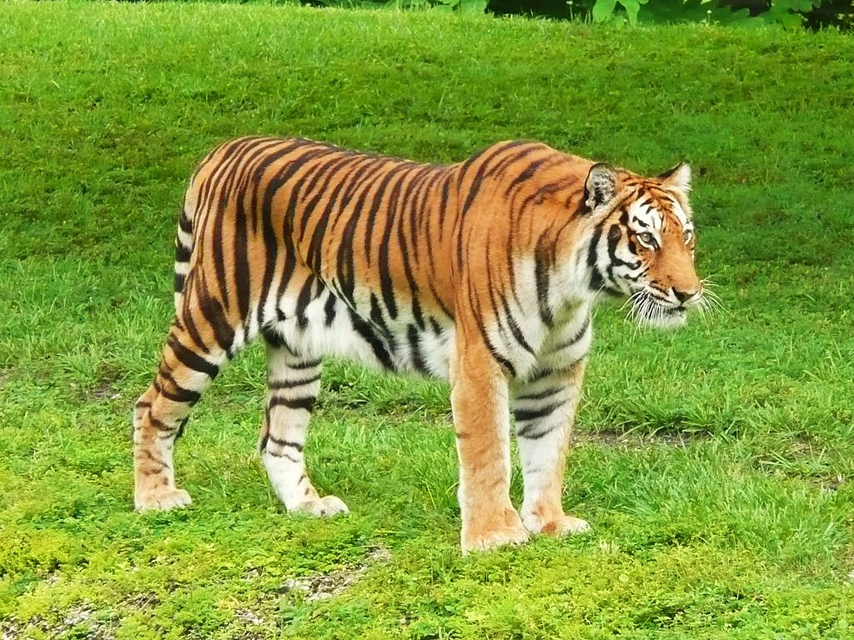

Slide 17
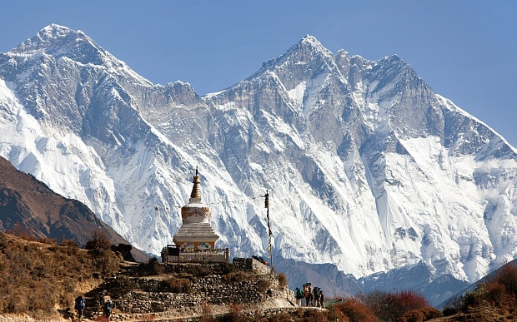
The Himalayas

Slide 18
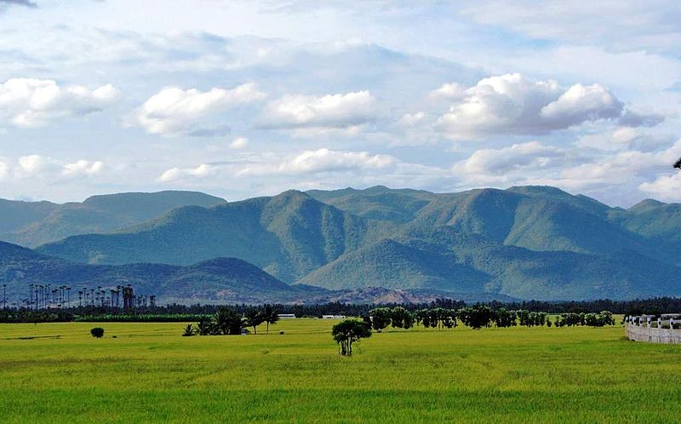
the Western Ghats

Slide 19
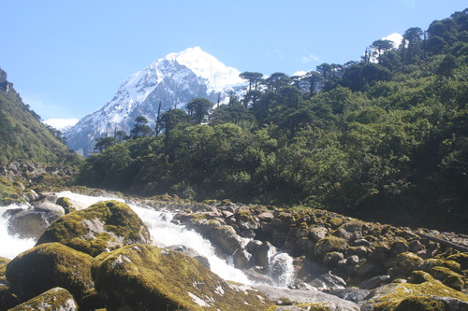
North East India

Slide 20
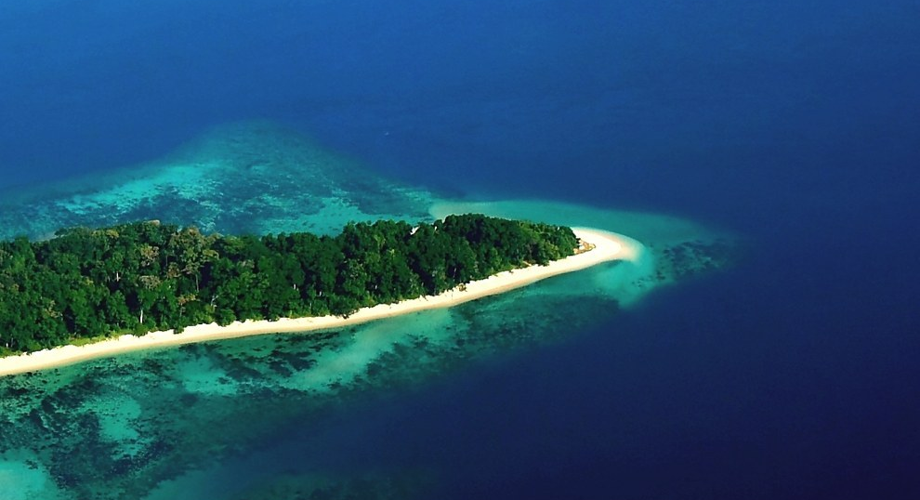
Nicobar Islands in India

Slide 21
Mission International Union for Conservation of Nature
is to influence, assist
societies the world to conserve nature and
to ensure that any use of natural resources
is equitable and ecologically

Slide 22
What is International Union for Conservation of Nature doing?
ENVIRONMENTAL LAW
FORESTS
WATER
WORLD HERITAGE
MARINE AND POLAR PROTECTED AREAS
SCIENCE AND KNOWLEDGE
BUISNESS
CLIMATE CHANGE
ECOSYSTEM MANAGEMENT

Slide 23
Providing scientific expertise on biodiversity issues
- IUCN Red List of Threatened Species
- IUCN Categories of Protected Areas
- Natural World Heritage Sites

Slide 24
  It is best known to the wider public for
  compiling and publishing the International Union for Conservation of Nature
Red List of Threatened Species,
which assesses the conservation status of species worldwide.

Slide 25
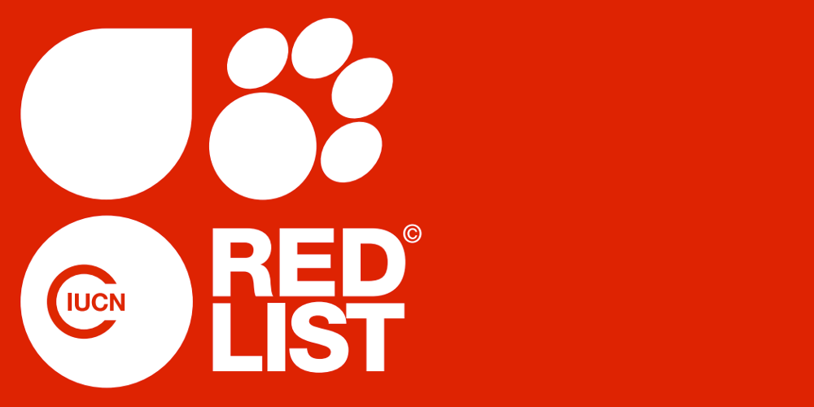

Slide 26
IUCN Red List
First published in 1964
IUCN Global species programme working with IUCN Species Survival Commission (SSC)
Access the conservation status of species, subspecies, varieties and even selected sub populations on global scale
Highlight the taxa threatened with extinction and thereby promote their conservation

Slide 27
Total number of species: 8-14 millions
Species described: 1.8 million
Species assessed: 45,000
Species in danger: 17,000 (38%)

Slide 28
This system is designed to determine the relative risk of extinction,
and the main purpose of the IUCN Red List is to catalogue
and highlight those plants and animals that are facing a higher risk of global extinction
i.e. those listed as Critically Endangered, Endangered

Slide 29
The IUCN Red List also includes information on plants, fungi and animals that are categorized as Extinct or Extinct in the Wild;
and on plants, fungi and animals that are either close to meeting the threatened thresholds or
that would be threatened were it not for an ongoing taxon-specific conservation programme (i.e., are Near Threatened)

Slide 30
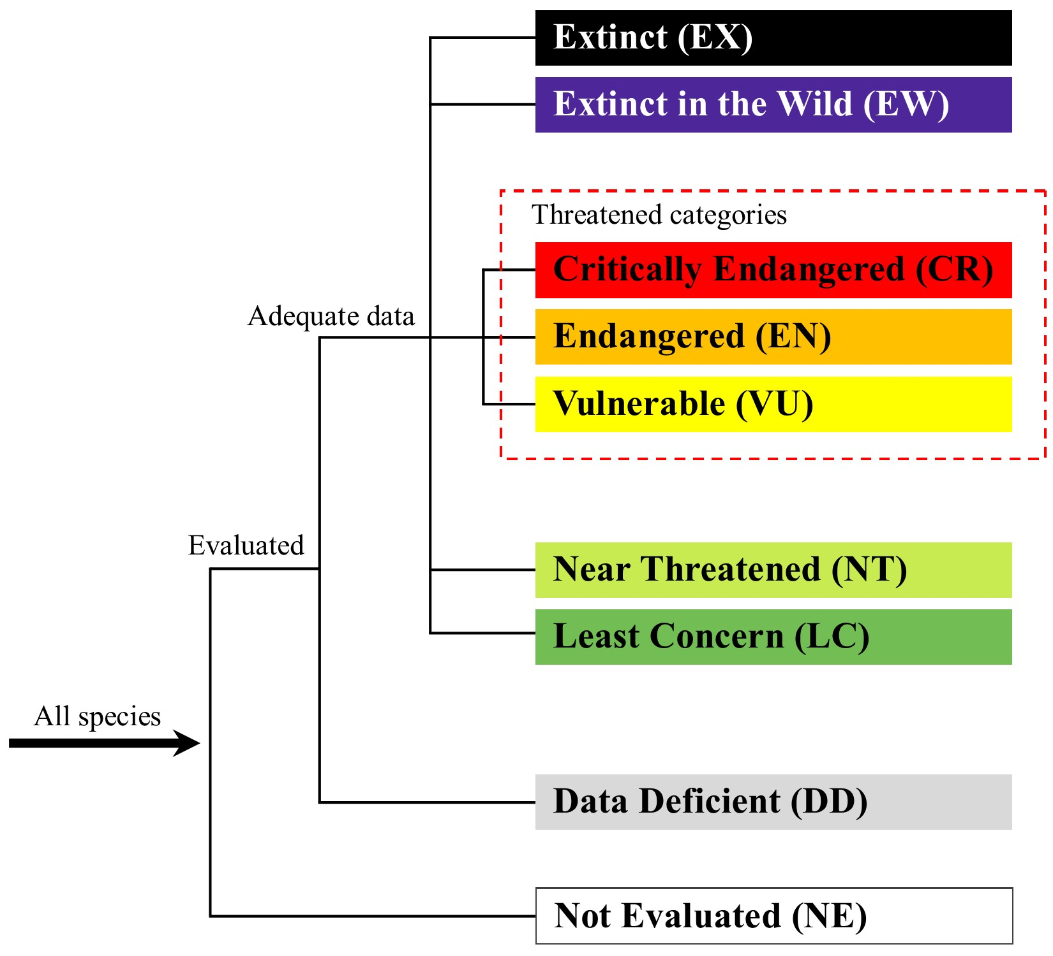
Categories

Slide 31
Four out of six of the great ape species
are now Critically Endangered, after the Eastern Gorilla (Gorilla beringei)
was uplisted from Endangered to Critically Endangered in 2016 due to an ongoing population decline.
If this continues, around 93% of Eastern Gorillas will be gone by 2054

Slide 32
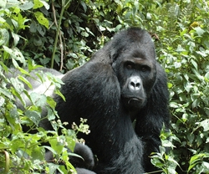

Slide 33
Previously listed as Endangered, the Giant Panda has now been assessed as Vulnerable/Sensitive,
as its population has grown due to
effective forest protection and reforestation.

Slide 34
The improved status confirms that the Chinese government's efforts to conserve this species are effective.
However, climate change is predicted to eliminate more than 35% of the Panda's bamboo habitat in the next 80 years.
The Chinese government's plan to expand existing conservation policy for the species is a positive step and
must be strongly supported to ensure its effective implementation.

Slide 35


Slide 36
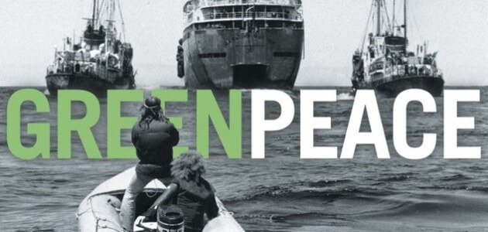

Slide 37
Being the largest and most influential international environmental organization,
Greenpeace is also known as a signicant pacifist organization

Slide 38
History
In 1971, a small group of activists
set sail to the Amchitka island off Alaska
to try and stop a US nuclear weapons test
Money for the mission was raised with a concert
sixteen thousand that filled Vancouver’s Pacific Coliseum left the concert entranced

Slide 39
Their old fishing boat was called “The Greenpeace”.
They choose the name “Greenpeace”:
summarize their two concerns –
environment and pacifism
These activists, the founders of Greenpeace, believed a few people could make a difference.
Nowadays, Greenpeace has 2.8 million supporters worldwide and exists in 41 countries.

Slide 40
In 1985 French agents attempted to stop Greenpeace members from traveling to
France for a demonstration against the nuclear test in the South Pacific.
Their ship “Rainbow Warrior” was bombed in the port of Auckland in New Zealand.
The French government later paid a compensation of USD 3.1 million after the incident was publicized.
As the event caused a sensation, Greenpeace received much publicity

Slide 41
The major activities of Greenpeace are to prevent any sort of harm
and bring about harmony between men and nature.
Greenpeace also attempts to stop toxic chemicals from polluting the environment
Climatic changes,
global warming,
and opposing genetically modified (GM) foods are also part of Greenpeace’s agenda

Slide 42
https://www.youtube.com/watch?v=wNN-Yl-SBTM

Slide 43
Issues
Arctic
Climate and Energy
Forests
Oceans

Slide 44
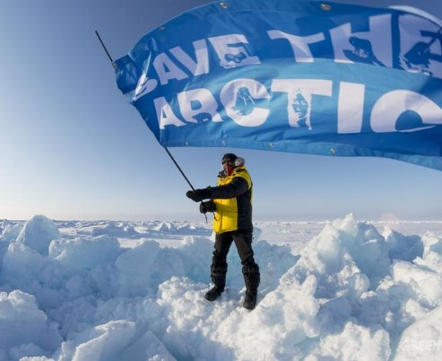

Slide 45
The Arctic is in danger.
The ice is retreating at an increasing speed,
clearing the path for oil companies
that see this catastrophe as a business opportunity.
Greenpeace campaigning to ban oil drilling and
destructive fishing in Arctic waters.

Slide 46
Climate change and the threats of nuclear energy are real.
That is why Greenpeace works to bring about a clean and just energy future.
Nuclear development plague the ecosystems and communities they occupy with safety and health risks.
The Energy [R]evolution is a set of ready-to-implement solutions that lead away from the dangers of climate chaos and nuclear meltdown.
It is a vision of the clean and just energy future for everyone on the planet

Slide 47
With 80 per cent of the planet's ancient forests already lost or degraded,
the need for increased protection of the world’s remaining forests is more urgent than ever.
Forests help stabilize the climate,
sustain life,
and are the source of culture for many communities.
Greenpeace challenge the global marketplace,
engage consumers,
pressure governments and
work with industry to protect the Boreal Forest, the Great Bear Rainforest and the Indonesian Rainforest

Slide 48
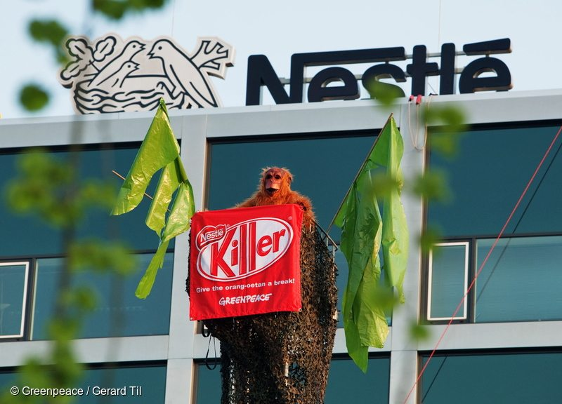
A Greenpeace activist dressed as an orangutan sits in a 'nest' in front of the Nestlé headquarters in Amsterdam, and urges the company to stop using palm oil from rainforest destruction.

Slide 49
  Greenpeace exposed Nestlé's role in driving the destruction of Indonesia's rainforests with a global campaign.
  Under its new policy, announced in May 2010,
  Nestlé committed to identify and exclude companies from its
  supply chain that own or manage
  “high risk plantations or farms linked to deforestation”
  This exclusion applied to companies such as Sinar Mas, Indonesia’s most notorious palm oil supplier.

Slide 50
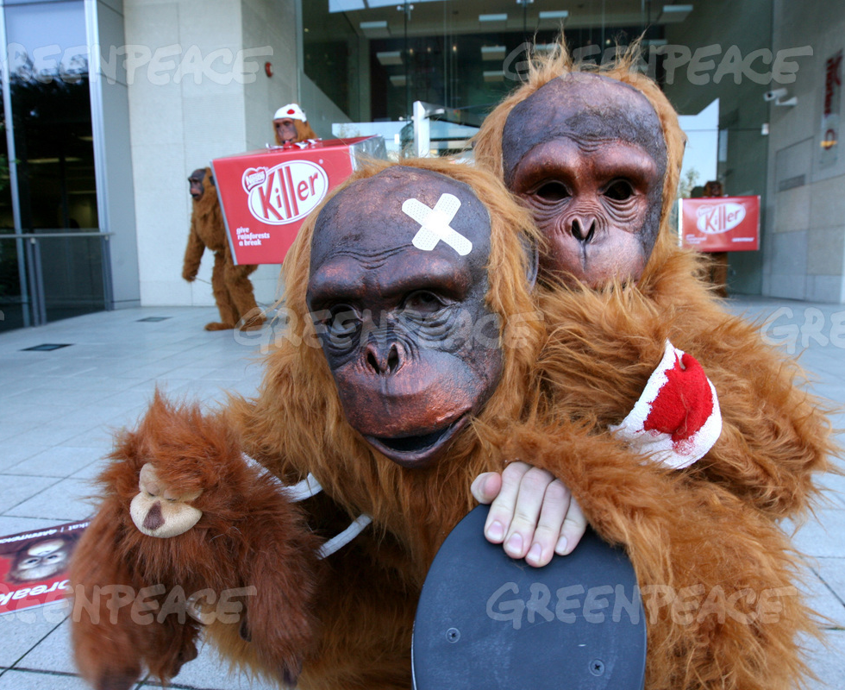

Slide 51
Greenpeace fight against
overfishing,
the marine pollution and
whaling
Greenpeace is against the extinction of tuna.

Slide 52
https://www.youtube.com/watch?v=hNQ-yNyzECk
https://www.youtube.com/watch?v=mOvLWjlDIqw

Slide 53
Greenpeace actions, impacts and criticism
Greenpeace method:
inform people about ecological problems and
pressure on leaders
Greenpeace is famous for its ‘non-violent direct action’.

Slide 54
Terms of direct action, the protests organized by Greenpeace members are always thrilling, of individual heroism,
dramatic
and wierd:)
In some occasions,
members chain themselves to trees in order to prevent them from being chopped down;
other examples include blocking the way of the big navigation ships which carry nuclear wastes.

Slide 55
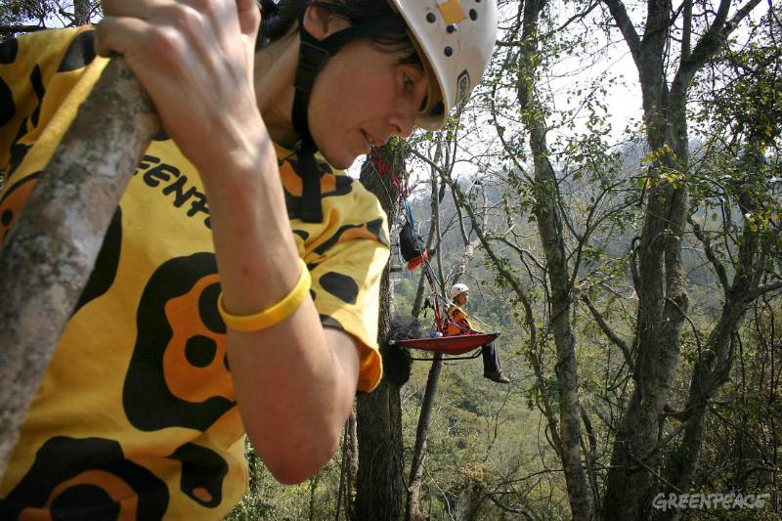

Slide 56
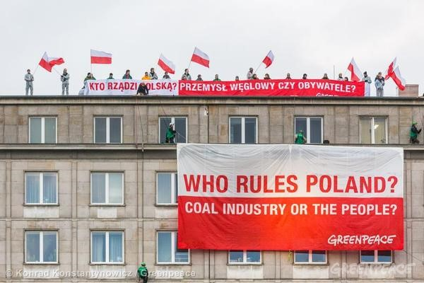

Slide 57
https://www.youtube.com/watch?v=Cyn7mrXyMZg
https://www.youtube.com/watch?v=302D8sIQtTQ
https://www.youtube.com/watch?v=15RP1Xj4KJE

Slide 58
Sometimes:
radical and illegal actions
Greenpeace criticisms:
problem with illegal action
Too radical actions,
shocking actions

Slide 59
https://www.youtube.com/watch?v=1BCA8dQfGi0
https://www.youtube.com/watch?v=2ExNmhDLsIk

Slide 60
In 2002, Esso began legal action against Greenpeace in France over the StopEsso website,
which uses a logo featuring a double dollar sign ($$) in place of the double "S" in the oil giant's red and blue logo.
StopEsso, a global coalition of groups including Greenpeace,
is campaigning around the world to stop Esso from sabotaging international action to address climate change

Slide 61
Esso had earlier claimed that a double dollar sign logo associated the company with
the Nazi SS,
but this was rejected by the court at a preliminary hearing.
Esso had demanded the withdrawal of all the logos, a penalty of 80,000 Euros a day for reputational damage and 80,000 Euro per day per logo if Greenpeace failed to comply.
It also demanded removal of all use of the term "StopEsso"

Slide 62
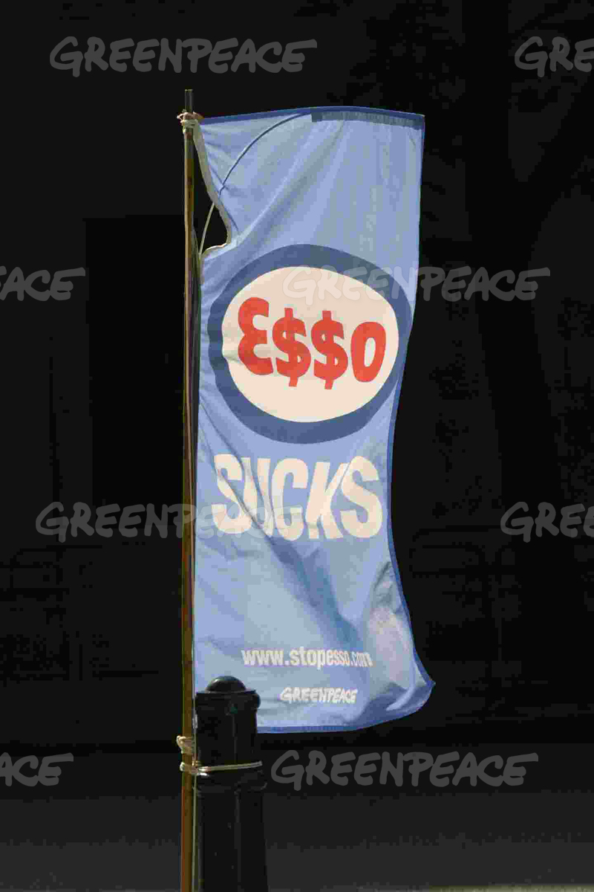

Slide 63
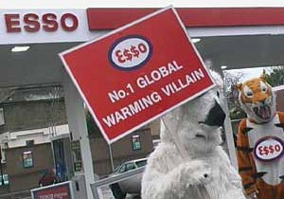

Slide 64
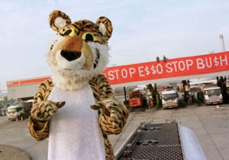

Slide 65
The networking of Greenpeace has a wide coverage.
As early as 80s, the Internet had already been utilized for organizing events.
In 1994, its website (www.greenpeace.org) was established.
Greenpeace utilizes the Internet to promote its activities by using lots of pictures and images
with great sensational effect to
capture readers’ attention

Slide 66
Through the development of technology in environmental conservation and
promoting environmentally-friendly products,
Greenpeace tries to reduce harm to the environment.

Slide 67
In face of global warming,
Greenpeace has attempted to persuade oil companies in developing alternative energy,
exerting much effort in promoting the use of solar and wind energy,
both of which are known to be non-pollutants.

Slide 68
https://www.youtube.com/watch?v=dHpHxA-9CVM

Slide 69
Green Cross International
Promotes legal, ethical and behavioral norms that ensure basic changes in values, actions, and attitudes of government, the private sector, and civil society, necessary to build a global community
Prevents and resolves conflicts arising from environmental degradation
Provides assistance to people affected by the environmental consequences of wars and conflicts

