Slide 1
CIRCUMSTANTIAL EVIDENCE
DISCLOSURE
DOROTA CZERWIŃSKA

Slide 2
BURDEN OF PROOF
An obligation to present the evidence and prove the fact to a certain level
In adversarial systems, lies exclusively on the prosecutor
In non-adversarial systems usually lies on the court as well
What is the level of certainty?
  USA: beyond reasonable doubt
  Poland: probability almost being certainty

Slide 3
TYPES OF EVIDENCE
Direct evidence – „first-hand evidence that does not require any inferences to be drawn in order to establish a proposition of fact”, e.g. eyewitness testimony
Circumstantial evidence – indirect evidence; „to reach a conclusion, the trier-of-fact would have to reason through the circumstantial evidence and infer the existence of some fact in dispute, such as inferring that the defendant killed the victim because the defendant’s fingerprints were found on the murder weapon”
D.W. Neubauer, H.F. Fradella, America’s Courts and Criminal Justice System, Cengage 2018, 13th ed. (all quotes in this presentation)

Slide 4
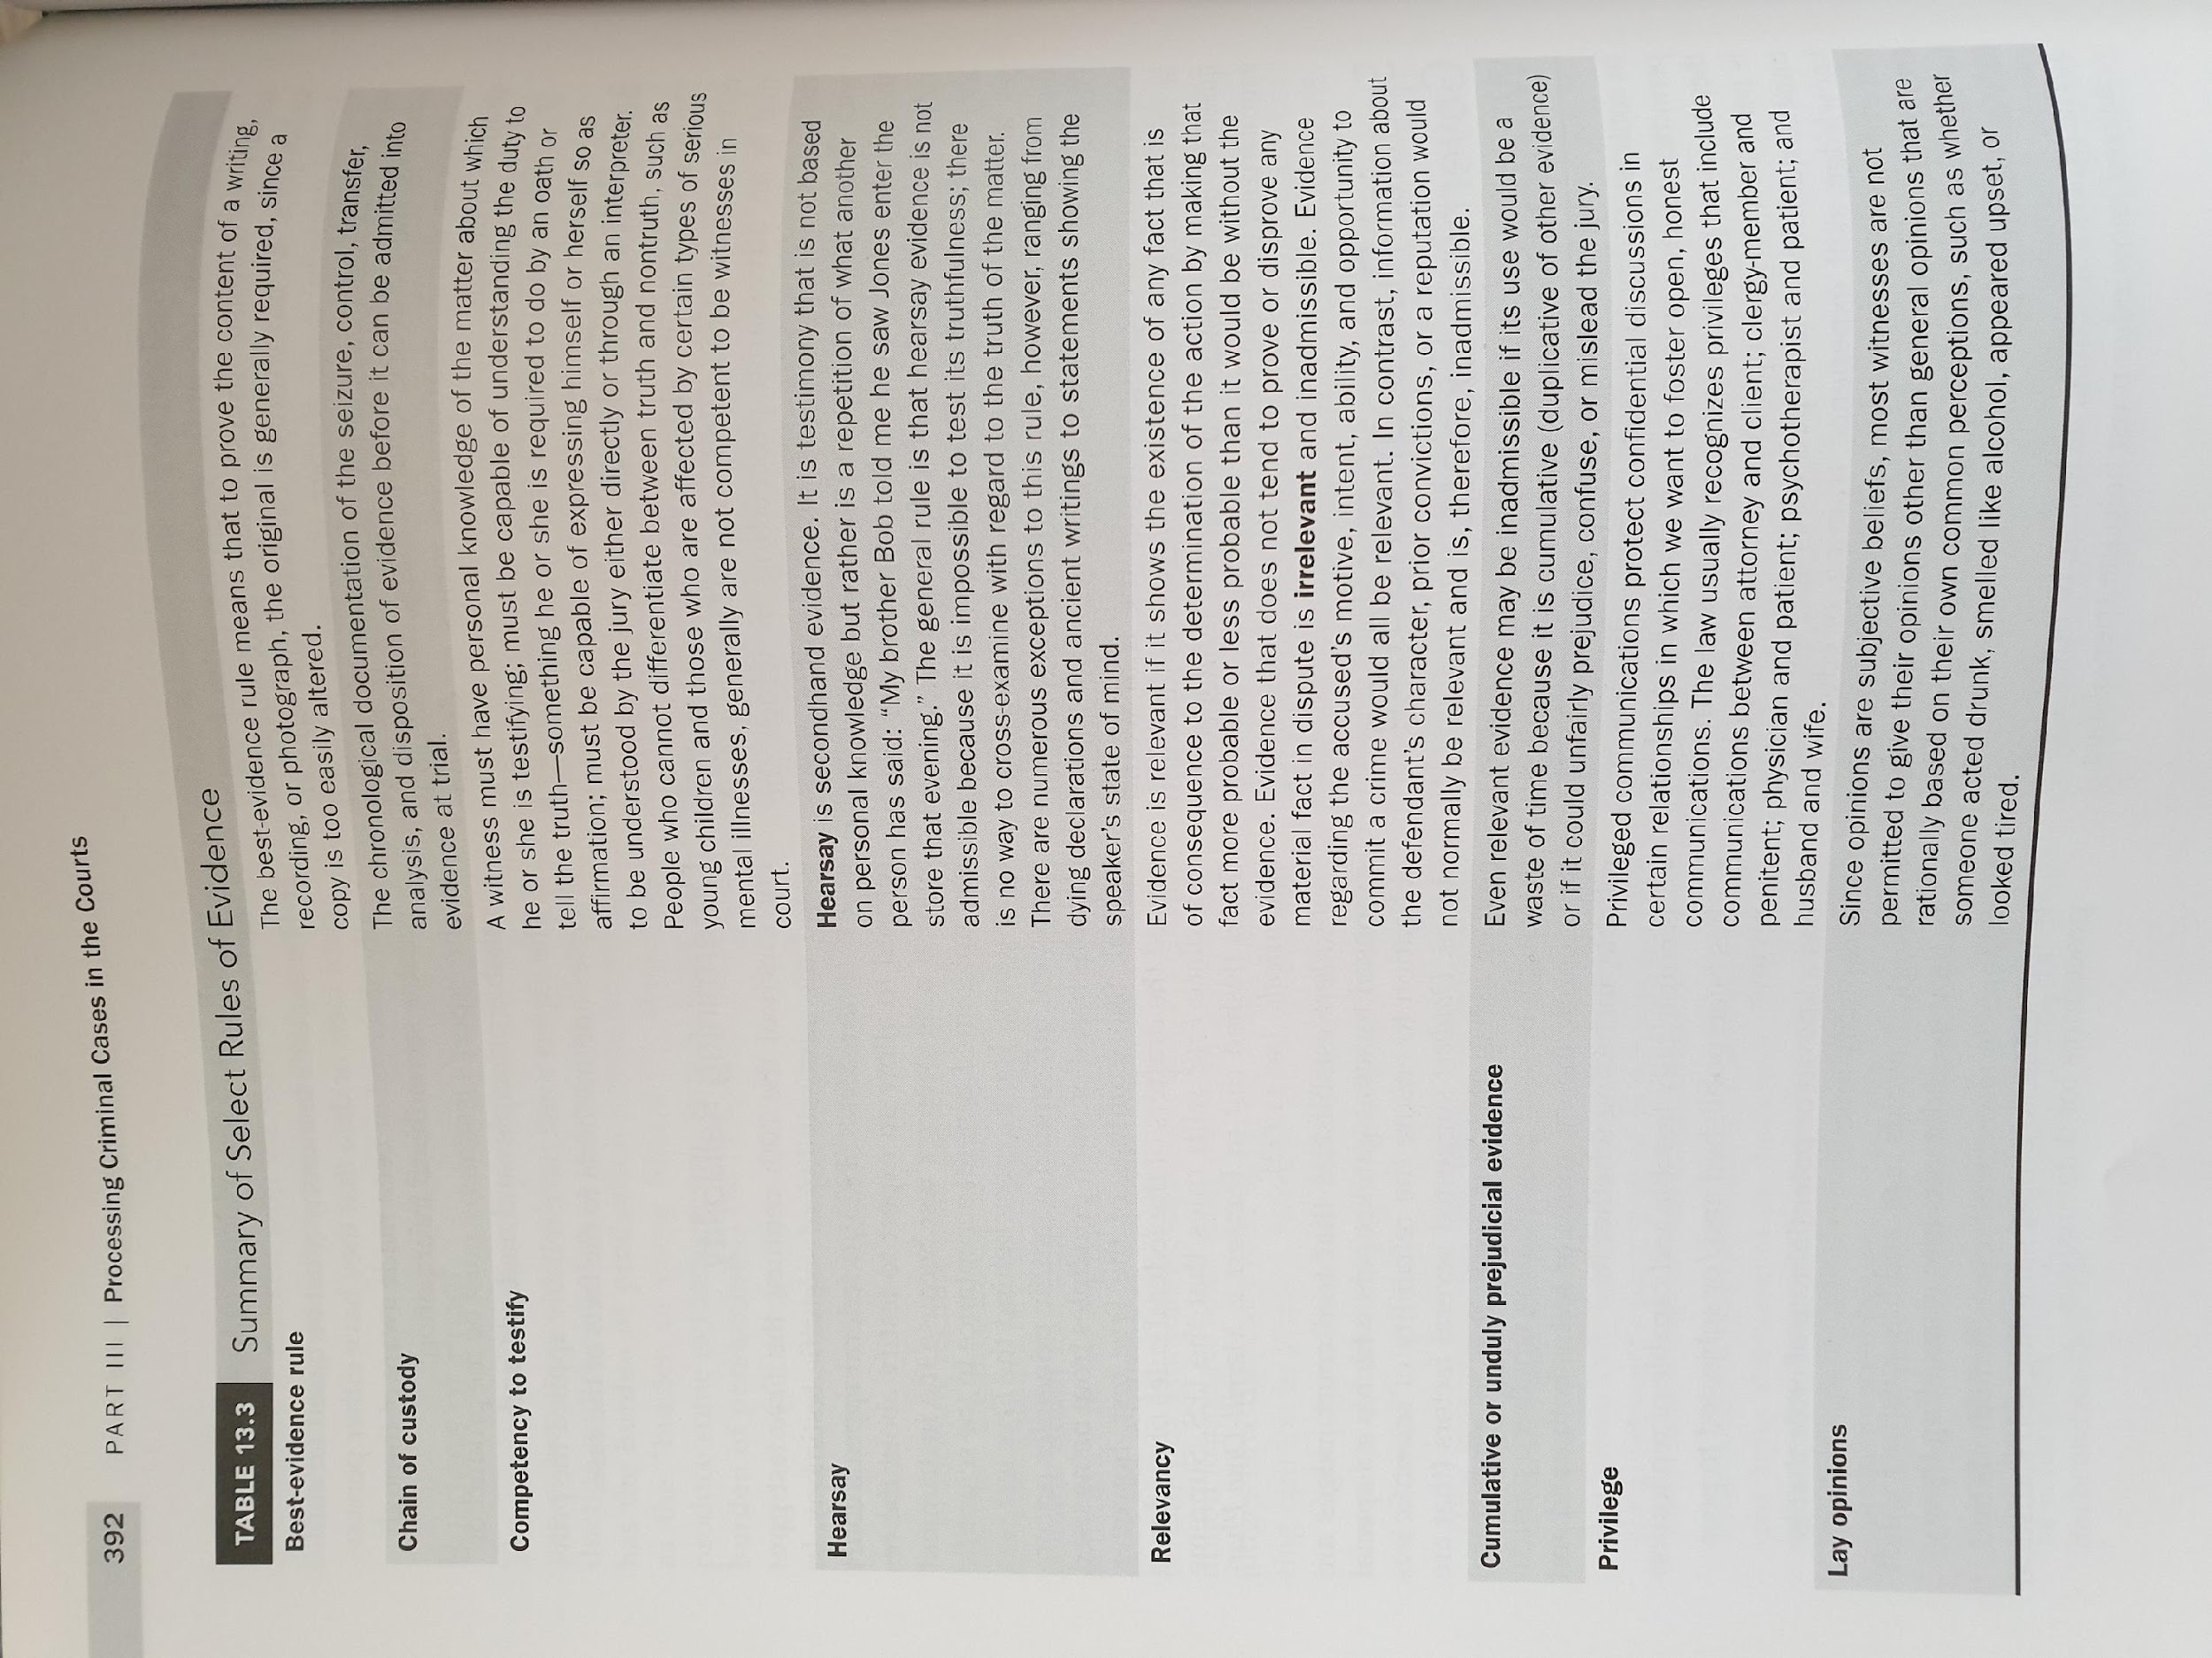
Basic Rules of Evidence in US Criminal Proceedings
Source: As on the previous slide.

Slide 5
DISCOVERY AND DISCLOSURE
DISCOVERY = formal and informal exchange of information between the prosecution and defence (=both ways)
It’s necessary for equality of arms
DISCLOSURE = duty of the prosecution and to some extent of the defence to disclose the evidence they possess
also discovery rather refers to USA, whereas disclosure - to England and Wales

Slide 6
EXCULPATORY AND IMPEACHMENT EVIDENCE
EXCULPATORY EVIDENCE = „any evidence that may be favorable to the defendant at trial either by tending to cast doubt on the defendant’s guilt or by tending to mitigate the defendant’s culpability, thereby potentially reducing the defendant’s sentence”
IMPEACHMENT EVIDENCE = „any evidence that would cast doubt on the credibility of a witness”

Slide 7
BRADY RULE
US Supreme Court in Maryland v Brady: „the suppression by the prosecution of the evidence favorable to an accused upon request violates due process where the evidence is material either to guilt or punishment, irrespective of the good or bad faith of the prosecution”
It only refers to admissible evidence
MATERIAL EVIDENCE = reasonable probability of the different result of proceedings had the evidence been presented
Brady rule does not require that the whole case file is shared

Slide 8
IMPEACHMENT EVIDENCE
Jencks v. US (1957) – duty to disclose prior witness statements if they are inconsistent with subsequent
Jencks Act – duty to disclose these even if they are not inconsistent, however only if the defense asks for it
Giglio v. US (1972) – duty to disclose all impeachment evidence, even if it is not another witness statement but e.g. criminal record of a witness

Slide 9
US V. RUIZ
There is no duty to disclose impeachment evidence before the plea negotiations
But how are you supposed to negotiate and make a well-informed decision whether to plead guilty if you do not know all the evidence that might influence your chances at trial?

Slide 10
RECIPROCAL DISCOVERY
the issue exclusive to adversarial systems; in inquisitorial systems the defence has no duty whatsoever to share any information with the prosecution
Limits: privilege against self-incrimination
E.g.: provide the prosecutor with a list of witnesses to be heard to support alibi defense
In some states when the defence calls the prosecutor to disclose, it has to disclose their materials
There are also extensive disclosure duties imposed on the defence in England and Wales

