Slide 1
Introduction to Criminal Law
Dr Konrad Lipiński
assistant professor
Department of Substantive Criminal Law

Slide 2
Class I
Dr Konrad Lipiński
Assistant Professor
Department of Substantive Criminal Law
coordinator of Introduction to Criminal Law course
contact details:
konrad.lipinski@uwr.edu.pl
room 202a (building A)
office hours – on faculty’s website

Slide 3
Class 1
Scope of classes and lectures
classes (7): – presentations and practical issues regarding articles 3, 5, 6 and 7 of Convention as well as specific offences and penalties
lectures (8): theoretical information concerning criminal law and it’s position in law system

Slide 4
Class 1
Form of classes and lectures. Evaluation
classes:
obligatory presence (absences need to be reported)
mandatory presentations by students
evaluation: presentations and active class participation
lectures:
voluntary presence
presentations by lecturer
evaluation: exam

Slide 5
Class 1
Classes – general rules
classes are stationary
each student is obliged to participate in classes
scope: basic concepts of criminal law, criminal responsibility and certain types of offences
short introduction by the lecturer at the beginning of each class
the main part of the class consists of presentations given by students on designated subjects
discussion and active participation may improve your grade

Slide 6
Class 1
Classes – general rules
Proposed topics of presentations:
Prohibition of torture (art. 3 ECHR)
Right to a fair trial in criminal cases (art. 6 ECHR)
No punishment without law (art. 7 ECHR)
Capital punishment
Imprisonment
Penalties other than imprisonment and capital punishment
Criminalization of terrorism
Criminalization of conspiracy
Criminalization of murder (degrees, murder and manslaughter etc.)
White-collar crimes
Blue-collar crimes
Corporate (criminal) liability
Criminalization of fraud
Criminalization of investment fraud
Criminalization of money laundering
Criminalization of bribery
Cyber-crime
Identity theft

Slide 7
Class 1
Classes – general rules
you are not limited to these topics
if you wish to present something else – consult it

Slide 8
Class 1
Classes – general rules
How to pass?
every student has to prepare a presentation
there are no substitutes, specifically essays
PowerPoint (or other) + oral comment
each presentation should take about 20-25 mins
it is not sufficient to read the presentation
solely reading presentation from telephone will result in negative grade

Slide 9
Class 1
Classes – general rules
How to pass?
each student has to present his/hers topic on a designated date
not presenting it on that date without valid justification will result in negative (2.0) grade
negative grade can be improved during last classes, but only to 3.0
each presentation should be prepared by two studens (3 or 1 only in specific cases)
presentations need to be sent to me at least one day before classes prior to 6PM
if you have any doubts while preparing the presentations – ask me before the classes

Slide 10
Class 1
Classes – general rules
How to pass?
presentation should include (mandatory elements):
explanation of the discussed concept
analysis of domestic (as chosen by student) and international law
discussing some controversies on the topic
presentation may also include (optional elements):
statistics
relevant case law
other interesting facts connected with analyzed topic

Slide 11
Class 1
Classes – general rules
presentations schedule
there are six classes left for presentations
the schedule will be available online (as an editable document)
students, who will declare preparing their presentation on next classes (in two weeks time) will get their grade improved by 0,5

Slide 12
Class 1
Classes – general rules
anti-plagiarism policy
plagiarism is a disciplinary offence
how to avoid it?
keep track of your sources
paraphrase or quote from your sources – you must not copy and paste
always credit the original author in in-text citation and in the reference list
do not use AI to generate the substantive content of your paper
if you use AI to e.g. generate table of contents or a summary, you have to disclose this fact in a footnote

Slide 13
Class 1
Classes – general rules
Summary – passing requirements
mandatory presentation
given by 2 studens (as a general rule)
20-25 mins
PowerPoint + oral comment
predetermined dates (as in editable doc)

Slide 14
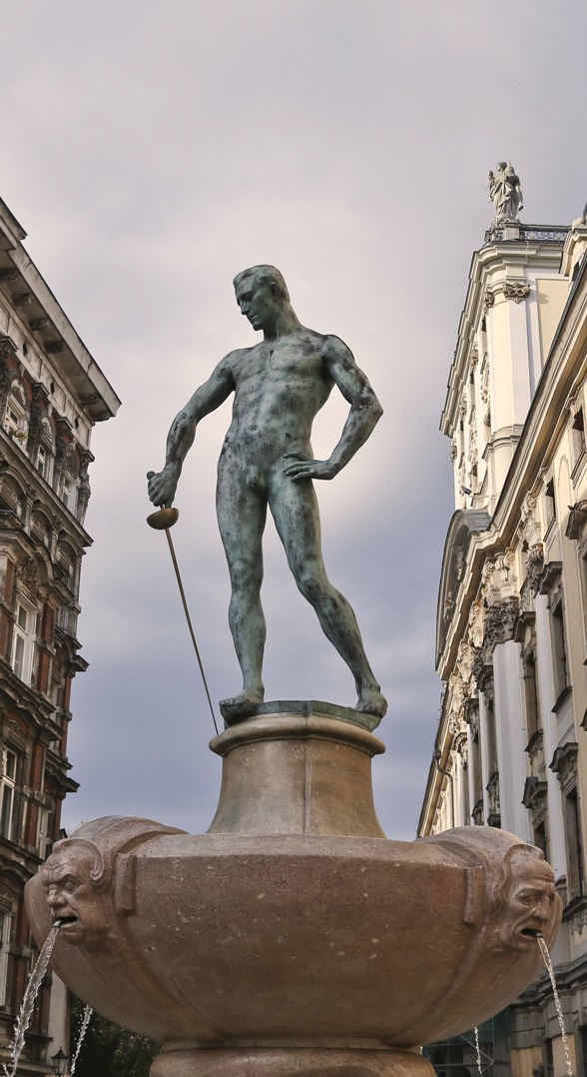
Thank you for your attention

