Slide 1
Introduction to Criminal Law
Dr Konrad Lipiński
assistant professor
Department of Criminal Law

Slide 2
Lecture II
previously on Introduction to Criminal Law:
introduction to the course
basic information about criminal law and its place in the system of law
basic information about European Convention on Human Rights
organization and structure of European Court of Human Rights

Slide 3
Lecture II
scope of the lecture
definition of criminal act
basic elements of criminal offence
in common law
in continental (Polish) law
sources of criminal law
international sources
sources of common law
sources of continental law

Slide 4
Lecture II
reminder: common law and continental law
Common law | Continental law
case law, developed mostly in judgments the law comes from courts developed from case to case, as the opportunity (and need) occurs judges are the great jurists focused on practical elements (law in action) | legal norms the law comes from statutes (acts of parliament) complete system professors are the great jurists focused on theoretical constructions and abstract thinking of law

Slide 5
Lecture II
definition of criminal act
different definitions in common law and in continental law
various definitions within every law system
among others, criminal act might be defined by:
its consequences
its elements (most common kind of definition in continental law)

Slide 6
Lecture II
definition of criminal act
„formal” definitions
„crime is an event that is prohibited by law, which can be followed by a prosecution in criminal proceedings and, thereafter, by punishment on conviction”
„A crime must be defined by reference to the legal consequences of the act (…) A crime then becomes an act that is capable of being followed by criminal proceedings, having one of the types of outcome (punishment etc.) known to follow these proceedings”
Williams, The Definition of Crime, 1955
Simester, Spencer, Sullivan, Virgo, Simester and Sullivan’s Criminal Law

Slide 7
Lecture II
definition of criminal act
distinguishing features of criminal acts
harmful nature
punishment
conviction as distinctive aspect of criminal law

Slide 8
Lecture II
harmful nature of criminal act
harm proscribed by criminal law is of greater degree (more serious) than that in the civil law
alternatively: it’s rather public than private in its nature
the same act can lead both to criminal and civil liability
the public as a whole has an interest in prevention and prosecution of criminal offences
criminal acts are usually morally wrong
mala per se – morally wrong in an obvious way (e. g. rape, murder)
mala prohibita – illegal, therefore wrong (e. g. failiure to file bankruptcy motion)

Slide 9
Lecture II
punishment as distinctive element of criminal offence
criminal law licences punishment, while civil law licences compensation
exceptions to this rule:
possibility of conviction without punishment in criminal cases
punitive damages in civil cases
punishment acts as a deterrent (where tortious remedies are insufficient)

Slide 10
Lecture II
punishment as distinctive element of criminal offence
„Parliament does not say, »Do not assault other people, please« (…) Rather, the law declares, »Do not assault other people, or else…«”
Simester and Sullivan’s Criminal Law…, op. cit.
censure (formal disapproval) as integral aspect of punishment

Slide 11
Lecture II
conviction as distinctive element of criminal law
criminal conviction – court’s verdict labelling the accused as guilty of an offence, and thus labelling him as a criminal
conviction for „stigmatic” offences as a penalty in its own right
a form of community condemnation
„a criminal” (offender, wrongdoer) > „a tortfeasor” (a person commiting a civil wrong)

Slide 12
Lecture II
basic elements of criminal offence
substantially different in common law and continental law
however, there are some common elements
some kind of human conduct (act or omission)
distinctive, external features (other than non-criminal conduct)
some type of mental awareness or at least possibility of such
possibility of avoiding liability due to moral reasons, some kind of justification or excuse

Slide 13
Lecture II
basic elements of criminal offence
common law systems
actus reus
mens rea
(lack of) defences
actus reus + mens rea = prima facie offence

Slide 14
Lecture II
basic elements of criminal offence
actus reus
external („objective”) element
an event or conduct which causes the harm that the law is designed to prevent

Slide 15
Lecture II
basic elements of criminal offence
mens rea
internal („subjective”) element
„guilty mind” such as intention, knowledge or recklessness
fault element + state of mind (separate in continental law)
actus non facit reum nisi mens sit rea – an act does not make a man guilty unless his mind is (also) guilty
varies for each offence

Slide 16
Lecture II
basic elements of criminal offence
defences
precisely: the absence of a valid defence
defences do not deny actus reus nor mens rea
alibi is not a defence in this particular sense
„defence” means something else in criminal procedure and substantive criminal law
defending by reference to events not contemplated in actus reus
absolution of fault
justifications and excuses

Slide 17
Lecture II
basic elements of criminal offence
continental law systems
various definitions
classical definition: F. von Liszt, E. Beling
neo-classical definition: K. Buchała
finalistic definition: H. Welzel, W. Wolter
contemporary definitions
uncertain number of elements creating criminal offence
so-called dogmatic structure of criminal offence

Slide 18
Lecture II
basic elements of criminal offence
continental law systems
classical definition
human conduct
naturalistic concept of an act
unlawfulness
includes lack of justification
guilt
psychological concept of guilt

Slide 19
Lecture II
basic elements of criminal offence
continental law systems
neo-classical definition
human conduct
sociological concept of an act
unlawfulness
includes social harm
includes lack of justification
guilt
normative theories of guilt

Slide 20
Lecture II
basic elements of criminal offence
continental law systems
finalistic definition
human conduct
will as an element of the act
action of omission (lack of expected action) – omission is not an act but absence of the act
intention (or lack of intention) as an element of the act
unlawfulness
includes social harm
includes lack of justification
guilt
pure normative theory

Slide 21
Lecture II
basic elements of criminal offence
continental law systems (Polish criminal law)
important: provision of law ≠ legal norm
a provision is an element of statute (section, paragraph)
a legal norm is an effect of interpretation of such provision

Slide 22
Lecture II
basic elements of criminal offence
continental law systems (Polish criminal law)
contemporary definition by A. Zoll
human conduct (act or omission)
unlawfulness
punishability
social harm (higher than minimal)
guilt (culpability)

Slide 23
Lecture II
basic elements of criminal offence
contemporary definition of criminal offence by A. Zoll
In this concept, criminal offence is a natural person’s conduct (act or omission), which is unlawful (in violation with law), punishable by criminal law, which causes social harm higher than minimal, if the guilt might be attributed to the offender.

Slide 24
Lecture II
basic elements of criminal offence
contemporary definition of criminal offence by A. Zoll
some of these elements might be found in Polish criminal code (article 1):

Slide 25
Lecture II
basic elements of criminal offence
contemporary definition of criminal offence by A. Zoll
includes pair of „coupled” legal norms
one of them is addressed to the possible offender
for example: „do not kill”
violation of this norm determines unlawfulness of the offence
the second one is addressed to the court
for example: „punish those, who kill other people”
fulfilling its scope of application determines punishability of the offence

Slide 26
Lecture II
basic elements of criminal offence
who might be an offender in Polish criminal law?
only natural person
age: over 17 years old
in cases of specific offences listed in art. 10 of Criminal Code: over 15 years old
prior to this age: only educational sanctions and penalties
corporate liability
not criminal liability per se
liability for „acts punishable by the law” – not offences, which require all of aforementioned elements (among others: mens rea and guilt)

Slide 27
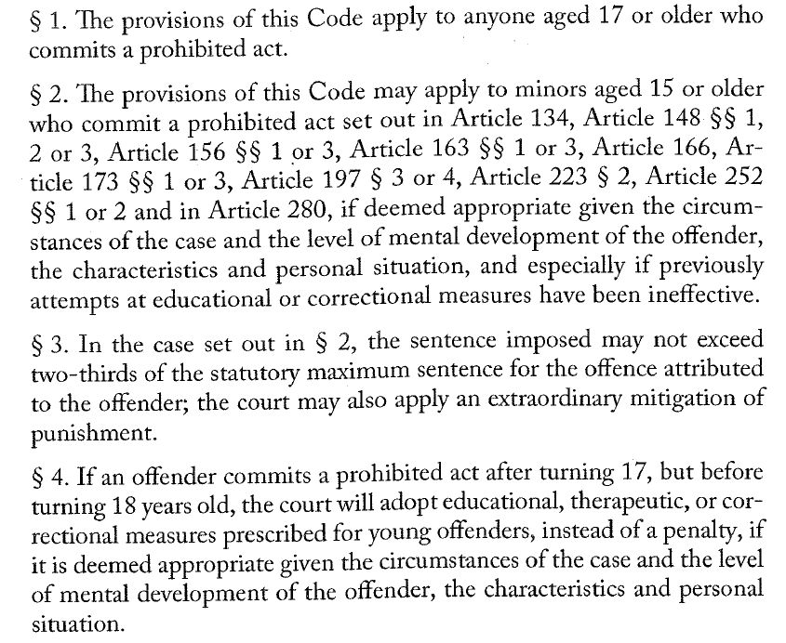
Lecture II

Slide 28
Lecture II
basic elements of criminal offence
classification of offences in Polish criminal law (types of offences)
the basic type – based on the general characteristics of a given prohibited act; this type refers to the ‘standard’ degree of social harm the act presents;
the privileged type – in comparison to the basic type, it contains additional elements within a prohibited act’s description that result in a more lenient assessment of the social harm the act presents
the aggravated type – in comparison to the basic type, it contains additional elements of a prohibited act’s description that result in a more severe assessment of the social harm the act presents
W. Jasiński, K. Kremens, Poland (In: International Encyclopaedia of Laws: Criminal Law), 2019

Slide 29
Lecture II
basic elements of criminal offence
classification of offences in Polish criminal law (types of offences)
example
basic type: voluntary manslaughter (penalty: minimum 8 years of imprisonment, 25 years of imprisonment or life imprisonment)
privileged type: killing of a human being by a perpetrator in a state of strong mental agitation that may be considered reasonable given the circumstances (penalty: 1 to 10 years of imprisonment)
aggravated type: manslaughter with particular atrocity (minimum 12 years of imprisonment, 25 years of imprisonment or life imprisonment)

Slide 30
Lecture II
basic elements of criminal offence
classification of offences in Polish criminal law
offences that might be committed by anyone capable of carrying criminal liability (so-called „common offences”)
e. g. murder, theft, rape
offences that might be committed by groups of persons specified in statute with certain characteristics (so-called „individual offences”)
e. g. bribery – may be committed by public official

Slide 31
Lecture II
sources of criminal law
international sources
sources of common law (common law crimes)
sources of continental criminal law

Slide 32
Lecture II
sources of criminal law
international criminal law - body of laws, norms, and rules governing international crimes and their repression, as well as rules addressing conflict and cooperation between national criminal-law systems.
(K. Kremens, W. Jasiński)

Slide 33
Lecture II
sources of criminal law
international sources
it’s impossible to present the full list of treaties and other international sources
international treaties
including fundamental human rights conventions
EU law
directives: minimum rules
Rome Statute of the International Criminal Court
bilateral and multilateral agreements concerning mainly cooperation in criminal matters

Slide 34
Lecture II
sources of criminal law
international sources – examples of human righs treaties
ECHR
International Covenant on Civil and Political Rights
The Convention against Torture and Other Cruel, Inhuman or Degrading Treatment or Punishment
The Convention on the Rights of the Child

Slide 35
Lecture II
sources of criminal law
international sources – examples of other treaties
treaties concerning criminalisation and punishment:
The Criminal Law Convention on Corruption
The Convention on Cybercrime
The Council of Europe Convention on Action against Trafficking in Human Beings
The Council of Europe Convention on the Prevention of Terrorism

Slide 36
Lecture II
sources of criminal law
international sources – examples of other treaties
treaties concerning procedural aspects of cooperation in criminal matters:
The European Convention on Extradition
The European Convention on Mutual Assistance in Criminal Matters
The European Convention on the Suppression of Terrorism
more: W. Jasiński, K. Kremens, Poland (In: International Encyclopaedia of Laws: Criminal Law), 2019

Slide 37
Lecture II
sources of criminal law
national sources
sources of common law crimes
sources of continental criminal law

Slide 38
Lecture II
sources of criminal law
common law crimes
in the past: created by precedents in specific cases
„judges select between alternative solutions in order to »satisfy a maximum of human wants with a minimum of other wants [and thus achieve] elimination of friction and waste, economizing of social effort, conservation of social assets, and adjustment of the struggle of individual human beings to satisfy their overlapping individual claims in life in civilized society, so that if each may not get all that he demands, he may at least obtain all that is reasonably practicable in a wise social engineering”
W. R. LaFave, Principles of Criminal Law, Second Edition

Slide 39
Lecture II
sources of criminal law
common law crimes
main assumption: it is hard for the legislature in advance to concieve of all possible anti-social behavior that ought to be criminal
may the courts create a new crime to plug a „loophole” in criminal law?
nullum crimen sine lege principle and fair warning – another lecture

Slide 40
Lecture II
sources of criminal law
common law crimes
nowadays – 4 sources:
statutes (acts of Parliament)
administrative regulations passed pursuant to legislative delegation of authority to an administrative agency (sub-statutory regulations)
constitutions (ocasionally)
common law of crimes (judicial precedents)

Slide 41
Lecture II
sources of criminal law
common law crimes
general rule in the U.S.: English common law existing at the time of the founding of the American colonies, if applicable to local conditions, is the law of the state, unless repealed by statute (expressly or impliedly)
statutes need to be construed (interpreted)
sometimes statutes send the interpreter back to common law definitions of specific offences
reception statutes – acts of Parliament formally accepting common law crimes and thus transforming them into statutory crimes

Slide 42
Lecture II
sources of criminal law
common law crimes
in some of the states codes expressly provide that there should be no crimes except as found in the code or some other statute
other states abolish common law crimes by implication
abolishing common law crimes does not necessarily mean abolishing common law defences

Slide 43
Lecture II
sources of criminal law
common law crimes
it is still possible in England and in some of the states for judges to develop new crimes
happens rarely
rather misdemeanors (less serious offences) than felonies
some states provide by statutes that nonstatutory crimes are misdemeanors
the public is entitled to fair warning of what conduct is criminal
American courts have no right to invent new crimes but only to declare the common law, however the common law can expand to meet a new situation hithereto unknown – not inventing new crimes, but applying common law principles
Australian criminal code: only statutory crimes

Slide 44
Lecture II
sources of criminal law
continental (Polish) criminal law
constitution
statutes

Slide 45
Lecture II
sources of criminal law
continental (Polish) criminal law
constitution
basic principles
nullum crimen sine lege (no offence without statute)
nulla poena sine lege (no punishment without statute)
non-retroactivity of criminal statutes
procedural guarantees: presumption of innocence, fair trial
Constitutional Tribunal’s judgments
CT as „negative legislator” - it is empowered to declare the non-conformity of statutory provisions with higher rank legal norms, which leads to their being deprived of binding legal force

Slide 46
Lecture II
sources of criminal law
continental (Polish) criminal law
statutes
codes
most importantly: criminal code of 1997
code of criminal procedure of 1997
criminal enforcement code of 1997
fiscal criminal code of 1999
petty offences code of 1971 – petty offences are not offences sensu stricto
petty offence code of procedure of 2001
other statutes declaring criminal offences
the act on counteracting drug addiction
the act on accountancy
commercial companies code
at least few hundred more statutes

Slide 47
Lecture II
sources of criminal law
continental (Polish) criminal law
structure of Criminal Code of 1997
General part
general provisions concerning principles of liability, inchcoate offences, parties to criminal offence, provisions refering to punishment etc.
Special part
groups of offences concerning specific legal interests
Military part
general provisions concerning principles of liability of soldiers and military officials
groups of specific individual offences

Slide 48
Lecture II
sources of criminal law
continental (Polish) criminal law
structure of Criminal Code of 1997
General part
Principles of criminal liability
Forms of Committing an Offence
Exclusion of criminal liability
Penalties
Penal mesures
Compensative mesures and forfeiture
Principles of passing sentence and penal measures
Relapse to crime

Slide 49
Lecture II
sources of criminal law
continental (Polish) criminal law
structure of Criminal Code of 1997
General part
Measures relating to placing an offender on probation
Concurrence of offences and the accumulation of penalties
Preventive Measures
Stautes of limitation
Expungement
Liability for offences committed abroad
Explanation of legal expressions
Relation to special laws

Slide 50
Lecture II
sources of criminal law
continental (Polish) criminal law
structure of Criminal Code of 1997
Special part – e. g.
Offences against the Republic of Poland
Offences against life and health
Offences against public safety
Offences against safety in traffic
Offences against the environment
Offences against freedom
Offences against public order
Offences against the credibility of documents
Property offences

Slide 51
Lecture II
sources of criminal law
continental (Polish) criminal law
sub-statutory regulation?
no criminal offence might be declared in sub-statutory regulation or an act of administration
in some instances it might be necessary to refer to the meaning of some words explained in sub-statutory regulation
limited impact on substantive criminal law
regulations play much more important role in criminal procedure and execution of punishment

Slide 52
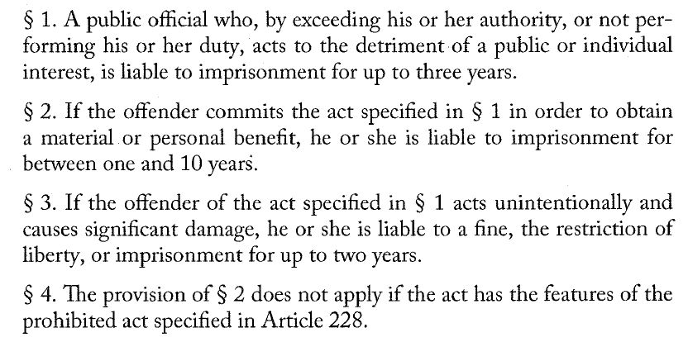
Lecture II
sources of criminal law
continental (Polish) criminal law
sub-statutory regulation?

Slide 53
Thank you for your attention

