Slide 1


Introduction to Criminal Law
Dr Konrad Lipiński
assistant professor
Department of Criminal Law

Slide 2
Lecture III
previously on Introduction to Criminal Law:
definition of criminal act
basic elements of criminal offence
  in common law
  in continental (Polish) law
sources of criminal law
  international sources
  sources of common law
  sources of continental law

Slide 3
Lecture III
scope of the lecture
principles of criminal law
  art. 7 ECHR
  common law
  continental law

Slide 4
Lecture III
reminder: common law and continental law
Common law | Continental law
case law, developed mostly in judgments the law comes from courts developed from case to case, as the opportunity (and need) occurs judges are the great jurists focused on practical elements (law in action) | legal norms the law comes from statutes (acts of parliament) complete system professors are the great jurists focused on theoretical constructions and abstract thinking of law

Slide 5
Lecture III
definition of criminal act
distinguishing features of criminal acts
harmful nature
punishment
conviction as distinctive aspect of criminal law

Slide 6
Lecture III
basic elements of criminal offence
common law systems
actus reus
mens rea
(lack of) defences
actus reus + mens rea = prima facie offence

Slide 7
Lecture III
basic elements of criminal offence
continental law systems (Polish criminal law)
contemporary definition by A. Zoll
human conduct (act or omission)
unlawfulness
punishability
social harm (higher than minimal)
guilt (culpability)

Slide 8
Lecture III
basic elements of criminal offence
contemporary definition of criminal offence by A. Zoll
In this concept, criminal offence is a natural person’s conduct (act or omission), which is unlawful (in violation with law), punishable by criminal law, which causes social harm higher than minimal, if the guilt might be attributed to the offender.

Slide 9
Lecture III
sources of criminal law
international sources
sources of common law (common law crimes)
sources of continental criminal law

Slide 10
Lecture III
scope of the lecture
principles of criminal law
  art. 7 ECHR
  common law
  continental law

Slide 11
Lecture III
sources of criminal law
continental (Polish) criminal law
constitution
statutes
  Criminal Code of 1997
  other statutes

Slide 12
Lecture III
principles of criminal law
continental (Polish) criminal law
individual authors differ in their classifying of particular regulations as principle
disputes concern rather name of the principle or classification rather than its merits
examples
  nullum crimen sine lege praevia = lex (severior) retro non agit
  lex severior retro non agit = lex mitior agit

Slide 13
Lecture III
principles of criminal law
continental (Polish) criminal law
nullum crimen sine lege
nulla poena sine lege
lex severior retro non agit / lex mitior agit
nullum crimen sine culpa
nullum crimen sine periculo sociali
principle of individual and personal liability
principle of humanitarianism

Slide 14
Lecture III
principles of criminal law
nullum crimen sine lege
  „no offence without statute”
  might be perceived as main principle

Slide 15
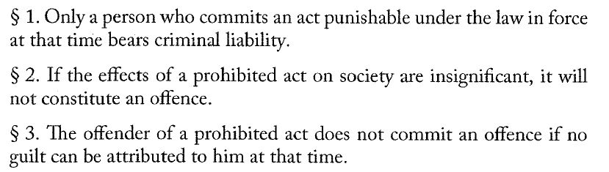
Lecture III
principles of criminal law
nullum crimen sine lege
  sources:
    Criminal Code (art. 1 par. 1)
    Constitution (art. 42)
      Nuremberg clause: an offence might be specified in international law
      addressed to the legislator
    ECHR (art. 7)

Slide 16
Lecture III
principles of criminal law
nullum crimen sine lege
  nullum crimen sine lege scripta
  nullum crimen sine lege stricta
  nullum crimen sine lege certa
  nullum crimen sine lege praevia

Slide 17
Lecture III
principles of criminal law
nullum crimen sine lege scripta
  scriptus (lat.) = written
  a principle, under which only a statute might serve as a source of criminal law
  statute understood formally – act of Parliament, adopted in appropriate manner by both chambers of Parliament (Sejm and Senat), signed by the President and promulgated
  theoretically an offence might be also specified in international law

Slide 18
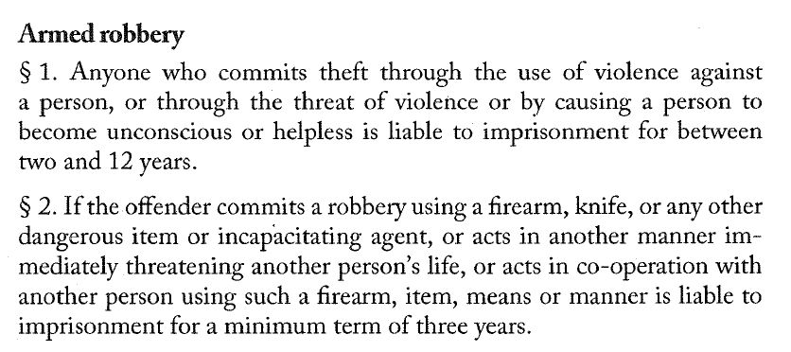
Lecture III
principles of criminal law
nullum crimen sine lege stricta
  strictus (lat.) = narrow, precise
  application of legal analogy to the detriment of the perpetrator is prohibited (prohibition of unfavorable analogy)
  however, so-called „half-analogy” is possible if mentioned by statute

Slide 19
Lecture III
principles of criminal law
nullum crimen sine lege certa
  certus (lat.) = sure, definite
  provisions of law should be as precise as possible
  the legislator should not use uncertain terms
  negative examples:
    „who slanders…”
    „who libels…”
    „who displays pornographic material…”
    theft with burglary (breaking and entering / breaking in, not out)

Slide 20
Lecture III
principles of criminal law
nullum crimen sine lege certa
  as specified by Constitutional Tribunal in judgment of 19 Jul. 2011, Case No. K 11/10 [translation: W. Jasiński, K. Kremens, Poland (In: International Encyclopaedia of Laws: Criminal Law), 2019]:
  a provision of criminal law should be precise, clear and legislatively correct;
  a recipient of a norm of criminal law should be able to reconstruct the key elements of a prohibited act solely on the basis of provisions describing the norm and thus with the use of linguistic rules of interpretation;
  an individual should not be uncertain as to whether or not given behaviour constitutes a prohibited act;
  a criminal norm should unequivocally designate the recipient of a prohibition, elements of a prohibited act and the type of sanction that may be imposed for the commission of the act in question;
  any use of terms that are vague or ambiguous in the area of criminal law requires special procedural guarantees that ensure that state bodies provide concrete meaning to a vague expression in a transparent and assessable way.

Slide 21
Lecture III
principles of criminal law
nullum crimen sine lege praevia
  basically the same as lex retro non agit
  „the law does not act backwards”
  concerns only ex post criminalization
  absolutely no ex post facto offences
  retroactive criminalization is impermissible

Slide 22
Lecture III
principles of criminal law
nulla poena sine lege
  „no punishment without statute”
  closely related to nullum crimen sine lege
    sometimes even perceived as one rule: nullum crimen, nulla poena sine lege
  acts punishable by law need to be specified in statute
  also a punishment (its limits) needs to be specified in statute

Slide 23
Lecture III
principles of criminal law
international sources of nullum crimen, nulla poena sine lege
  Universal Declaration of Human Rights (art. 11)
  International Covenant on Civil and Political Rights (art. 15)
  European Convention on Human Rights (art. 7)
  EU Charter of Fundamental Rights (art. 49)

Slide 24
Lecture III
principles of criminal law
nullum crimen, nulla poena sine lege in ECHR
Article 7
No one shall be held guilty of any criminal offence on account of any act or omission which did not constitute a criminal offence under national or international law at the time when it was committed. Nor shall a heavier penalty be imposed than the one that was applicable at the time the criminal offence was committed.

Slide 25
Lecture III
principles of criminal law
nullum crimen, nulla poena sine lege in ECHR
  3 important ECtHR judgments:
    Kokkinakis v. Greece
    Vyerentsov v. Ukraine
    Jorgic v Germany

Slide 26
Lecture III
principles of criminal law
nullum crimen, nulla poena sine lege in ECHR
  Kokkinakis v. Greece (25 May 1993)
  „The Court points out that Article 7 para. 1 (art. 7-1) of the Convention is not confined to prohibiting the retrospective application of the criminal law to an accused’s disadvantage. It also embodies, more generally, the principle that only the law can define a crime and prescribe a penalty (nullum crimen, nulla poena sine lege) and the principle that the criminal law must not be extensively construed to an accused’s detriment, for instance by analogy; it follows from this that an offence must be clearly defined in law. This condition is satisfied where the individual can know from the wording of the relevant provision and, if need be, with the assistance of the courts’ interpretation of it, what acts and omissions will make him liable.”

Slide 27
Lecture III
principles of criminal law
nullum crimen, nulla poena sine lege in ECHR
  Kokkinakis v. Greece
    (…) prohibiting the retrospective application of the criminal law to an accused’s disadvantage. (…) => nullum crimen sine lege praevia
    only the law can define a crime and prescribe a penalty (nullum crimen, nulla poena sine lege) => nullum crimen sine lege scripta ?
    (…) the criminal law must not be extensively construed to an accused’s detriment, for instance by analogy => nullum crimen sine lege stricta
    (…) an offence must be clearly defined in law. This condition is satisfied where the individual can know from the wording of the relevant provision (…) what acts and omissions will make him liable. => nullum crimen sine lege certa

Slide 28
Lecture III
principles of criminal law
nullum crimen, nulla poena sine lege in ECHR
  Vyerentsov v. Ukraine (11 April 2013)
  „62. The Court reiterates that the guarantee enshrined in Article 7, which is an essential element of the rule of law, occupies a prominent place in the Convention system of protection, as is underlined by the fact that no derogation from it is permissible under Article 15 of the Convention in time of war or other public emergency. It should be construed and applied, as follows from its object and purpose, in such a way as to provide effective safeguards against arbitrary prosecution, conviction and punishment (see S.W. v. the United Kingdom, 22 November 1995, § 34, Series A no. 335‑B, and C.R. v. the United Kingdom, 22 November 1995, § 33, Series A no. 335‑C). Accordingly, it embodies, in general terms, the principle that only the law can define a crime and prescribe a penalty (nullum crimen, nulla poena sine lege) (see Kokkinakis v. Greece, 25 May 1993, § 52, Series A no. 260‑A). While it prohibits in particular extending the scope of existing offences to acts which previously were not criminal offences, it also lays down the principle that the criminal law must not be extensively construed to an accused’s detriment, for instance by analogy (see Coëme and Others v. Belgium, nos. 32492/96, 32547/96, 32548/96, 33209/96 and 33210/96, § 145, ECHR 2000-VII; Achour v. France [GC], no. 67335/01, § 41, ECHR 2006‑IV; and Kononov v. Latvia [GC], no. 36376/04, § 185, ECHR 2010).”

Slide 29
Lecture III
principles of criminal law
nullum crimen, nulla poena sine lege in ECHR
  Vyerentsov v. Ukraine (11 April 2013)
  „63. When speaking of »law« Article 7 alludes to the very same concept as that to which the Convention refers elsewhere when using that term, a concept which comprises statute law as well as case-law (see, mutatis mutandis, The Sunday Times (no. 1), cited above, § 47; Kruslin v. France, 24 April 1990, § 29, Series A no. 176‑A; and Casado Coca v. Spain, 24 February 1994, § 43, Series A no. 285‑A). In this connection, the Court has always understood the term »law« in its »substantive« sense, not its »formal« one. It has thus included both enactments of lower rank than statutes and unwritten law (see, in particular, mutatis mutandis, De Wilde, Ooms and Versyp v. Belgium, 18 June 1971, § 93, Series A no. 12). In sum, the »law« is the provision in force as the competent courts have interpreted it (see Leyla Şahin v. Turkey [GC], no. 44774/98, § 88, ECHR 2005-XI).”

Slide 30
Lecture III
principles of criminal law
nullum crimen, nulla poena sine lege in ECHR
  Vyerentsov v. Ukraine (11 April 2013)
  „64. Furthermore, the term »law« implies qualitative requirements, including those of accessibility and foreseeability (see, among other authorities, Cantoni v. France, 15 November 1996, § 29, Reports of Judgments and Decisions 1996‑V; Coëme and Others, cited above, § 145; and E.K. v. Turkey, no. 28496/95, § 51, 7 February 2002). These qualitative requirements must be satisfied as regards both the definition of an offence and the penalty that the offence in question carries (see Achour [GC], cited above, § 41). An individual must know from the wording of the relevant provision and, if need be, with the assistance of the courts’ interpretation thereof, what acts and omissions will render him criminally responsible and what penalty will be imposed for the act and/or omission in question (see, among other authorities, Cantoni, cited above, § 29). Furthermore, a law may still satisfy the requirement of »foreseeability« where the person concerned has to take appropriate legal advice to assess, to a degree that is reasonable in the circumstances, the consequences which a given action may entail (see, among other authorities, Cantoni, cited above, § 35, and Achour [GC], cited above, § 54).”

Slide 31
Lecture III
principles of criminal law
nullum crimen, nulla poena sine lege in ECHR
  Jorgic v. Germany (12 July 2007)
    Background to the case:
    „7. In 1969 the applicant, a national of Bosnia and Herzegovina of Serb origin, entered Germany, where he legally resided until the beginning of 1992. He then returned to Kostajnica, which forms part of the city of Doboj in Bosnia, where he was born.
    8. On 16 December 1995 the applicant was arrested when entering Germany and placed in pre-trial detention on the ground that he was strongly suspected of having committed acts of genocide. (…)
    35. Article 220a of the Criminal Code [genocide – K. L.] was inserted into the German Criminal Code by the Act of 9 August 1954 on Germany’s accession to the Genocide Convention and came into force in 1955 (…)
    36. The applicant is the first person to be convicted of genocide by German courts under Article 220a since the incorporation of that Article into the Criminal Code. At the time the applicant committed his acts in 1992, a majority of scholars took the view that genocidal “intent to destroy a group” under Article 220a of the Criminal Code had to be aimed at the physical-biological destruction of the protected group (…). However, a considerable number of scholars were of the opinion that the notion of destruction of a group as such, in its literal meaning, was wider than a physical-biological extermination and also encompassed the destruction of a group as a social unit (…).”

Slide 32
Lecture III
principles of criminal law
nullum crimen, nulla poena sine lege in ECHR
  Jorgic v. Germany (12 July 2007)
    construction of genocide (art. 220a of German CC):
    „105. The Court notes that the domestic courts construed the »intent to destroy a group as such« systematically in the context of Article 220a § 1 of the Criminal Code as a whole, having regard notably to alternatives no. 4 (imposition of measures which are intended to prevent births within the group) and no. 5 (forcible transfer of children of the group into another group) of that provision, which did not necessitate a physical destruction of living members of the group in question. The Court finds that the domestic courts’ interpretation of »intent to destroy a group« as not necessitating a physical destruction of the group, which has also been adopted by a number of scholars (see paragraphs 36 and 47 above), is therefore covered by the wording, read in its context, of the crime of genocide in the Criminal Code and does not appear unreasonable.”

Slide 33
Lecture III
principles of criminal law
nullum crimen, nulla poena sine lege in ECHR
  Jorgic v. Germany (12 July 2007)
    context of international law:
    „106. Furthermore, the Court, like the national courts, considers it necessary, in order to determine the essence of the offence of genocide, to take into consideration also the codification of the prohibition of genocide in Article II of the Genocide Convention, for the observance of which Article 220a had been incorporated into the Criminal Code and in the light of which the said Article was to be construed. As the wording of Article 220a of the Criminal Code corresponds to that of Article II of the Genocide Convention in so far as the definition of genocide is concerned, the above reasoning with respect to the scope of the prohibition of genocide equally applies.”

Slide 34
Lecture III
principles of criminal law
nullum crimen, nulla poena sine lege in ECHR
  Jorgic v. Germany (12 July 2007)
    „107. Moreover, the German courts’ interpretation has not only been supported by a number of scholars at the relevant time of the commission of the crime (see paragraph 36 above), the United Nations General Assembly also agreed with the wider interpretation adopted by the German courts in the present case in its Resolution 47/121 of 18 December 1992, (see paragraph 41 above).
    108. Consequently, the applicant’s acts, which he committed in the course of the ethnic cleansing in the Doboj region with intent to destroy the group of Muslims as a social unit, could reasonably be regarded as falling within the ambit of the offence of genocide.”

Slide 35
Lecture III
principles of criminal law
nullum crimen, nulla poena sine lege in ECHR
  Jorgic v. Germany (12 July 2007)
    foreseeability:
    „109. In deciding, secondly, whether the domestic courts’ interpretation of the crime of genocide could reasonably be foreseen by the applicant at the material time, the Court notes that the applicant is the first person to be convicted of genocide by German courts under Article 220a since the incorporation of that Article into the Criminal Code in 1955. In these circumstances the Court finds that, as opposed to cases concerning a reversal of pre-existing case-law, an interpretation of the scope of the offence which was – as in the present case – consistent with the essence of that offence must, as a rule, be considered as foreseeable. Despite this, the Court does not exclude that, exceptionally, an applicant could rely on a particular interpretation of the provision being taken by the domestic courts in the special circumstances of the case.”

Slide 36
Lecture III
principles of criminal law
nullum crimen, nulla poena sine lege in ECHR
  Jorgic v. Germany (12 July 2007)
    foreseeability:
    „113. In view of the foregoing, the Court concludes that, while many authorities had favoured a narrow interpretation of the crime of genocide, there had already been several authorities at the material time which had construed the offence of genocide in the same wider way as the German courts. In these circumstances, the Court finds that the applicant, if need be with the assistance of a lawyer, could reasonably have foreseen that he risked being charged with and convicted of genocide for the acts he committed in 1992. In this context the Court also has regard to the fact that the applicant was found guilty of acts of a considerable severity and duration: the killing of several people and the detention and ill-treatment of a large number of people over a period of several months as the leader of a paramilitary group in pursuit of the policy of ethnic cleansing.”

Slide 37
Lecture III
principles of criminal law
nullum crimen, nulla poena sine lege in ECHR
  Jorgic v. Germany (12 July 2007)
    foreseeability:
    „114. Therefore, the national courts’ interpretation of the crime of genocide could reasonably be regarded as consistent with the essence of that offence and could reasonably be foreseen by the applicant at the material time. These requirements being met, it was for the German courts to decide which interpretation of the crime of genocide under domestic law they wished to adopt. Accordingly, the applicant’s conviction for genocide was not in breach of Article 7 § 1 of the Convention.”

Slide 38
Lecture III
principles of criminal law
nullum crimen, nulla poena sine lege in ECHR
  summary:
    non-derogable
    there’s no nullum crimen sine lege scripta in ECtHR judgments
    n. c. s. l. stricta / certa / praevia apply
    most important part of nullum crimen sine lege in ECHR: (reasonable) foreseeability

Slide 39
Lecture III
principles of criminal law
nullum crimen sine lege in common law
  = principle of legality
    „being governed by rules which are fixed, knowable and certain” (A. Ashworth)
  3 sub-principles:
    the principle of non-retroactivity
    the principle of maximum certainty
    the principle of strict construction of penal statutes

Slide 40
Lecture III
principles of criminal law
nullum crimen sine lege in common law
the principle of non-retroactivity
  = nullum crimen sine lege praevia
  a person should never be convicted or punished except in accordance with a previously declared offence governing the conduct in question
  S.W. and C. R. v. United Kingdom:
    „it is possible for the existing elements of an offence to be clarified or adapted to new circumstances or developments in society in so far as this can reasonably be brought under the original concept of the offence. The constituent elements of an offence may not however be essentially changed to the detriment of an accused and any progressive development by way of interpretation must be reasonably foreseeable to him with the assistance of appropriate legal advice if necessary”
  It is not that the law ought to exist before the conduct took place, but that it ought to have been foreseeable that the law would be changed in a particular direction

Slide 41
Lecture III
principles of criminal law
nullum crimen sine lege in common law
the principle of maximum certainty
  = nullum crimen sine lege certa
  „fair warning” and „void for vagueness” principles
  some vagueness is inevitable; it’s „maximum certainty”, not „absolute certainty”
  more general „quality of law” standard in ECHR – Sunday Times vs UK Case
    „49. (…) Firstly, the law must be adequately accessible: the citizen must be able to have an indication that is adequate in the circumstances of the legal rules applicable to a given case. Secondly, a norm cannot be regarded as a "law" unless it is formulated with sufficient precision to enable the citizen to regulate his conduct: he must be able – if need be with appropriate advice – to foresee, to a degree that is reasonable in the circumstances, the consequences which a given action may entail”

Slide 42
Lecture III
principles of criminal law
nullum crimen sine lege in common law
the principle of maximum certainty
  stems from respect for the citizen as a rational, autonomous individual and as a person with social and political duties who requires fair warning of the criminal law’s provisions and no undue difficulty in ascertaining them (A. Ashworth)
  when the rules are vaguely drafted, they bestow considerable power on the agents of law enforcement

Slide 43
Lecture III
principles of criminal law
nullum crimen sine lege in common law
the principle of strict construction
  = nullum crimen sine lege stricta
  relates to the court’s task in interpreting legislation
    reminder: construction = interpretation of law (statutes)
  theoretical approach: any doubt in the meaning of a statutory provision should, by strict construction, be resolved in favour of the defendant

Slide 44
Lecture III
principles of criminal law
nullum crimen sine lege in common law and continental law
nullum crimen sine lege = principle of legality
  n. c. s. l. praevia = non-retroactivity principle
  n. c. s. l. certa = principle of maximum certainty
  n. c. s. l. stricta = principle of strict construction
  equivalent of n. c. s. l. scripta = fair warning
most important and common element in both systems and ECHR – reasonable foreseeability

Slide 45
Lecture III
principles of criminal law
foreseeability as essential element of nullum crimen sine lege
reasonable man standard – „man on the street”, law-abiding citizen as comparison
Conally v. General Construction Co case (US Supreme Court):
  „a statute which either forbids or requires the doing of an act in terms so vague that men of common intelligence must necessarily guess at its meaning and differ as to its application, violates the first essential of due process of law”

Slide 46
Lecture III
principles of criminal law
foreseeability as essential element of nullum crimen sine lege
reasonable man standard
foreseeability of unlawfulness in Polish CC (art. 30)
  lack reasonable foreseeability as justification

Slide 47
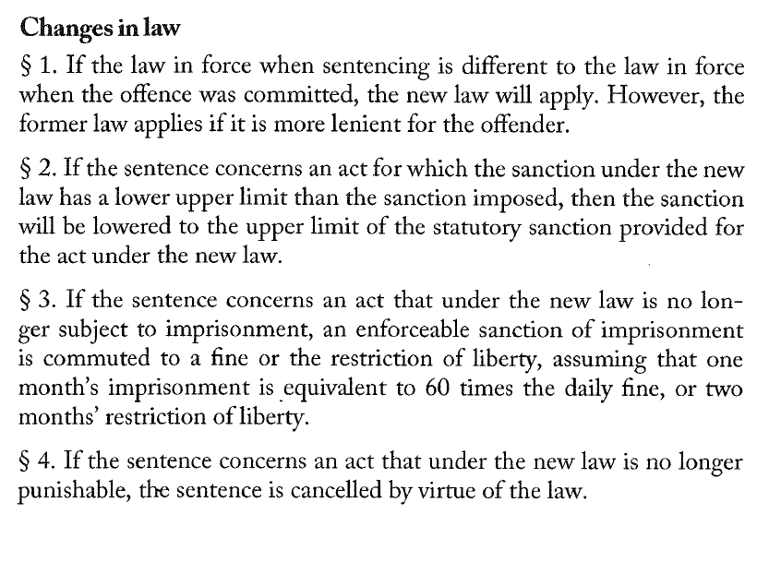
Lecture III
principles of criminal law
lex mitior agit
  principle of milder statute
  stated in art. 4 par. 1 of CC
  two points:

Slide 48
Lecture III
principles of criminal law
lex retro non agit vs lex retro agit
  lex retro non agit = nullum crimen sine lege praevia (art. 1 par. 1 CC)
  lex retro agit = lex mitior agit (art. 4 par. 1 CC)
  how can they coexist?
    lex mitior (retro) agit = lex severior retro non agit
    lex mitior concerns only previously prohibited offencs
    lex retro non agit concerns only ex post criminalization
    non-retroactivity of statutes constituting offences + retroactivity of milder statutes

Slide 49
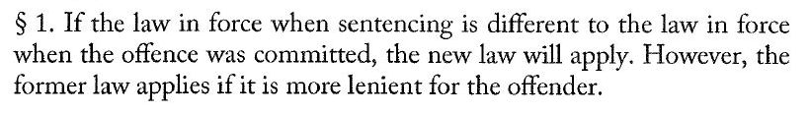
Lecture III
principles of criminal law
lex retro non agit vs lex retro agit
  how can they coexist?
    lex mitior (retro) agit = lex severior retro non agit
    lex mitior concerns only acts, that were prohibited during their commission
    lex retro non agit concerns only ex post criminalization (acts not previously prohibited)

Slide 50
Lecture III
principles of criminal law
nullum crimen sine culpa
  culpa = guilt, culpability
  „no offence without guilt”
  no strict liability / absolute liability offences
  no definition of culpability (more: previous lecture)

Slide 51
Lecture III
principles of criminal law
nullum crimen sine periculo sociali
  periculo sociali (lat.) = social harm, social danger
  substantial element of criminal act

Slide 52
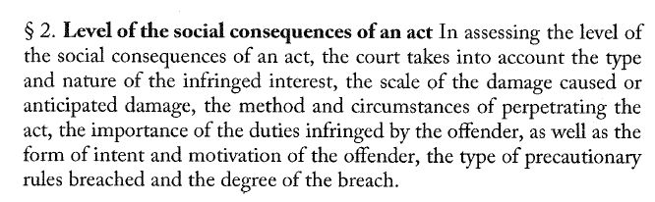
Lecture III
principles of criminal law
nullum crimen sine periculo sociali
  legal definition of social harm in concreto – art. 115 par. 2 CC

Slide 53
Lecture III
principles of criminal law
nullum crimen sine periculo sociali
  elements of social harm:
    type and nature of infringed legal interest
    scale of the damage (done or possible)
    the method and circumstances of perpetrating the act
    importance of duties infringed by the offender
    form of intent and motivation
    type of precautionary rules breached by the perpetrator and the degree of the breach

Slide 54
Lecture III
principles of criminal law
principle of individual and personal liability
  only a perpetrator of a prohibited act can be held criminally liable and criminal responsibility cannot be attributed to anyone else
  on the other hand: a perpetrator might suffer consequences of his – and only his – wrongdoing
  art. 20 & 21 par. 1, art. 55 CC

Slide 55
Lecture III
principles of criminal law
principle of humanitarianism
  sources: Constitutuon (art. 30), ECHR (art. 3)
  art. 3 CC

Slide 56
Lecture III
principles of criminal law
additional principle: ultima ratio
  principle of minimum criminalization
  criminal law as the last resort
  rather principle of criminalization than criminal law itself
  criminalization is justified only in order to protect individual autonomy or to protect social arrangements necessary to ensure that individuals have the capacity and facilities to exercise their autonomy
  addressed to the legislator
    legislator should consider possibility of tackling the problem firstly by other forms of regulation and control than criminal law

Slide 57

Thank you for your attention

