Slide 1
Related rights
types, definitions, time laps in UK and international law
Iryna Kravchenko
302771

Slide 2
definition
Related rights are the rights of a creative work not connected with the work's actual author. It is used in opposition to the term "authors' rights".
Related rights can be a general term for a range of property rights

Slide 3
Why related?
They are related to copyright = simply related rights
Could be also called the rights neighbouring to copyright with regard to the fact that they are close to copyright
Neighbouring rights is a more literal translation of the original French droits voisins.
Both authors' rights and related rights are copyrights in the sense of English or U.S. law.

Slide 4
Essence
They are secondary rights and cannot exist on their own but they accrue from the copyrighted work.
They are also known as entrepreneurial rights.
These are the rights given to the persons or legal entities who contribute to producing or making of the copyrighted work.

Slide 5
Subjects
Neighbouring rights were created for categories of people who are not technically authors:
performing artists,
producers of phonogrammes,
those involved in radio and television broadcasting.

Slide 6
scope
Related rights vary much more widely in scope between different countries than authors' rights. The rights of performers, phonogram producers and broadcasting organizations are certainly covered, and are internationally protected

Slide 7
International regulation
International Convention for the Protection of Performers, Producers of Phonograms and Broadcasting Organisations from 1961
*Rome Convention*
The agreement extended copyright protection for the first time from the author of a work to the creators and owners of particular, physical manifestations of intellectual property, such as audiocassettes or videocassettes.

Slide 8
International regulation
Geneva Phonograms Convention, 1971 → for the protection of producers of phonograms against unauthorized duplication
Brussels Convention, 1974 → Relates to the distribution of programme–carrying signals transmitted by satellite
Treaty on Intellectual Property in Respect of Integrated Circuits, 1989
Agreement on Trade-Related Aspects of Intellectual Property Rights (TRIPS Treaty), 1994
WIPO Performances and Phonograms Treaty, 1996

Slide 9
European regulation
Copyright Directive, 2001
Rental and Lending Directive, 2006
Satellite and Cable Directive, 1993
Directive on the enforcement of intellectual property right, 2004
Directive on the legal protection of databases, 1996
Directive on the term of protection of copyright and certain related rights amending the previous 2006 Directive (“Term Directive”), 2011
Orphan Works Directive, 2012
Directive on collective management of copyright and related rights and multi-territorial licensing of rights in musical works for online use in the internal market, 2014
Directive and Regulation implementing the Marrakech Treaty, 2017
Regulation on cross-border portability of online content services in the IM, 2017

Slide 10
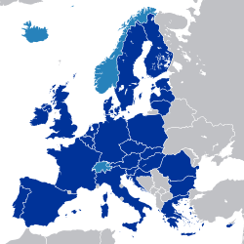
goal
The general aim in the EU harmonisation efforts is to enable RR-protected goods (e.g. books, music, films, software etc.) and services (e.g. services offering access to these goods) to move freely within the internal market.

Slide 11
UK regulations

Slide 12
UK regulations
The Copyright and Related Rights Regulations 2003 transpose Directive 2001/29/EC (EU copyright directive) into United Kingdom law.
modify the concept of broadcast and broadcasting to take account of development in the internet
restrict the acts which are permitted without infringing copyright (in particular acts which could be performed commercially)
provide new measures for the protection and enforcement of copyright and performers' rights

Slide 13
Related rights and copyright?
Do related rights detract copyright protection?
Related rights do not diminish or undermine copyright protection for a work that is performed, recorded or broadcast

Slide 14
Related rights and copyright?
Related rights are independent of any authors' rights → a CD recording of a song is protected by four copyright-type rights:
Authors' rights of the composer of the music
Authors' rights of the lyricist
Performers' rights of the singer and musicians
Producers' rights of the person or corporation that made the recording

Slide 15
Performer's' rights
many countries grant moral rights to performers as well as the economic rights covered by the Rome Convention (Arts. 7–9),
the rights of paternity and integrity are required by the WPPT (Art. 5).
Article 14 of the Rome Convention sets a minimum term for the protection of performers' rights of 20 years
The TRIPS Agreement (Art. 14.5) has extended this to 50 years.
In the EU, performers' rights last for 50 years from the end of the year of the performance, unless a recording of the performance was published → 50 years from the end of the year of publication(Art. 3(4), Directive 93/98/EEC).

Slide 16
Phonogram producers
The term phonogram is used to refer to any sound recording:
under the Rome Convention, it must be composed exclusively of a sound recording,
some national laws protect film soundtracks with the same measures to the extent that they are not also protected by other rights.
The producers of phonograms have the right to prevent the direct or indirect reproduction of the recording (Art. 10 Rome Convention, Art. 2 Geneva Phonograms Convention).

Slide 17
Broadcasting organizations
Article 13 of the Rome Convention specifies that broadcasting organizations shall have the right to prohibit (or license):
the rebroadcasting of their broadcasts;
the fixation (recording) of their broadcasts;
the reproduction of fixations of their broadcasts;
the communication of their broadcasts to the public in places where an entrance fee is charged.
a minimum term → 20 years from the end of the year in which the broadcast was first made (TRIPS Agreement (Art. 14.5).
In the EU broadcasters' rights last for 50 years from the end of the year the broadcast was first made (Art. 3(4), Directive 93/98/EEC).

Slide 18
Film producers
Directive 2006/115/EC and Directive 2001/29/EC provide rights to producers of the first fixation ("master copy") of a film or other audiovisual work. Film producers have the right to prevent:
the direct or indirect reproduction of the film (Art. 2, Directive 2001/29/EC);
the distribution of the film (or copies thereof) to the public for sale (Art. 9, Directive 92/100/EEC);
the "making available to the public" of the film (Art 3, Directive 2001/29/EC).
These rights last for 50 years from the end of the year the film was made available to the public, or for 50 years from the end of the year the master copy was made if the film is not released (Art. 3(3), Directive 93/98/EEC).

Slide 19
Exploitation of performers’ rights in practice
In most situations the producer of a sound recording or film will need to enter into a contract with the performer(s) to hire their services. As the owner of the economic rights in the recording or film, they will also be in a position to exploit the performance by use of the recording or film.

Slide 20
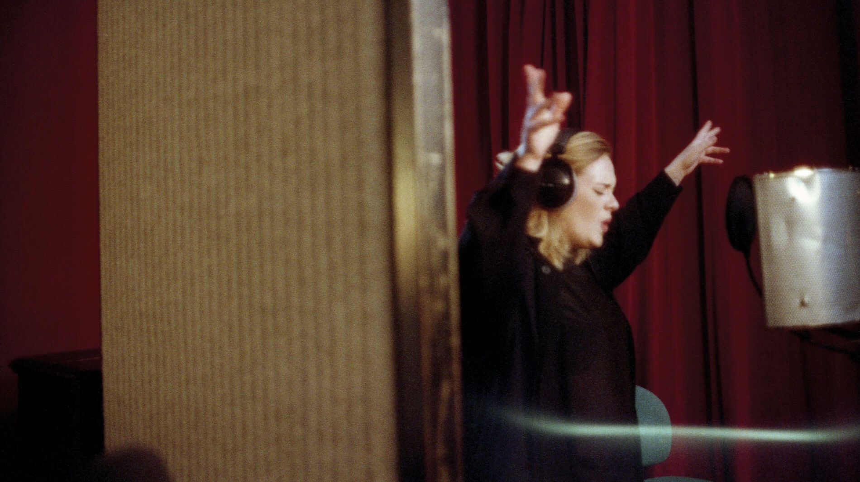
Music industry
In the case of the music industry, the record company will typically ensure that all performers sign agreements in industry- approved terms which, in return for the performer’s fee:
Give permission for the recording of the performance
Assign the performers’ property rights ( so the record company can make copies of the master recording and distribute it via physical copies and electronically)
Make arrangements for a payment in respect of the right to equitable remuneration to be made to the performer

Slide 21
The right to be acknowledged as the performer /MORAL RIGHT ?
The right to be acknowledged as the performer arises whenever a person “produces or puts on”a performance in public, when a performance is broadcast live, when sound recordings of the performance are communicated to the public, or when copies are issued to the public. Thus, the right protects musicians in relation to the exploitation of recordings, but only protects actors in relation to live performance and broadcast.

Slide 22
bibliography
Copyright, Designs and Patents Act 1988
http://www.legislation.gov.uk/ukpga/1988/48/pdfs/ukpga_19880048_en.pdf
https://en.wikipedia.org/wiki/Related_rights
https://eur-lex.europa.eu/homepage.html
Directive 2001/29/EC of the European Parliament and of the Council
Convention for the Protection of Performers, Producers of Phonograms and Broadcasting Organizations, 1961
https://www.wipo.int/treaties/en/ip/rome/
https://eur-lex.europa.eu/LexUriServ/LexUriServ.do?uri=CELEX:32001L0029:EN:HTML
https://www.wipo.int/portal/en/

Slide 23
Thank you!

